Slide 1
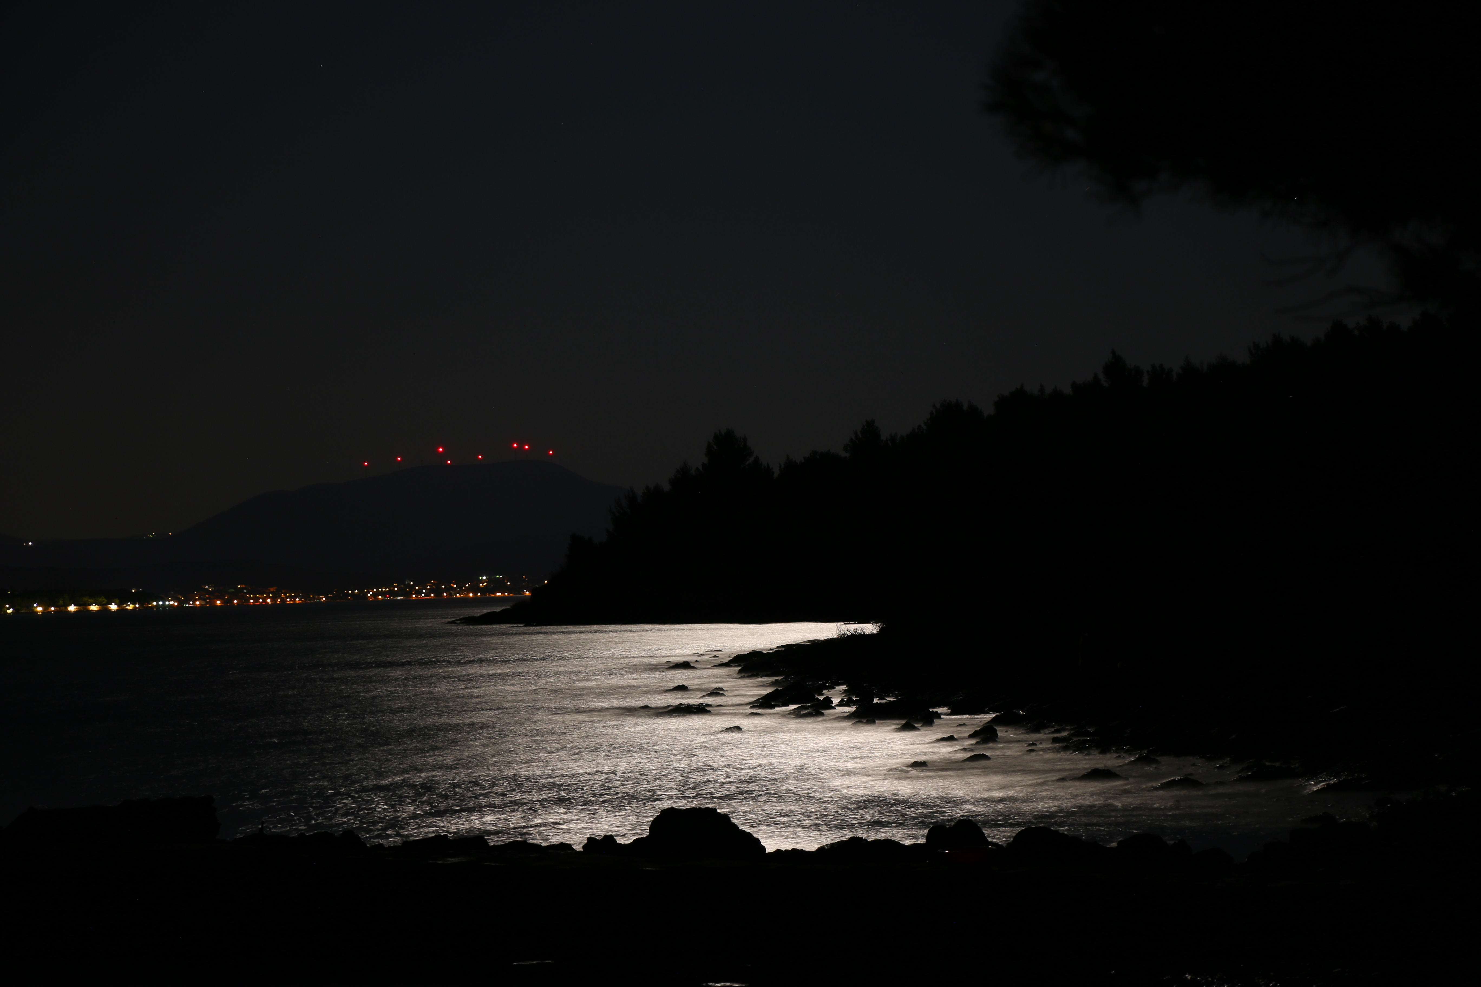
Stacking interactions – a broader perspective
Krešimir Molčanov, Biserka Kojić-Prodić
Rudjer Bošković Institute
Zagreb, Croatia

Slide 2
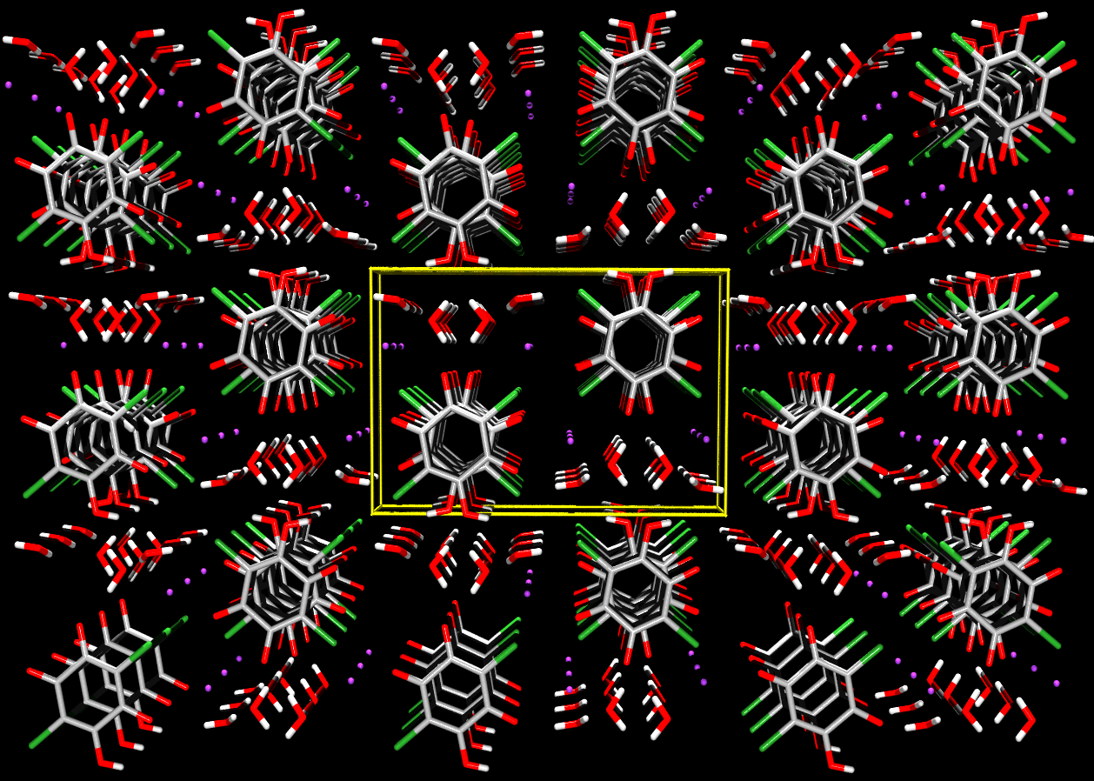
KHCA∙2H₂O
P 2₁/c
0
b
a
CrystEngComm, 2009, 11, 1407.

Slide 3
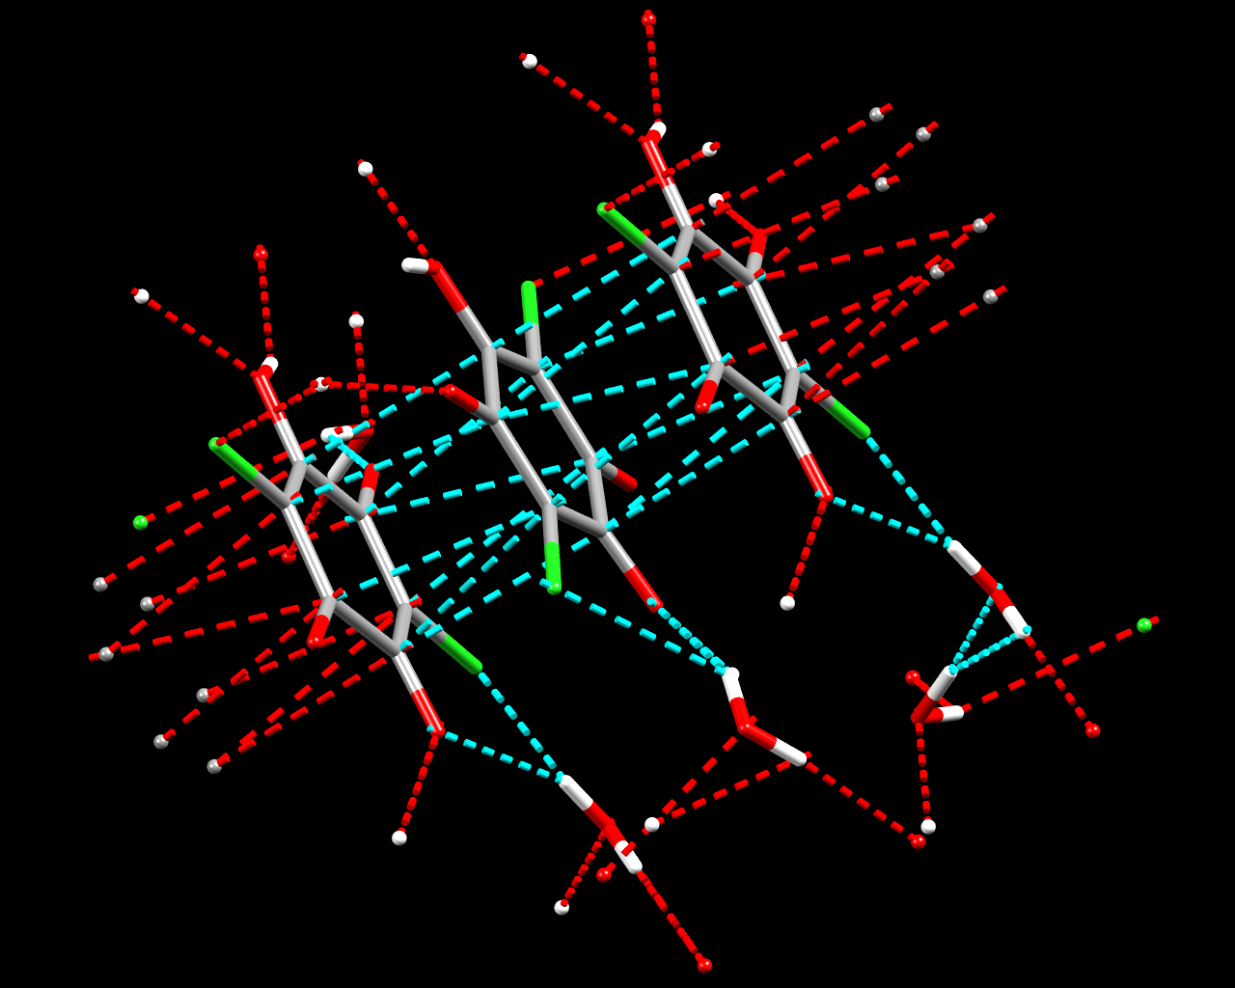
KHCA∙2H₂O
P 2₁/c
Centroid distance:
3.229(2) Å
Offset ≈ 0.2 Å
c
CrystEngComm, 2009, 11, 1407.

Slide 4
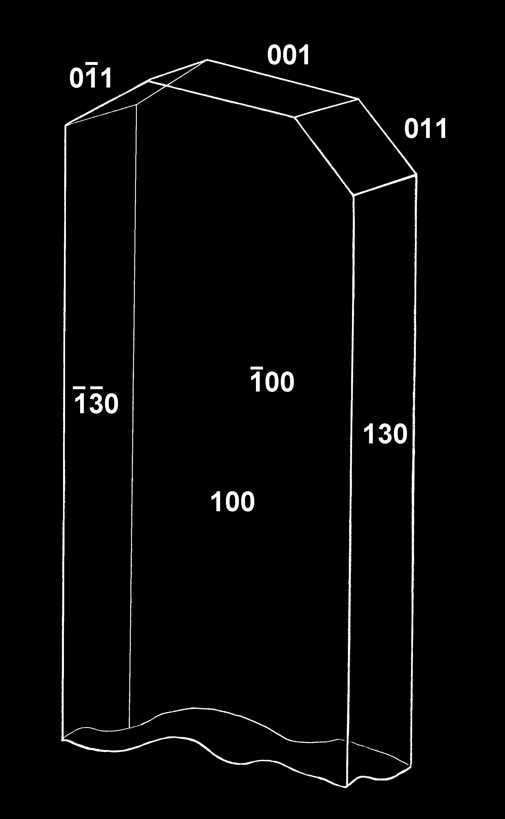
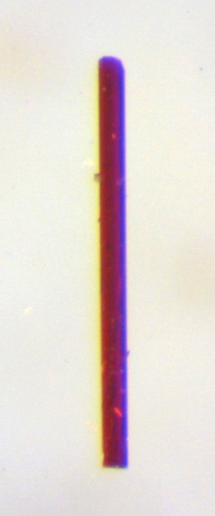
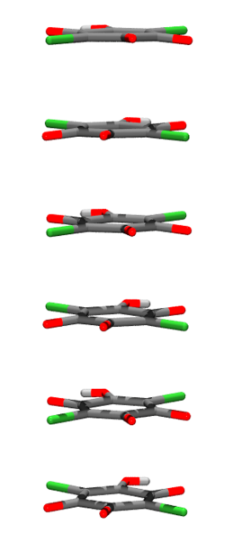
Is it because of stacking?
c
CrystEngComm, 2015, 17, 8645.

Slide 5
Common misconceptions
It occurs only between aromatic rings
It is a weak interaction (E < 1 kcal mol⁻¹)
In crystal packing it plays a ‘second fiddle’ to stronger interactions such as hydrogen bonding
It can’t be used in crystal engineering

Slide 6
An amazing discovery,
your majesty! It could
win us an IgNobel prize!
Look, these coins stack!
That means gold is aromatic!

Slide 7
Types of π-interactions
Weak: dominantly dispersion, E < 5 kcal mol⁻¹
Medium: dominantly electrostatic, E = 5 – 15 kcal mol⁻¹
Strong: partially covalent, E > 15 kcal mol⁻¹
Similar to stacking: π-hole interactions

Slide 8
Weak interactions
Aromatic rings
Heteroaromatic rings
Strongly charged non-aromatic rings (e.g. chloranilate dianions)
Dominantly dispersion, E < 5 kcal mol⁻¹
Almost all studied examples

Slide 9
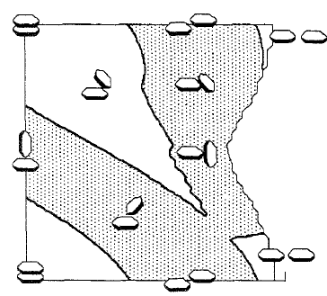
Stacking of aromatic rings
Typical centroid
distance:
> 3,8 Å
α
Repulsion
Offset typically
1,7 – 1,8 Å
Attraction
offset
Hunter & Sanders, JACS, 1990, 112, 5525.
Hunter, Singh, Thornton, J. Mol. Biol, 1991, 208, 837.

Slide 10
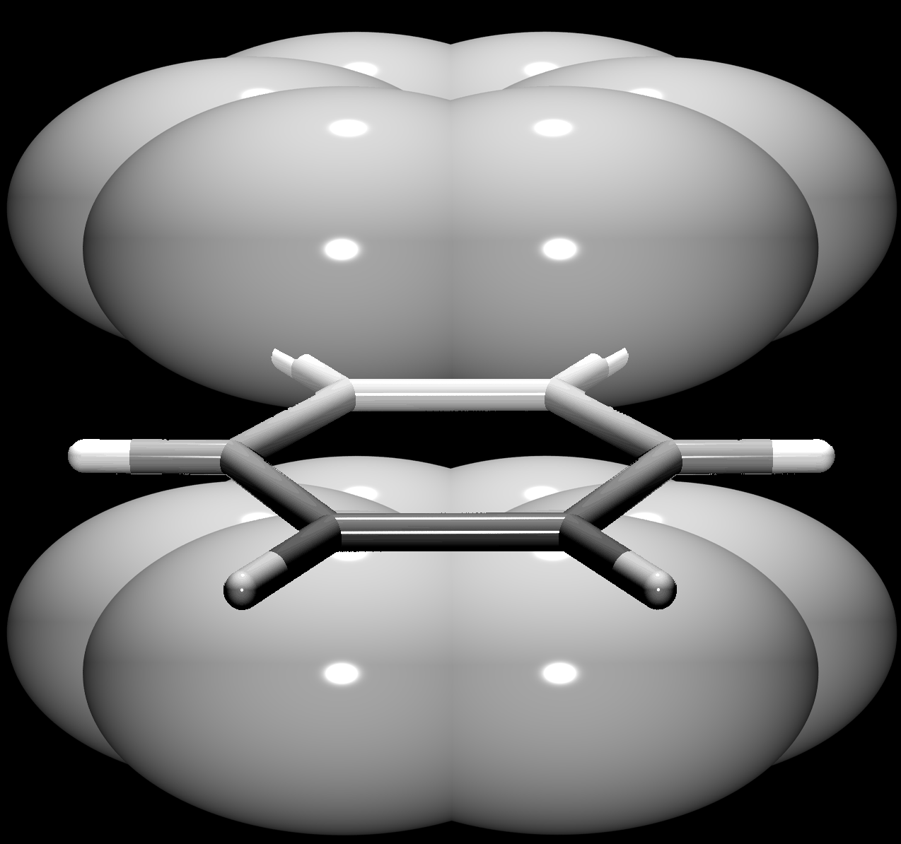
Aromatic π-interactions:
quadrupolar moments
σ∙∙∙π attraction
π∙∙∙π repulsion
δ⁻
σ∙∙∙π attraction
δ⁺
δ⁺
δ⁻

Slide 11
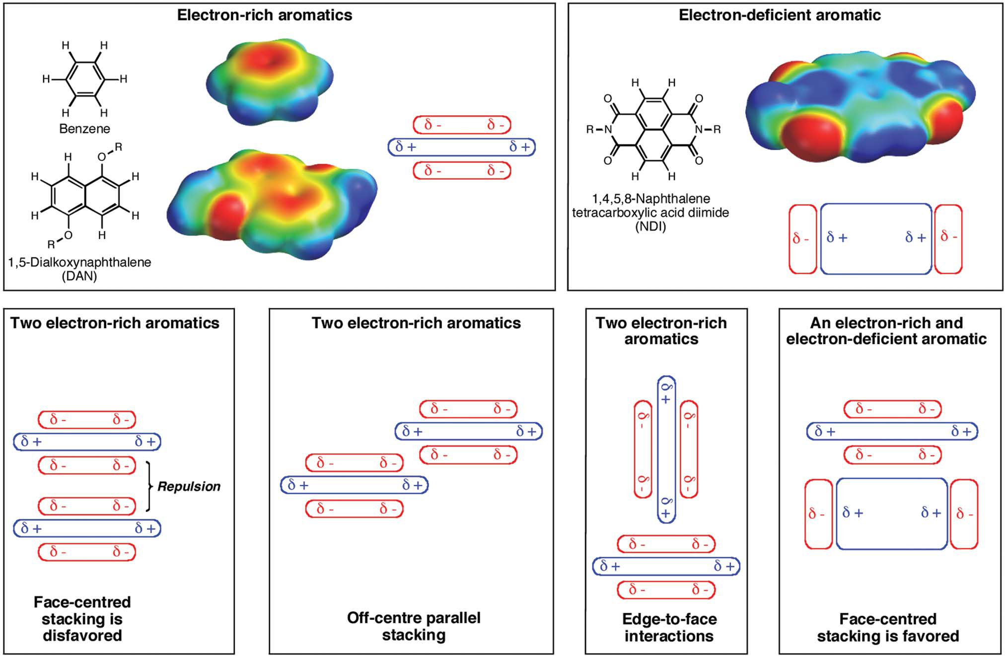
Rethinking the term „pi-stacking”
Martinez & Iverson, Chem. Sci., 2012, 3, 2191.

Slide 12
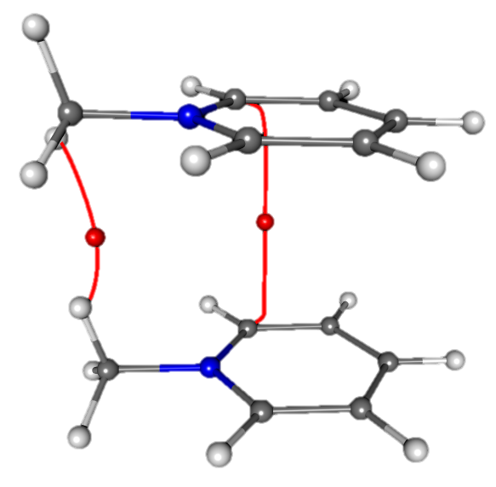
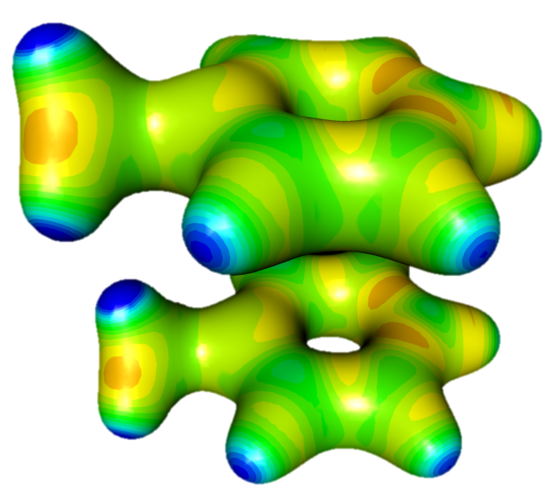
No attractive interactions:
N-methylpyridinium cations
ρ_{max} = 0.018 e Å⁻¹
Cg…Cg = 3.776(2) Å
CgI_perp = 3.766(2) Å
α = 0°
β = 4.2°
Offset = 0.279 Å
Cryst. Growth Des., 2019, 19, 391-402.

Slide 13
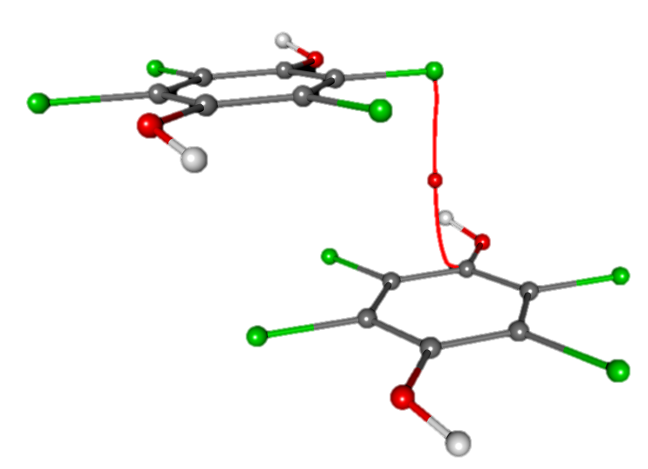
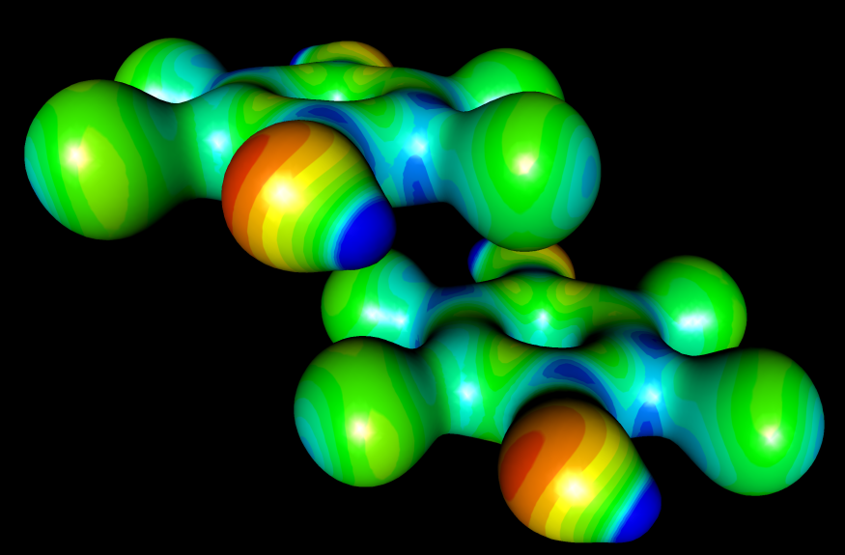
Weak interactions:
tetrachlorohydroquinone
ρ_{max} = 0.034 e Å⁻¹
3.55 Å
3.50 Å
Cg…Cg = 4.7740(9) Å
CgI_perp = 3.3957(2) Å
α = 0.00(2)°
β = 44.7°
Offset = 3.356 Å
Cryst. Growth Des., 2019, 19, 391-402.

Slide 14
Medium strong interactions
2,5-dihydroxyquinonate monoanions
Other non-aromartic rings
Metal-chelate rings
Dominantly electrostatic, E = 5 – 15 kcal mol⁻¹

Slide 15
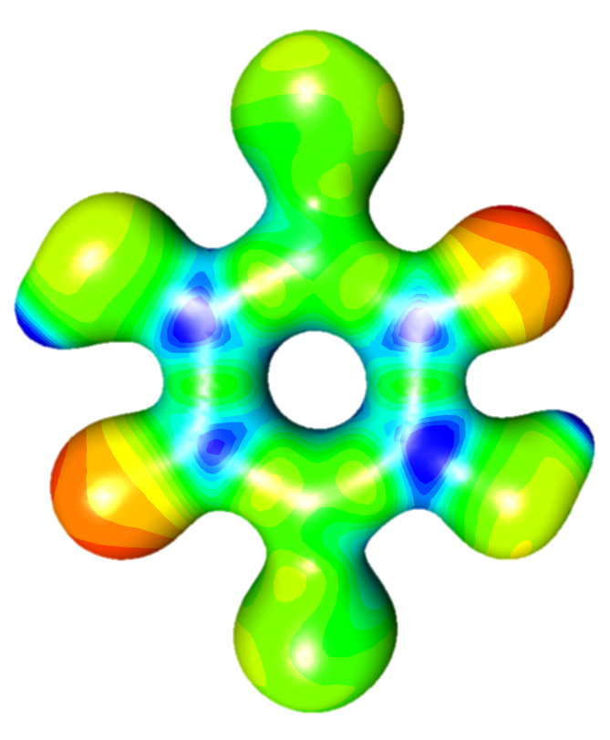
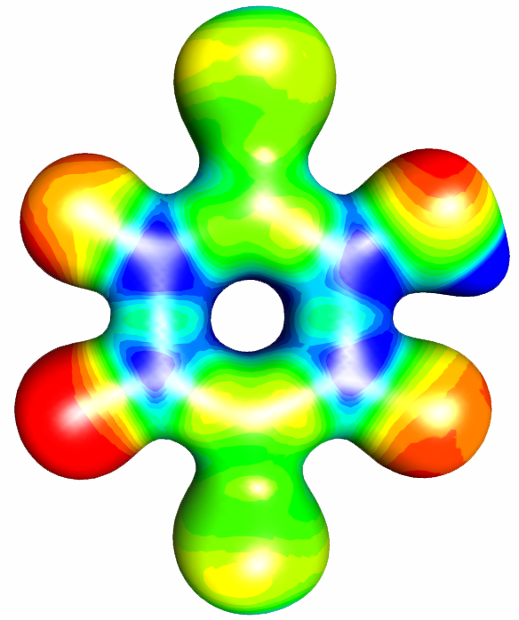
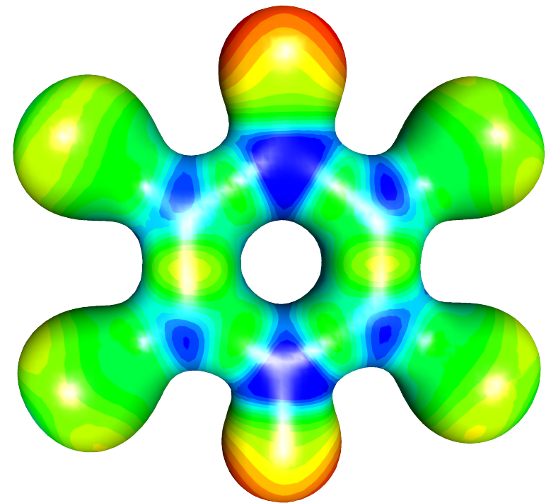
Quinoid rings: no more quadrupoles
Cryst. Growth Des., 2019, 19, 391-402; 2019, 19, 2801-2810.

Slide 16
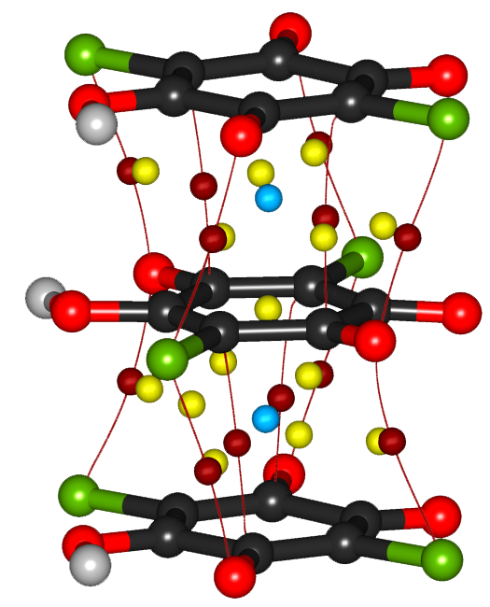
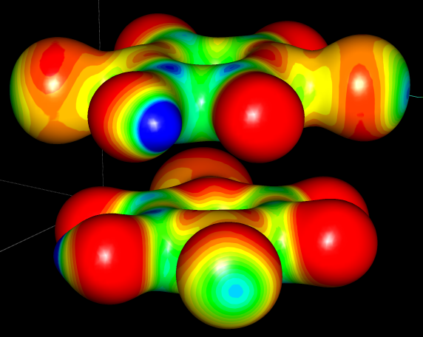
Quinone anions: hydrogenchloranilate
3.229(2) Å
ρ_{max} = 0.059 e Å⁻¹
E > 10 – 15 kcal mol⁻¹
CrystEngComm, 2015, 17, 8645.

Slide 17
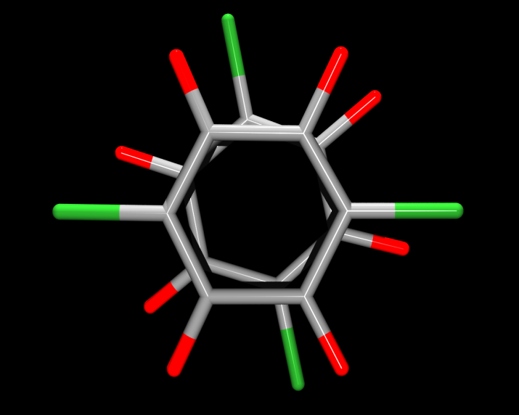
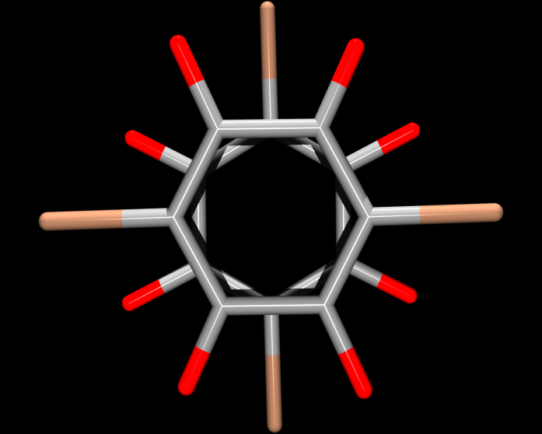
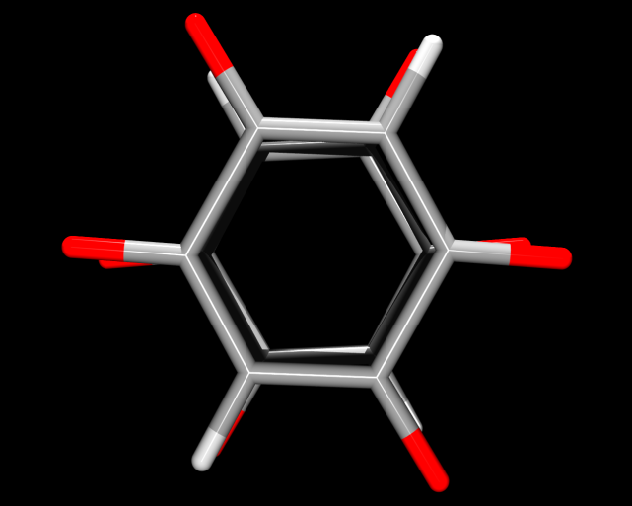
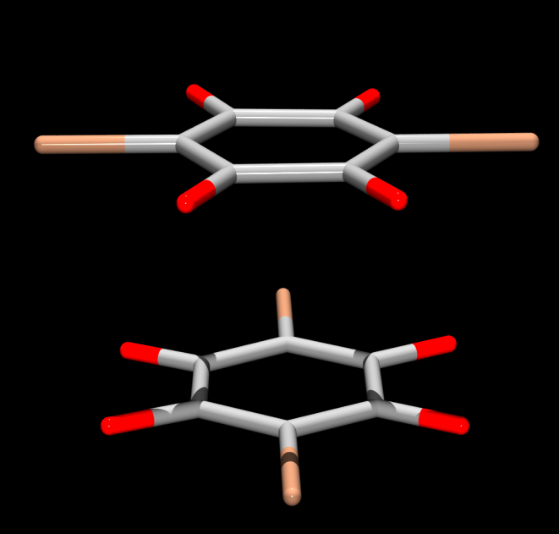
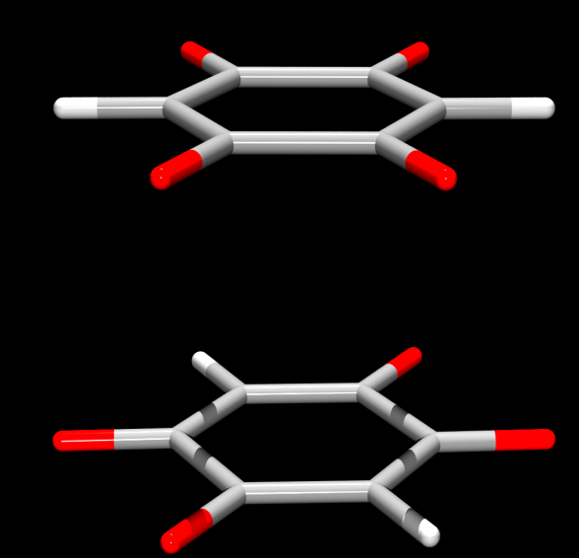
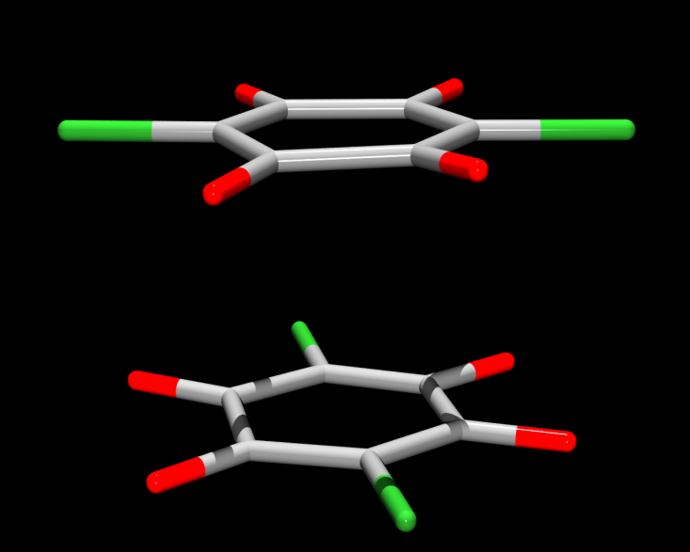
Effect of substituents
DHQ²⁻
HCA⁻
HBA⁻
CrystEngComm, 2013, 15, 135-143.

Slide 18
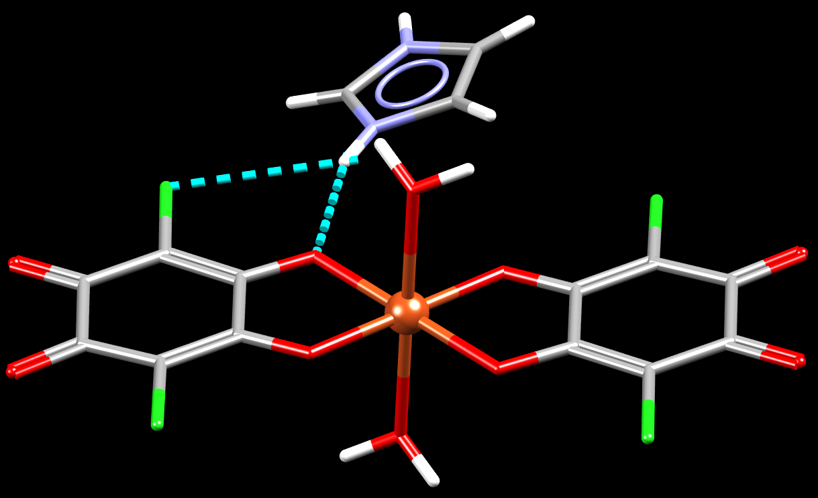
Metal-chelate rings: aromatic?
[Cu(CA)₂(H₂O)₂]Him₂
RSC Adv., 2016, 6, 62785-62796.

Slide 19
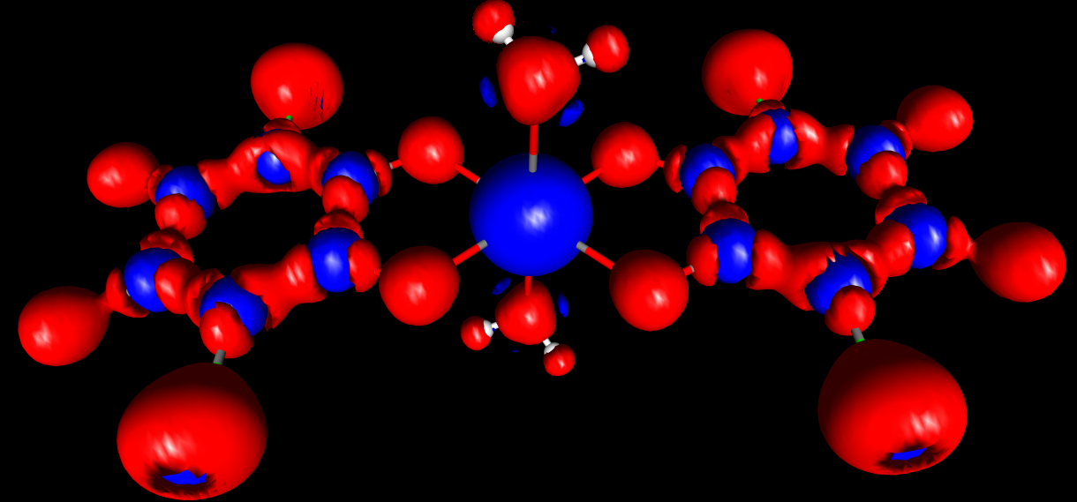
Metal-chelate rings: aromatic?
Laplacian of electron density
Cu-O bond critical points (3,-1):
Cu1-O1
ρ_{tot} = 0.33 e Å⁻³
Laplacian = 5.87
Cu1-O2
ρ_{tot} = 0.36 e Å⁻³
Laplacian = 6.11
Cryst. Growth Des., 2019, 19, 2801-2810.

Slide 20
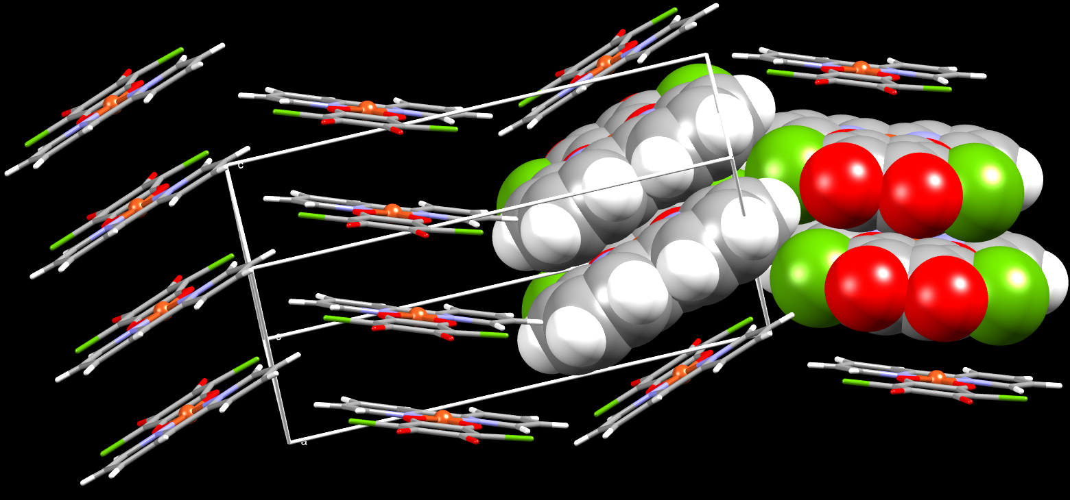
Stacking of metal-chelate rings in [Cu(CA)(2,2’-bpy)]
c
b
0
3.28 Å
a
Dalton Trans., 2013, 42, 15756-15765.

Slide 21
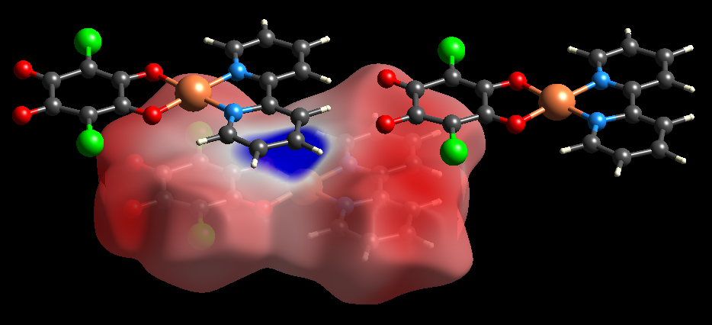
Stacking of metal-chelate rings: electrostatic potential
IUCrJ, 2019, 6, 156-166.
Dalton Trans., 2013, 42, 15756-15765.

Slide 22
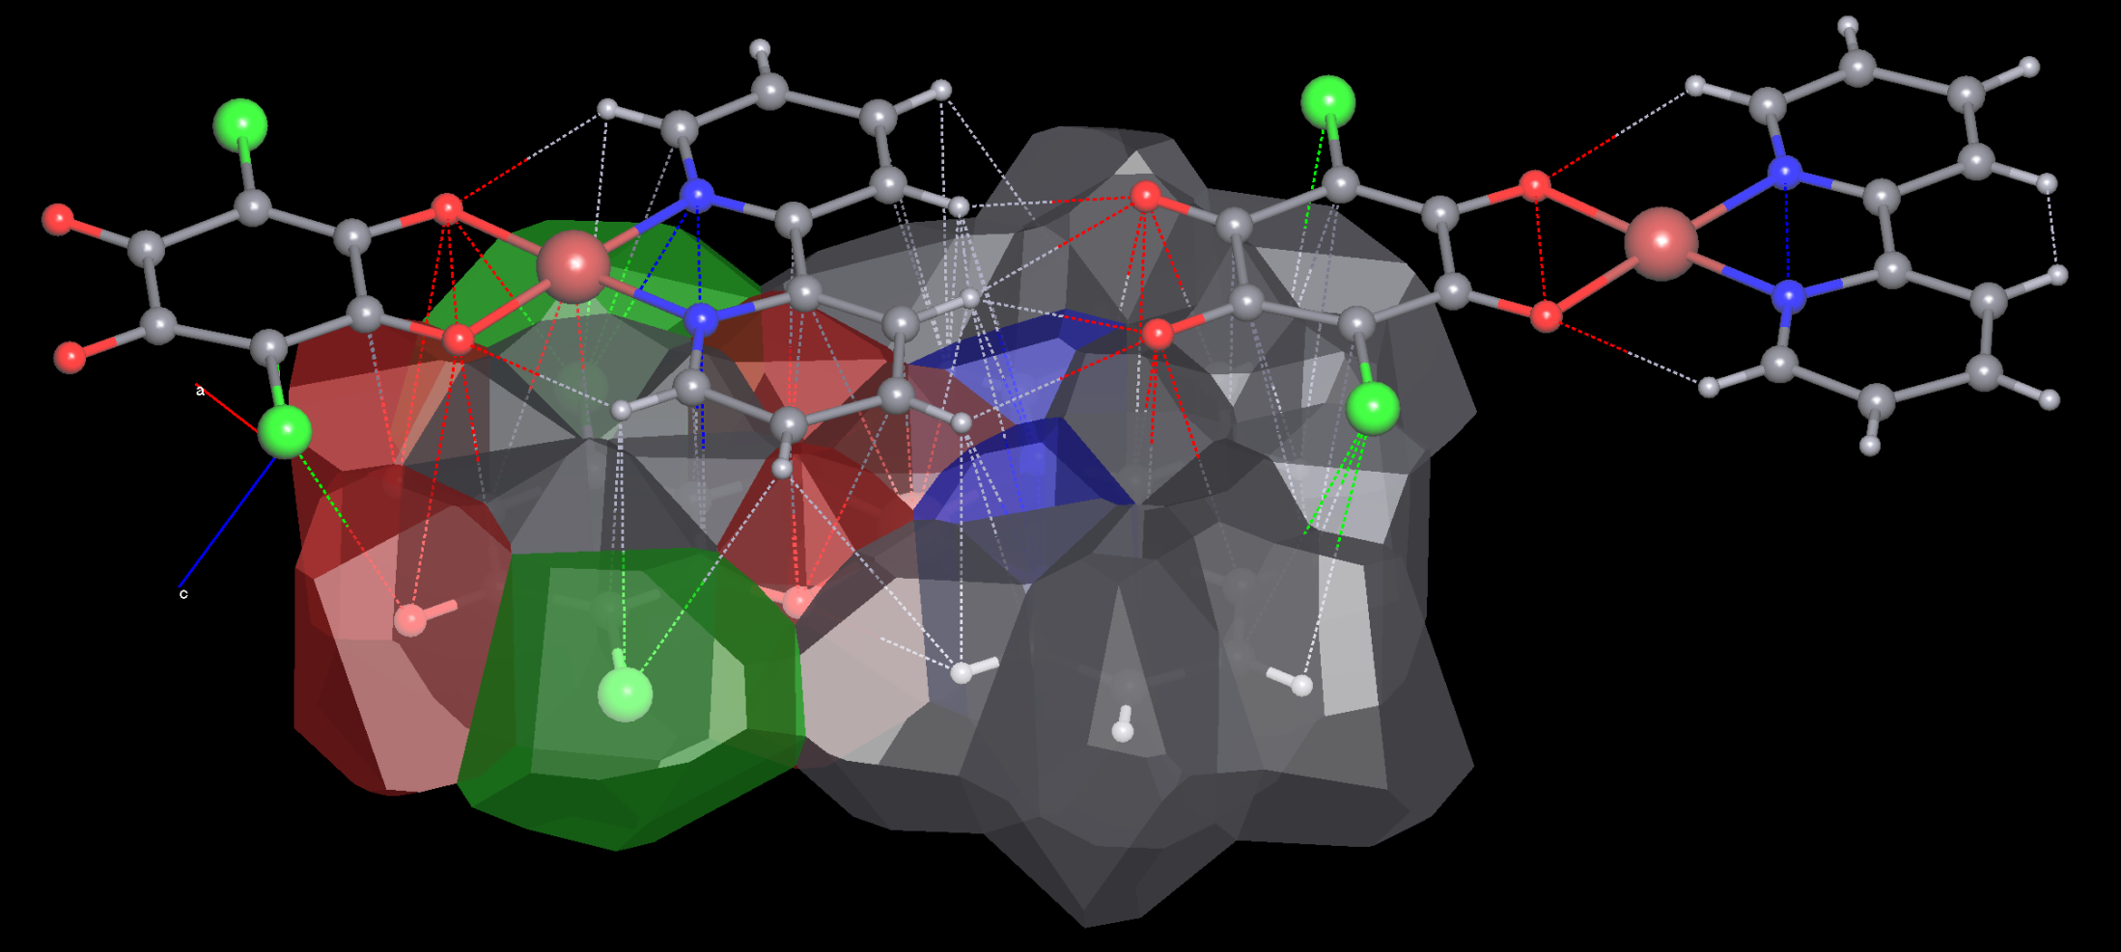
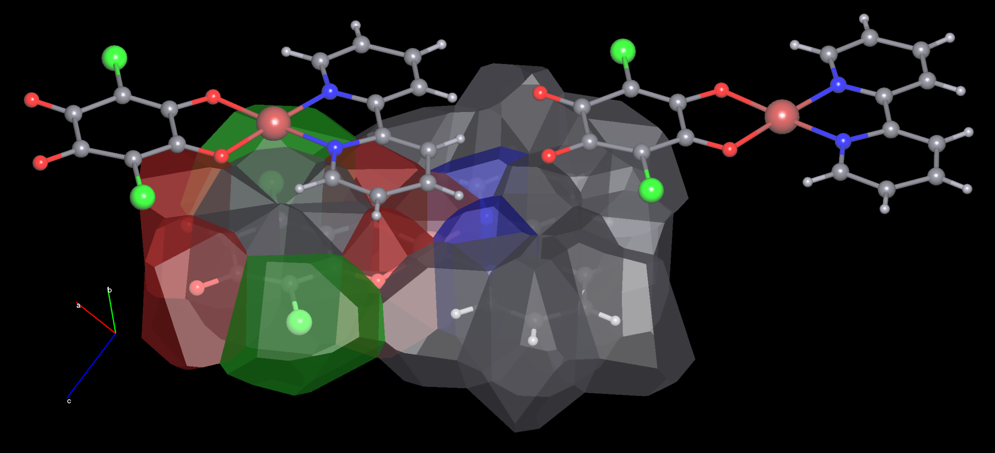
Stacking of metal-chelate rings:
Voronoi-Dirichlet polyhedra
IUCrJ, 2019, 6, 156-166.
Dalton Trans., 2013, 42, 15756-15765.

Slide 23
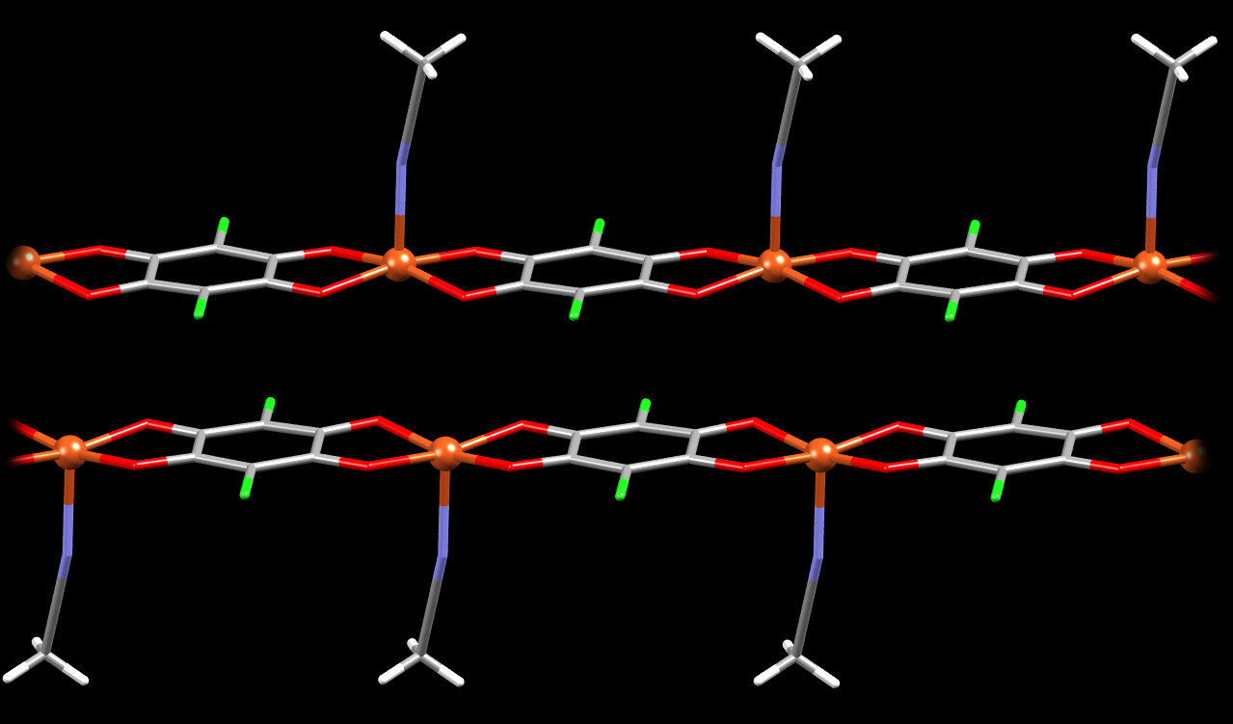
π-Stacking of the coordination polymers: [Cu(CA)(MeCN)]_{n}
3.26 Å
offset:
≈ 1.6 Å
RSC Adv., 2016, 6, 62785-62796.

Slide 24
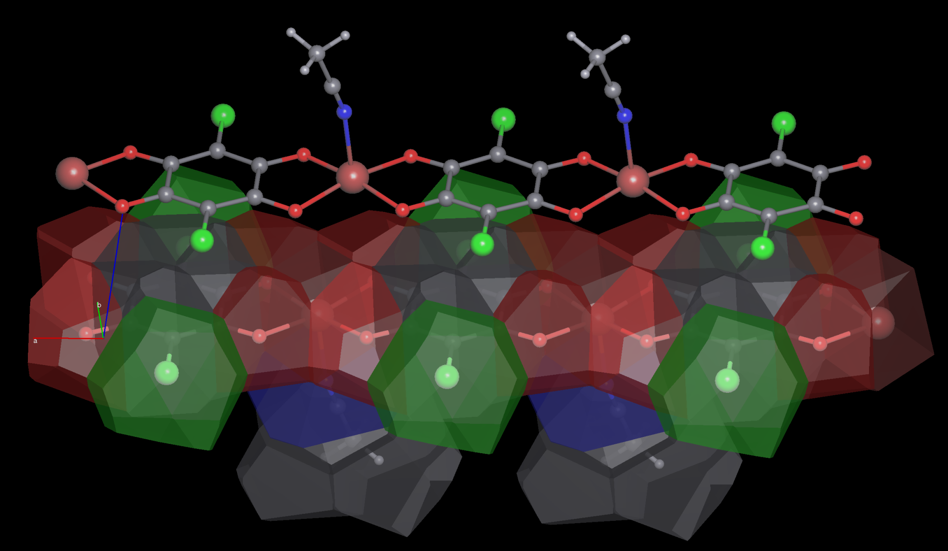

π-Stacking of the coordination polymers: [Cu(CA)(MeCN)]_{n}
IUCrJ, 2019, 6, 156-166.
RSC Adv., 2016, 6, 62785-62796.

Slide 25
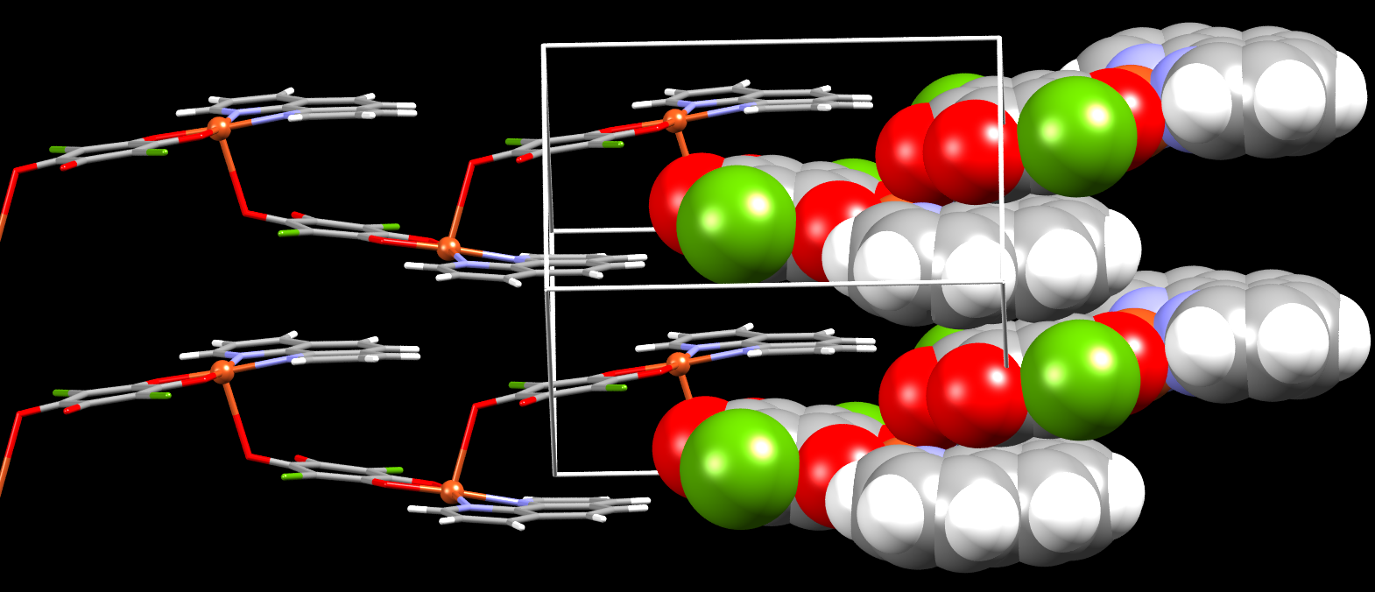
Stacking or bonding?
[Cu(CA)(1,10’-phen)]
c
2.574(2) Å
0
b
≈ 3.2 Å
a
Dalton Trans., 2014, 43, 7208-7218.

Slide 26
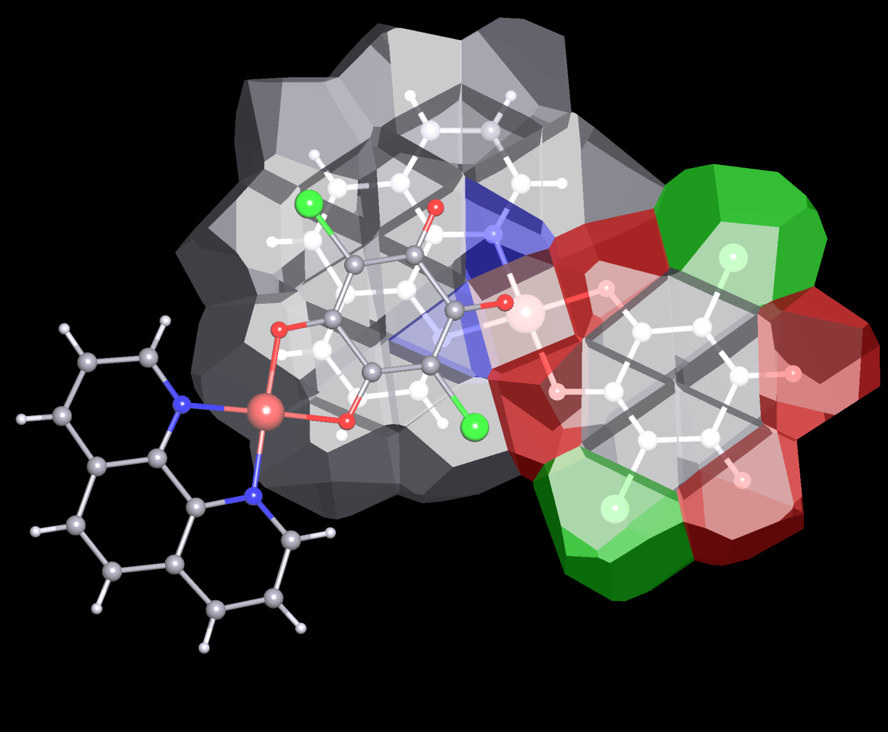
Stacking or bonding?
[Cu(CA)(1,10’-phen)]
IUCrJ, 2019, 6, 156-166.
Dalton Trans., 2014, 43, 7208-7218.

Slide 27
Strong Interactions
Pancake bonding between planar radicals
Significant covalent component: multicentric two-electron covalent bonding
Electrostatic contribution
E > 15 kcal mol⁻¹

Slide 28
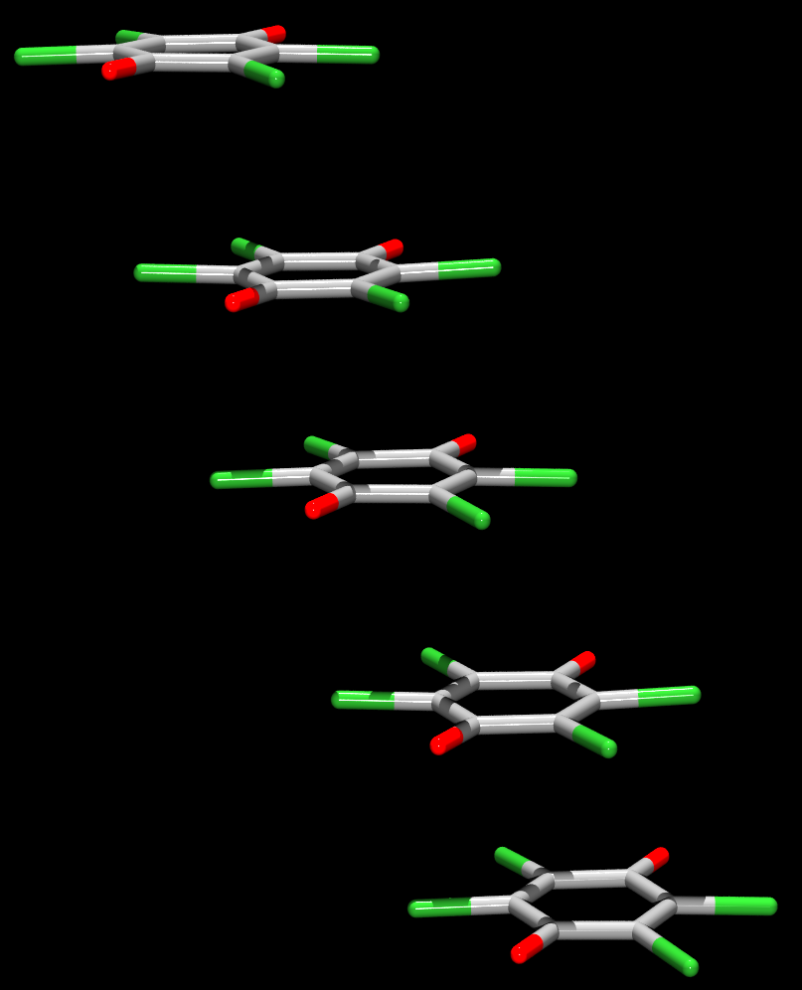
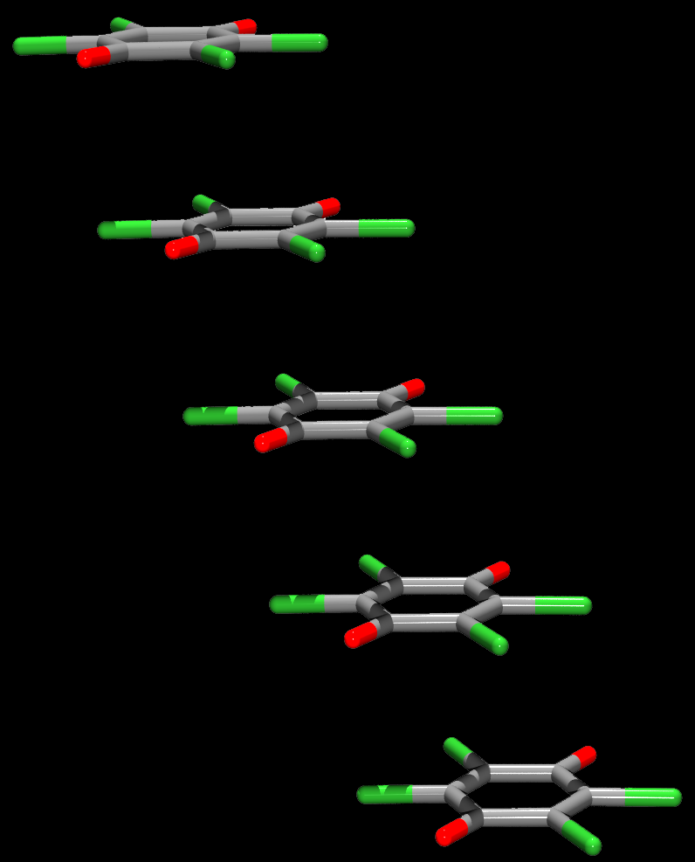
Pancake bonding between semiquinone radicals: KCl₄Q·MeCOEt
200 K
Antiferromagnetic
3.46 Å
3.58 Å
3.27 Å
3.46 Å
Reversible!
Single crystal
to
Single crystal
3.58 Å
3.46 Å
100 K
Diamagnetic
3.27 Å
3.46 Å
CrystEngComm, 2012, 14, 7958-7964.

Slide 29
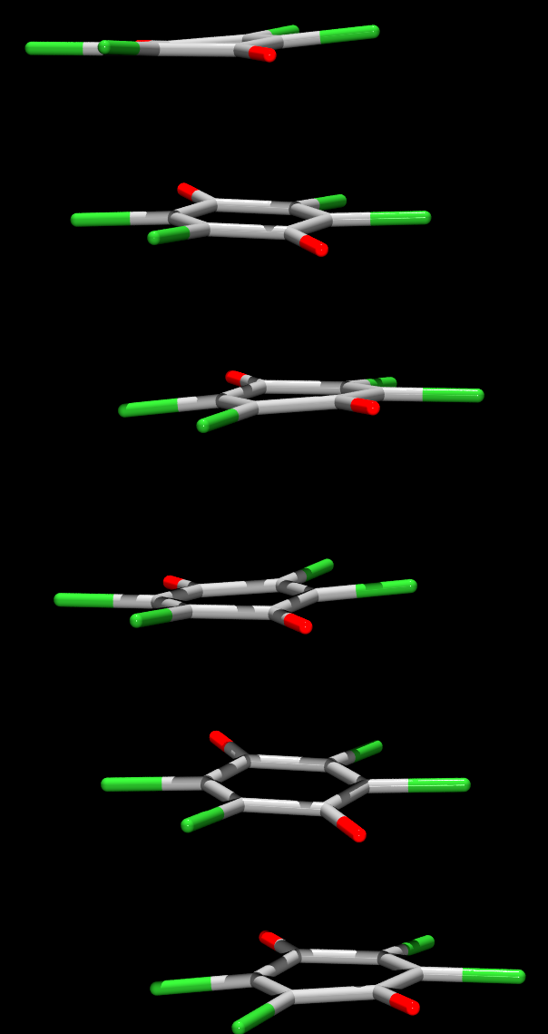
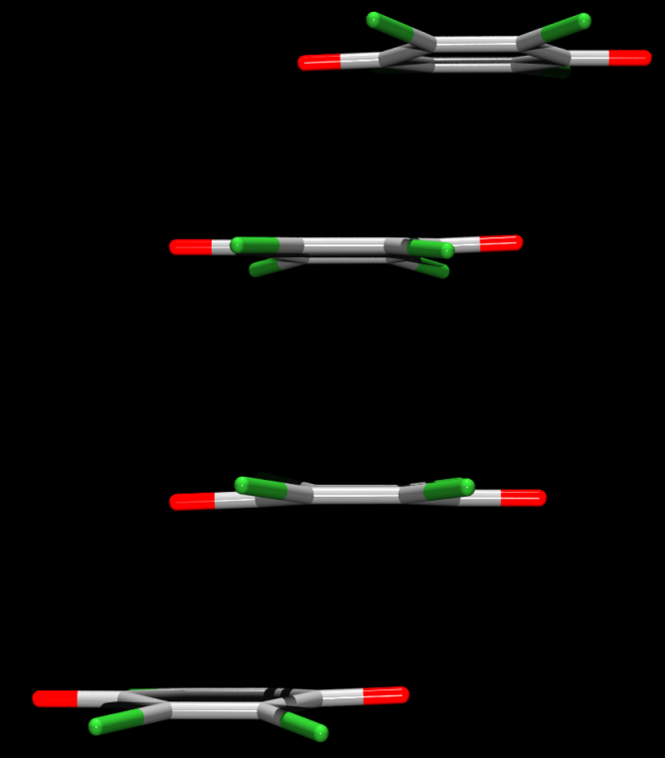
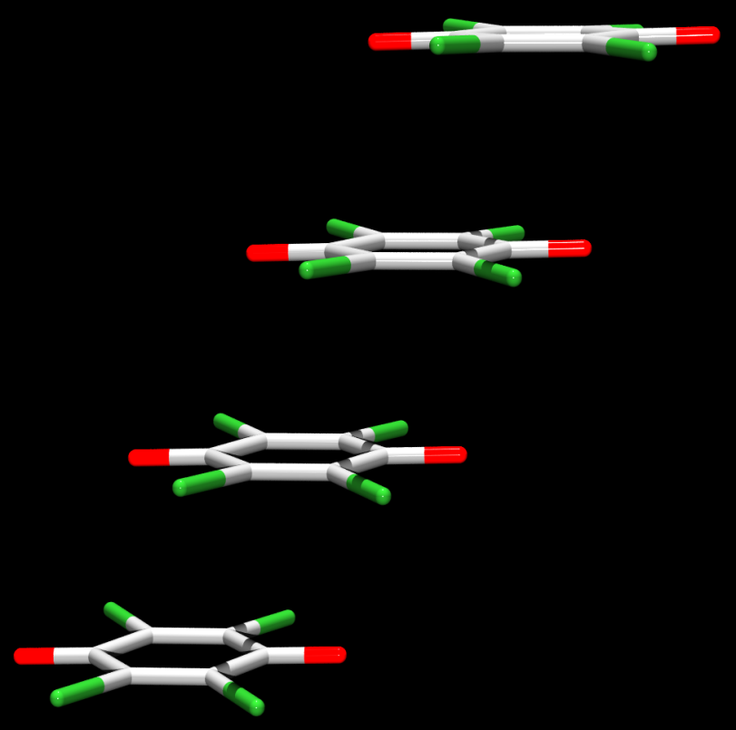
Three types of pancake-bonded stacks: N-MePy·Cl₄Q, [N-Me-4-(Me)₂NPy]₂(Cl₄Q)₃
dimers
equidistant radicals
trimers
2.84 Å
2.86 Å
3.60 Å
3.17 Å
3.59 Å
B
A
IUCrJ, 2019, 6, 156-166.
Cryst. Growth Des., 2016, 16, 4777-4782.
Chem. Eur. J., 2018, 24, 8292-8297.

Slide 30
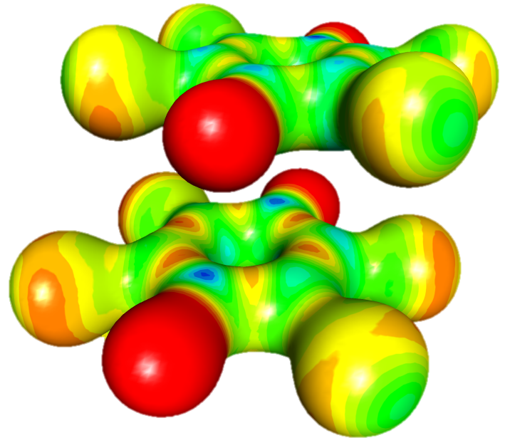
Interactions between the rings in a pancake-bonded dimer
2.86 Å
Offset: 2.07 Å
0.5 e Å⁻³
IUCrJ, 2019, 6, 156-166.
Cryst. Growth Des., 2019, 19, 391-402.

Slide 31
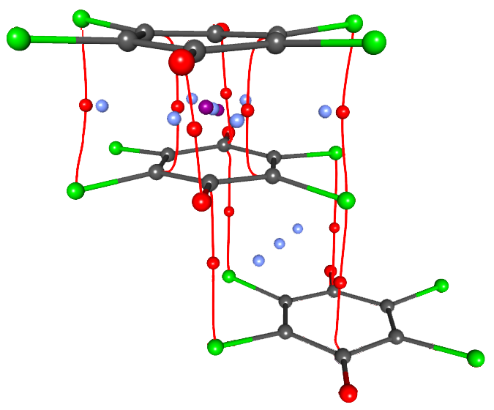
Critical points in a pancake-bonded dimer
ρ_{max} > 0.095 e Å⁻³
2.86 Å
ρ_{max} < 0.040 e Å⁻³
3.60 Å
(3, -1) bond
(3, +1) ring centroid
(3, +3) cage centroid
IUCrJ, 2019, 6, 156-166.
Cryst. Growth Des., 2019, 19, 391-402.

Slide 32
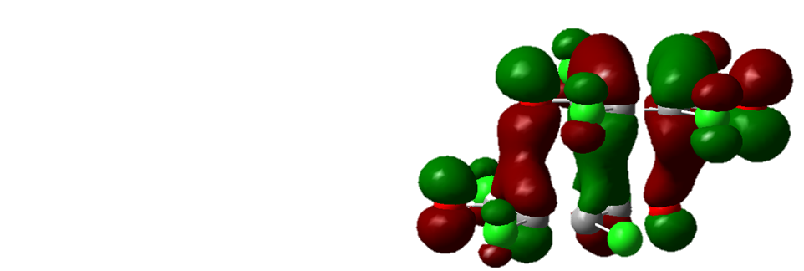
Pancake bonded dimer:
HOMO orbitals
Covalent contribution: –9.4 kcal mol⁻¹
Intermolecular bond order
all atoms | 0.80
only C atoms | 0.27
inter-dimer | 0.04
IUCrJ, 2019, 6, 156-166.
Cryst. Growth Des., 2019, 19, 391-402.

Slide 33
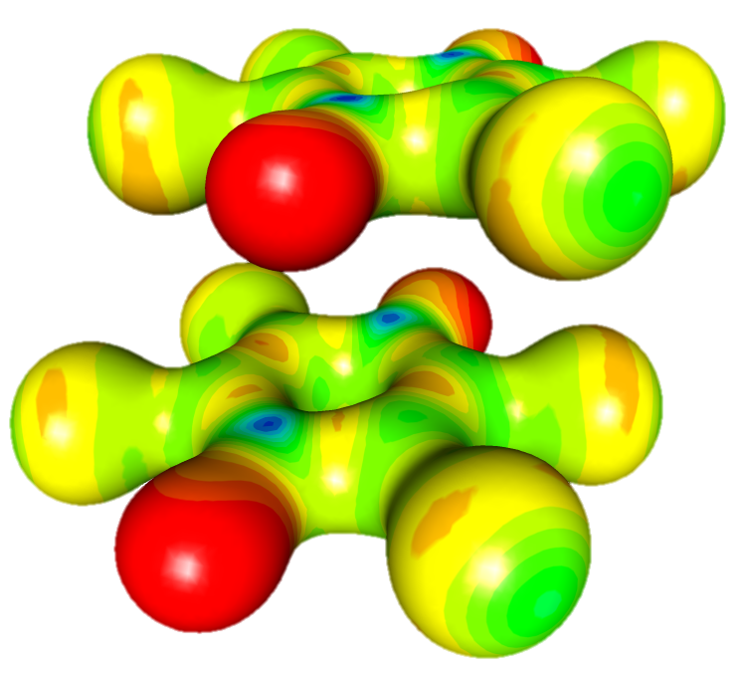
Interactions between the equidistant radicals
3.17 Å
Offset: 2.06 Å
0.5 e Å⁻³
IUCrJ, 2019, 6, 156-166.
Cryst. Growth Des., 2019, 19, 391-402.

Slide 34
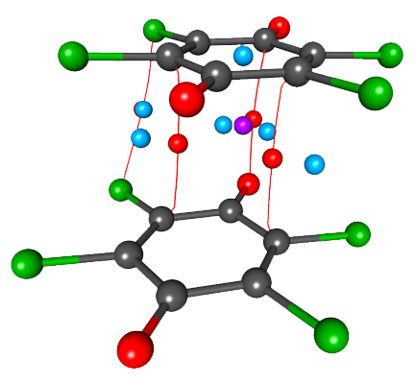
Critical points between equidistant radicals
ρ_{max} < 0.050 e Å⁻³
3.17 Å
(3, -1) bond
(3, +1) ring centroid
(3, +3) cage centroid
IUCrJ, 2019, 6, 156-166.
Cryst. Growth Des., 2019, 19, 391-402.

Slide 35
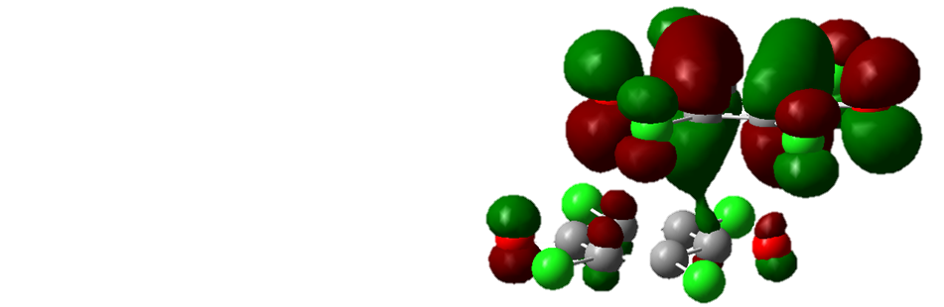
Pancake bonding between equidistant rings: HOMO orbitals
Covalent contribution: –2.9 kcal mol⁻¹
Intermolecular bond order
all atoms | 0.26
only C atoms | 0.09
IUCrJ, 2019, 6, 156-166.
Cryst. Growth Des., 2019, 19, 391-402.

Slide 36
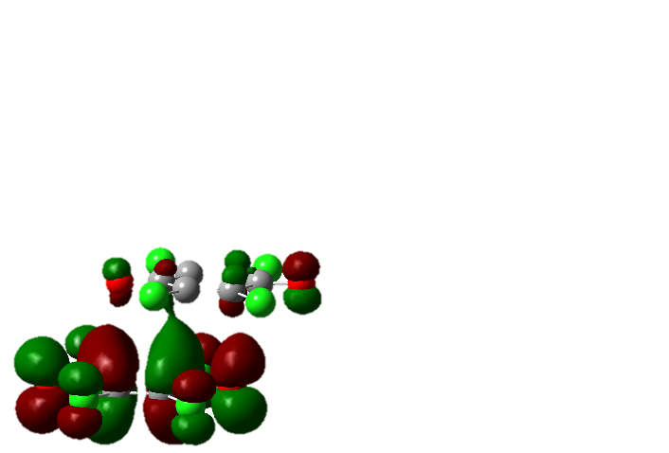
Pancake bonded polymer!
e⁻
e⁻
e⁻
e⁻
ΔE = 0.34 eV
IUCrJ, 2019, 6, 156-166.

Slide 37
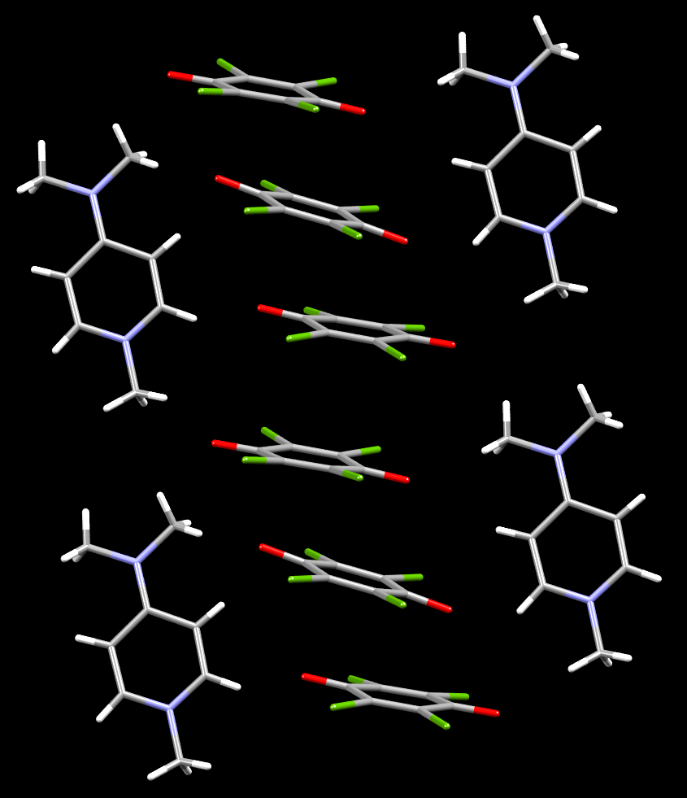
Pancake-bonded trimers in
[N-Me-4-(Me)₂NPy]₂(Cl₄Q)₃
–0,58
Charges from P_{val}:
+0.96
–1.92
–0,76
–0,58
+0.96
2–
1+
1+
IUCrJ, 2019, 6, 156-166.
Chem. Eur. J., 2018, 24, 8292-8297.

Slide 38
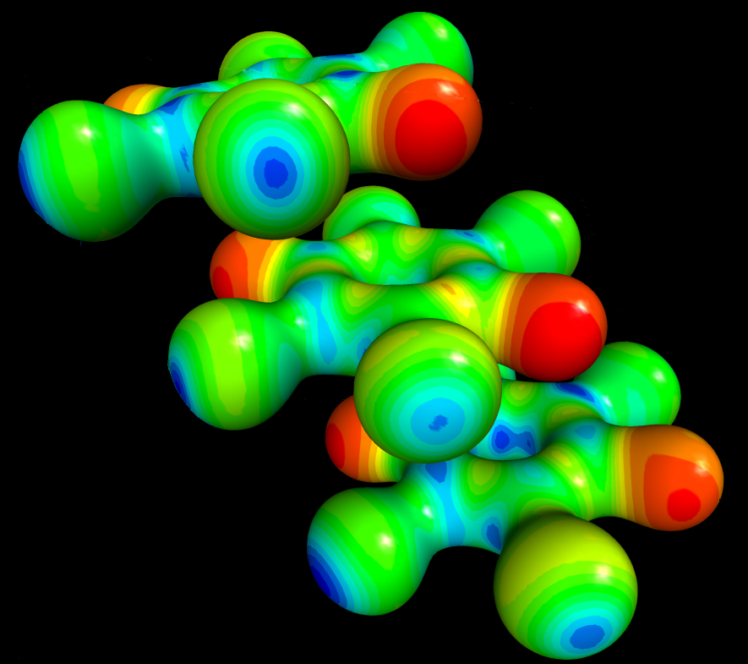
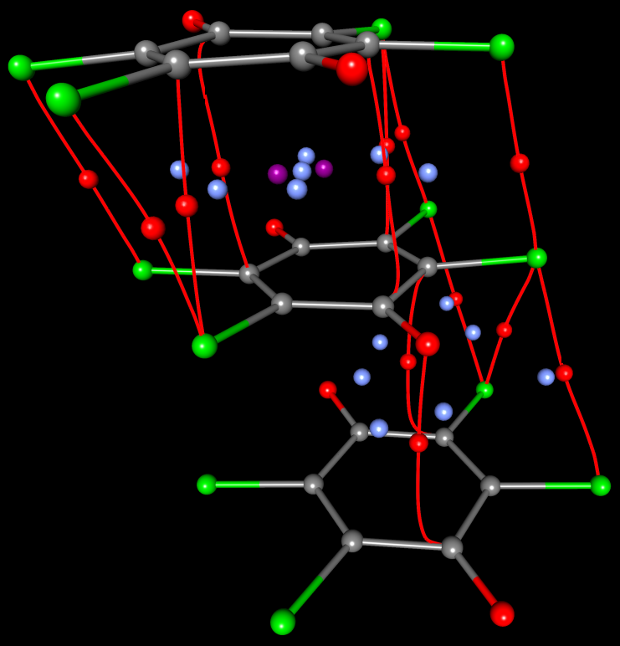
Pancake bonding between three rings
ρ_{max} > 0.077 e Å⁻³
2.84 Å
3.59 Å
ρ_{max} < 0.045 e Å⁻³
IUCrJ, 2019, 6, 156-166.
Chem. Eur. J., 2018, 24, 8292-8297.

Slide 39
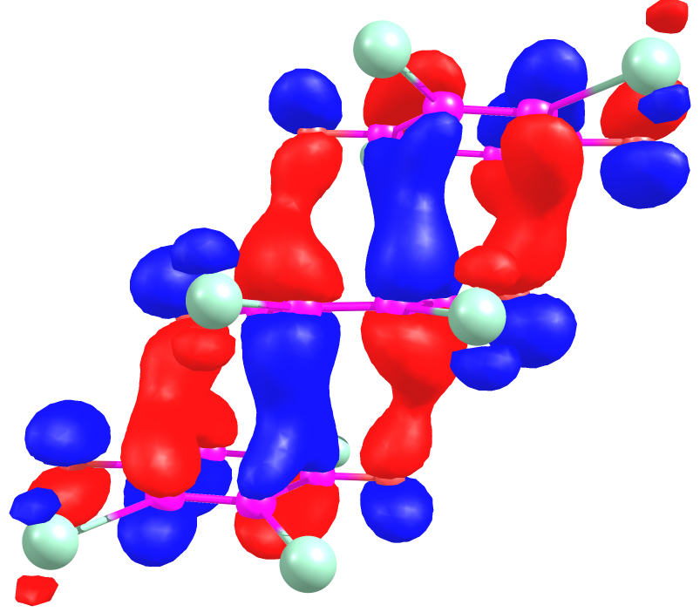
Pancake bonding between three rings: HOMO orbitals
Intermolecular bond order
all atoms | < 0.71
probably | ~ 0.5
Covalent contribution: –4.11 kcal mol⁻¹
IUCrJ, 2019, 6, 156-166.
Chem. Eur. J., 2018, 24, 8292-8297.

Slide 40
Electric conductivity
vs. interplanar distance (100 K)
Cl₄Q∙N-MePy
Br₄Q∙N-MePy
DDQ∙N-Me-2Pic
3.2855(16) Å
3.1587(13) Å
3.122(3) Å
CrystEngComm, 2018, 20, 1862-1873.

Slide 41



Inductive effect of the substituents
Br₄Q
Cl₄Q
DDQ
LUMO
LUMO
LUMO
ΔE
ΔE
ΔE
HOMO
HOMO
HOMO
CrystEngComm, 2018, 20, 1862-1873.

Slide 42
New research: pancake bonding under extreme conditions
Collaboration with E. V. Boldyreva (Novosibirsk State University)
Variable-temperature crystallography (80 – 400 K)
High-pressure crystallography (up to ca. 10 GPa)
Electric conductivity and magnetism measurements under high pressure?

Slide 43
Conclusions
 | weak | medium | strong
E / kcal mol⁻¹ | < 5 | 5 - 15 | 15
Dominant interaction | dispersion | electrostatic | covalent
Hydrogen bonding | C-H···O, C-H···S, C-H···Cl | O-H···O, N-H···N, O-H···N | RAHB, CAHB, LBHB, HF···FH, OH₂···H⁺···H₂O (Zundel ion)
Halogen bonding | C-Cl···O | N-Br···N, N-I···N | N-bs···3,5-dmp, halonium ions
π-stacking | aromatics, heteroaromatics... | quinones, metal-chelates | planar radicals: dimers, trimers, equidistant stacks
IUCrJ, 2019, 6, 156-166.

Slide 44

Acknowlegdements
RBI, Zagreb
Biserka Kojić-Prodić
Zoran Štefanić
Marijana Jurić
Lidija Androš Dubraja
Nadica Maltar-Strmečki
Ana Šantić
Dijana Žilić
Darko Babić
Valentina Milašinović
Lidija Kanižaj
Université de Lorraine
Christian Jelsch
Claude Lecomte
Emmanuel Wenger
Slimane Dahaoui
University of Zagreb
Vladimir Stilinović
Damir Pajić
Nikolina Novosel
Krešo Zadro
University of Ljubljana
Anton Meden
Rigaku Oxford Diffraction Ltd.
Marcus Winter
Dyanne Cruikshank
KI, Ljubljana
Jernej Stare
Gregor Mali
Dušan Hadži
Jože Grdadolnik
Georgetown Univ., USA
Miklosz Kertesz
Zhongyu Mou
UNAM, Mexico City
Jesús Hernández-Trujillo
Bruno Landeros-Rivera
Croatian Science Foundation, grant no. IP-2014-09-4079
Croatian Academy of Sciences and Arts
French-Croatian bilateral, Slovenian-Croatian bilateral

