Slide 1
The role of contextual factors in the effect of contact on generalized and specific prejudices towards national minorities: a cross-national approach
Tomislav Pavlović*, Renata Franc
Ivo Pilar Institute of Social Sciences
The ESRA Conference, University of Zagreb
July 15 - 19, 2019, Zagreb
*Tomislav Pavlović’s work on DARE has been supported by a Croatian Science Foundation within Young Researchers’ Career Development Project – Training of Doctoral Students (DOK-01-2018) financed by the European Union from the European Social Fund (ESF). This publication reflects
only the views of the authors; the European Commission and Research Executive Agency are not responsible for any information it contains.

Slide 2
Introduction
Contact hypothesis
More contact = less prejudice (Allport, 1956)
Confirmed by newer studies
Meta-analysis by Pettigrew and Tropp (2006)
713 samples from 515 studies
Negative factors that diminish its effectiveness?
Reconstructed by Kende et al. (2017)
660 samples across 36 cultures
Cultural hierarchy values and SDO and weaker contact-prejudice relationship
Egalitarianism and stronger contact-prejudice relationship
General conclusion: cultural differences affect the contact-prejudice relationship
Cultural? Economic? Socio-political?
Common and/or specific component of prejudice? (Brandt and Crawford, 2019; Akrami, Ekehammar and Bergh, 2011; Meeusen and Kern, 2016)
contact
prejudice
Notes:
Prejudice = negative evaluation of a group or an individual based on group membership (crandall et al., 2002)

Slide 3
Aims of this study
test the contact as predictor of generalized as well as specific prejudices towards national minorities (Roma, Jews, Muslims) in the context of other common predictors
test the differences in predictiveness of contact in the context of specific macro-level indicators of inter-group equality and wellbeing (operationalized by national homogeneity, Human Development Index, GINI index, risk of violating human rights and socialist historical legacy)
compare linear and interactive relationship of contact as a determinant of generalized prejudice and prejudice towards specific national minorities

Slide 4
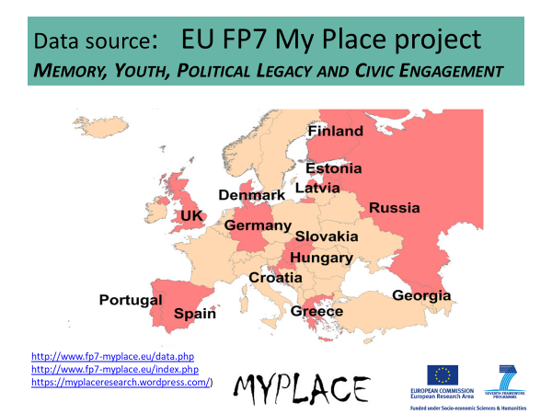
Method
EU FP7 MyPlace data
16935 participants aged 15-25 (50.2% women), from 14 European countries
Excluded:
Participants with incomplete answers
Jews and Muslims
Citizens of other countries
Included:
7515 participants
3742 (50.2%) women

Slide 5
Operationalizations of constructs – IVs and contextual factors
Main predictor
Contact: Close friends that belong to a different racial/ethnic group, belong to a different social class, are of different political or religious beliefs, gender and sexual orientation (CFI = .974, RMSEA = .078, SRMR = .025)
Other individual predictors
Economic chauvinism: Stricter border controls, migrants having the same rights as citizens of the country, citizens having employment advantages when job are scarce (r = .24 - .37)
Threat experience: Experience of being threatened due to support for political movement, being a minority, sexual orientation, belonging to a subculture and gender (CFI = .982, RMSEA = .047, SRMR = .021)
Interpersonal trust: Most people can be trusted/cannot be too careful (0-10)
Political orientation - Left-right (0-10)
Satisfaction with life - overall estimate (0-10)
Satisfaction with income - coping with income (1-4)
Contextual factors
National homogeneity (% of foreigners)
History of communism
GINI
Human Development Index
Risk of human rights abuse
Notes:
Maplecroft’s human rights risk indeks 2012

Slide 6
Operationalizations of constructs - DVs
DVs
Prejudice against Roma
Roma/Gypsies/travellers make a positive contribution to the society. // Police should be stricter with Roma/Gypsies/travellers. (r = -0.45)
Prejudice against Jews
Jews talk to much about Holocaust. // Jews make a positive contribution to the society. (r = -0.27)
Prejudice against Muslims
Muslims make a positive contribution to the society. // It is right to be suspicious towards Muslims. (r = -0.43)
General prejudice
All of the previous (following table)

Slide 7
Correlations
Table 1. Correlations between prejudices and their common predictors (N = 7515)
 | (1) | (2) | (3) | (4) | (5) | (6) | (7) | (8) | (9) | (10) | (11)
(1) prejudice against Roma | 1 | 0.36* | 0.48* | 0.79* | 0.23* | -0.10* | -0.14* | -0.08* | 0.45* | -0.13* | 0.11*
(2) prejudice against Jews |  | 1 | 0.52* | 0.76* | 0.20* | -0.18* | -0.17* | -0.03 | 0.40* | -0.17* | 0.20*
(3) prejudice against Muslims |  |  | 1 | 0.84* | 0.25* | -0.20* | -0.24* | -0.03 | 0.52* | -0.20* | 0.22*
(4) generalized prejudice |  |  |  | 1 | 0.28* | -0.20* | -0.23* | -0.06* | 0.57* | -0.21* | 0.22*
(5) political orientation |  |  |  |  | 1 | -0.10* | -0.10* | -0.04 | 0.26* | 0.00 | 0.03
(6) interpersonal trust |  |  |  |  |  | 1 | 0.11* | -0.01 | -0.23* | 0.16* | -0.16*
(7) contact index |  |  |  |  |  |  | 1 | 0.15* | -0.18* | 0.10* | -0.08*
(8) threat index |  |  |  |  |  |  |  | 1 | -0.06* | -0.08* | 0.01
(9) economic chauvinism |  |  |  |  |  |  |  |  | 1 | -0.20* | 0.23*
(10) satisfaction with life |  |  |  |  |  |  |  |  |  | 1 | -0.38*
(11) satisfaction with finances |  |  |  |  |  |  |  |  |  |  | 1
* p < .001

Slide 8
Results
Generalized prejudice (Adj. R² = .40)
 | Est. | Std. Error | t-value | Pr(>|t|)
(Intercept) | 12.105 | 0.345 | 35.04 | < 2e-16 ***
contact index | -0.091 | 0.008 | -11.69 | < 2e-16 ***
threat index | -0.060 | 0.037 | -1.65 | 0.10
economic chauvinism | 0.738 | 0.015 | 47.81 | < 2e-16 ***
satisfaction with life | -0.144 | 0.019 | -7.73 | 1.22e-14 ***
satisfaction with finances | 0.279 | 0.045 | 6.14 | 8.45e-10 ***
political orientation | 0.246 | 0.016 | 15.40 | < 2e-16 ***
interpersonal trust | -0.066 | 0.015 | -4.24 | 2.29e-05 ***
Prejudice against Muslims (Adj. R² = .32)
 | Est. | Std. Error | t-value | Pr(>|t|)
(Intercept) | 3.509 | 0.154 | 22.86 | < 2e-16 ***
contact index | -0.047 | 0.003 | -13.55 | < 2e-16 ***
threat index | 0.022 | 0.016 | 1.37 | 0.171
economic chauvinism | 0.275 | 0.007 | 40.16 | < 2e-16 ***
satisfaction with life | -0.055 | 0.008 | -6.64 | 3.30e-11 ***
satisfaction with finances | 0.137 | 0.020 | 6.77 | 1.37e-11 ***
political orientation | 0.089 | 0.007 | 12.52 | < 2e-16 ***
interpersonal trust | -0.039 | 0.007 | -5.65 | 1.62e-08 ***
Prejudice against Roma (Adj. R² = .22)
 | Est. | Std. Error | t-value | Pr(>|t|)
(Intercept) | 4.488 | 0.173 | 25.95 | < 2e-16 ***
contact index | -0.017 | 0.004 | -4.27 | 2.02e-05 ***
threat index | -0.077 | 0.018 | -4.24 | 2.29e-05 ***
economic chauvinism | 0.274 | 0.008 | 35.42 | < 2e-16 ***
satisfaction with life | -0.046 | 0.009 | -4.91 | 9.48e-07 ***
satisfaction with finances | -0.006 | 0.023 | -0.28 | 0.782
political orientation | 0.094 | 0.008 | 11.77 | < 2e-16 ***
interpersonal trust | 0.012 | 0.008 | 1.50 | 0.134
Prejudice against Jews (Adj. R² = .20)
 | Est. | Std. Error | t-value | Pr(>|t|)
(Intercept) | 4.107 | 0.151 | 27.25 | < 2e-16 ***
contact index | -0.027 | 0.003 | -8.10 | 6.45e-16 ***
threat index | -0.005 | 0.016 | -0.30 | 0.762
economic chauvinism | 0.189 | 0.007 | 28.03 | < 2e-16 ***
satisfaction with life | -0.043 | 0.008 | -5.32 | 1.07e-07 ***
satisfaction with finances | 0.149 | 0.020 | 7.50 | 6.92e-14 ***
political orientation | 0.063 | 0.007 | 9.03 | < 2e-16 ***
interpersonal trust | -0.038 | 0.007 | -5.67 | 1.45e-08 ***
For 7507 df, d = .20 when t = ±8.7!

Slide 9
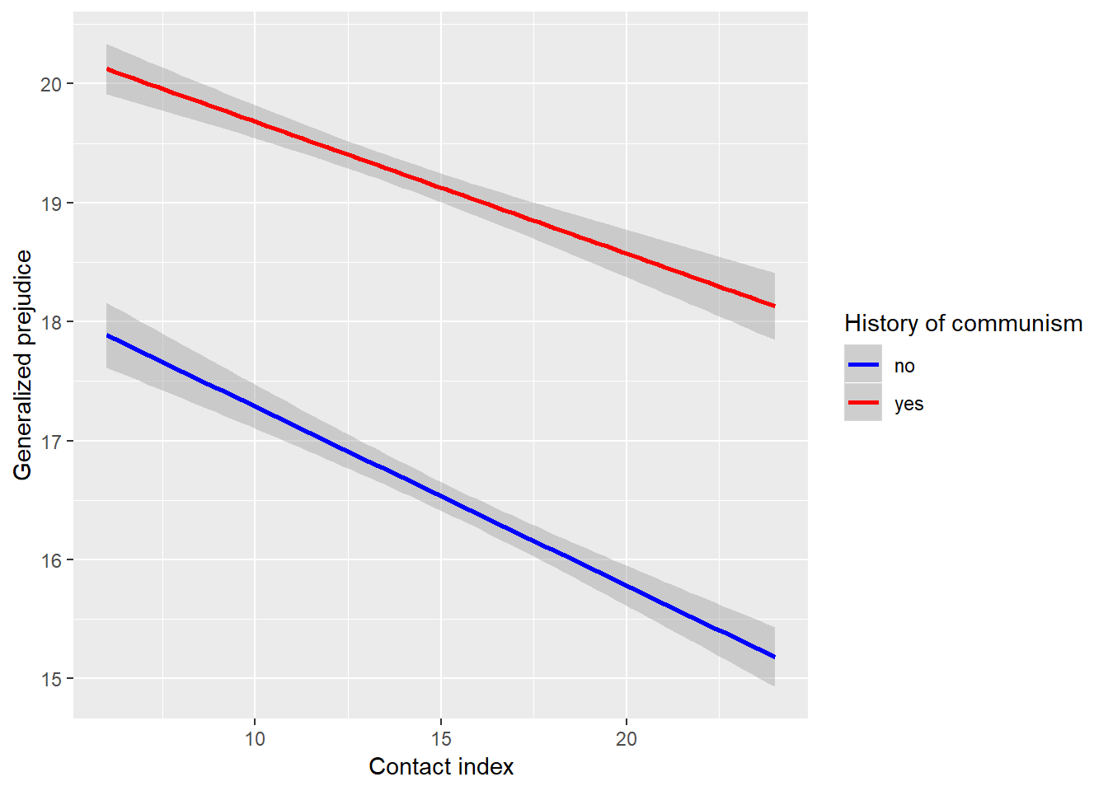
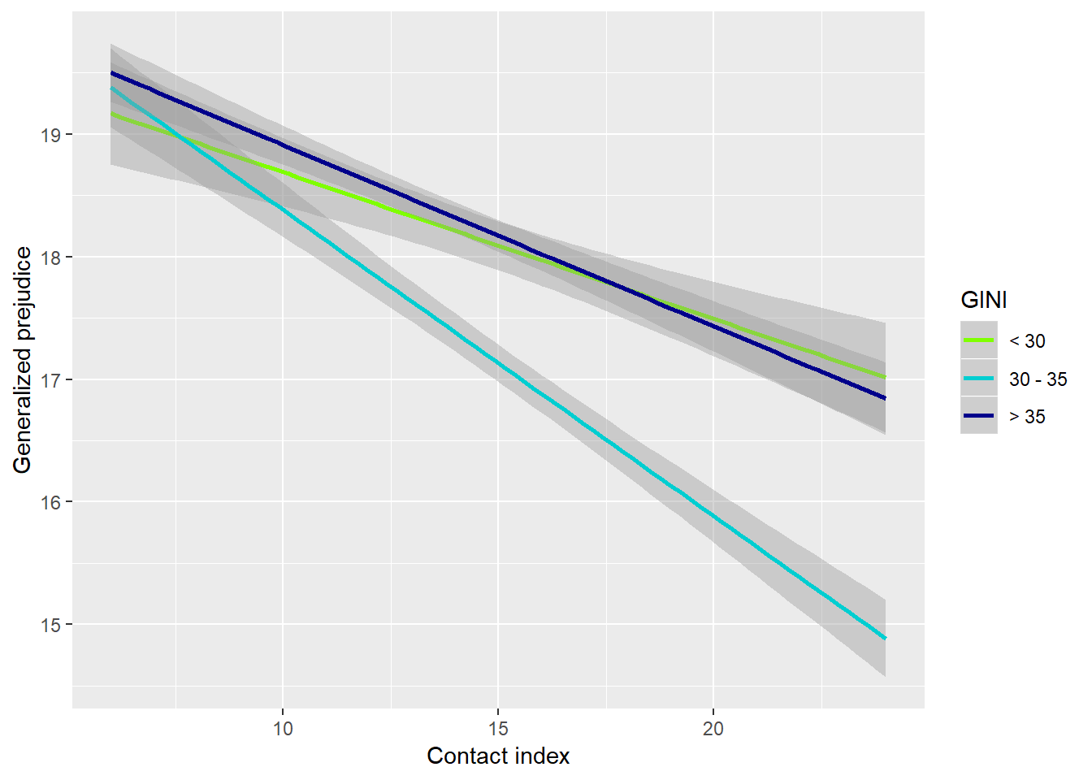
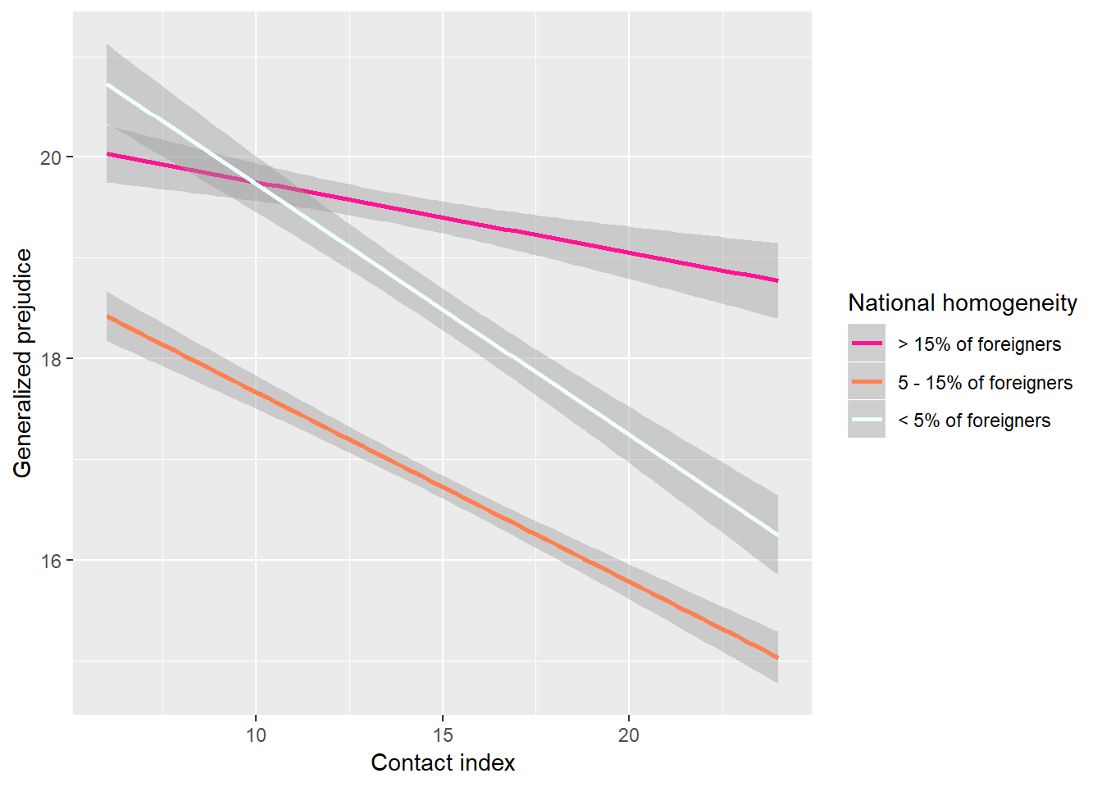
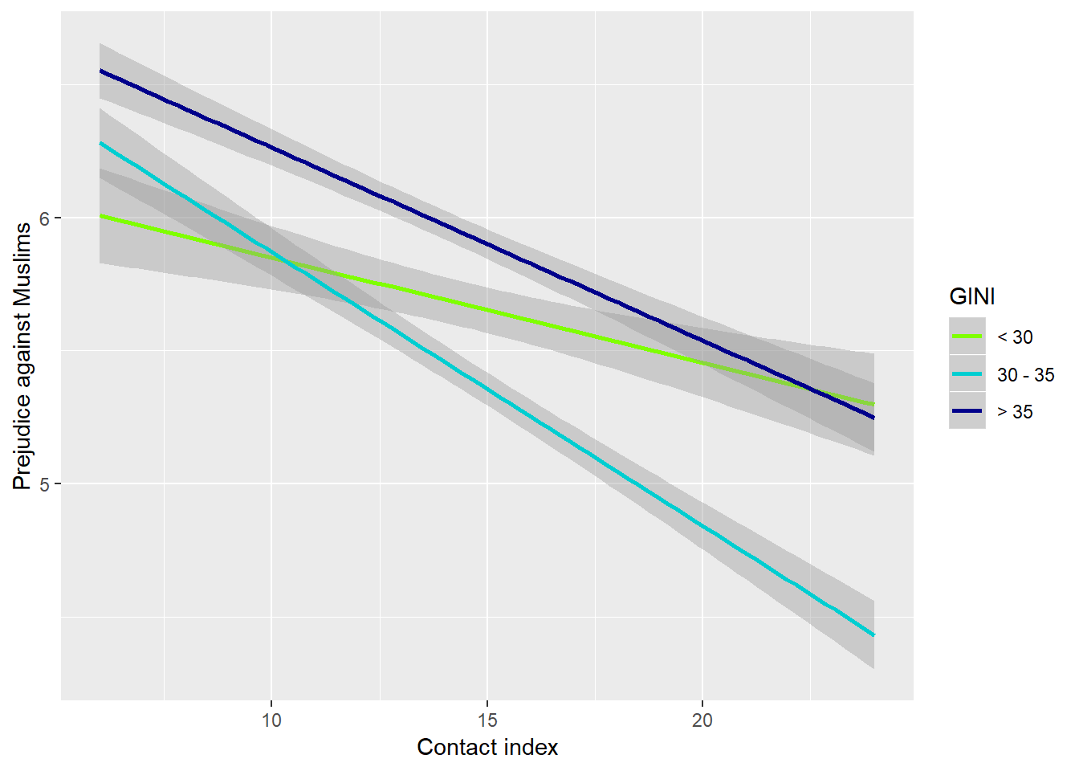
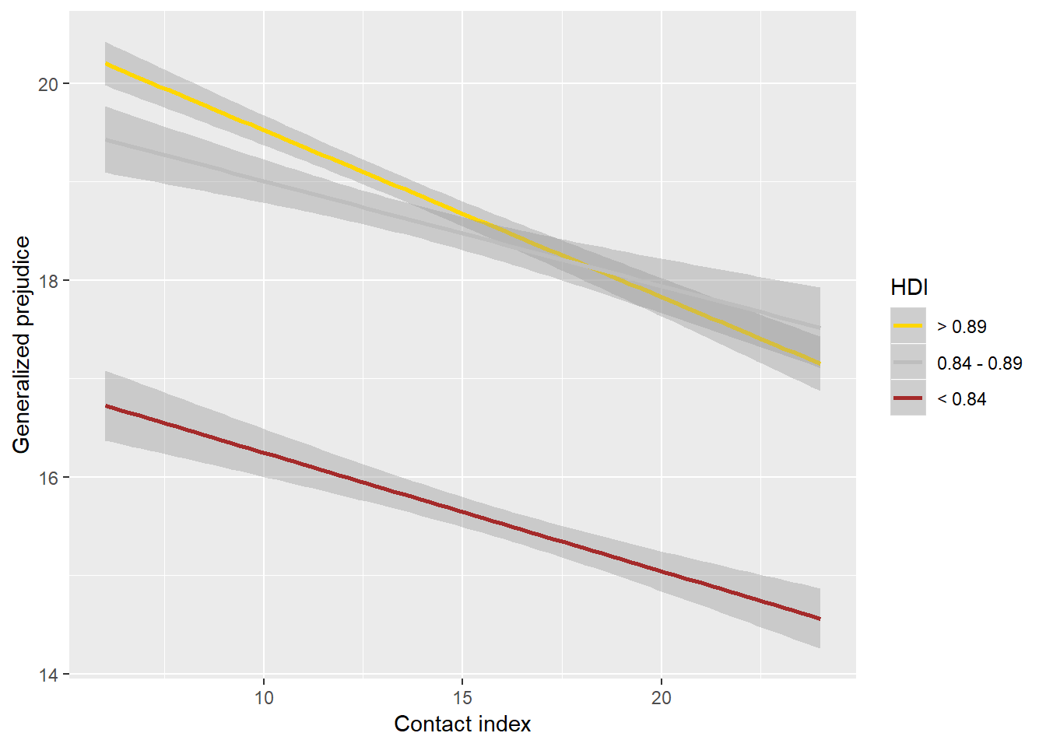
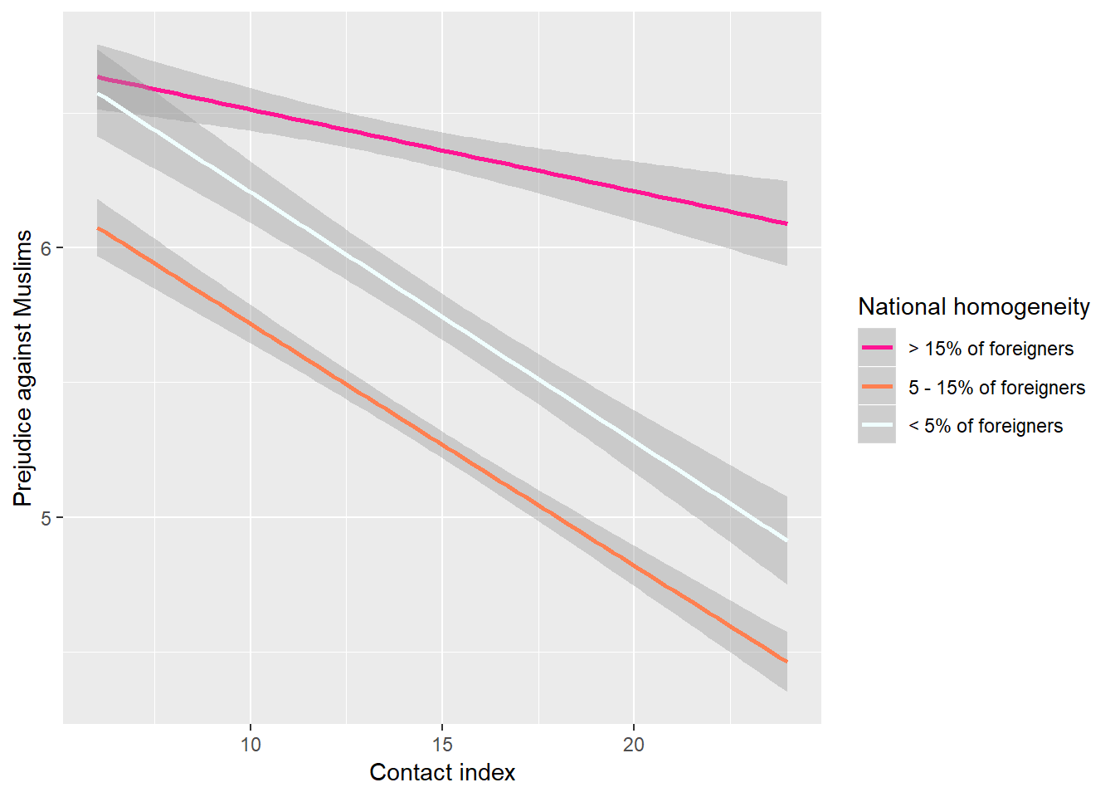
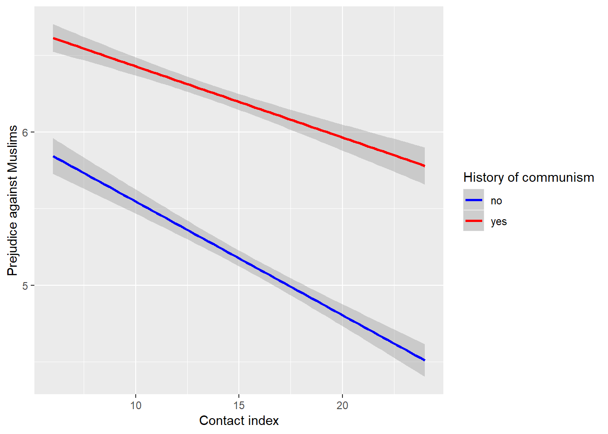
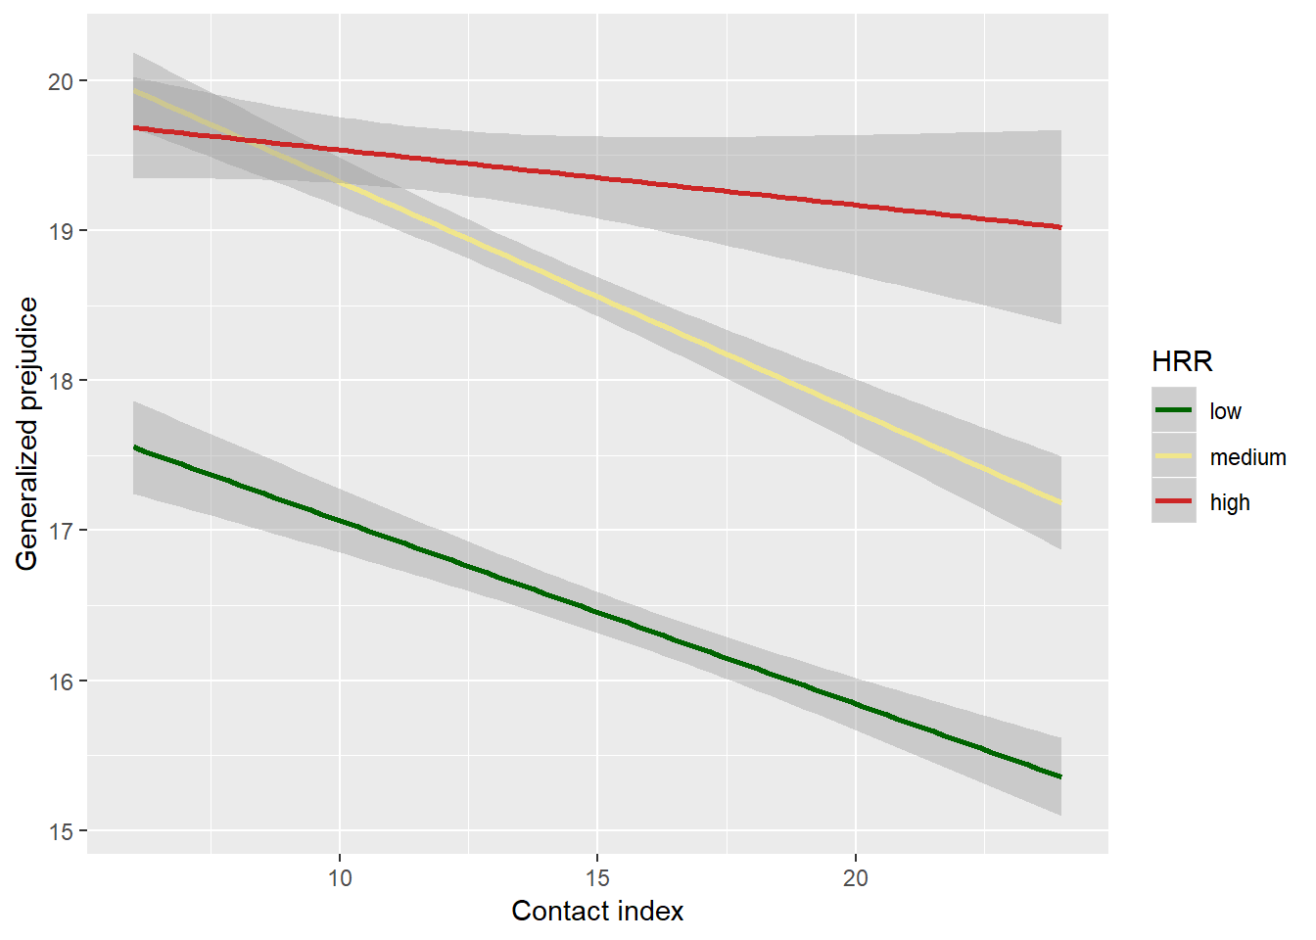
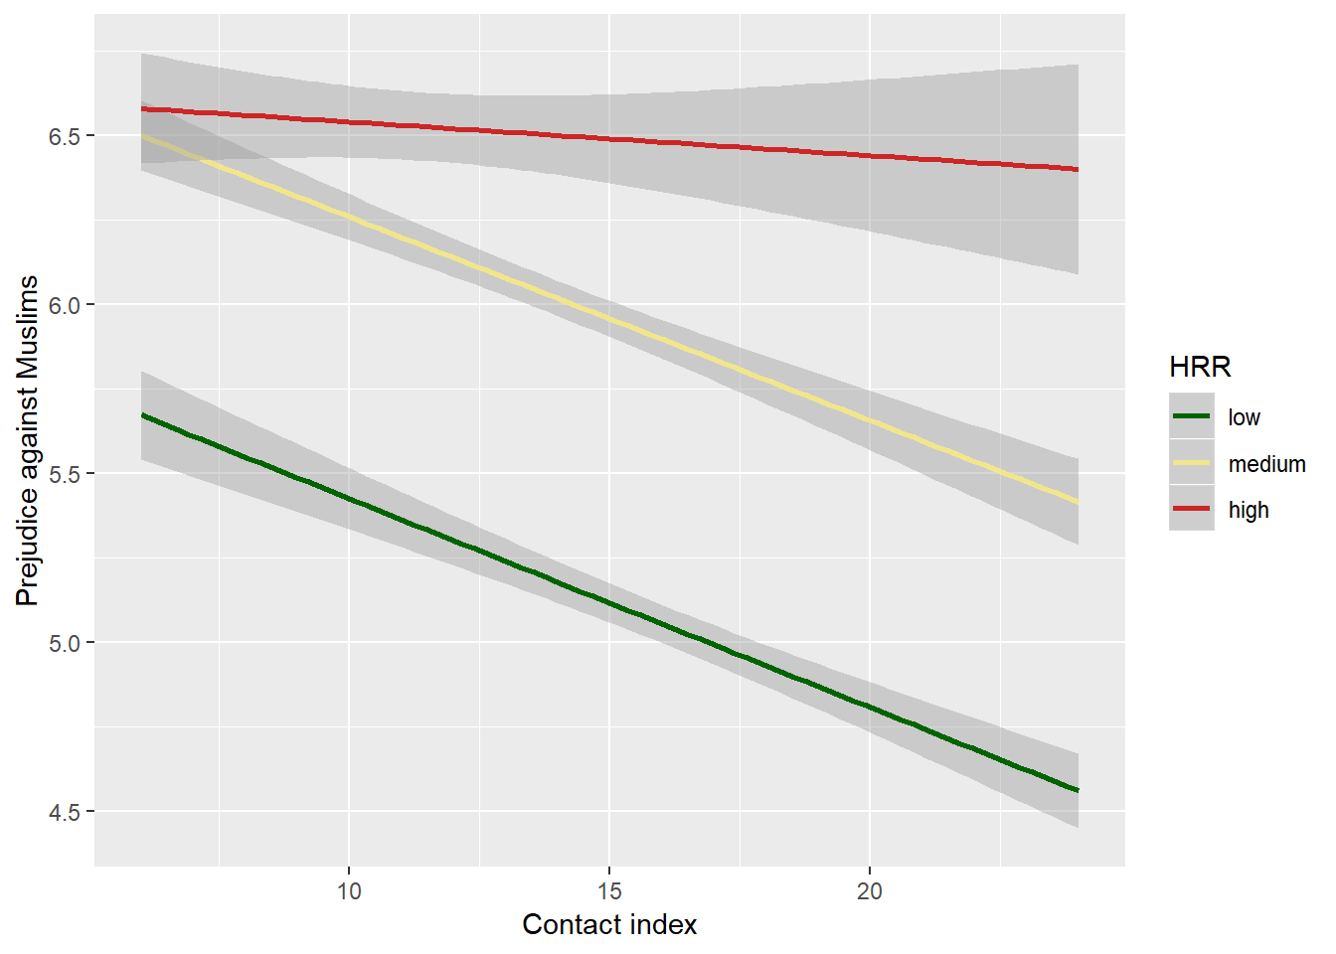
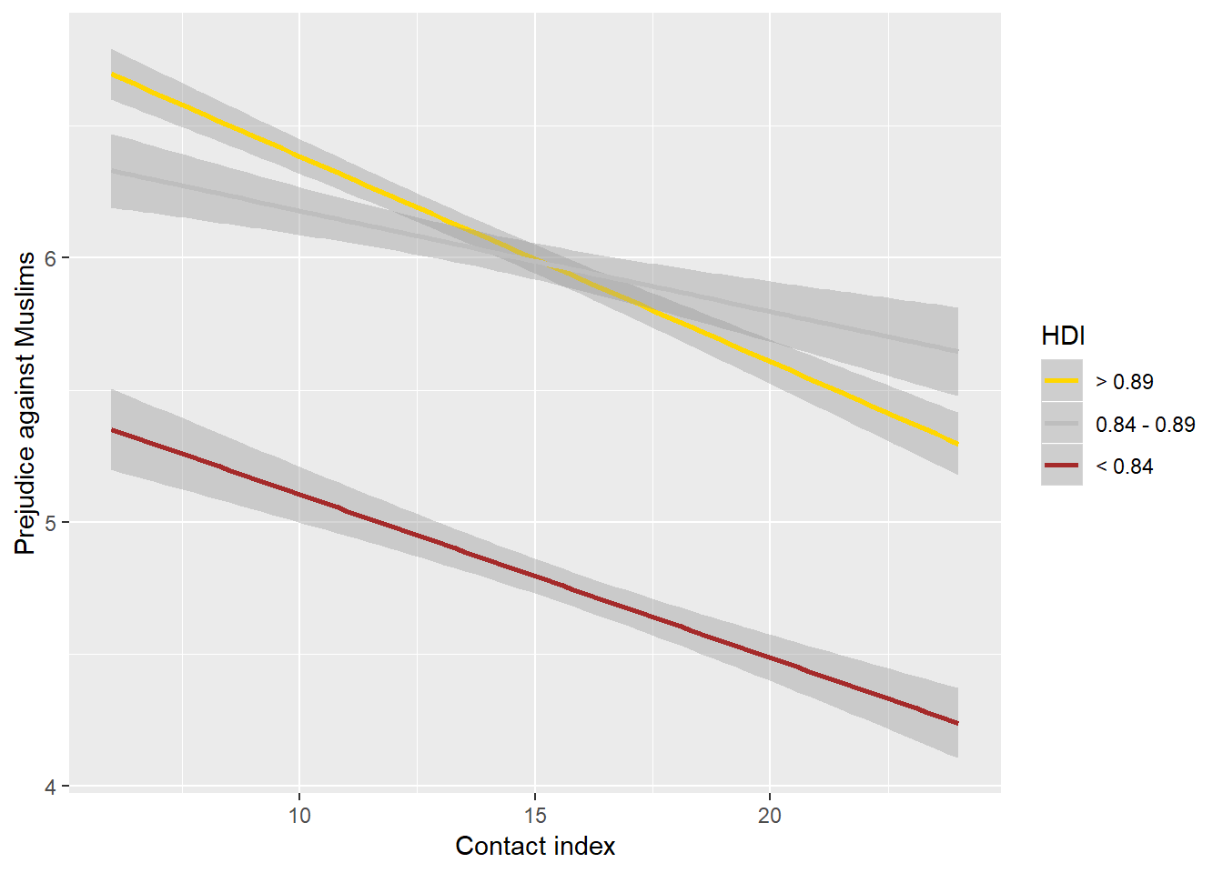
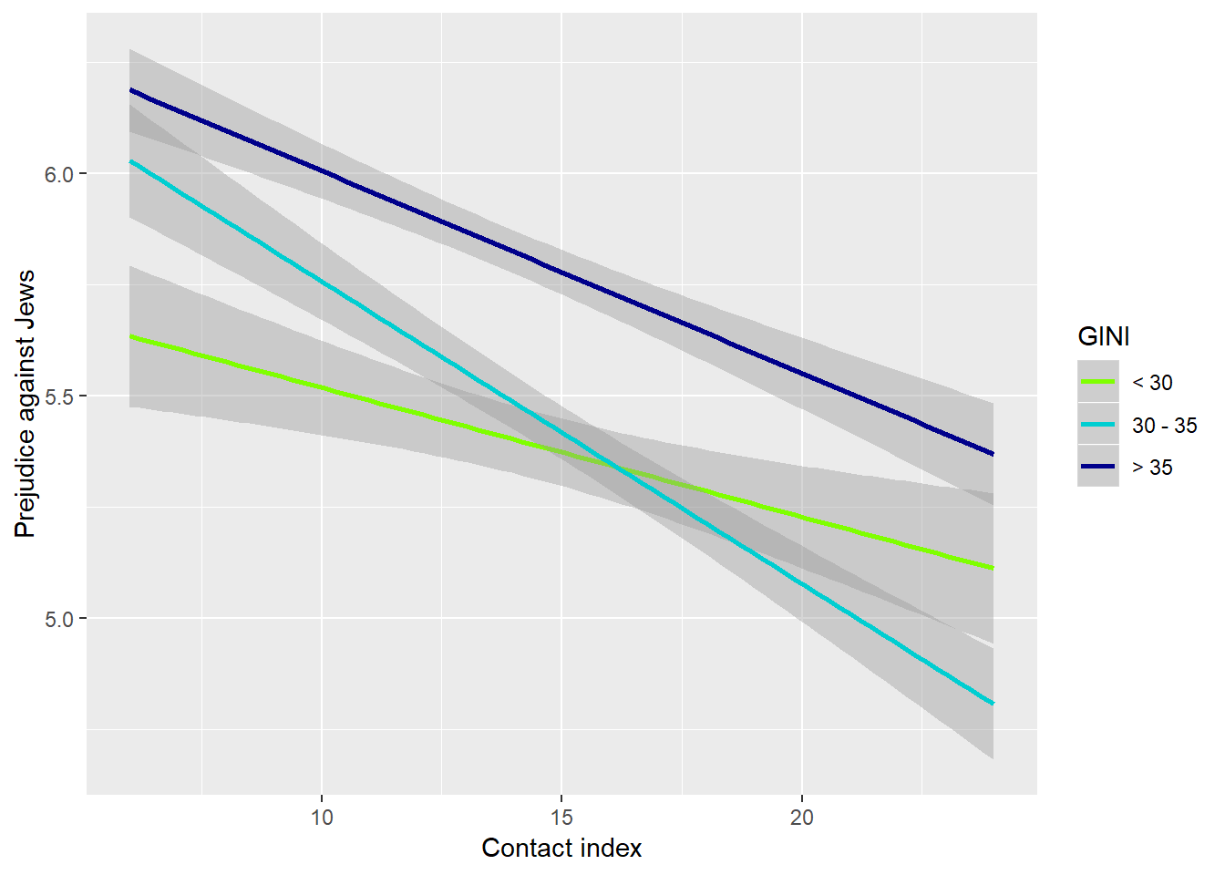
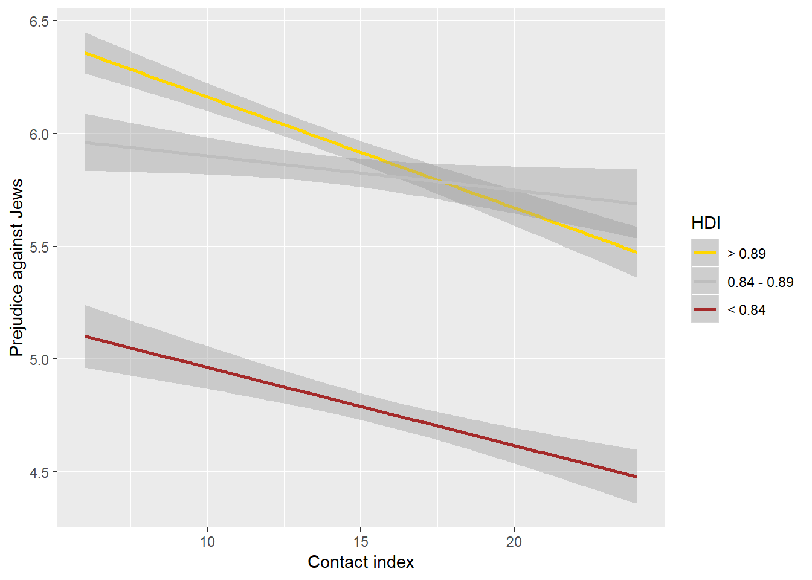
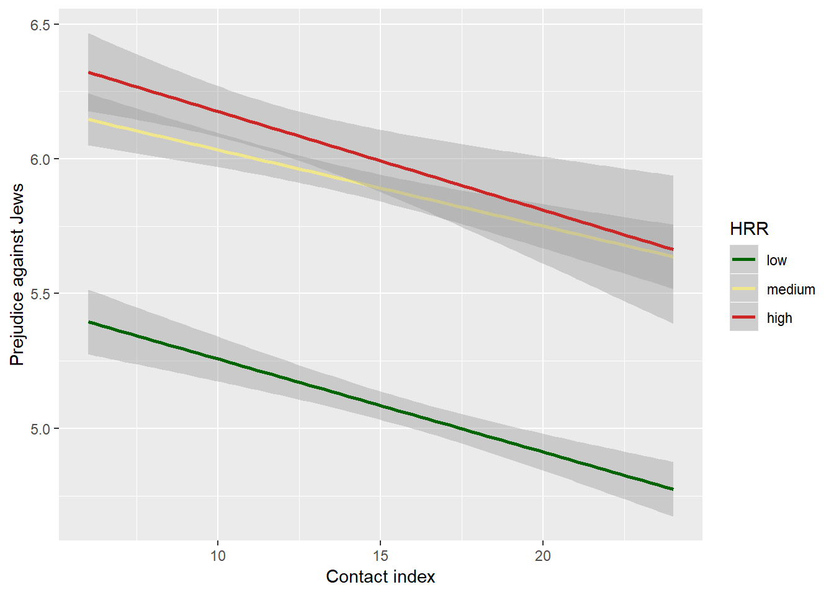
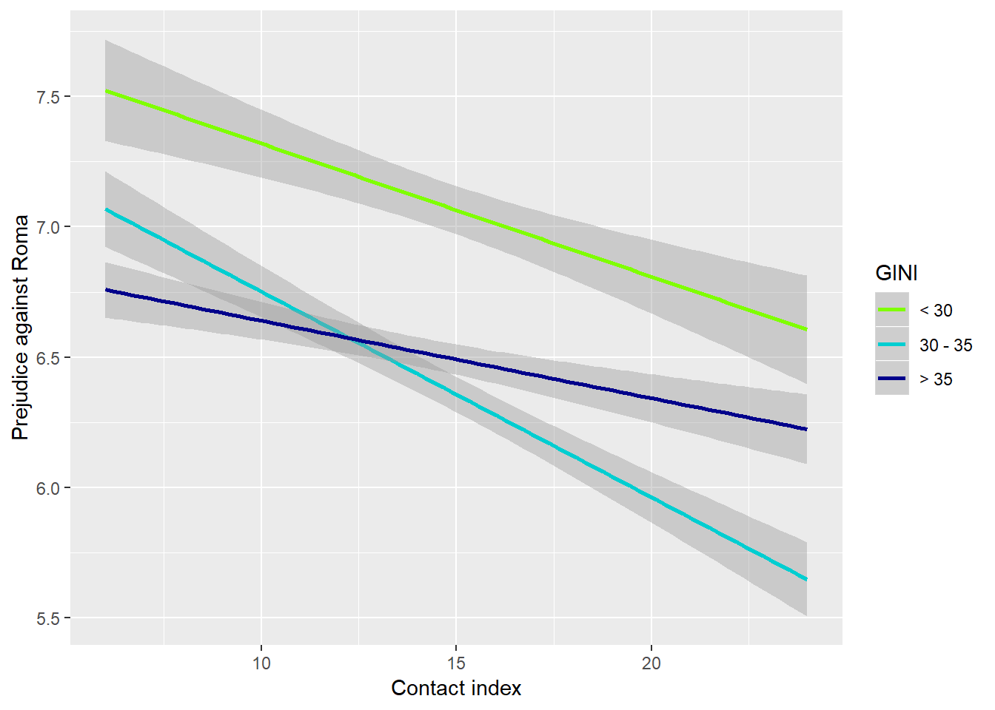
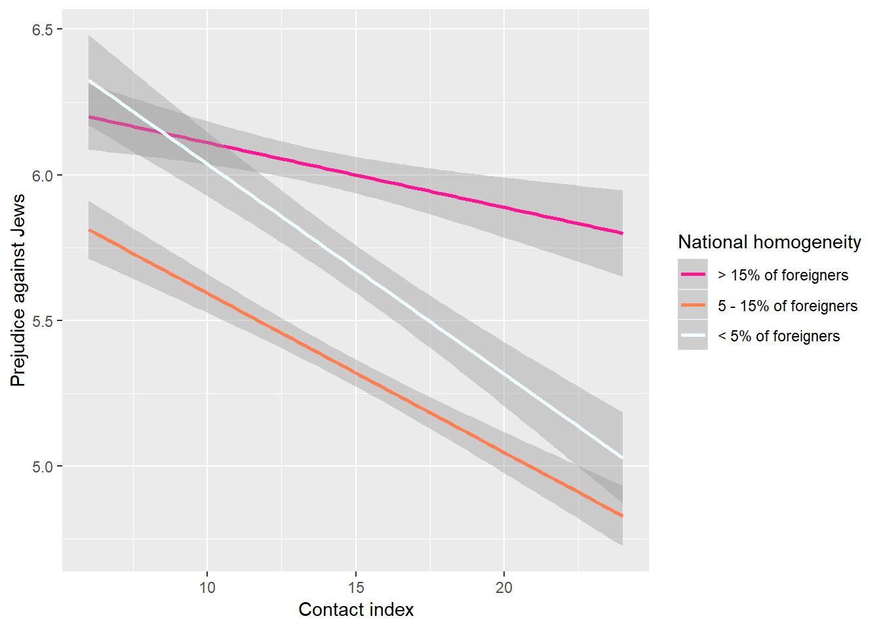
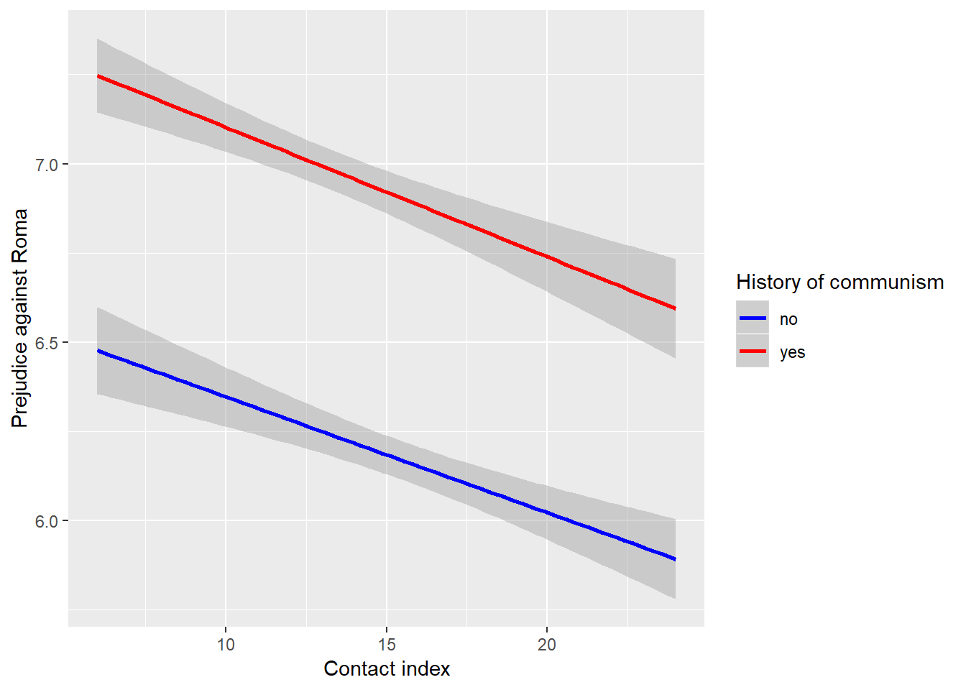
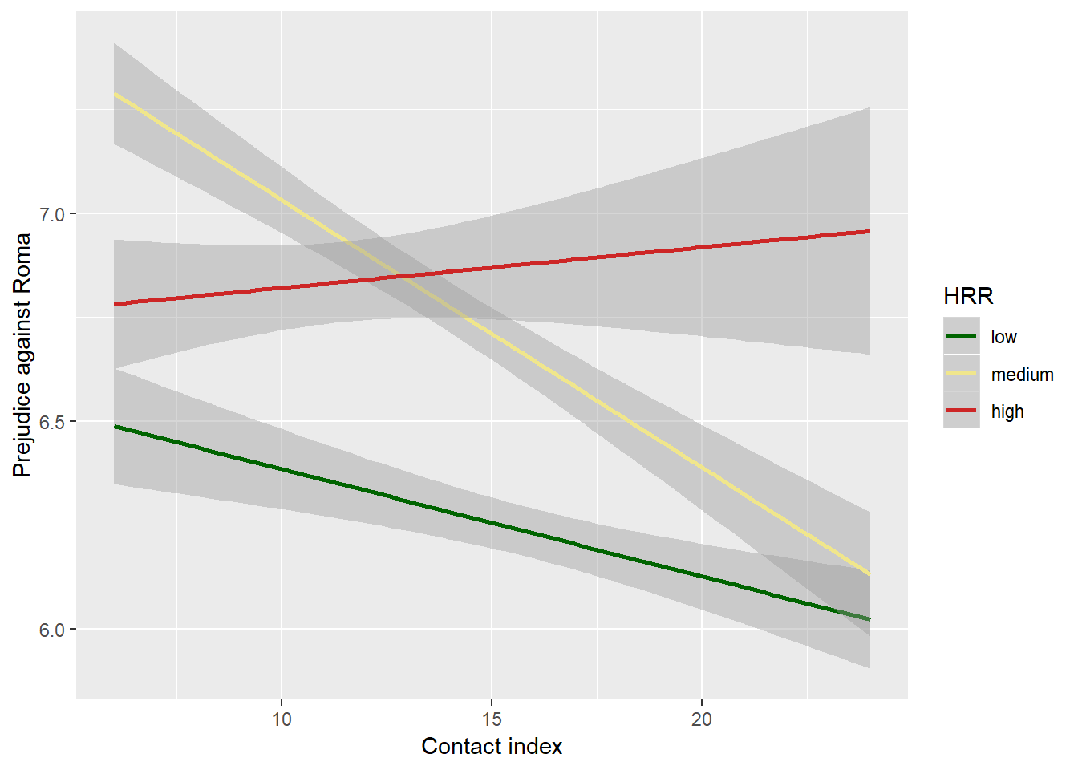
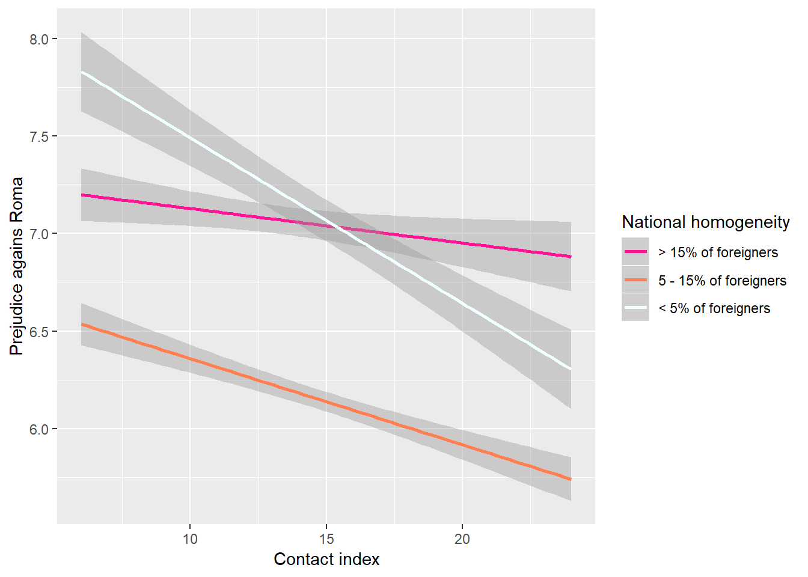
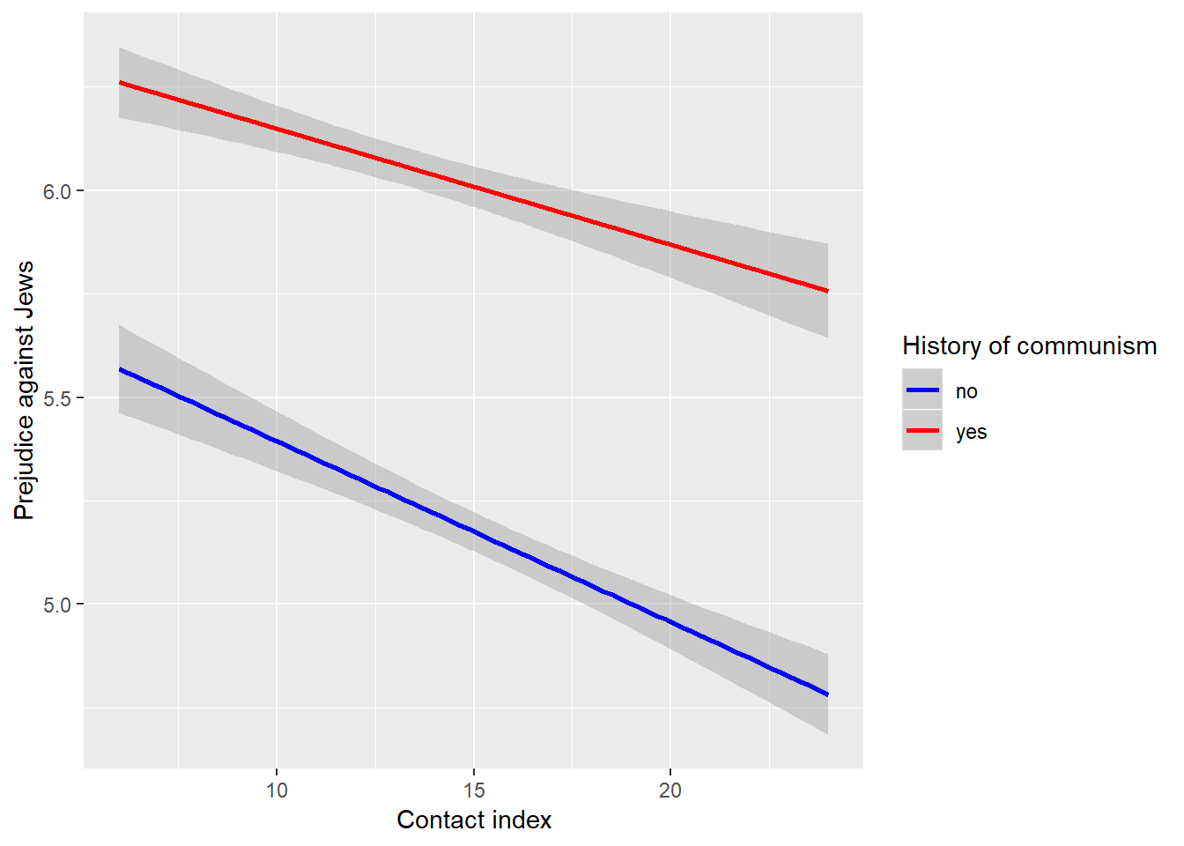
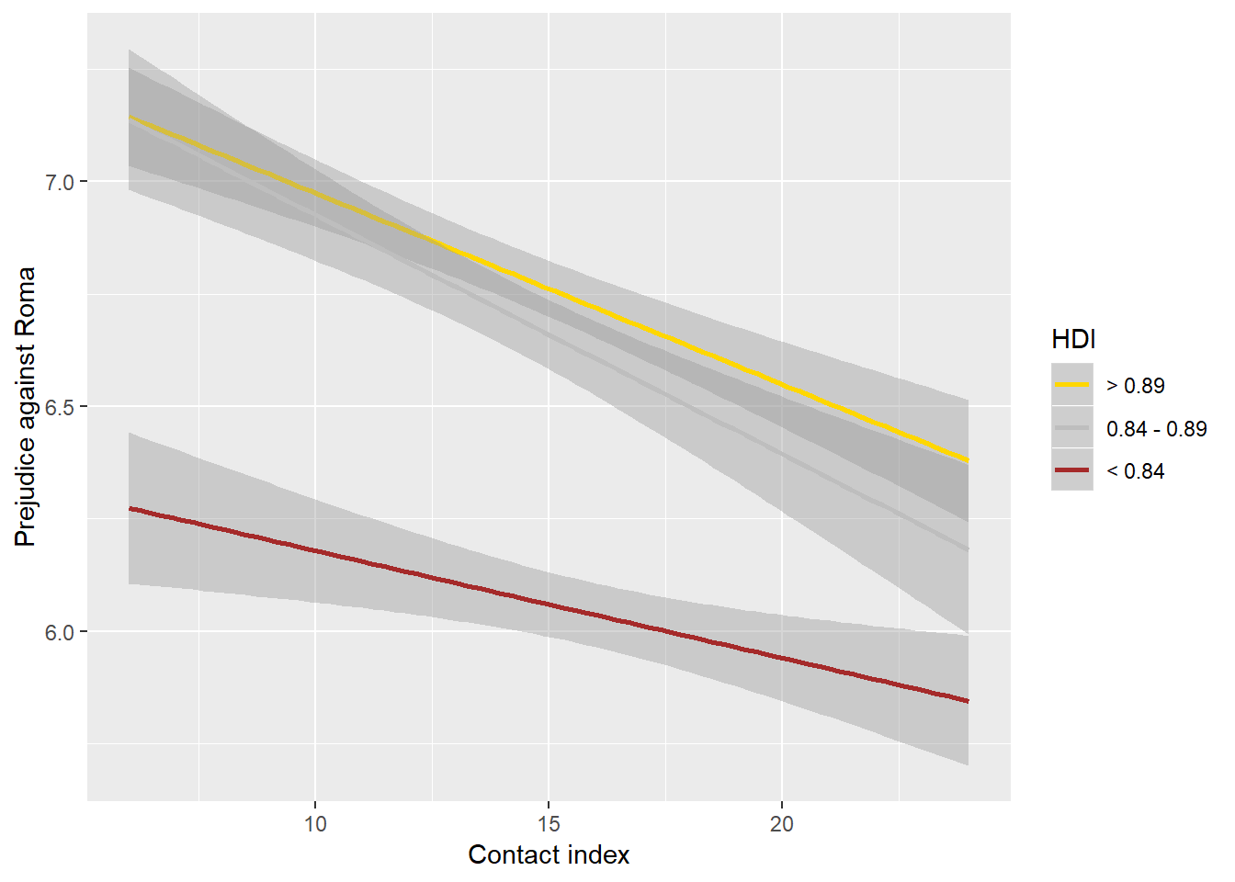
Intercept: Δχ²(1) = 59.78, p < .0001
Slope: Δχ²(2) = 10.23, p = .0060
Intercept: Δχ²(1) = 137.99, p < .0001
Slope: Δχ²(2) = 9.56, p = .0084
Intercept: Δχ²(1) = 80.68, p < .0001
Slope: Δχ²(2) = 46.62, p < .0001
Intercept: Δχ²(1) = 183.48, p < .0001
Slope: Δχ²(2) = 5.44, p = .0659
Intercept: Δχ²(1) = 248.17, p < .0001
Slope: Δχ²(2) = 40.02, p < .0001
Intercept: Δχ²(1) = 142.09, p < .0001
Slope: Δχ²(2) = 15.96, p = .0040
Intercept: Δχ²(1) = 41.36, p < .0001
Slope: Δχ²(2) = 48.30, p < .0001
Intercept: Δχ²(1) = 189.07, p < .0001
Slope: Δχ²(2) = 31.87, p < .0001
Intercept: Δχ²(1) = 148.69, p < .0001
Slope: Δχ²(2) = 24.47, p < .0001
Intercept: Δχ²(1) = 66.01, p < .0001
Slope: Δχ²(2) = 30.12, p < .0001
HDI
GINI
HRR
National homogeneity
Communist heritage
Intercept: Δχ²(1) = 297.61, p < .0001
Slope: Δχ²(2) = 23.71, p < .0001
Intercept: Δχ²(1) = 219.74, p < .0001
Slope: Δχ²(2) = 26.77, p < .0001
Intercept: Δχ²(1) = 2.32, p = .1275
Slope: Δχ²(2) = 0.09, p = .9584
Intercept: Δχ²(1) = 30.39, p < .0001
Slope: Δχ²(2) = 0.79, p < .6713
Intercept: Δχ²(1) = 18.86, p < .0001
Slope: Δχ²(2) = 18.85, p < .0001
Intercept: Δχ²(1) = 114.74, p < .001
Slope: Δχ²(2) = 11.75, p = .0028
Intercept: Δχ²(1) = 137.50, p < .0001
Slope: Δχ²(2) = 5.64, p = .0595
Intercept: Δχ²(1) = 41.89, p < .0001
Slope: Δχ²(2) = 9.87, p = .0072
Intercept: Δχ²(1) = 4.74, p = .0294
Slope: Δχ²(2) = 10.50, p = .0052
Intercept: Δχ²(1) = 213.43, p < .0001
Slope: Δχ²(2) = 13.60, p = .0011
Notes:
S obzirom da ih zanima psoeno razlika opća mjere specifična bilo bi čini mi se da bi bilo dobor kad bi mogao i slike za generalnu mjeru ugurati na isti slajd
*dodano

Slide 10
Discussion
Contact generally lowers prejudice (in line with hundreds of studies; Pettigrew and Tropp, 2006; Kende et al., 2017)
Generalized, against Muslims
Less effective for prejudice against Roma and Jews
Characterictics of the contact?
Quantity/distinctiveness of minorities?
Historical legacy?
The contact-prejudice relationship is different in specific conditions
high HRR and % of foreigners in a country
Similarities between generalized and specific prejudices
Except with respect to human rights risk
Important role of economic chauvinism
In line with earlier studies (e.g., Hjotr, 2016; O’Rourke and Sinnott, 2004)
Limitations
Small number of countries
Missing values
Validity of contact and prejudice measures
Non-representative samples
No causality!
Contact is not always a solution!
Notes:
U raspravi odnosno zaključku malo mi nedostaje izravniji odgovori na neka od na početno navedenih zadataka ili problema
1. test the contact as predictor of generalized as well as specific prejudices towards national minorities (Roma, Jews, Muslims) in the context of other common predictors IMA
2. test the differences in predictiveness of contact in the context of specific macro-level indicators of inter-group equality and wellbeing (operationalized by national homogeneity, Human Development Index, GINI index, risk of violating human rights and socialist historical legacy)
Neki zaključak
3. compare linear and interactive relationship of contact as a determinant of generalized prejudice and prejudice towards specific national minorities
letne
Neki zaključak posebice u što rezultati govore o vrijednosti predrasuda prema specifičnim grupama u odnosu na generaliziranu mjeru
I pod limitations i mjera kontakta je ustvari vrlo općenita (opećeniti drugi a nije usmjerena samo na općenito nacionalne manjine ni posbne nacionalne manjine bilo bi bolje da smo imali takvu opću i spcifične mjere kontakta
* Dodani zaključci i proširena ograničenja

Slide 11
Thank you!
www.dare-h2020.org

