Slide 1
ESF Science Policy Briefing 42
Research Infrastructures in the Digital Humanities
MERIL/MOFRI Final Workshop Strasbourg, 12-13 November 2012
Milena Žic Fuchs Chair of the Standing Committee for the Humanities, ESF University of Zagreb, Faculty of Humanities and Social Sciences
Marko Tadić University of Zagreb, Faculty of Humanities and Social Sciences

Slide 2
SCH RI Expert Group
Professor Claudine Moulin (Chair of the SCH RI Expert Group), Trier Center for Digital Humanities, Universität Trier, Germany – SCH member (LU)
Dr Arianna Ciula, Humanities and Social Sciences Unit, European Science Foundation (FR)
Professor Margaret Kelleher, An Foras Feasa, National University of Ireland Maynooth – SCH member (IE)
Professor Marko Tadić, Department of Linguistics, University of Zagreb – SCH member (HR)
Professor Maria Ågren, Department of History, Uppsala University – SCH member (SE)
Professor Andrea Bozzi, Istituto Linguistica Computazionale, CNR – SCH member (IT)
Professor Kristin Kuutma, Institute of Cultural Research and Fine Arts, University of Tartu – SCH member (EE)

Slide 3
List of Authors
Professor Claudine Moulin (Chair of the editorial group), Trier Center for Digital Humanities, Universität Trier, Germany – SCH member (LU)
Dr Julianne Nyhan, Trier Center for Digital Humanities, Universität Trier (DE) / Department of Information Studies, University College London (UK)
Dr Arianna Ciula, Humanities and Social Sciences Unit, European Science Foundation (FR)
Professor Margaret Kelleher, An Foras Feasa, National University of Ireland Maynooth – SCH member (IE)
Professor Elmar Mittler, Göttingen University (DE)
Professor Marko Tadić, Department of Linguistics, University of Zagreb – SCH member (HR)
Professor Maria Ågren, Department of History, Uppsala University – SCH member (SE)
Professor Andrea Bozzi, Istituto Linguistica Computazionale, CNR – SCH member (IT)
Professor Kristin Kuutma, Institute of Cultural Research and Fine Arts, University of Tartu – SCH member (EE)

Slide 4
The Historical Background of SPB42
work on this report begun in early 2009 following the decision of the ESF Standing Committee for the Humanities (SCH) to make RIs in the Humanities one of its top priorities
the SCH set up the SCH Expert Group on RIs (led by professor Claudine Moulin) in 2009
the SPB42 builds on already existing documents pertaining to RI in the Humanities and especially on the report compiled by an earlier SCH ‘Vision Group on RIs’ which met during 2007
Strategic Workshop on Research Communities and Research Infrastructures in the Humanities
organised by the ESF Standing Committee for the Humanities and RI Expert Group
October 2010, Strasbourg
experts contributing to the SPB42
24 from Europe and the US with their knowledge and expertise
15 from Europe and Japan gave invaluable input in wider consultation process
the final document was revised after comments from external peer reviewers

Slide 5
Science Policy Briefing (SPB)
ESF publications are means to
deliver position statements on urgent science policy issues
suggest science policy directions
42nd SPB in the series that covers all scientific fields
recommendations from SPBs are intended to trigger targeted efforts by relevant stakeholders
ESF and its Member Organisations
governments
European Commission
European Parliament
other international agencies
industry
academia

Slide 6
Urgent science policy issues for RIs in Humanities in SPB42
six main topics covered
recording the state of art and needs
integrating physical and digital RIs
following strategic directions
support partnerships and networking
reaching academic recognition
disseminating information
a number of case studies intertwined
examples of research activities reflecting the particular issue

Slide 7
The State of Art and Needs
detailed inventory of current research activities and future needs in terms of infrastructural support (e.g., standards, tools, licences)
MERIL project (http://www.meril.eu)
covering all scientific fields, but defining closely
categories of RI relevant for Humanities (collections, archives, resources, facilities...)
transversal RI categories (conceptual models, GIS info, timeline info, visualisation...)
fostering partnerships across different communities and institutions
better coordination of funding and activities at European level covering
scholarly community, libraries, archives, museums, private institutions
public bodies, commercial sector
recognition and establishment of RI ecosystems where multiple levels of co-exist and collaborate harmoniously
pan-European, national or local
community-driven or institutional

Slide 8
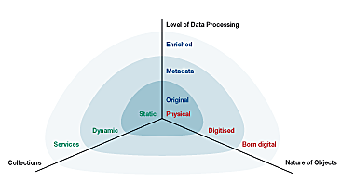
Physical and Digital RIs
actual challenges in integrating
physical RI and digital RI
physical and digital objects collections
definition, preservation, maintaining, accessing
identification of means to bridge ‘physical’ with ‘digital’
support for interdisciplinary profiles that are able to act as ‘translators’ between
Computer Science/Engineering approaches/traditions
Humanities approaches/traditions
educating young experts that will
use future RI in Humanities
maintain future RI in Humanities
A set of concurrent criteria for defining the RI in Humanities

Slide 9
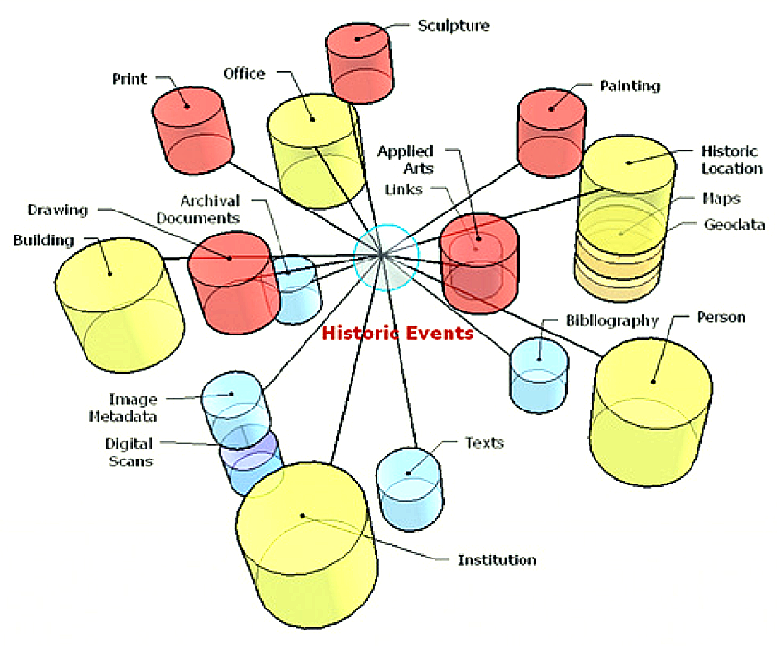
Partnerships and Networking
establishment of partnerships/alliances across communities and institutions
scholarly community
public libraries/archives/museums
private institutions
access policies (e.g. OA, PA), coordination of depositing rules (primary data, processed data, research output) are issues that can only be tackled jointly by
digital libraries + archives/documentation centres + information sciences
research organisations in the Humanities
relevant partnerships with the private sector to contribute to
innovation society and ‘smart economy’ strategies
social and economic benefits, including market innovation
Simplified data model, showing entities interconnected by ‘historic event’ relations

Slide 10
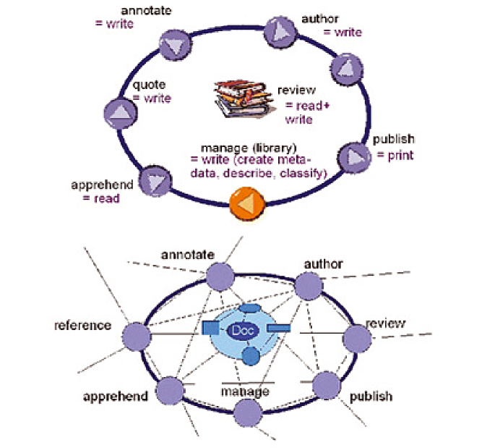
Academic Recognition
change in academic culture
recognition of process-oriented character of digital publications
establishment of more comprehensive mechanisms (including peer review) to secure scholarly reliability and recognition of research within and across RI
fostering of interdisciplinary tools and teams
while all contributing specialist roles and competences are recognised and rewarded
implementation of targeted advocacy
e.g., for emerging cross-disciplinary fields and their relevant academic recognition
The traditional scholarly information continuum and de-constructionist scholarly information continuum

Slide 11
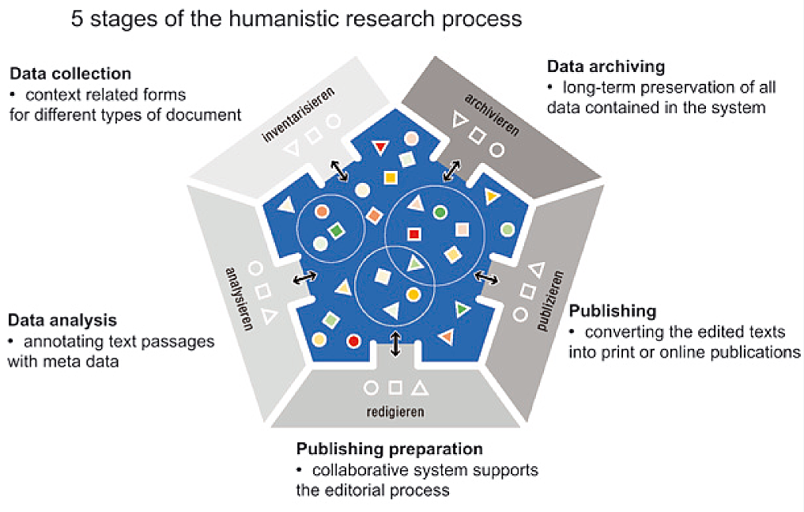
Digital Research in the Humanities: who is responsible for RIs?
with smartphones it is common for the general user to choose across thousands of standardised apps for special purposes. Similar facilities in the Digital Humanities?
established standards are rare
researcher may lack a critical mass of digital data and material
still few incentives in academia to undertake digital research
urgent need for
standards for metadata
organisation and interlinking of data and texts (e.g. semantic web)
OA, PA publishing in text and data repositories
INF-Project Research Network and Database System (FuD) – CRC 600 Strangers and Poor People

Slide 12
Who is responsible for RIs?
current challenges in Digital Humanities
digital research is mainly project driven: small scattered groups, short timescales
digital data and documents are volatile: they need long-term preservation (e.g. PIDs)
digital objects must be available to be consulted for a long period: they need institutions responsible for maintaining them for future generations of researchers
every researcher in the Humanities in Europe must be assured of finding a service provider for
their digital research activities
short-term accessibility
long-term preservation of data and publications
key dimension to the this objective
concept of a Europe-wide RI for Humanities with strong (virtual) centres (e.g. like in CLARIN-ERIC or DARIAH project)
designed to support the development, promotion and implementation of shared protocols and standards

Slide 13
Dissemination and Outreach
development of RIs that have outreach built into their management plans
emergence of a new research culture beyond established academic circles
demonstration and dissemination
of scholarly results of research arising from/facilitated by RIs
of existing models of good practice to demonstrate how to build new and effective community infrastructures and use existing ones

Slide 14
Conclusions about SPB42
the first overview of the state of art of RI in the Humanities from wide-perspective
positions the Digital Humanities research based on existing and future RI
the first overview of issues that have to be addressed, geared towards
funding agencies
recognising the importance of RI in the Humanities
academia
triggering off research potentials existing in usage of RI in the Humanities

Slide 15
Recommendations for the future development of MERIL: a view from the Humanities
the MERIL/MOFRI will
develop recommendations on requirements for RI
study the merits and applicability of the European legal framework for RI proposed by the EC
there is a need to maintain the inventory of national research infrastructures with European and global significance
specific requirement for data bases and repositories as RIs
substantially different from other types of RIs
might require special attention
this is paralleling the outcome of the MERIL/MOFRI/ESFRI workshop on European relevance
where it was found that for the physical and digital RI’s in the SSH further discussion is needed

Slide 16
Recommendations for the future development of MERIL: a view from the Humanities
the present input to MERIL of SSH should be seen as
an initial, pilot attempt
in the future development of MERIL special attention should be paid to SSH introducing
finer criteria regarding both physical and digital RIs in SSH
a bridge between physical and digital Ris

Slide 17
Standing Committee for the Humanities (SCH)
European Science Foundation 1 quai Lezay-Marnésia BP90015 67080 Strasbourg cedex France
Email: humanities@esf.org
www.esf.org/human

Slide 18
www.esf.org

