Slide 1
Governing Through Crime: Response to the Crisis or a Part of the Crisis?
Krešimir Petković
kpetkovic@fpzg.hr

Slide 2
Structure
Why penal policy and the crisis?
Governing through crime (in the USA)
Governing through crime in Croatia?
historical context
gender
families
schools
Interpretations: the private and the political

Slide 3
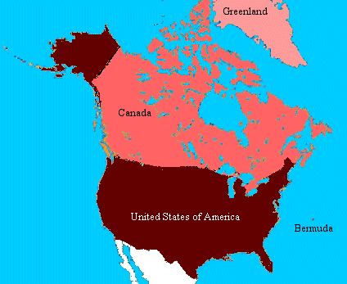
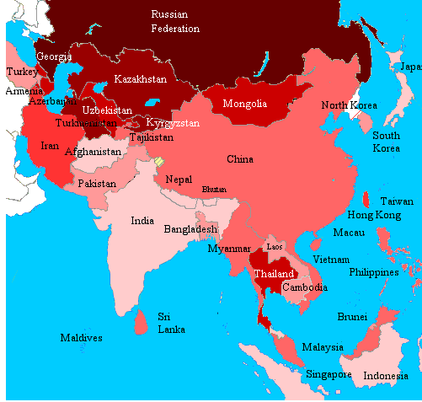
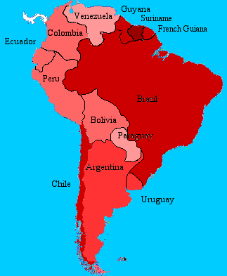
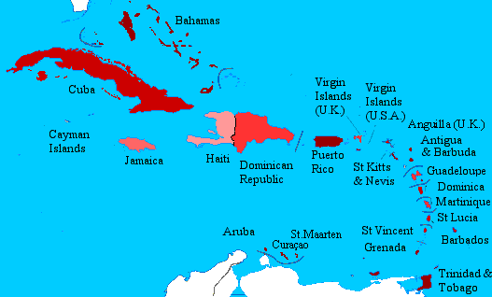
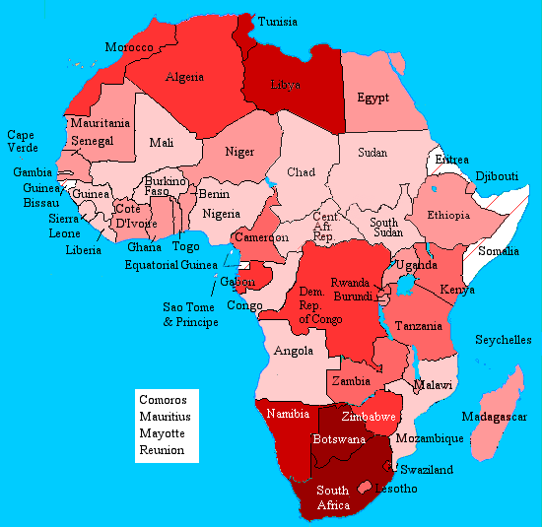
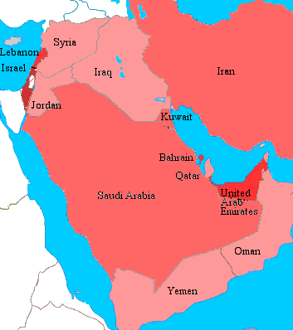
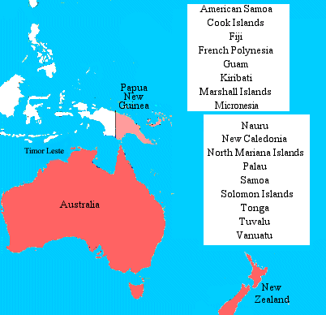
Penal cartography (www.prisonstudies.org)

Slide 4
The problem: penal policy and decadence of (liberal-democratic) politics
“Lacking a ‘vision thing’ with which to imagine the future and direct society the imagination of the political elite (indeed of western culture more generally) has withered and where there was previously a sense of possibilities and improvement, today’s energy is put into attempts at damage limitation and harm reduction. Within this more limited mindset the tendency is to shift one’s eyes from the horizon and onto the ‘gutter’ to discover ad nauseam the dangers that lurk there” (Waiton, 2009: 372)

Slide 5
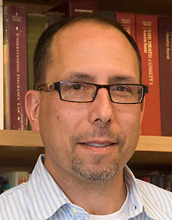
Governing through Crime
“Americans have built a new civil and political order structured around the problem of violent crime” which has “become central in the exercise of authority in America, by everyone from the president of the United States to the classroom teacher” (Simon 2007: 3, 4).

Slide 6
Penal policy and societal change
Families
frequent penal interventions; One strike and you’re out
Schools
children as victims and perpetrators; discipline has become “a central ritual organizing school life”
Workplaces (public and private)
mobbing, sexual harassment and other types of workplace violence

Slide 7
Consequences
Criminalization becomes “a primary tool of social justice”
Penal bureaucracy governing private life
Authoritarian potential: penal complex permeates private sphere and can be used to prosecute, discipline and incarcerate subjects
Growth of penal population (prison + probation + parole) as a problem for democracy

Slide 8
Theoretical importance
Foucault: “circular ontology” of the state
Peters: governance vs. state
“how the public sector, in conjunction with private sector actors, transnational actors, or alone, is capable of providing direction and control for society”
the idea is to “place the behaviour of individuals into the broader context of governing”

Slide 9
Croatia: penal reforms (2000-)
Material penal law
new incriminations, and stricter punishments, generally raising minimal and maximal prison terms for different offenses
Penal procedure
prosecution-led criminal investigation; plea bargaining
Special disciplinary regulations
football hooliganism; family violence, etc.

Slide 10
New penal code (2013)
a “strange brew”: punitiveness + disciplinary economy
maximum prison penalty of 50 years for cases of extreme violence
penalization of “rampant driving”
“exceptionality of short prison term” clause
fines, community work and special obligations
workplace mobbing and harassment = up to 2 years
discriminating of a person on the basis of “political and other beliefs”, “education”, “genetic inheritance” and “gender identity” = up to 3 years prison

Slide 11
Governing sex & gender
sexual and domestic crimes (articles 152-179)
“sexual intercourse without consent”; the institute of “avoidable error”
coercive prostitution (“a difficult position”; “relation of dependence”) = 1-10 years for clients
statutory rape (“child of 15 years and younger”) = 1-10 years
grooming = up to 3 years
stalking = up to 1 years; up to 3 years (former partner)
“mutilation of female genital organs”

Slide 12
Governing families
“introducing children to pornography”, penalizing alimentation non-payment, ignoring of the “decision for the benefit of the child”, “leaving the family member in a difficult position” = up to 3 years
Family code forbids corporal punishment of children
Special legislation on family violence (2003, 2009)
shorter prison terms, fines and protection measures; consecutive state strategies, operational police rules of procedure and protocols

Slide 13
Governing schools
anti-violence strategies and programs
moral panic about school violence (“Alarm: 8 cases of sexual violence among schoolchildren”)
education of parents of violent children and obligation for school bureaucracies to produce a report twice a year on measures taken, state of security in school and implementation of prevention of violence programmes

Slide 14
Example #1: family violence
“Spanking – even today almost common practice in Croatia” (Vecernji list 16/2/2013)
“corporal punishment in the upbringing” = “educationally inappropriate procedure”
picturesque stories and childhood memories → educational role of limited use of corporal punishment.
romanticizing the times before the proliferation of different diagnoses and institutional intrusions in the family
attacks on human rights, rights of children and globalization
bitter memories of abusive and violent parents

Slide 15
Example #2: school violence
“Pupil attacks teacher: he kicks her in the stomach. While she is lying, he kicks her again” (Jutarnji list 9/2/2012)
verbal attacks launched at children’s ombudsman, “quasi-educational measures”, human rights and democracy
ironizing of the discourses of social pedagogy, social work and child psychology
aetiology of violence, impact of environment, bad upbringing, alienation and emotional problems
projections of weakness of bureaucratic procedures to cope with violence
banal calls for switching and drubbing in schools

Slide 16
Theoretical interpretation
“interpretive governance” (Rhodes 2012: 40-41)
actors “resist, transform, and thwart the agendas of elites”
“the importance of beliefs, practices, traditions, and dilemmas for the study of the changing state”
“governance is not necessarily state-centered, given that the power relations are strategic and are not statically defined as emanating from the top down” (Innes and Steele 2012: 717)

Slide 17
Political interpretation(s)
Governing through crime contains “the Calvins and Torquemadas of the family“ (Huxley)
a dark number of violence and oppression, emerges in the light → more just and less violent society by the means of penal policy and disciplinary measures
Hypertrophied penal policy dangerously erases differences between state and society as spheres of organization of human life
not rational but driven by different ideological agendas and economic interests of special groups and policy entrepreneurs, seconded by media-amplified penal hysteria and various false victims and victimizations
new horrors constantly “emerge from the gutter”

Slide 18
Penal policy and the crisis
Dependent variable
higher crime → harsher penal policy
Independent variable
harsher penal policy → more crime
Variable dependent on politics
punishment as a surrogate for political vision
What kind of politics (and why) produces victims, perpetrators and prisons (“punishing the demos”)?

