Slide 1


2nd CEE e-Health Academy (CEEeHA)
Innovation as prerequisite for eHealth
        Miroslav Mađarić, PhD
        University Hospital Center Zagreb

Slide 2

Contents:
Definitions, barriers and myths in innovation
innovation has to be accepted for eHealth implementation
eHealth is bringing innovation in health services
Specific aspects of innovation in health care and eHealth
Stories about innovation specifics in (e)Health:
Canaries in the SW mine: TQM of medical SW by FDA
From weakness to opportunity: Cladribine vs. post-it
SRM: Cleveland Clinic Innovation Center
eHealth innovative advances in in Croatia
Conclusion

Slide 3
Innovation definitions
Definitions quiz (= how “hermetic”?):
Good, new idea
New process
Novelty that brings sustainable advantage
Invention or patent
Deliverable of R&D department
Completely opposite to imitation
Better product

Slide 4

Quick audience survey
Raise the hand if you are coming from:
private sector: eHealth industry
  Do you have managed innovation process?
public sector: healthcare provider
  Do you have managed innovation process?
  Result reflects the myths of innovation:
  Asia → USA → W. Europe → CEE
  Private business → Public sector → health sector.

Slide 5

12 myths about innovation
Invention = innovation, and imitation ≠ innovation
Only major innovations are profitable (discoveries, patents)
Innovation is the matter of managers, experts and R&D
Innovation relates only to new products and technologies
Innovation is chaos (= lack of standards, best practice, plan)
Innovation is matter of private, not public sector
All innovations are positive! Weakness can’t be innovation?
Every innovation strives for major changes and expenditures
“We will not go Chapter 11 without innovation!”
Innovation management was made up by consultancy firms
Innovation management is bureaucracy
Expertise is most important for innovation, not the “climate”.

Slide 6
Innovation and (e)Health
Innovation in public sector:
  Away from the myth that it is only for business organisations!
Healthcare:
  immanently conservative mindset and structure
eHealth:
  major innovation area in healthcare (+ drugs, devices)
Barriers for eHealth as innovation:
  “We are good enough also w/o computers!”
  “IT experts don’t understand medicine!”
  “We should heal patients and not deal with computers!”
  “Innovation = experiment (on patient?)”

Slide 7
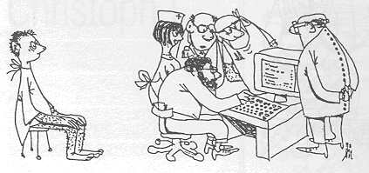
Last myth depicted in cartoon!

Slide 8
Controversy and prerequisite:
Controversy of eHealth as an innovation in healthcare:
innovation has to be accepted for eHealth implementation
eHealth is bringing innovation in health services ;-)
Relation of innovation and eHealth:
Readiness for eHealth implementation = readiness for innovation!
Recall following myths:
  nr. 6&9: “Hospitals are partially on the market, w/o innovation they lag behind!”
  nr. 12: “Promote innovation climate in your institution!” (“good guys”)
  nr. 10: “Is innovation management needed?” YES!

Slide 9
Innovation stories about innovation specific in (e)Health:
“Canaries in the SW mine”: TQM of clinical SW by FDA:
  Clinical SW = Medical Device (Croatia: #RIS!?)
  TQM loop: malfunctioning → FDA
  FDA → Certified SW manufacturer
  No usual lousy excuses (“Works as designed!”)
  → quick and strong feedback loop!
From weakness to opportunity:
  post-it vs. Cladribine
SRM: Cleveland Clinic Innovation Center →
KBC Zagreb: collecting useful ideas →

Slide 10

Cleveland Clinic Innovation Center (CCI)
corporate venturing
breakthroughs of Clinic employee into:
  patient-benefiting medical products,
  creates new business opportunities
  unique capabilities to the commercial market, and
  economic growth in Northeast Ohio
CCI creates:
a unique entrepreneurial environment
invention fostering where everyone can participate:
  physicians,
  nurses,
  researchers,
  administrators - not just a few select individuals!
35 Cleveland Clinic spin-offs in the last decade
have received equity investment - more than $500 million to date!

Slide 11
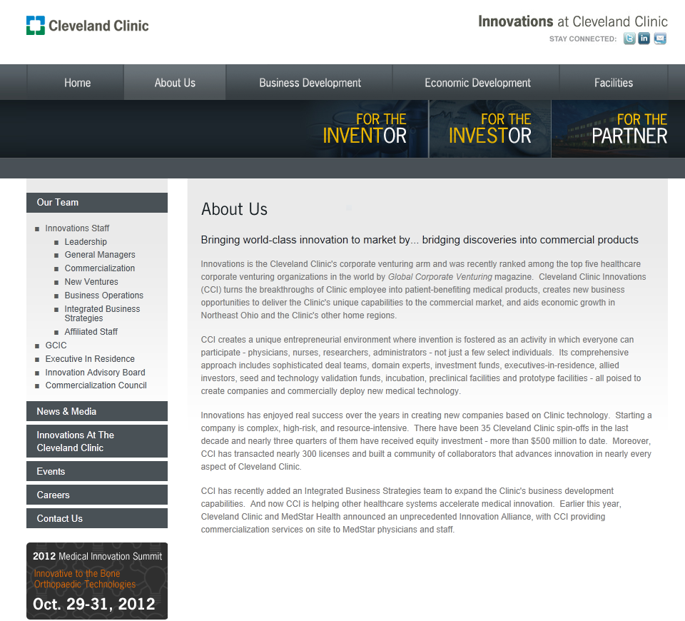
Cleveland Clinic Innovation Center

Slide 12
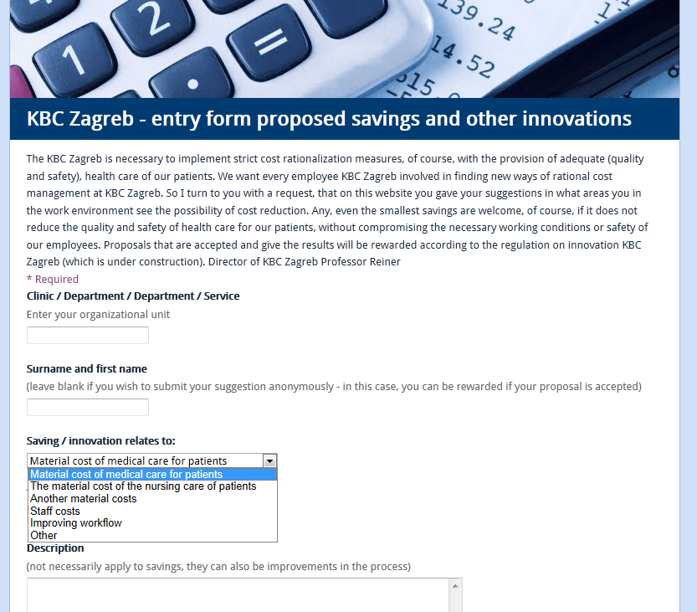
Proposals for innovative cost cutting:

Slide 13
eHealth innovative advances in Croatia:
e-prescriptions
e-medications (NIKI)
e-guidelines →
e-booking/e-referrals →
e-Waiting-list →

Slide 14

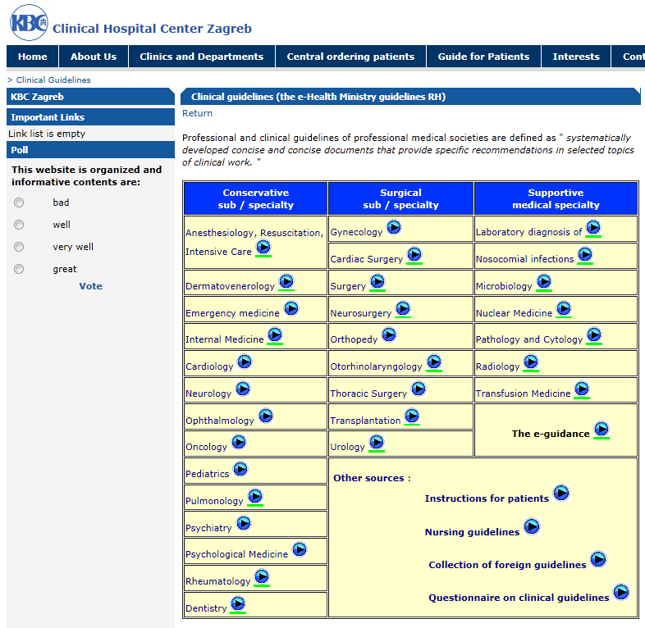
Clinical guidelines
NGC:
http://guideline.gov/:
2.400 guidelines edited:
National societies mentioned:
“British”: 356
Germany: 92
Hungary: 17
Croatia: 5

Slide 15
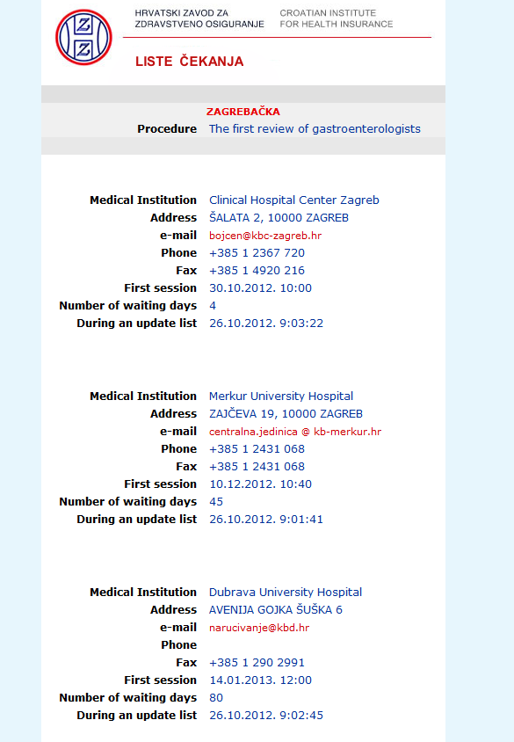
e-Waiting list in Croatia
e-Waiting_list:
National level
Information and contact for GPs and patients
Pilot with 210 procedures
60 hospitals until Dec. 2012.
e-Booking:
one month phased delay for every county
1.1.2013. full implementation

Slide 16
Conclusions:
eHealth success is closely tied to innovation (management)!
Immitate successful innovators!
Establish innovation management:
  within organizations and
  at national level
Accept and process useful ideas from every source
Foster positive innovation climate:
  “Innovators are good guys!”

Slide 17


Innovation on every corner:
“I like to hear:
‘It had to be done’ instead:
‘This was not my job’”.

Slide 18
Tnx for your attention!
Questions?
(also welcome on madjaric@kbc-zagreb.hr)

