Slide 1
COST CM1206
Advances on Green Technologies,
April 18-20, 2016, Poznan, Poland
VISCOMETRIC STUDY OF AQUEOUS SOLUTIONS OF IMIDAZOLIUM BASED IONIC LIQUIDS: INFLUENCE OF ALKYL CHAIN LENGTH
Renato Tomaš, Aleksandar Tot, Marija Bešter-Rogač
Faculty of Chemsity and Technology, University of Split, Croatia; E-mail: rtomas@ktf-split.hr
Faculty of Sciences, University of Novi Sad, Serbia
Faculty of Chemistry and Chemical Technology, University of Ljubljana, Slovenia

Slide 2
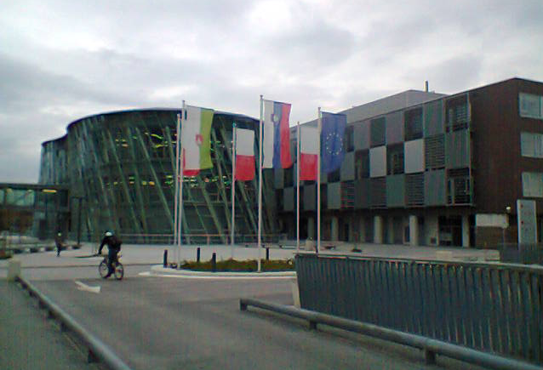
Outline
STSM APPLICATION
Who: Assoc. Prof. Dr. Renato Tomaš, University of Split (MC member from Croatia, WG2 - Chemical and Physical Properties of ILs; STSM leader)
Where: Chair of Physical Chemistry, Faculty of Chemistry and Chemical Technology, University of Ljubljana, Slovenia, host-professor: Prof. Dr. Marija Bešter-Rogač
When: from March, 1st to March, 31th 2016
Why: international cooperation

Slide 3
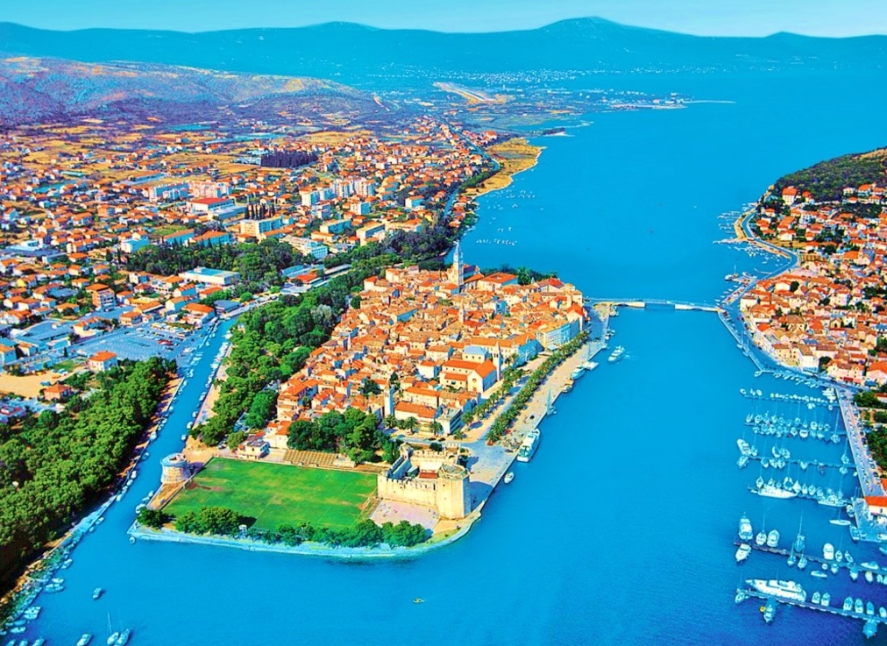
Outline
About me: born in Trogir, Croatia, June 20, 1967
2002: received a Ph.D. in Natural Sciences, Chemistry, from the Faculty of Chemistry and Technology (FCT), University of Split
From 1994: employed on Department of Physical Chemistry, FCT; currently as associate professor of physical chemistry
Field of work: solution chemistry – thermodynamics of electrolyte solutions

Slide 4
Outline
About University of Split:
was established in 1974,
include eleven faculties, one academy of arts, and four university department
there are about 20000 students enrolled in the University’s undergraduate, graduate and postgraduate programs,
second largest in Croatia; the first is University of Zagreb
CITY OF SPLIT
FCT

Slide 5
INTRODUCTION
Subject of the present studies are aqueous solutions of few imidazolium based ionic liquids (ILs) with chloride ion. Imidazolium-based ILs were chosen because of their thermal stability and the insignificant degree of sensitivity to air.
We consider that ILs are practically simple 1-1 electrolytes: their advantage is that their structure can be varied and thus they can serve as excellent model system.
Thermodynamic and transport properties of investigeted ILs were obtained by viscometric measurements at different temperatures.
Viscosity of electrolyte solutions along with the thermodynamic properties, gives a lot of information about the ion-ion, ion-solvent, and solvent-solvent interactions.
The main objective of the present investigation is to provide new accurate experimental viscosity and density data (ILs + water).

Slide 6
INTRODUCTION
Here I will present you results of my investigation within STSM project which was held on Faculty of Chemistry and Chemical Technology, University of Ljubljana.
There are no many experimental studies of viscosity and density for binary systems (ILs + water) at different temperatures.
I will present you new data for viscosity B-coefficients.
Viscosity B-coefficient depends on ion-solvent interactions and temperature.
The structure making or structure breaking capacity of this ILs investigated here will be discussed.

Slide 7
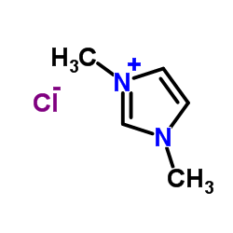
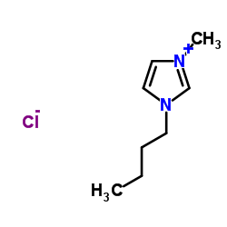
EXPERIMENTAL SETUP
Chemicals used in this experiment:
- water (ultra pure)
- ILs from IOLITEC Technologies GmbH, Germany:
*1,3-DIMETHYLIMIDAZOLIUM CHLORIDE (98%); M = 132.59 g mol⁻¹
**1-BUTYL-3-METHYLIMIDAZOLIUM CHLORIDE (99%); M = 174.67 g mol⁻¹
*
**

Slide 8
EXPERIMENTAL SETUP
Stock-solution prepared by mass from DMIMCl (BMIMCl) and water.
Purity of ILs was checked using chloride ISE potentiometric titration with automatic titrator (736 GP TITRINO, METROHM):
∼1 g stock-solution of ILs in water was titrated with standard solution of AgNO₃ (c = 0.10001 ±0.0006 mol L⁻¹ ).
Real molality (m ≡ mole of ILs per kg of water) of stock-solution was:
m(DMIMCl + water) = 0.09549 mol kg⁻¹
m(BMIMCl + water) = 0.10616 mol kg⁻¹
I prepared 8 working-solutions from stock-solution of ILs:
(∼0.005 to ∼0.075 mol kg⁻¹)

Slide 9
EXPERIMENTAL SETUP
Viscosities of solutions were determined with a micro Ubbelohde viscometer (Schott Geräte, type and capillary no. 53610), and an automatic flow time measuring system VISCOSYSTEM AVS 370.
The viscometer was immersed in a transparent bath with the precision of the set temperature better than 0.01°C.
Each MEASUREMENT (flow time) was automatically repeated at least 5 times (reproducibility of the flow time was 0.02%).
…than the kinematic viscosity (ν) of solutions was converted into absolute (dynamic) viscosity (η): η = ν d
Density of investigated solutions at all working temperatures were determined using Anton Paar density meter (DMA 5000) with a reproducibility ∼5 ⋅ 10⁻⁶ g cm⁻³

Slide 10
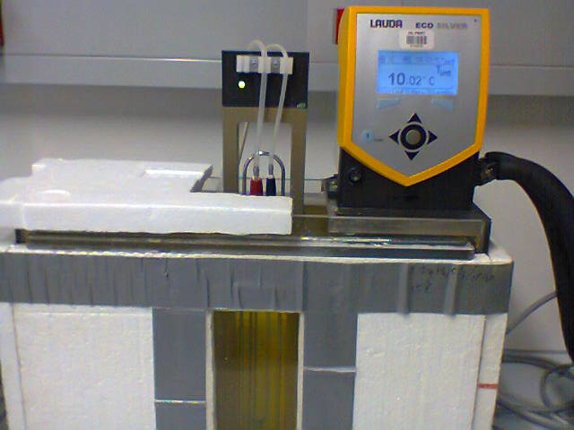
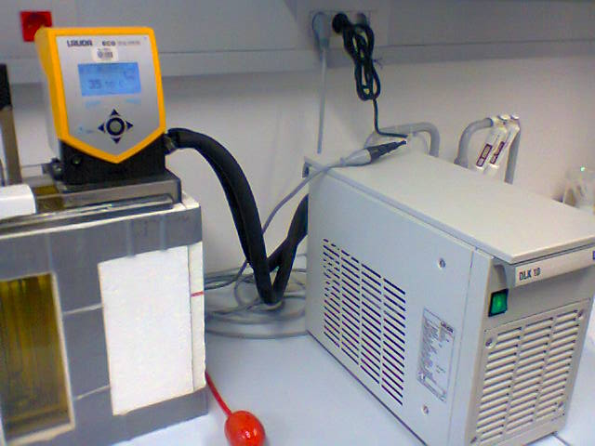
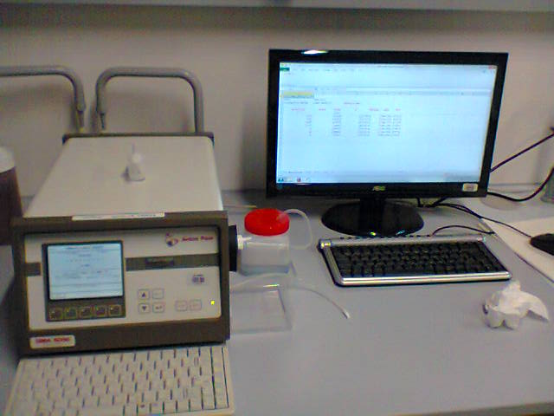
EXPERIMENTAL SETUP

Slide 11
EXPERIMENTAL SETUP
Molarity (c / mol dm⁻³) was obtained from the molality and density data:
d, η = f( c, T)
∼0.005 M ≤ c ≤ ∼ 0.1 M
273.15 < T / K< 303.15
Experimental densities, d
Experimental viscosities, η
Reference: R. Tomaš, T. Jovanović, M. Bešter-Rogač, Acta Chim. Slov. 62 (2015) 531.

Slide 12
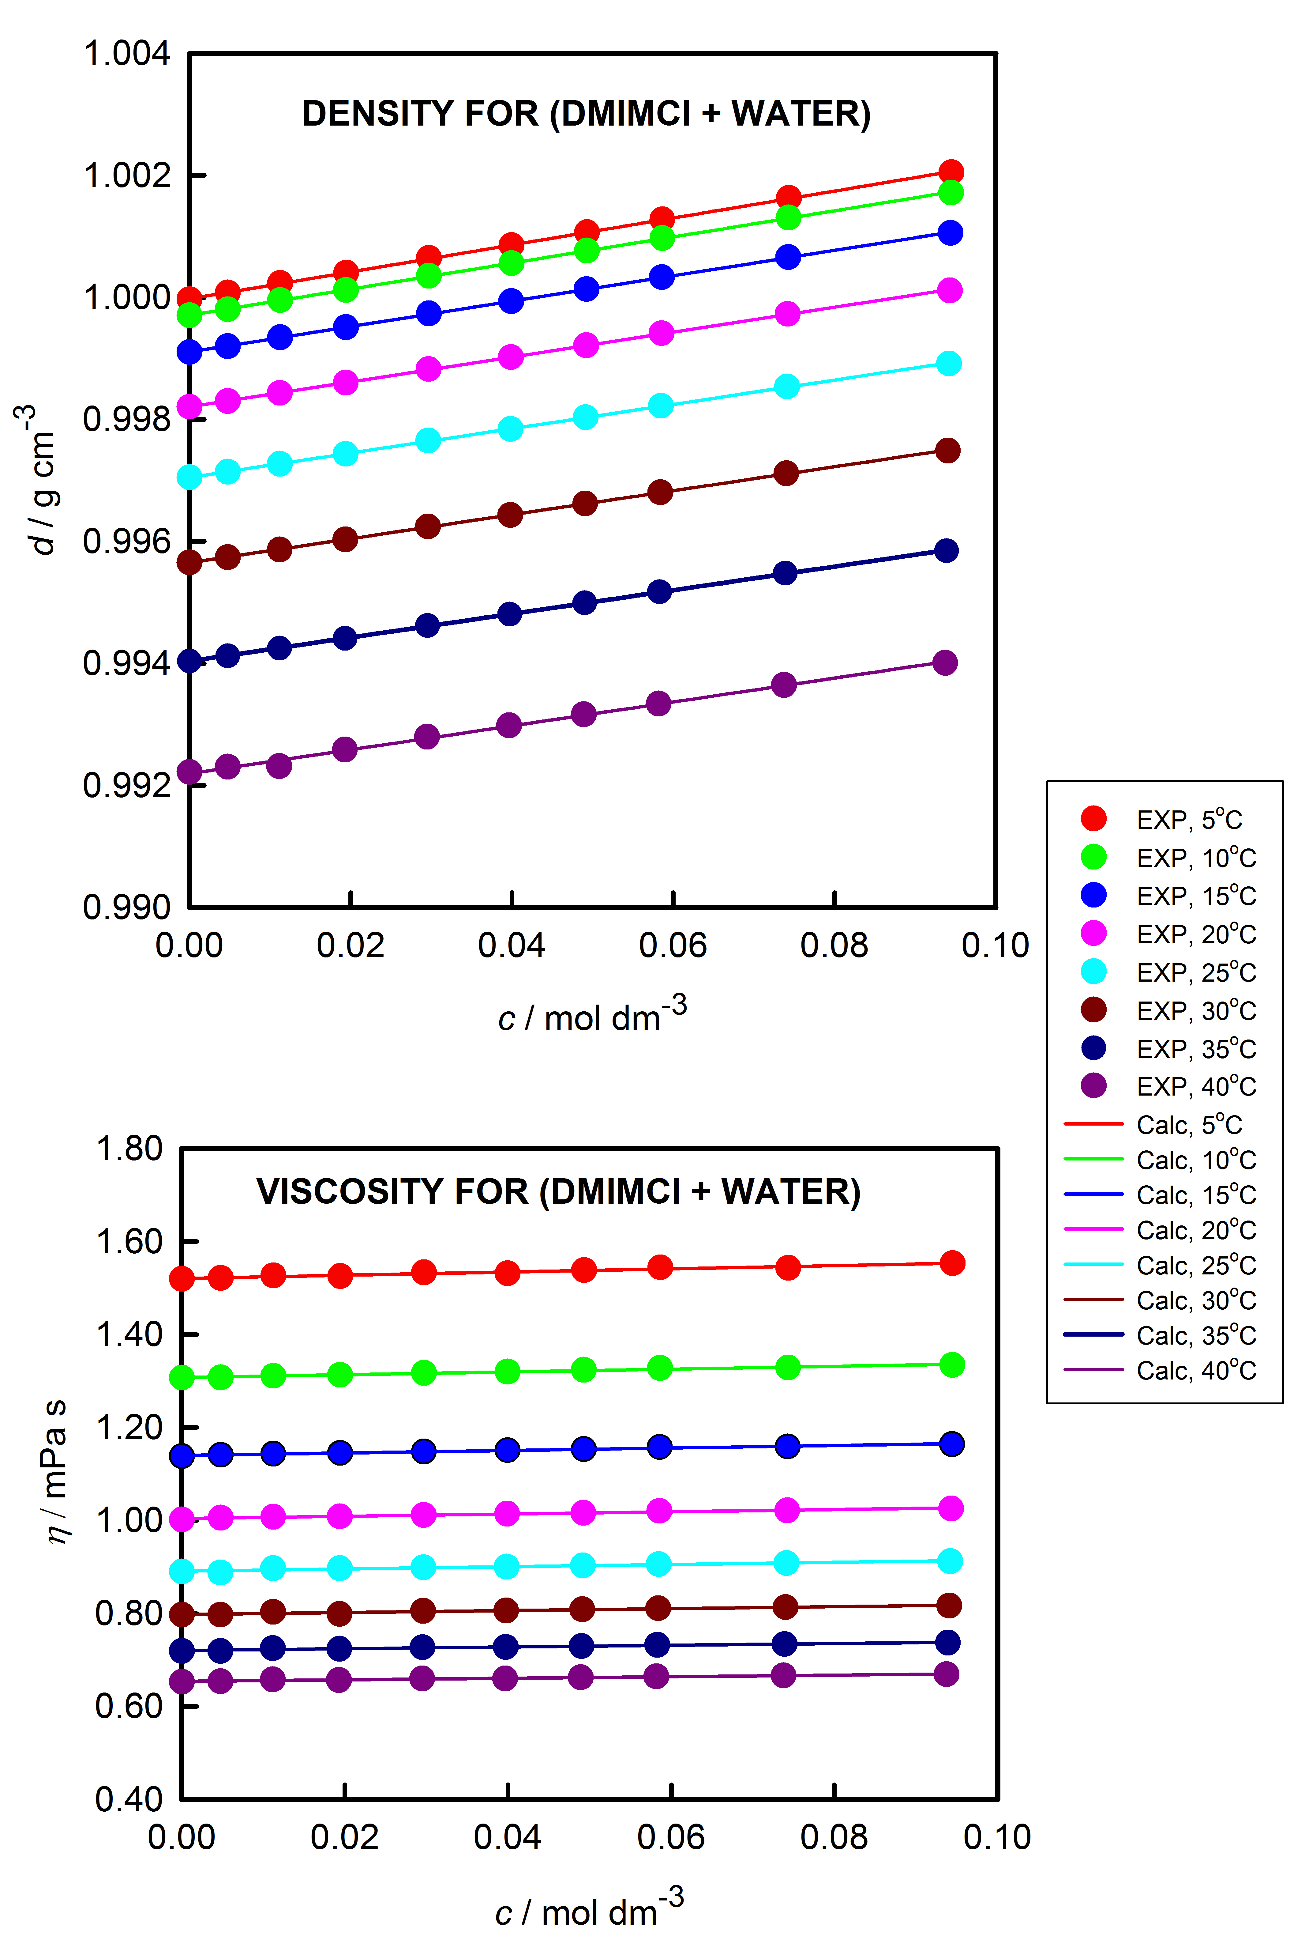
RESULTS
Viscosity and density for (DMIMCl + water):

Slide 13
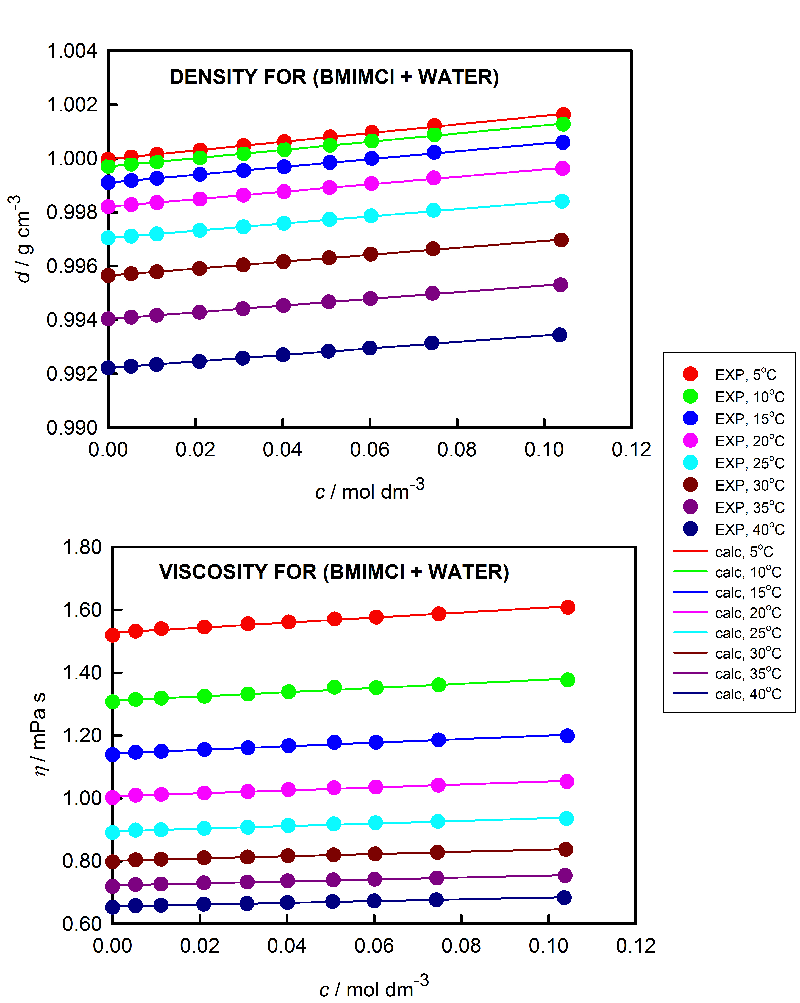
RESULTS
Viscosity and density for (BMIMCl + water):

Slide 14
RESULTS
Relative viscosity (η_{r} = η / η₀) data for systems (DMIMCl + water) and (BMIMCl + water) are related to the molarity:
Jones-Dole equation
Ref.: G. Jones, M. Dole, J. Am. Chem. Soc.
51 (1929) 2950. viscosity A-coefficient
viscosity B-coefficient
can be obtained
from the intercept
and the slope of the
straight line

Slide 15
RESULTS
Viscosity A-value also can be calculated theoretically from the ionic interaction theory by Falkenhagen and Vernon:
viscosity A-coefficient is a measure of long-range ion-ion
interactions
by help of the values for ε_{r} and η₀ for water,
and limiting molar conductivities
at temperature,T
we calculated A-values!
(also experimentally from graph)

Slide 16
RESULTS
Table 1.:
A-coefficients as calculated from Falkenhagen and Vernon equation for DMIMCl and BMIMCl in water at different temperatures
T / K | A_{DMIMCl} / dm^{3/2} mol^{-1/2} | A_{BMIMCl} / dm^{3/2} mol^{-1/2}
273.15 | 0.006195 | 0.007007
283.15 | 0.006285 | 0.007099
288.15 | 0.006376 | 0.007176
293.15 | 0.006454 | 0.007250
298.15 | 0.006531 | 0.007333
303.15 | 0.006608 | 0.007405
308.15 | 0.006692 | 0.007477
313.15 | 0.006802 | 0.007547

Slide 17
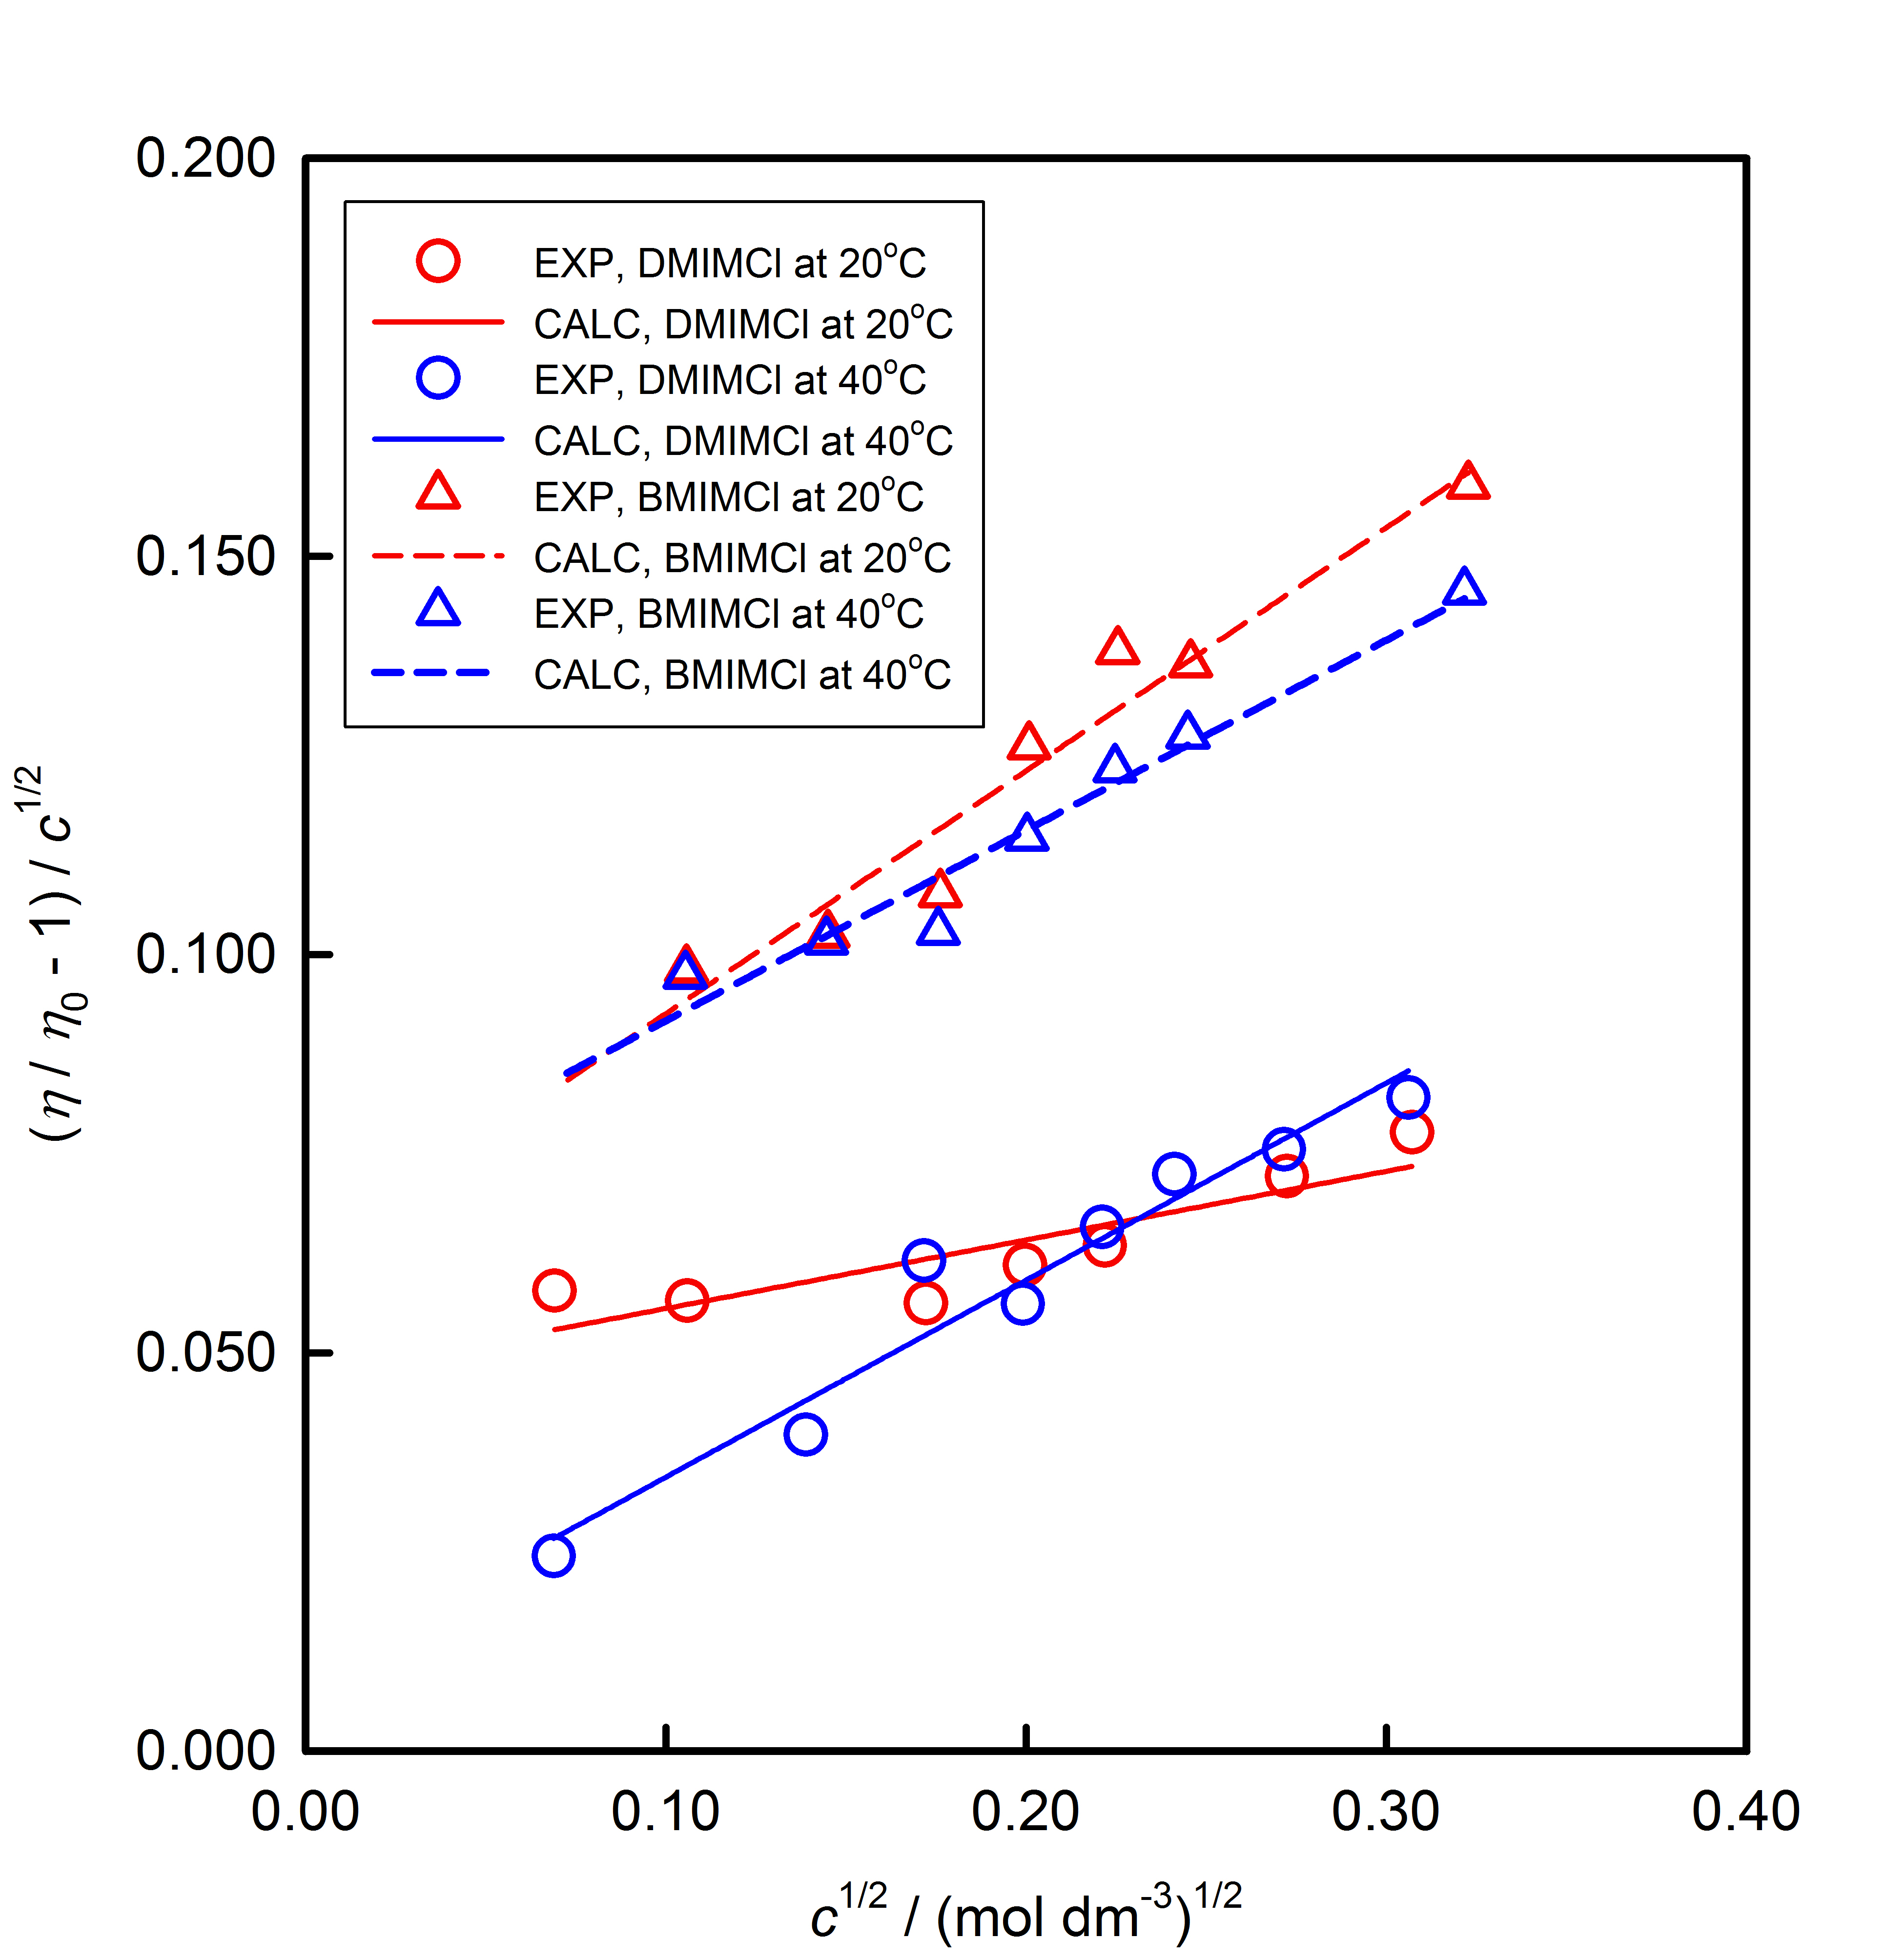
RESULTS
Fig. 1. Jones-Dole
plots

Slide 18
RESULTS
Table 2.:
The experimental viscosity B-coefficients for DMIMCl and BMIMCl in water at different temperatures
B_{NaCl} / dm³ mol⁻¹ – values are from literature (H. D. B. Jenkins, Y. Marcus, Chem. Rev. 95 (1995) 2695
T / K | B_{NaCl} / dm³ mol⁻¹ | B_{DMIMCl} / dm³ mol⁻¹ | B_{BMIMCl} / dm³ mol⁻¹
273.15 | 0.034 | 0.2176 ± 0.0003 | 0.2557 ± 0.0006
283.15 | 0.053 | 0.2022 ± 0.0013 | 0.3680 ± 0.0014
288.15 | 0.063 | 0.1490 ± 0.0015 | 0.3695 ± 0.0012
293.15 | 0.071 | 0.1076 ± 0.0008 | 0.3050 ± 0.0006
298.15 | 0.080 | 0.1711 ± 0.0009 | 0.2967 ± 0.0006
303.15 | 0.083 | 0.1776 ± 0.0010 | 0.2523 ± 0.0003
308.15 | 0.088 | 0.2061 ± 0.0005 | 0.2418 ± 0.0002
313.15 | 0.093 | 0.2474 ± 0.0005 | 0.2390 ± 0.0003

Slide 19
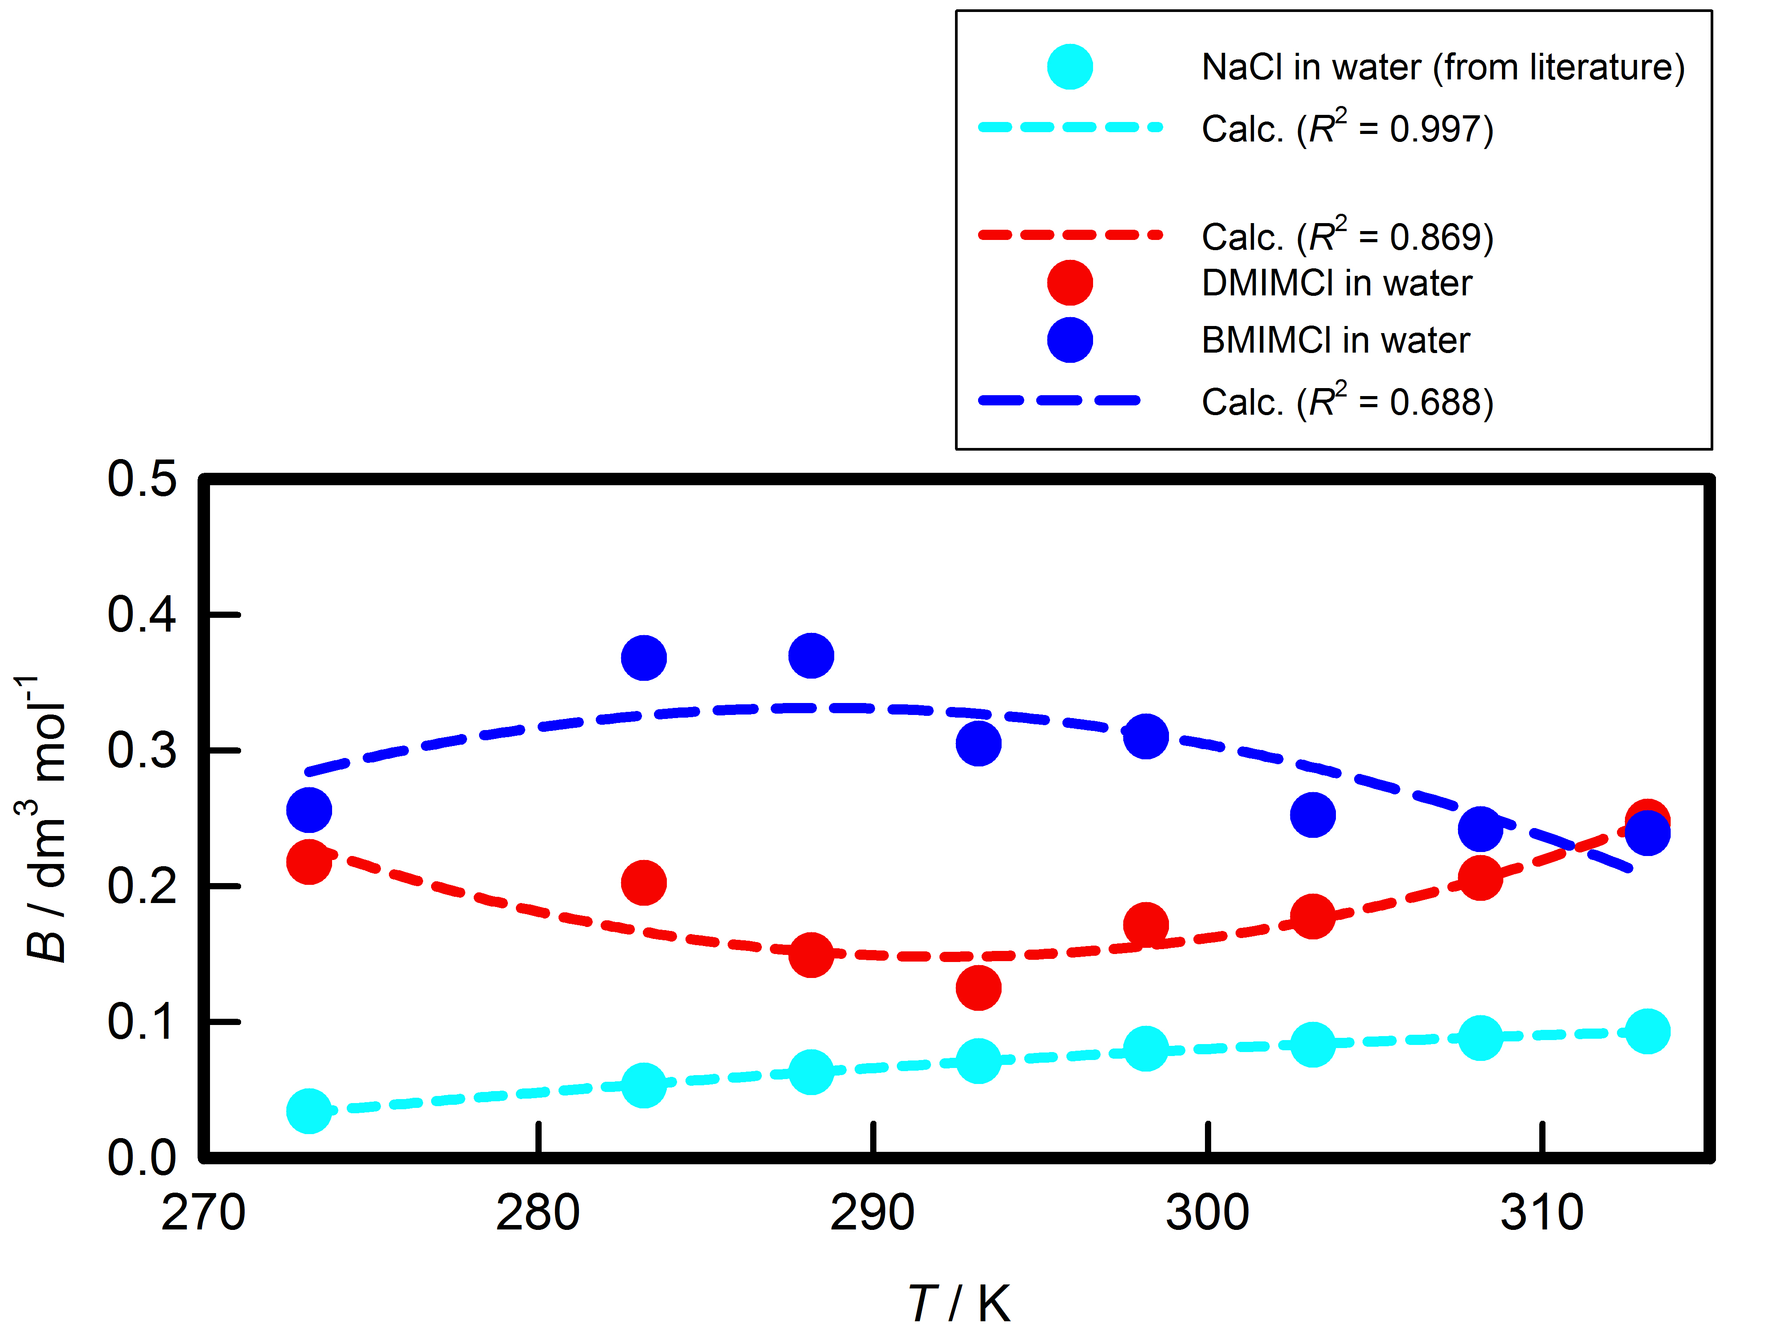
RESULTS
From temperature dependencies for viscosity B-coefficients, we were obtained next second order polynomials :
for (DMIMC in water): B = 19.27 – 0.1309 T + 0.000224 T²
for (BMIMC in water): B = –16.49 – 0.1167 T – 0.000202 T²
Fig. 2.
Fig.2.

Slide 20
CONCLUSIONS
In present work, the B-coefficients for both investigated ILs (DMIMCl and BMIMCl) in water medium (obtained by Jones-Dole equation) are positive.
At given temperature, the viscosity B-coefficients follow the order: B(BMIMCl) > B(DMIMCl); this may be attributed to stronger BMIMCl-water interactions.
All obtained values of B-coefficients are bigger than values of A-coefficients in water suggesting that ion-solvent interactions are more powerful than ion-ion interactions. This conclusion agrees with literature (association constants for both ILs in water are small).
It is well known that the sodium chloride in water at 298.15 K has a structure-breaking nature (dB / dT = 0.0014 dm³ mol⁻¹ K⁻¹). DMIMCl in water at 298.15 K exhibits also positive temperature coefficient, dB / dT = 0.0027 dm³ mol⁻¹ K⁻¹, while for BMIMCl this value is negative, dB / dT = –0.0039 dm³ mol⁻¹ K⁻¹

Slide 21
CONCLUSIONS
INFLUENCE OF ALKYL CHAIN LENGTH: It would be interesting extend this research also on the binary systems (water + 1-ethyl-3-methylimidazolium-, 1-hexyl-3-methylimidazolium-, and 1-octyl-3-methylimidazolium chloride) … very soon will be do it!
Volumetric and viscometric properties for all imidazolim based ILs will be presented (or published).

Slide 22
Thanks
Thank you for your attention!
Dear collegues Marija and Aleksandar …
… thanks for joint cooperation!
My thanks goes to staff of Chair of Physical Chemistry, FKKT, University of Ljubljana!
Thanks COST Action (CM 1206) for financial support!
Thanks my wife Anita and sons Petar and Lovre!

