Slide 1
Application of GNSS Technology for Car Tracking and Remote Control
Goran Jurković, M.Sc., and Edouard Ivanjko, Ph.D.
Faculty of Transport and Traffic Sciences, University of Zagreb, Croatia, www.fpz.hr
Vlado Sruk, Ph.D.,
Faculty of Electrical Engineering and Computing, University of Zagreb, Croatia, www.fer.hr

Slide 2
Introduction
Research conducted in usage of GNSS Technology in real world scenario to make everyday car using more user friendly and to further increase car safety (grand theft auto)
Car monitoring (tracking and engine history) and remote controlling (doors, locks, windows, engine start and shut down)
Achieved solution based on integration of technologies: GSM, GPRS, GPS/GNSS, CANBUS, LAMP (HTML, PHP, MySQL), TCP/Ip socket server, Android Application
Notes:
Research conducted in usage of GNSS Technology in real world scenario to make everyday car using more user friendly and to further increase car safety (grand theft auto)
Car monitoring (tracking and engine history) and remote controlling (doors, locks, windows, engine start and shut down)
Achieved solution based on integration of technologies: GSM, GPRS, GPS/GNSS, CANBUS, LAMP (HTML, PHP, MySQL), TCP/Ip socket server, Android Application

Slide 3
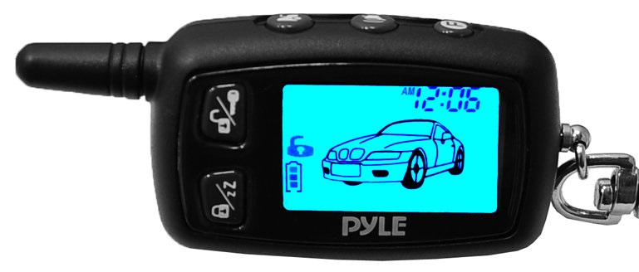
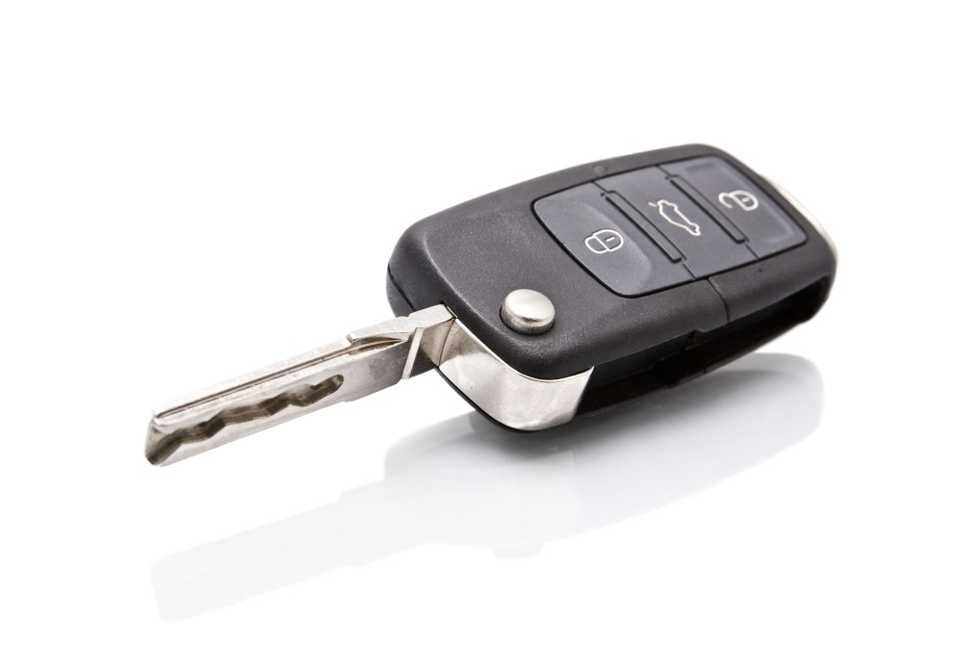
Introduction – Car Safety
Widely available after market alarm systems:
one way or two way remote controllers
limited distance
additional gadgets to carry in pockets
Standard in-fabric alarm systems:
basic options
easily disabled by thefts
All lack of tracking history and monitoring information
Notes:
Prikazi tmonkey6

Slide 4
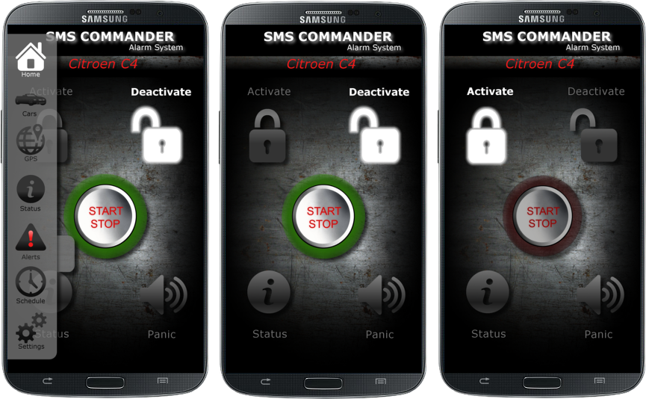
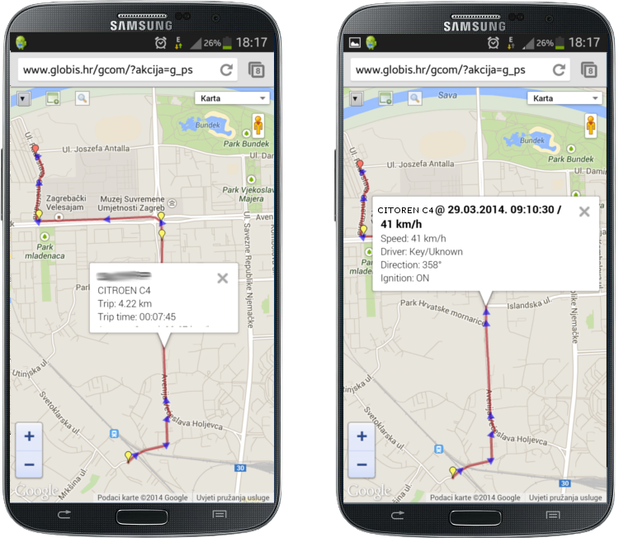
Introduction – Car Safety of Future
GNSS/GPRS Based Device:
Integration of many services (remote control, tracking, etc)
Limitless distance of remote control
Tracking and car monitoring history
No need for carrying car keys or additional gadgets
Notes:
Prikazi MOTOcommanderEN

Slide 5
Introduction – Achieved solution
Remote control of the vehicle:
Engine start up and forced shut down
Door locks and alarm control
Window opening and closing
Car monitoring and information about theft actions
No need for carrying car keys
Tracking history and additional engine information:
engine rpm and car speed
trip history and current location
Additional keyless car entry in emergency:
unlocking the car with entering PIN on hidden keyboard button

Slide 6
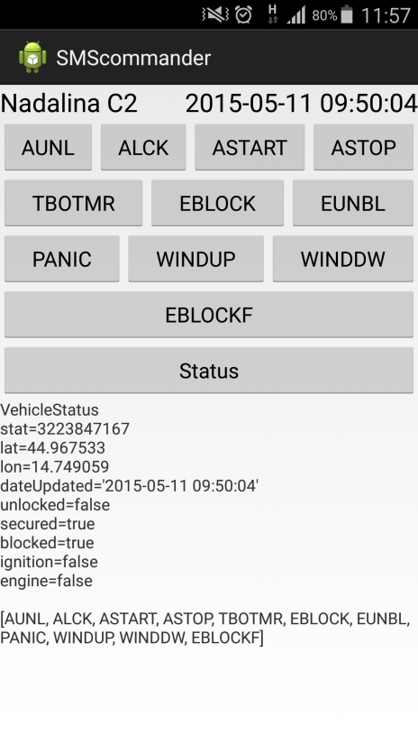
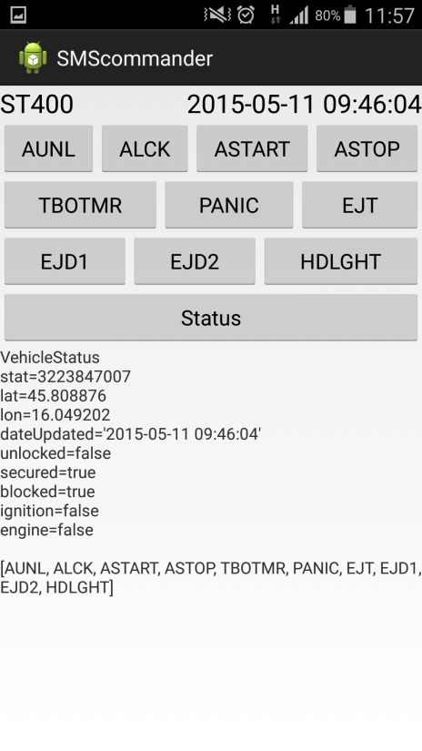
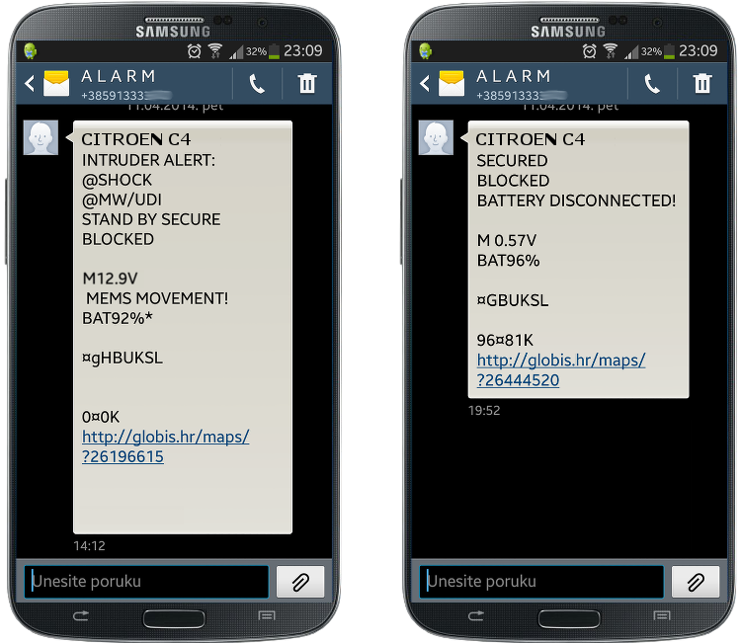
Introduction – Achieved solution
Remote control and monitoring of the vehicle over:
GUI on application for smartphone
text UI interface over messages (SMS) for older phones
GUI on Web page on personal computer

Slide 7
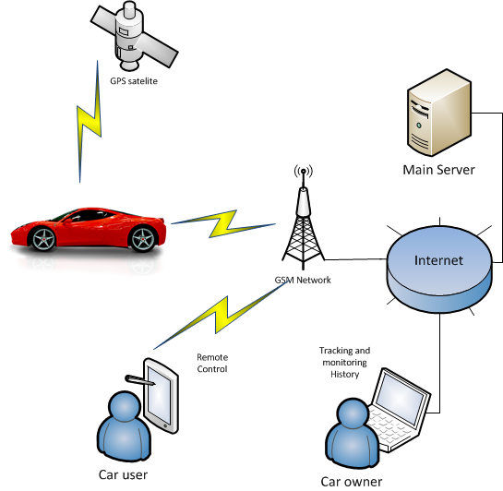
Introduction – Achieved solution
Advancement in technology using GNSS device

Slide 8
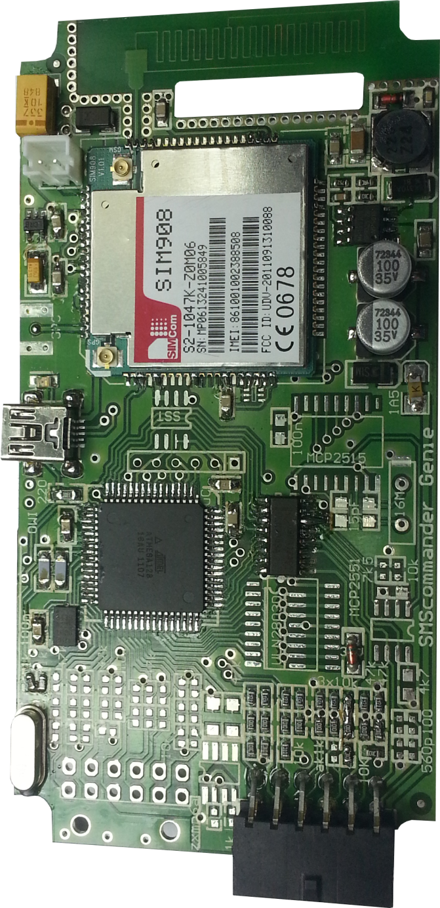
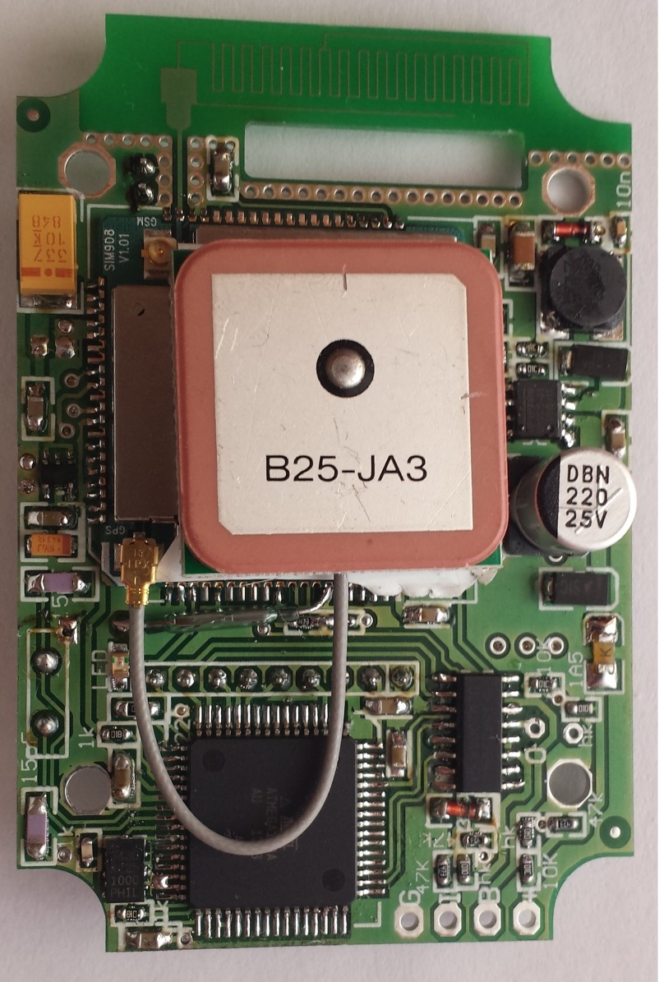
GNSS capable device inside Vehicle
Hardware based on Atmel AVR micro-controller and SimCom Ltd. SIM908 GSM/GPRS/GNSS module
Device is equipped with FOTA for faster development of a software inside by enabling firmware updates over the GPRS using HTTP
On board alarm features and sensors
Interface to car engine and harness
MCP2515 CANBUS processor and MCP2551 driver for addition information on newer cars
Smaller version in waterproof casing for motorcycle installation

Slide 9
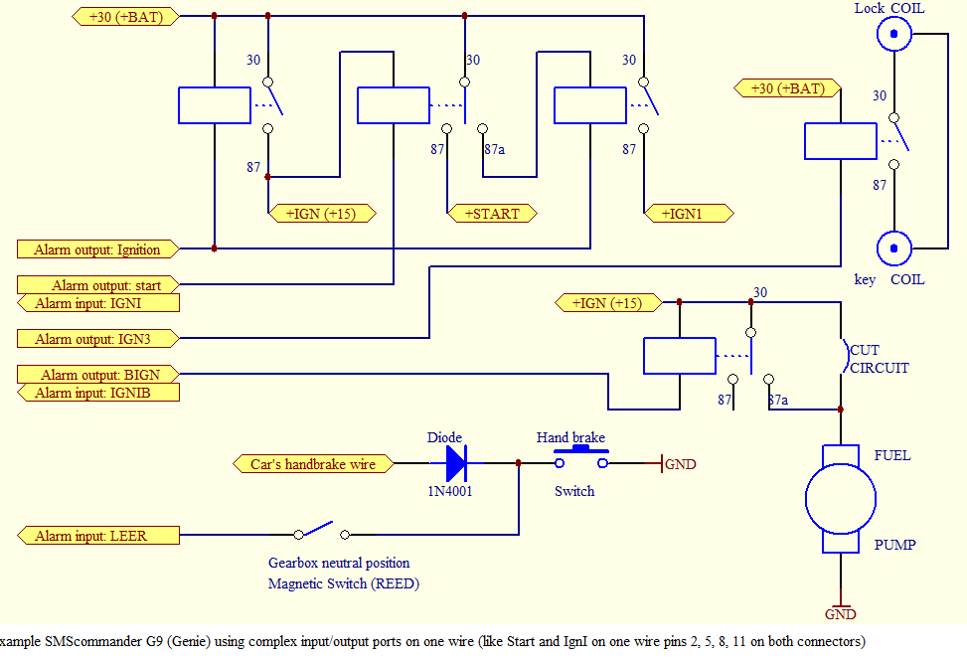
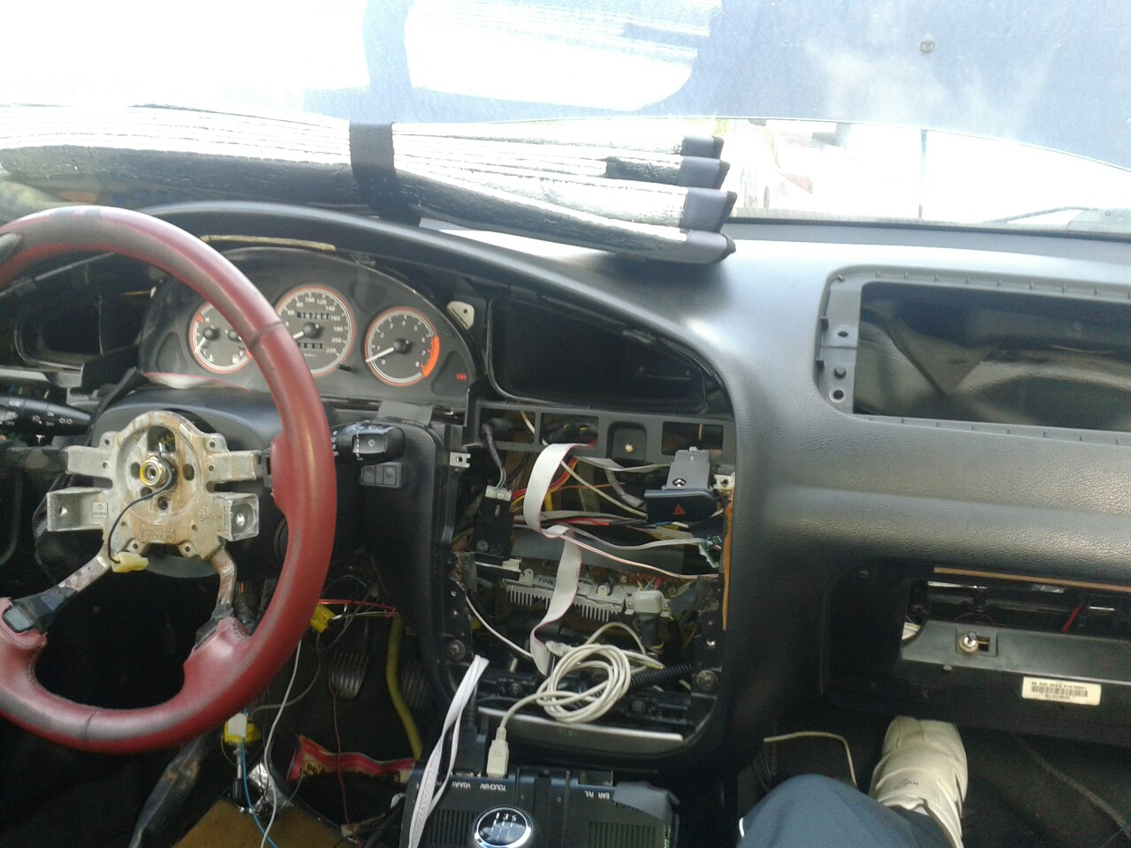
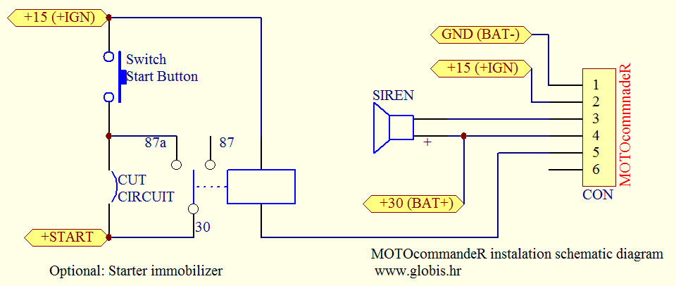
Wiring device to Vehicle ECU

Slide 10
CANBUS connection to Vehicle ECU
Hardware based on Mocrochip MCP2515 and MCP2551
Information about vehicle state over just two digital wires
Every car model has it’s own addresses of particular information (big database of every car make and model)
Possibility of sending commands over CANBUS to change particular state of the car:
locking and unlocking doors
opening and closing windows
turning lights on and off
starting up the engine
Information about CANBUS addresses about particular car is proprietary information and cannot be obtained by legal channels (reverse engineering)

Slide 11
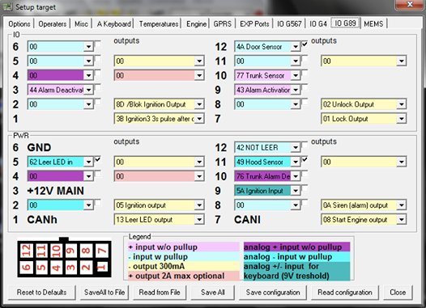
Wiring configuration of Device

Slide 12
Linux based Main server
TCP/Ip statefull socket server (GCC)
Permanent TCP connection to vehicle and Android devices
Relaying commands from Android devices to vehicle
Relaying and sending SMS on alerts
Stores geo location and other data in MySQL database for history and reports
HTTP server based on PHP
Generating and displaying tracking history and vehicle information
Complex setup of geofences, personnel, vehicle rules and policies

Slide 13
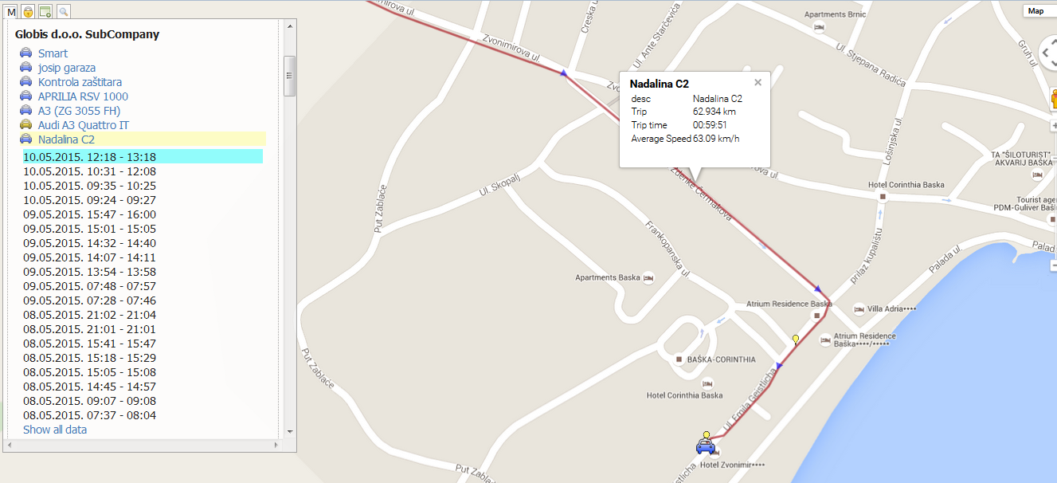
HTTP server based on PHP

Slide 14
Android Application as a Remote Controller
Remote controller based on graphical user interface (work in progress)
Doesn’t have distance limitation (GSM coverage)
Permanent TCP/Ip connection to socket server for faster command relay (relaying time under 1 second)
Additional information and future upgrades available with simple change of the application
Displayed buttons correlate to real in-car installation
Notes:
prikazi vovlolunl i audi a5

Slide 15
Conclusion and future work
GUI for Android and IPhone applications needs attention
expanding CANBUS database is constant work in progress
solving sending CANBUS commands to car’s ECU would make installation easier and more market friendly
less installation working hours (possibility of marketing outside of Croatia)
installation could be done by amateurs (cost of installation lowered)
more complex traction history and additional reports are work in progress

Slide 16
Thank you for attention!
For further information, please contact:
goran.jurkovic@fpz.hr
edouard.ivanjko@fpz.hr
vlado.sruk@fer.hr
http://www.globis.hr/

