Slide 1

Stacking of planar conjugated rings – beyond aromatics
Krešimir Molčanov
Rudjer Bošković Institute
Zagreb, Croatia

Slide 2

13th Slo-Cro Crystallographic Meeting, Bovec, 2004.

Slide 3

15th Slo-Cro Crystallographic Meeting, Jezersko, 2006.

Slide 4
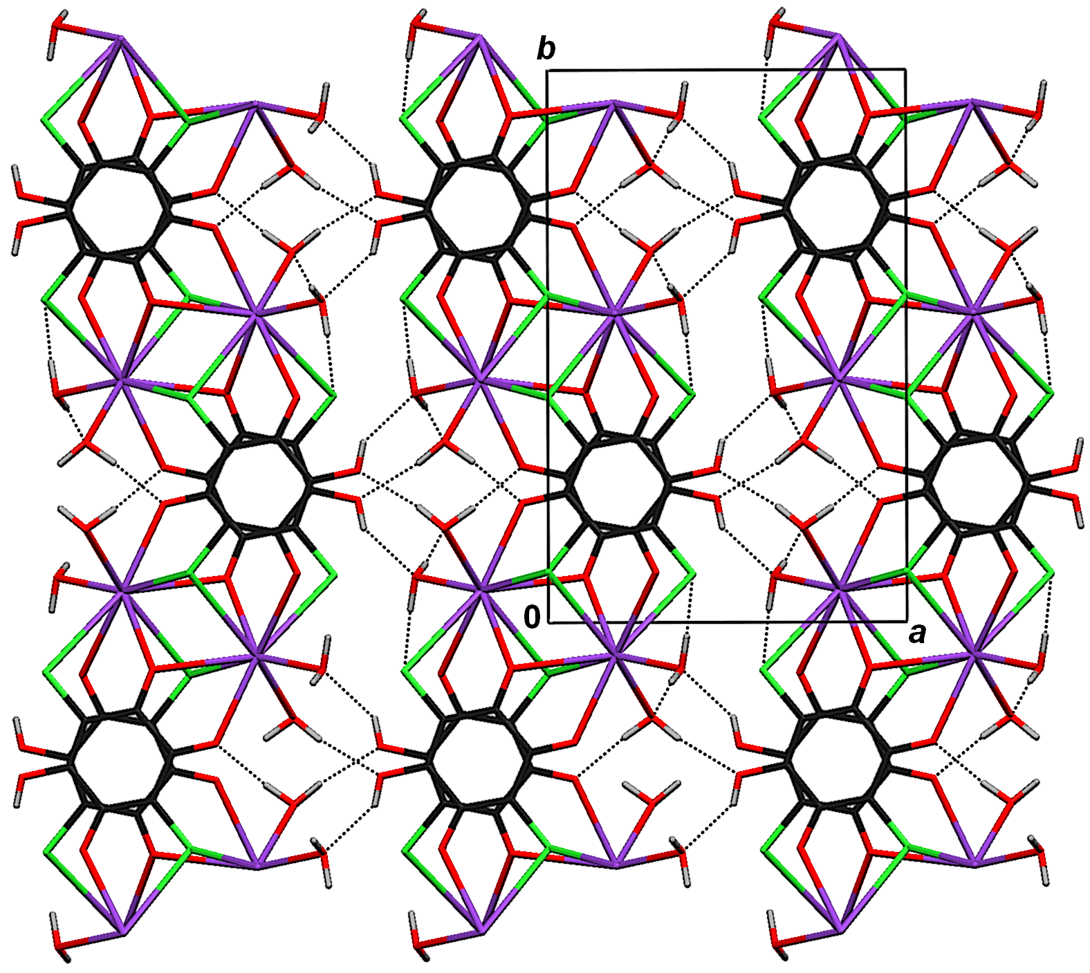
Potassium hydrogen chloranilate dihydrate
space group
P 2₁/c
17th Slo-Cro Crystallographic Meeting, Ptuj, 2008.

Slide 5
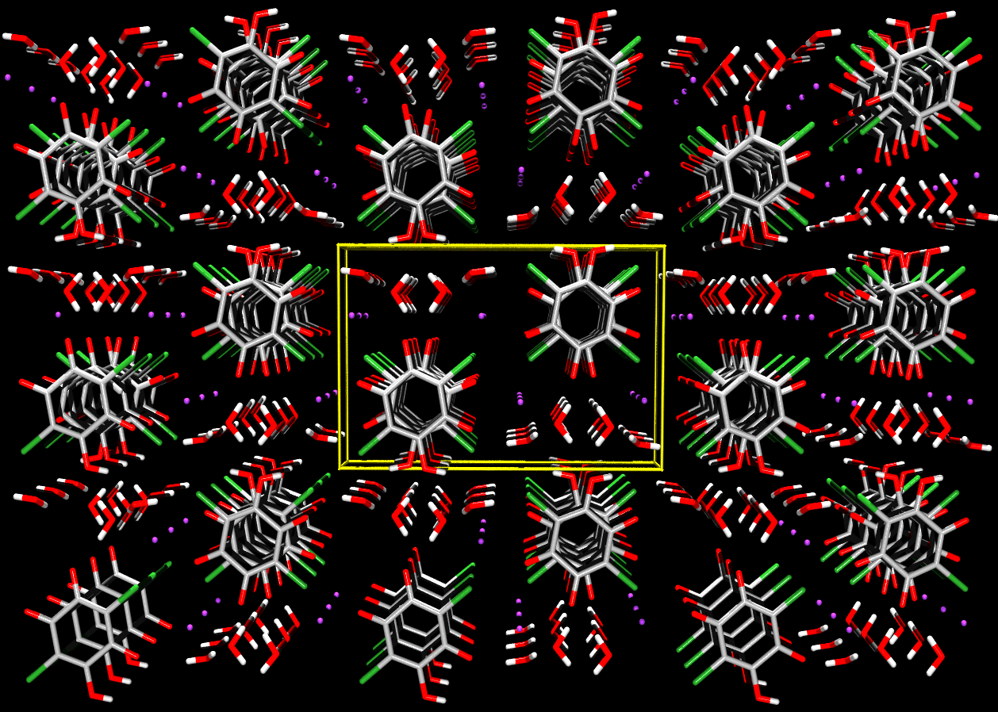
KHCA∙2H₂O
P 2₁/c
0
b
a
Molčanov, Kojić-Prodić, Meden, CrystEngComm, 2009, 11, 1407.

Slide 6
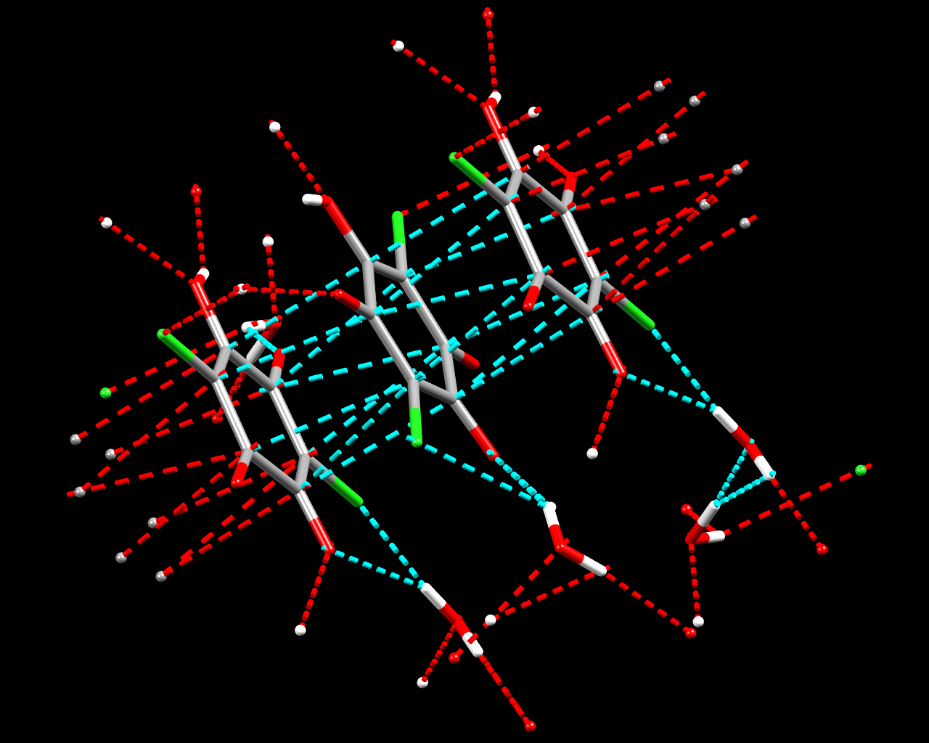
KHCA∙2H₂O
P 2₁/c
Centroid distance:
3.229(2) Å
Offset ≈ 0.2 Å
c
Molčanov, Kojić-Prodić, Meden, CrystEngComm, 2009, 11, 1407.

Slide 7
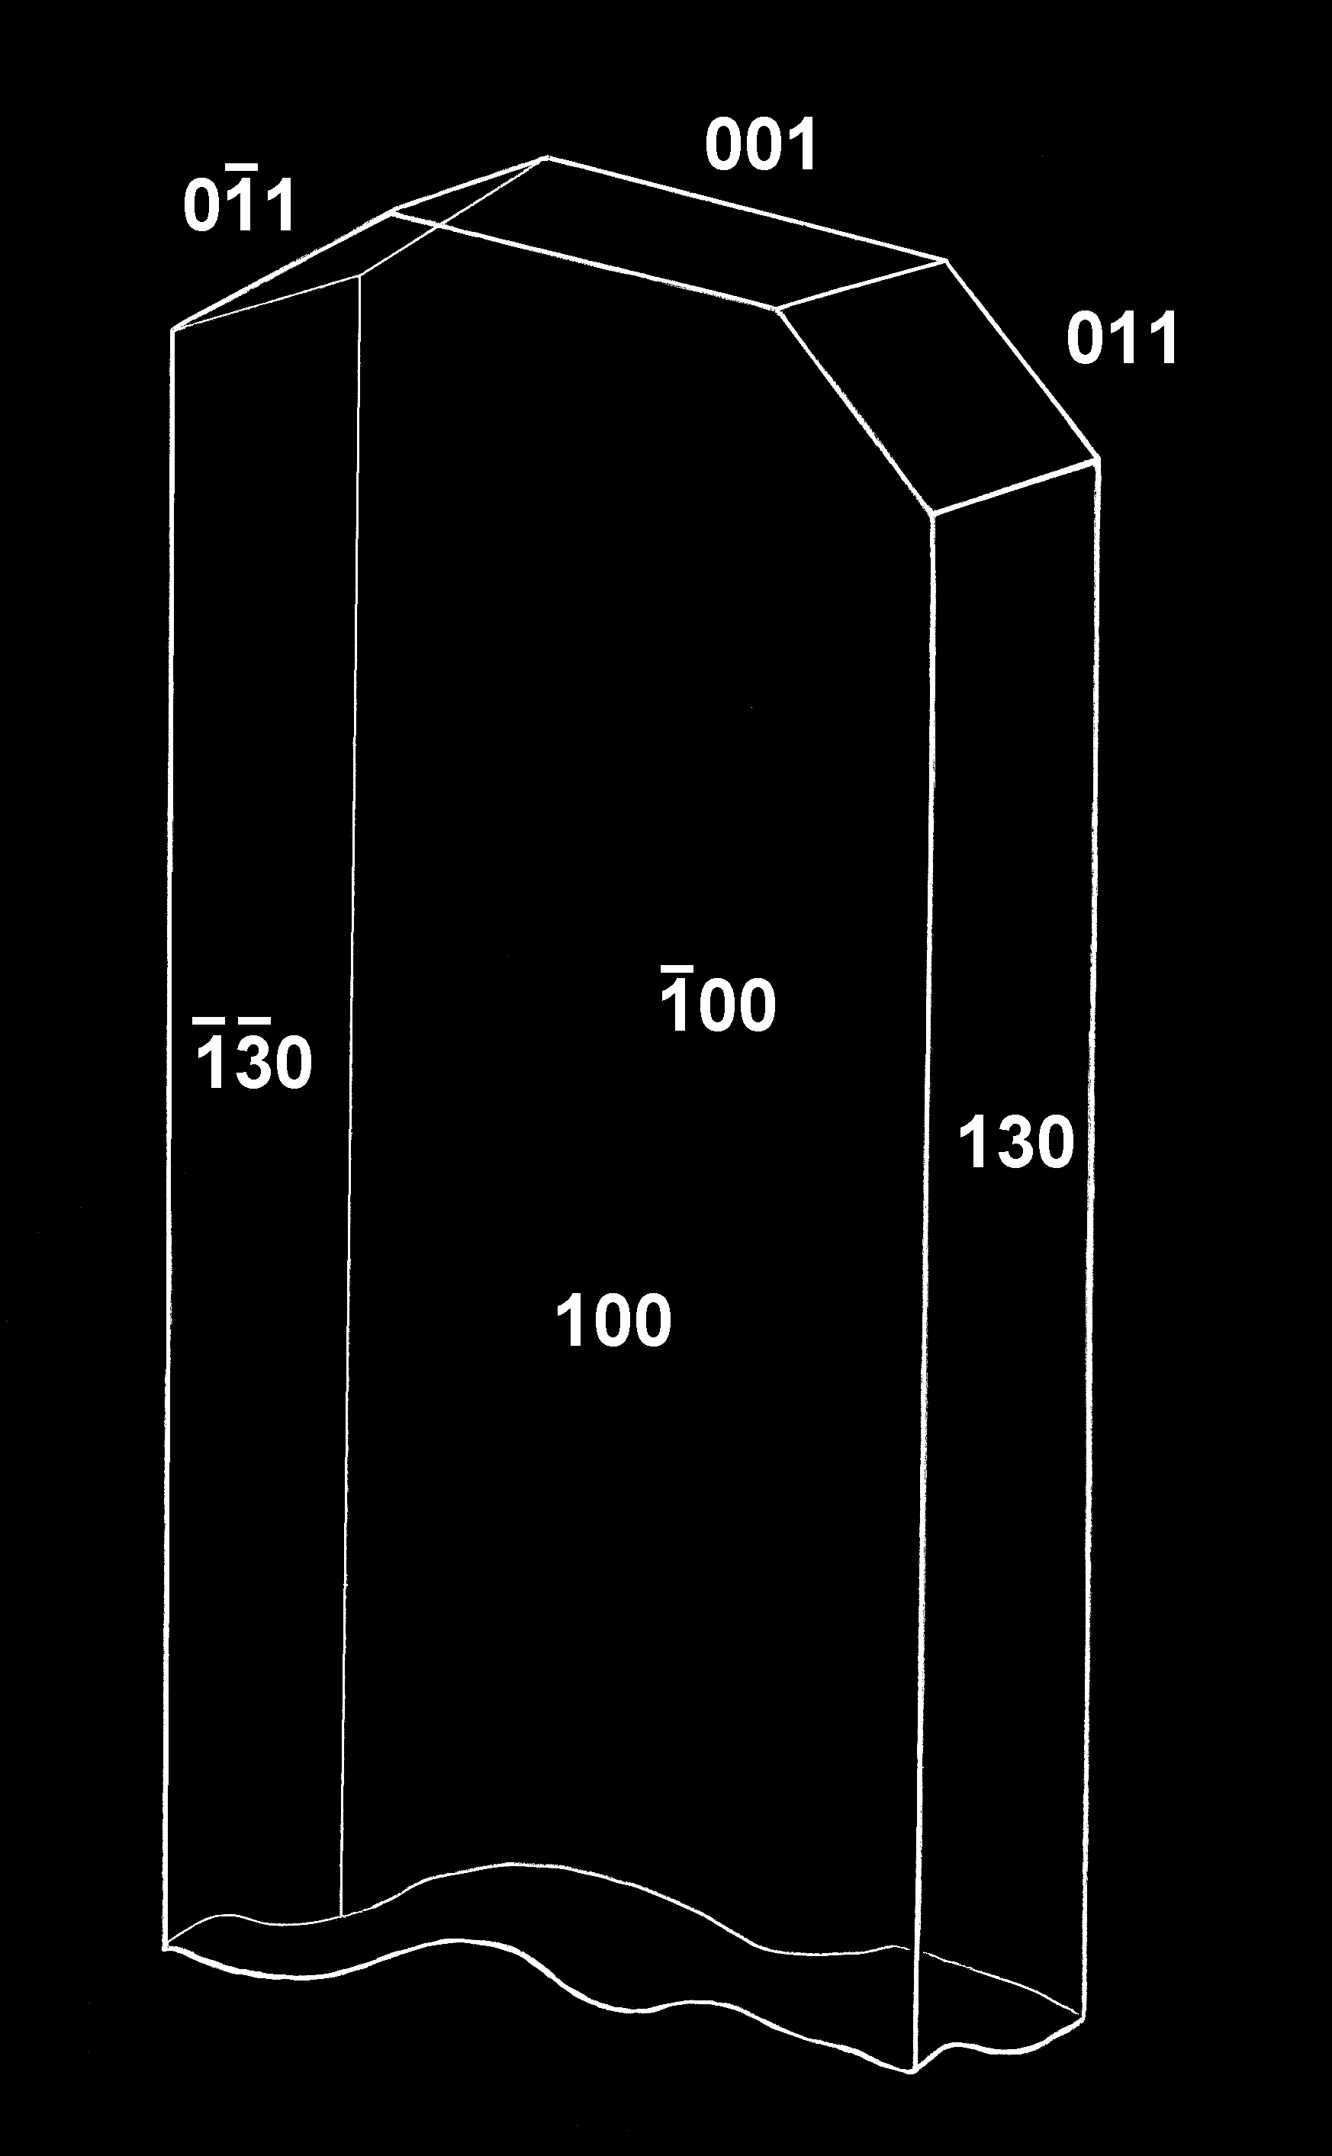
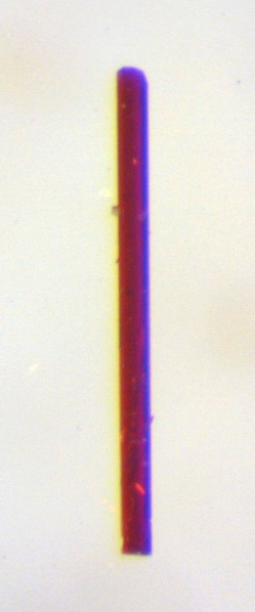
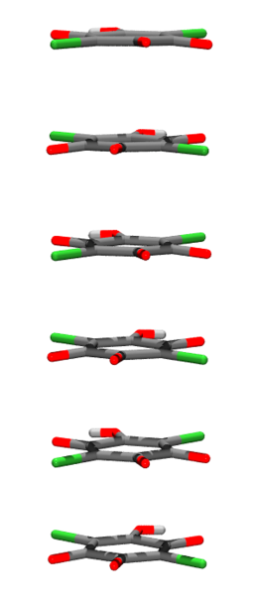
Is it because of stacking?
c
Molčanov, Jelsch et al., CrystEngComm, 2015, 17, 8645.

Slide 8
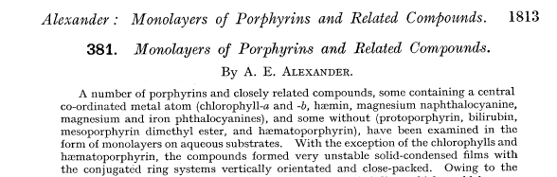
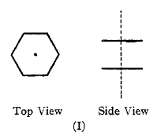
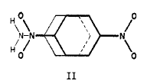
(Pre)history
In 1930’s: porphyrines forming layers; charge transfer
J. Chem. Soc., 1937
Landauer & McConnel, J. Am. Chem. Soc., 1952, 74, 1221.

Slide 9
What is it?
Is it dispersion?
It is interaction of quadrupolar moments?
Is it charge transfer?
Is it overlap of π-orbitals?
Is it magnetic interaction due to ‘ring currents’?
How to name it? π∙∙∙π interaction, π-interaction,
aromatic interaction, π-stacking, σ-π stacking…
From Wikipedia:
In chemistry, pi stacking (also called π–π stacking) refers to attractive,
noncovalent interactions between aromatic rings, since they contain
pi bonds.

Slide 10
Common misconceptions
It occurs only between aromatic rings
It is a weak interaction (E < 1 kcal mol⁻¹)
In crystal packing it plays a ‘second fiddle’ to stronger interactions such as hydrogen bonding
It can’t be used in crystal engineering

Slide 11
An amazing discovery,
your majesty! It could
win us an IgNobel prize!
Look, these coins stack!
That means gold is aromatic!

Slide 12
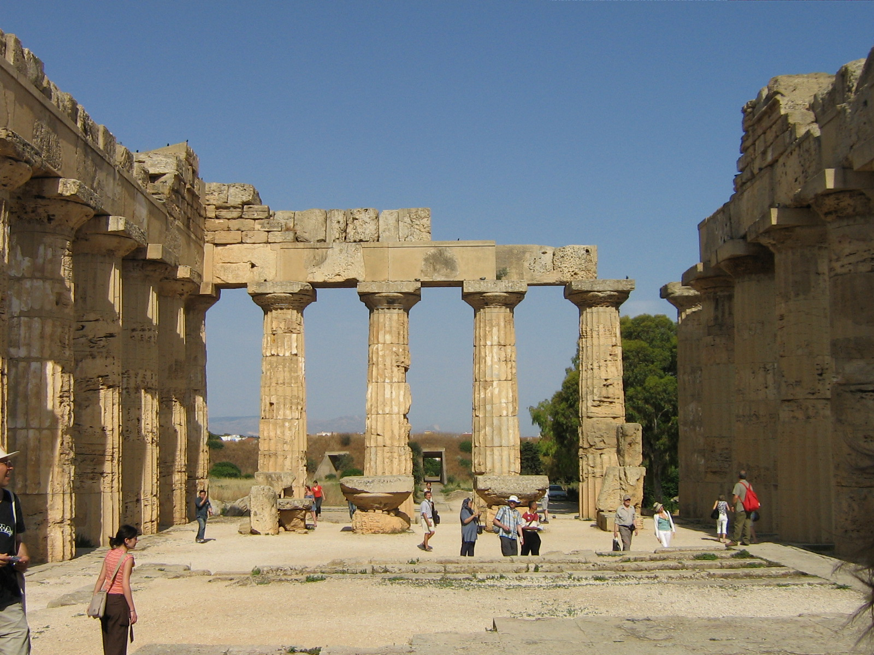
Temple of Hera, Selinunte, Sicily built ca. 460 B.C.
1,2 x 10¹¹ Å

Slide 13
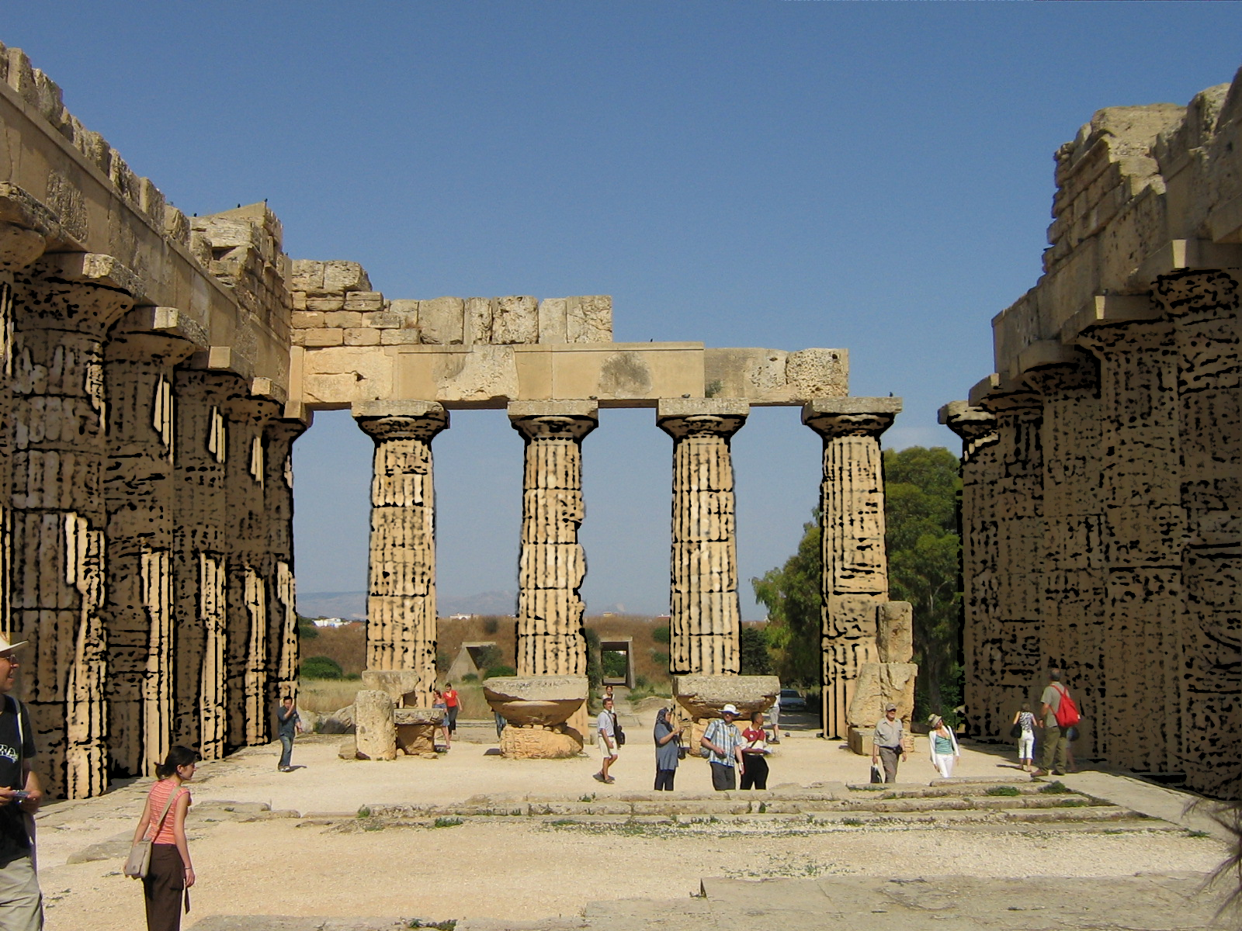
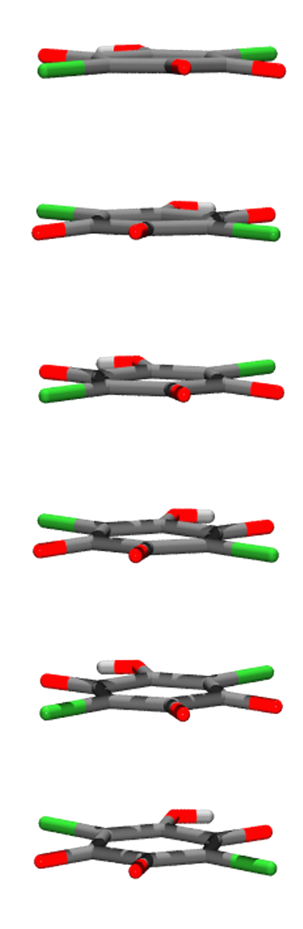
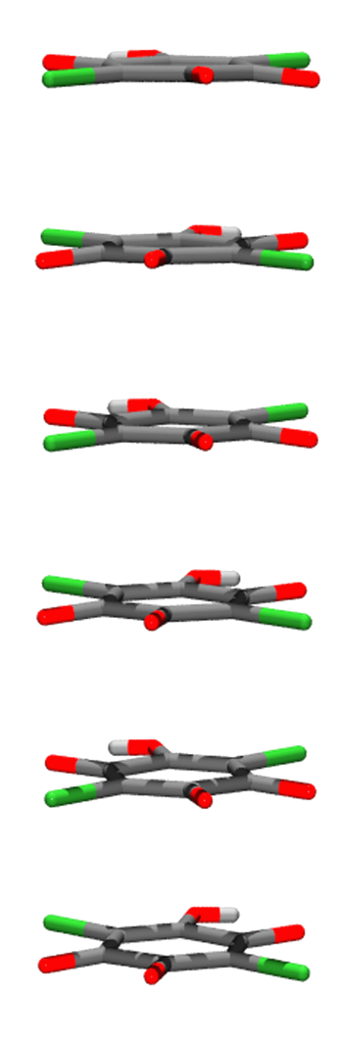
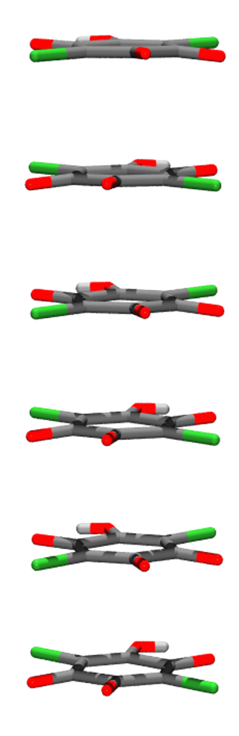
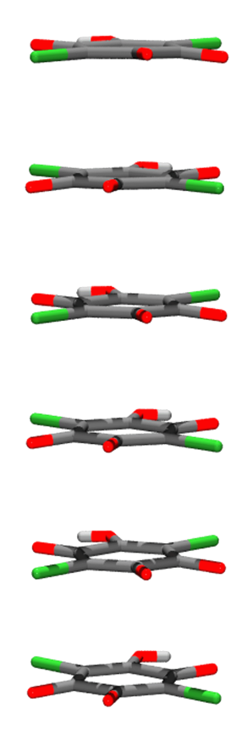
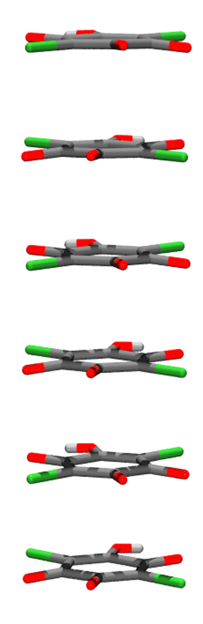
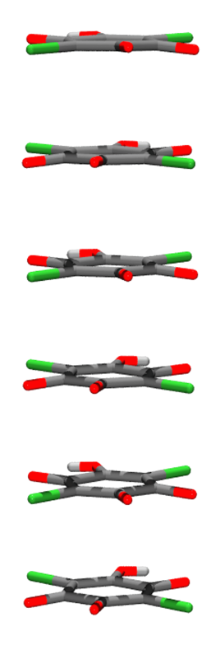
Temple of Hera, Selinunte, Sicily built ca. 460 B.C.

Slide 14
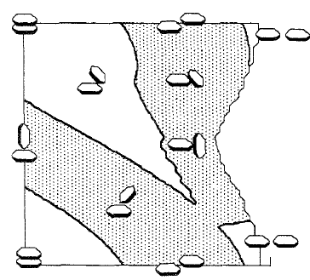
Stacking of aromatic rings
Typical centroid
distance:
> 3,8 Å
α
Repulsion
Offset typically
1,7 – 1,8 Å
Attraction
offset
Hunter & Sanders, JACS, 1990, 112, 5525.
Hunter, Singh, Thornton, J. Mol. Biol, 1991, 208, 837.

Slide 15
A simple explanation: quadrupolar moments
C. Janiak, J. Chem. Soc., Dalton Trans., 2000, 3885-3896.

Slide 16
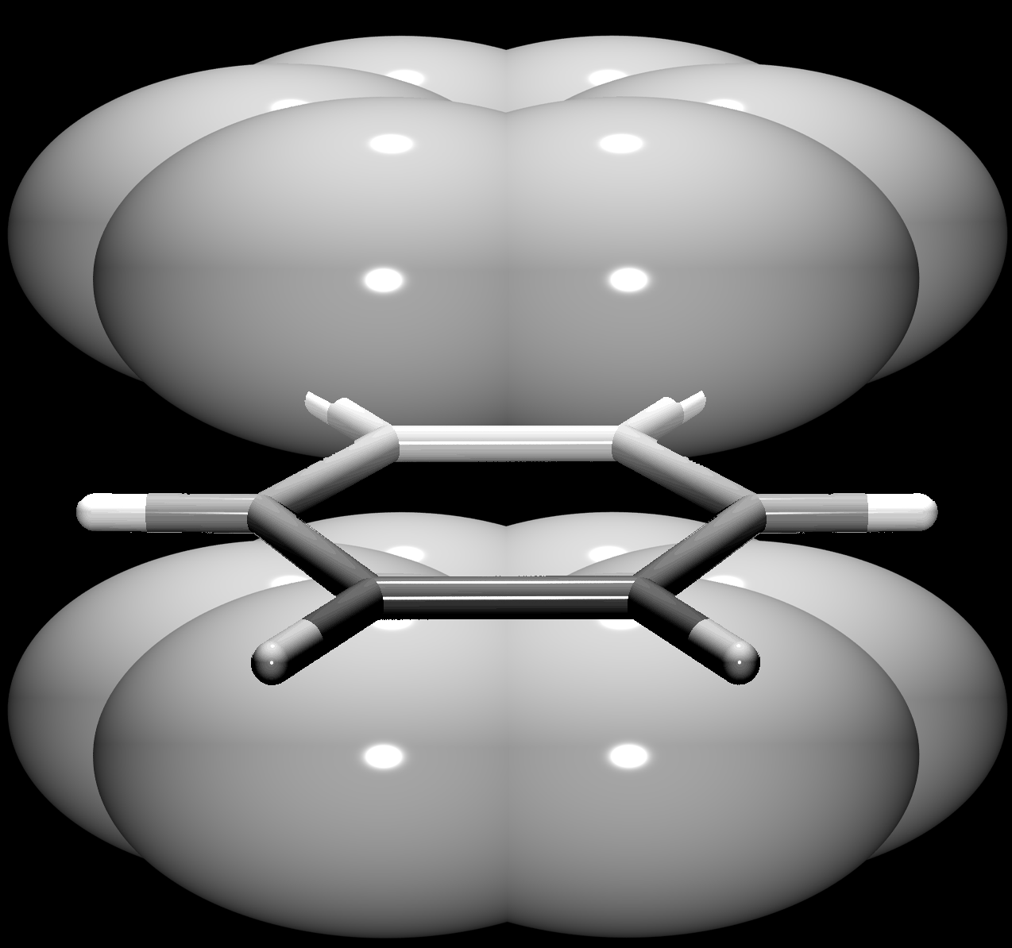
Aromatic π-interactions:
quadrupolar moments
σ∙∙∙π attraction
π∙∙∙π repulsion
δ⁻
σ∙∙∙π attraction
δ⁺
δ⁺
δ⁻

Slide 17
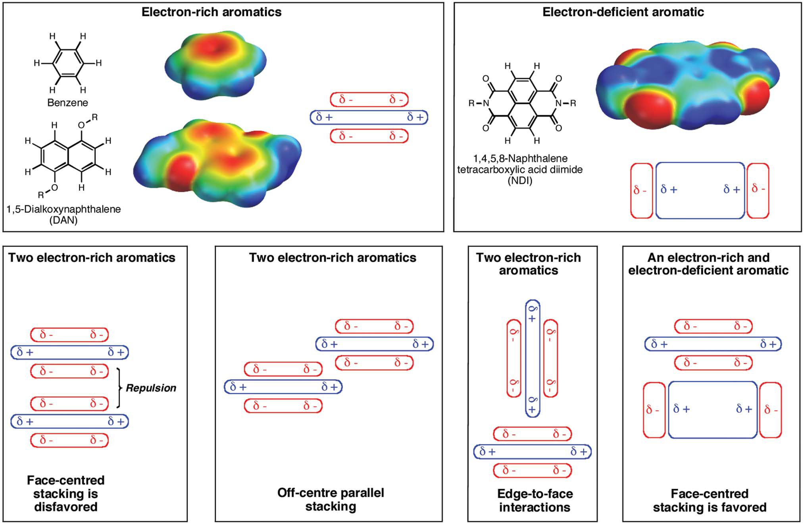
Rethinking the term „pi-stacking”
Martinez & Iverson, Chem. Sci., 2012, 3, 2191.

Slide 18
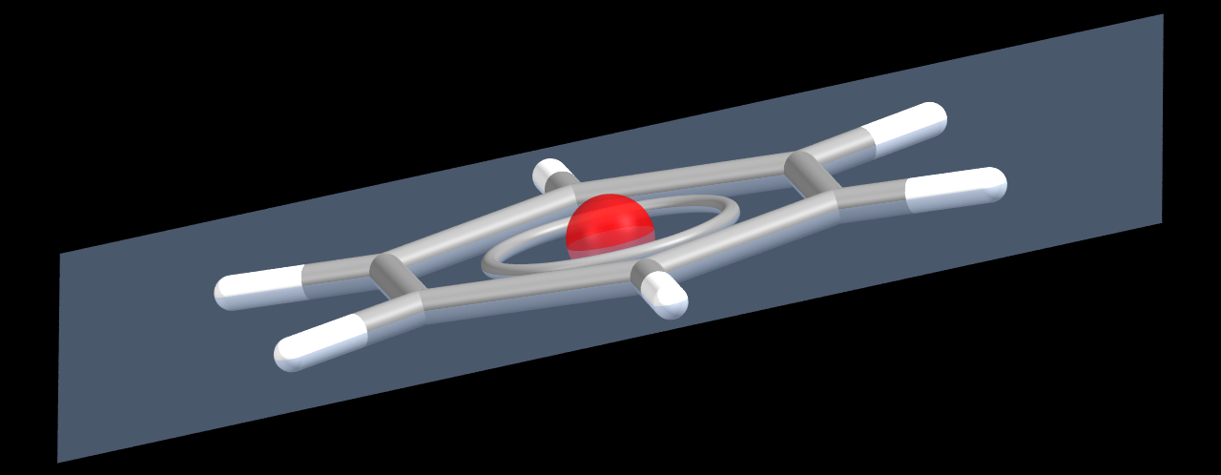
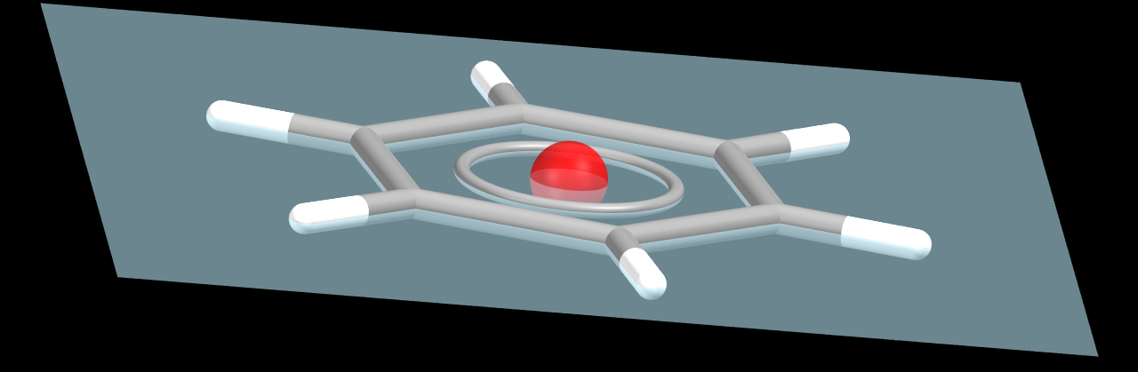
Geometric parameters for description of stacking
Calculated by PLATON:
β
Cg∙∙∙Cg
CgI_perp
α
∙
offset
Offset = Cg∙∙∙Cg∙sin(β)

Slide 19
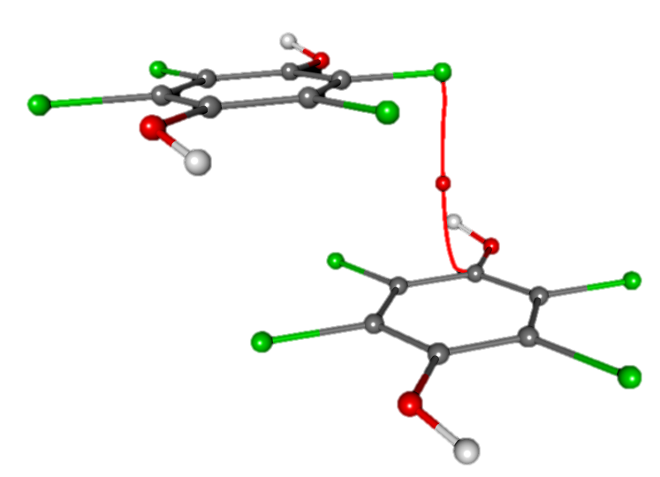
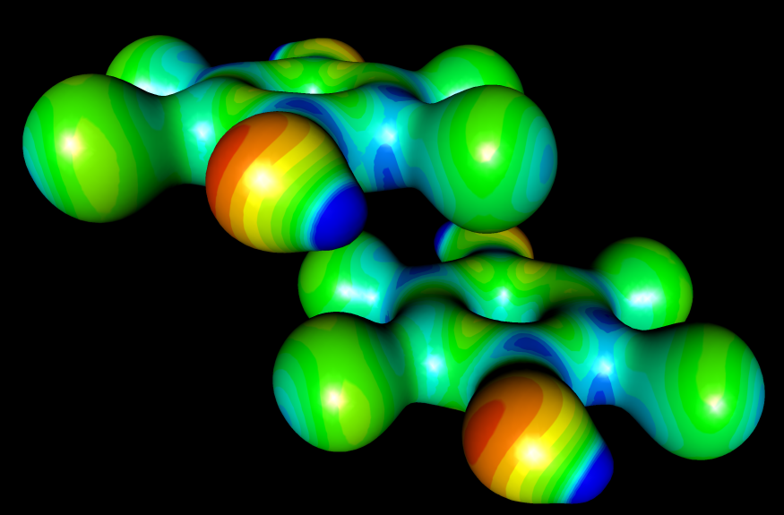
Aromatic rings:
tetrachlorohydroquinone
ρ_{max} = 0.034 e Å⁻¹
3.55 Å
3.50 Å
Cg…Cg = 4.7740(9) Å
CgI_perp = 3.3957(2) Å
α = 0.00(2)°
β = 44.7°
Offset = 3.356 Å

Slide 20
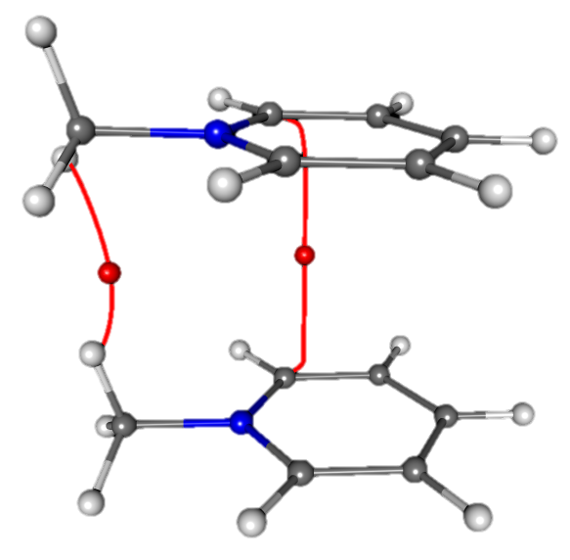
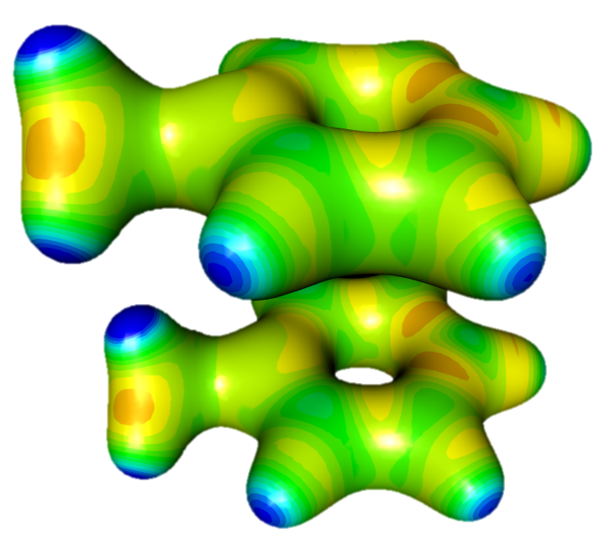
Heteroaromatic rings:
N-methylpyridinium cations
ρ_{max} = 0.018 e Å⁻¹
Cg…Cg = 3.776(2) Å
CgI_perp = 3.766(2) Å
α = 0°
β = 4.2°
Offset = 0.279 Å

Slide 21
Types of planar conjugated rings
aromatic
quinoid
semiquinoid
metal chelates

Slide 22
More planar conjugated rings

Slide 23
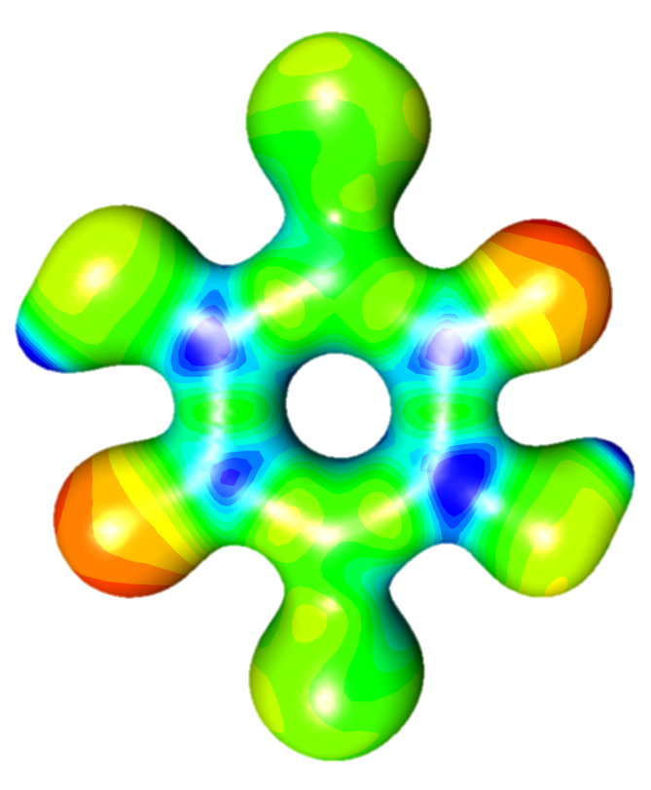
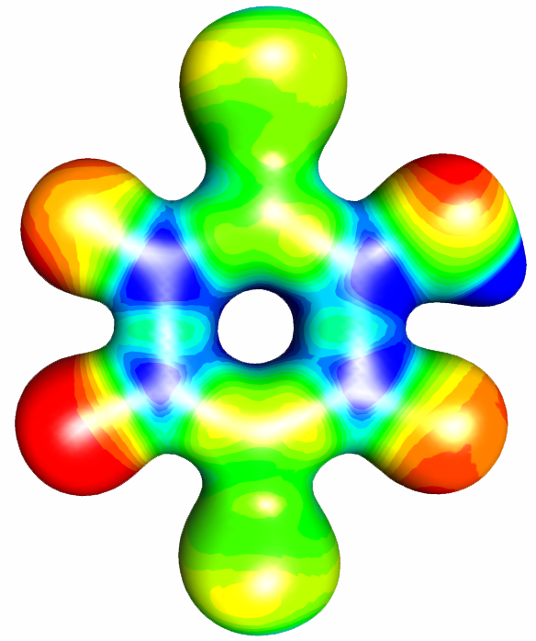
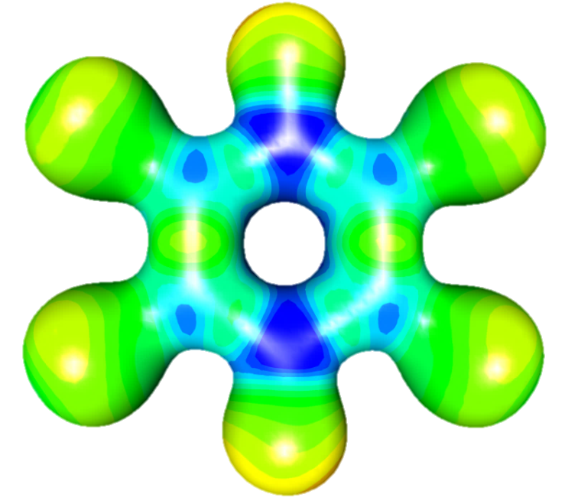
Quinoid rings: no more quadrupoles

Slide 24
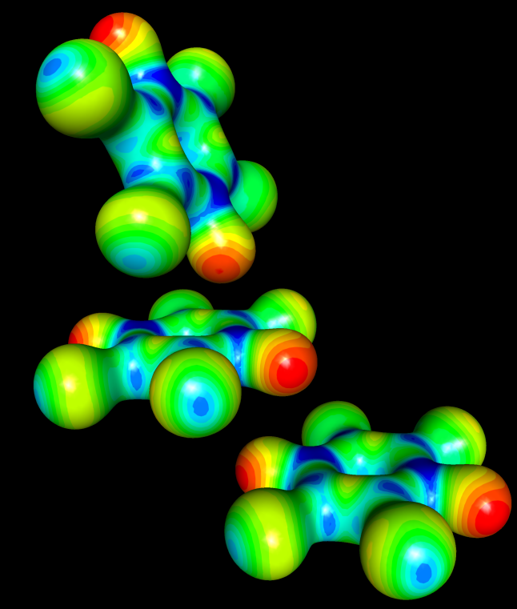
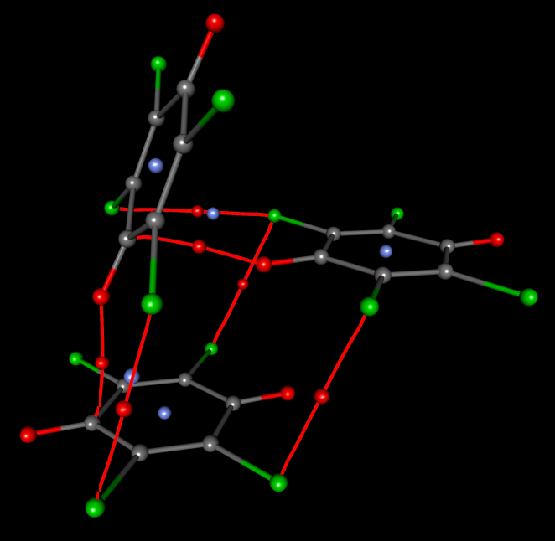
Netural quinones: tetrachloroquinone
α = 68°
2.77 Å
ρ_{max} = 0.042 e Å⁻¹
3.13 Å
Cg…Cg = 5.66 Å
CgI_perp = 3.17 Å
α = 0°
ρ_{max} = 0.080 e Å⁻¹

Slide 25
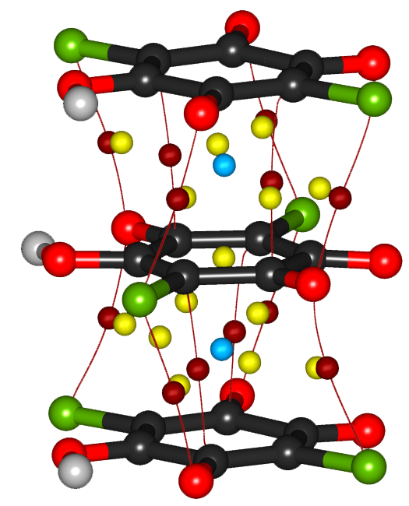
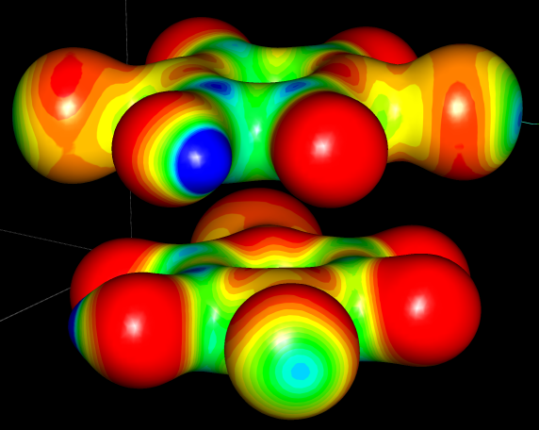
Quinone anions: hydrogenchloranilate
3.229(2) Å
ρ_{max} = 0.059 e Å⁻¹
E > 10 – 15 kcal mol⁻¹
Molčanov, Jelsch et al., CrystEngComm, 2015, 17, 8645.

Slide 26
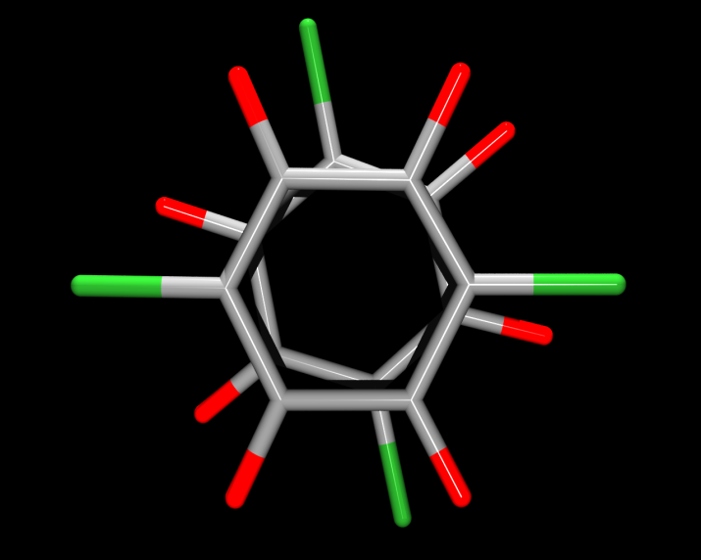
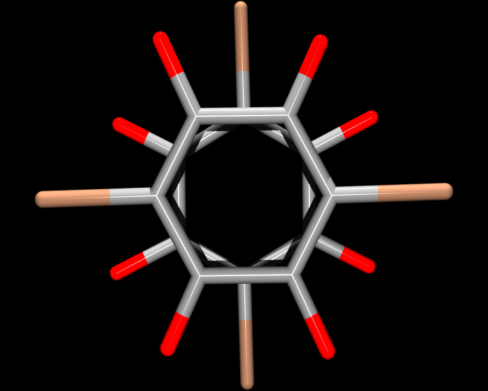
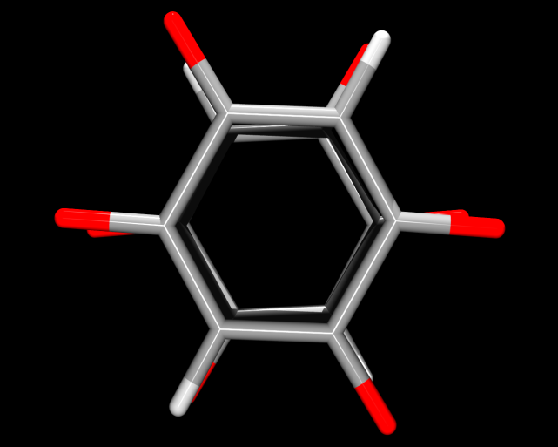
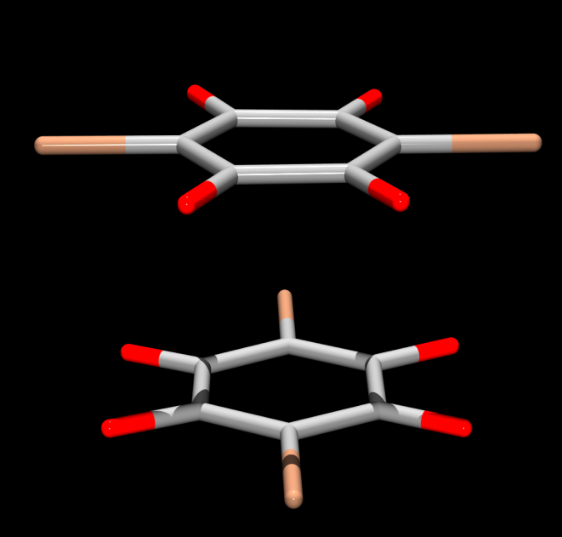
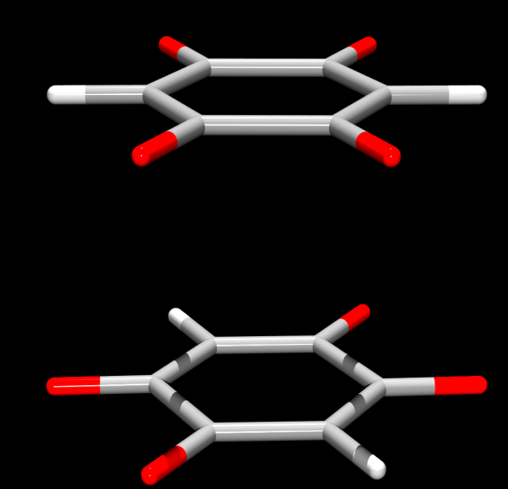
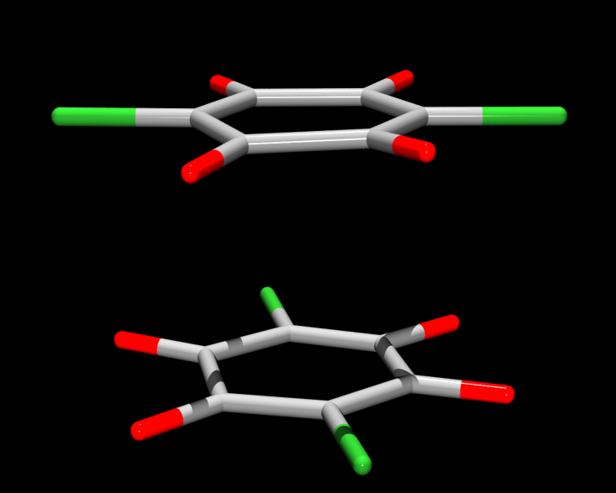
Effect of substituents
DHQ²⁻
HCA⁻
HBA⁻
Molčanov, Kojić-Prodić, Babić, Stare,CrystEngComm, 2013, 15, 135-143.

Slide 27
Semiquinone radicals
..
X = Cl :
Cl₄Q
X = Br :
Br₄Q
X = Cl, CN :
DDQ
X = F :
F₄Q

Slide 28
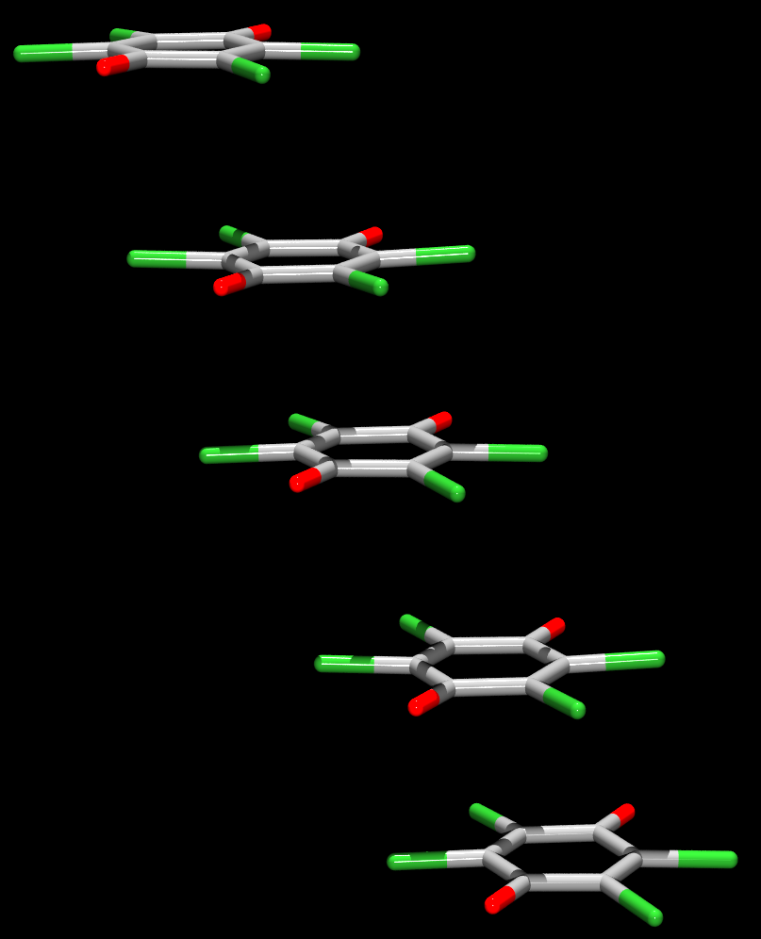
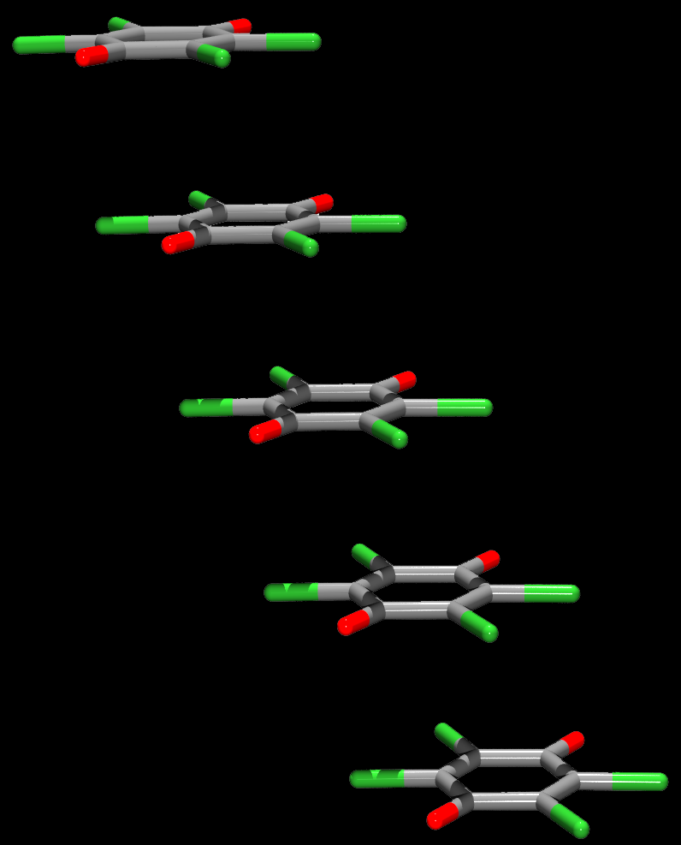
Stacking of semiquinone radicals: spin coupling
200 K
Antiferromagnetic
3.46 Å
3.58 Å
3.27 Å
3.46 Å
Reversible!
Single crystal
to
Single crystal
3.58 Å
3.46 Å
100 K
Diamagnetic
3.27 Å
3.46 Å
CrystEngComm, 2012, 14, 7958-7964.

Slide 29
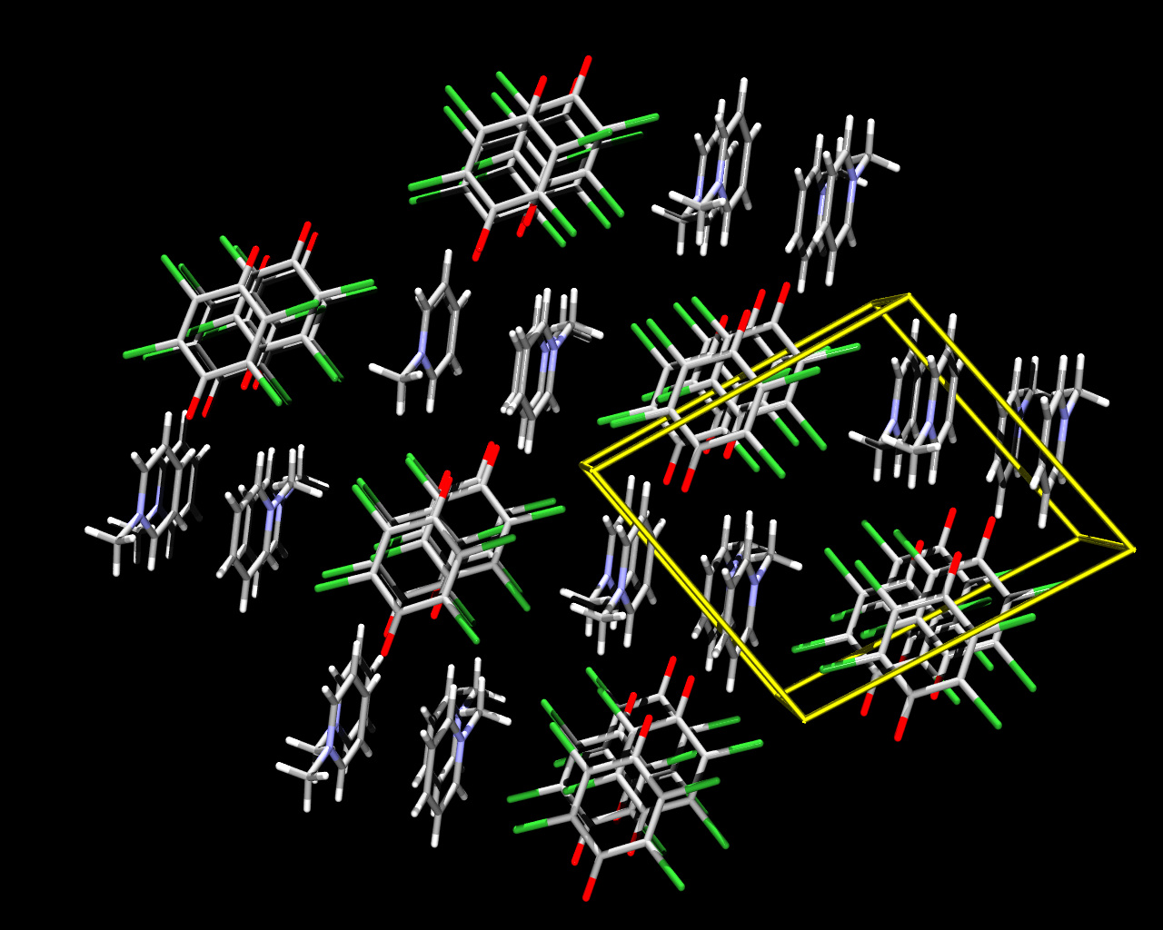
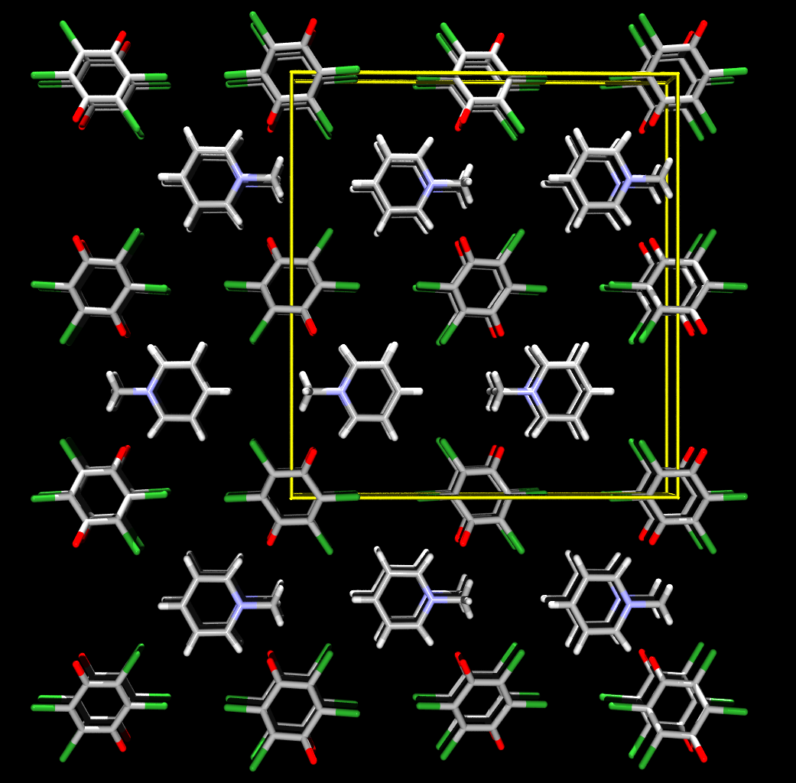
Two polymorphs of N-MePy∙Cl₄Q
triclinic
orthorhombic
b
b
0
0
a
a
c
c
Molčanov, Stilinović, Šantić, Maltar-Strmečki, Pajić, Kojić-Prodić, Cryst. Growth Des., 2016, 16, 4777-4782.

Slide 30
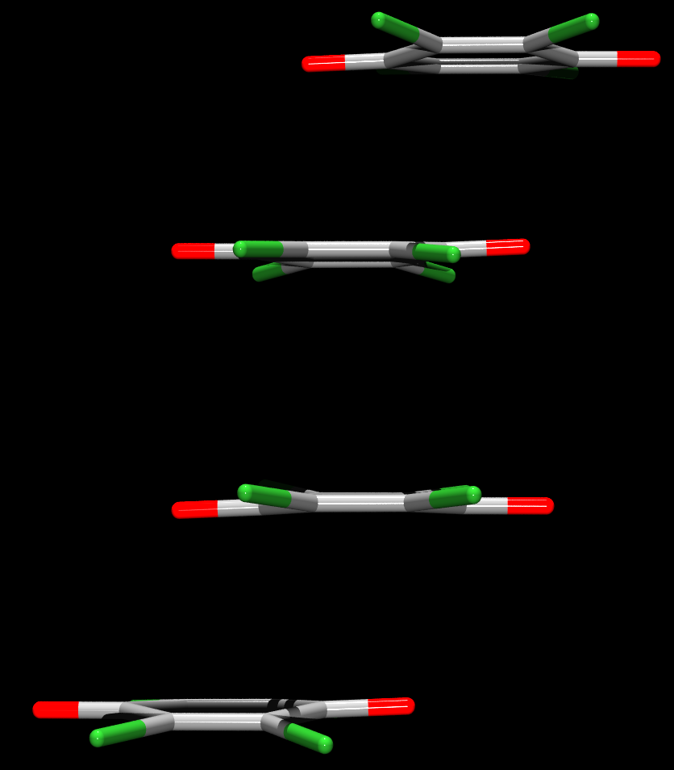
N-MePy·Cl₄Q, triclinic
2.903(1) Å
3.663(1) Å
Peierls-type deformation
Dimers with coupled spins
Diamagnetic
2.903(1) Å
Cryst. Growth Des., 2016, 16, 4777-4782.

Slide 31
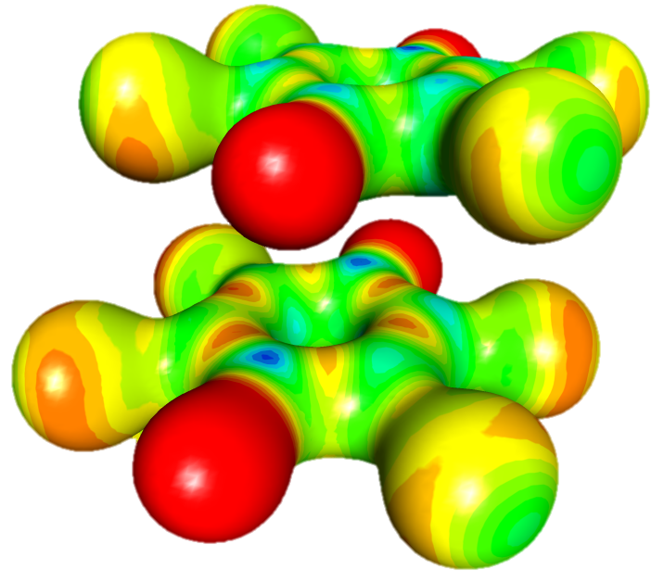
Interactions between the rings
(diamagnet, dimer)
2.90 Å
Offset: 2.07 Å
0.5 e Å⁻³

Slide 32
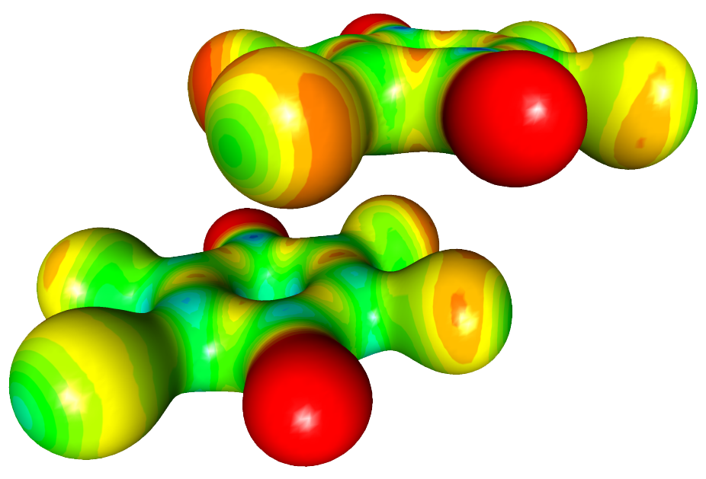
Interactions between the rings
(diamagnet, between dimers)
3.66 Å
Offset: 2.8 Å
0.5 e Å⁻³

Slide 33
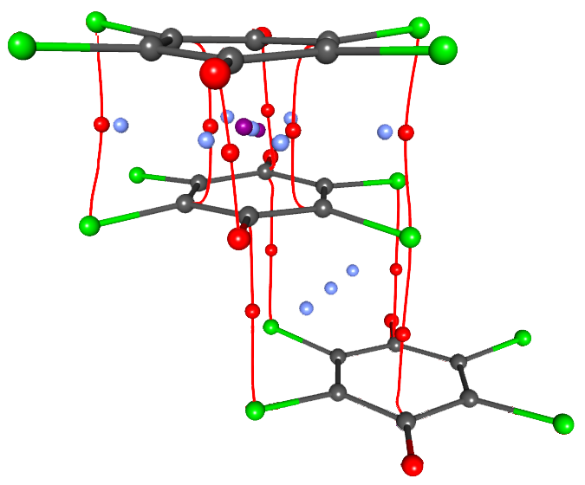
Critical points (diamagnet)
ρ_{max} > 0.095 e Å⁻³
2.90 Å
ρ_{max} < 0.040 e Å⁻³
3.66 Å
(3, -1) bond
(3, +1) ring cenroid
(3, +3) cage centroid

Slide 34
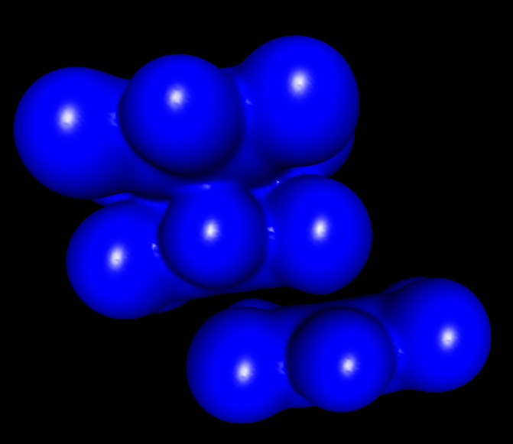
Interactions between the rings
(diamagnet)
2.90 Å
3.66 Å
0.05 e Å⁻³

Slide 35
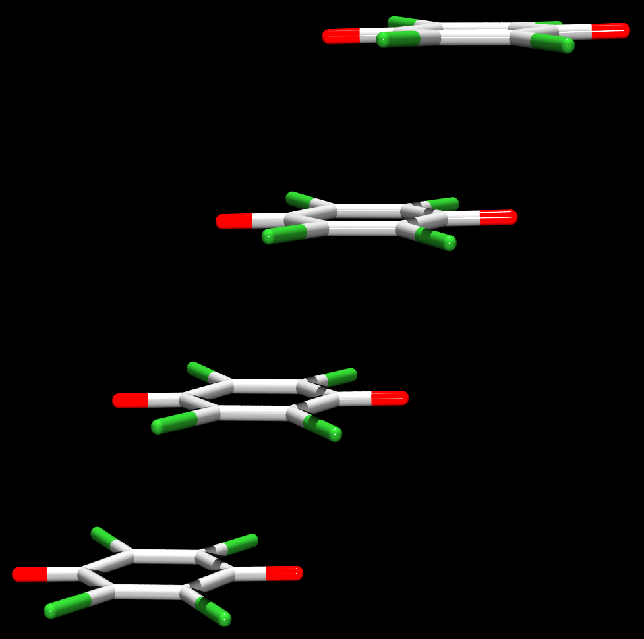
N-MePy·Cl₄Q, orthorhombic
3.283(1) Å
1D antiferromagnetic coupling in a stack
Semiconductor:
σ ≈ 10⁻⁶ (Ω cm)⁻¹
E_{DC} ≈ 0.34 eV
3.283(1) Å
3.283(1) Å
Cryst. Growth Des., 2016, 16, 4777-4782.

Slide 36
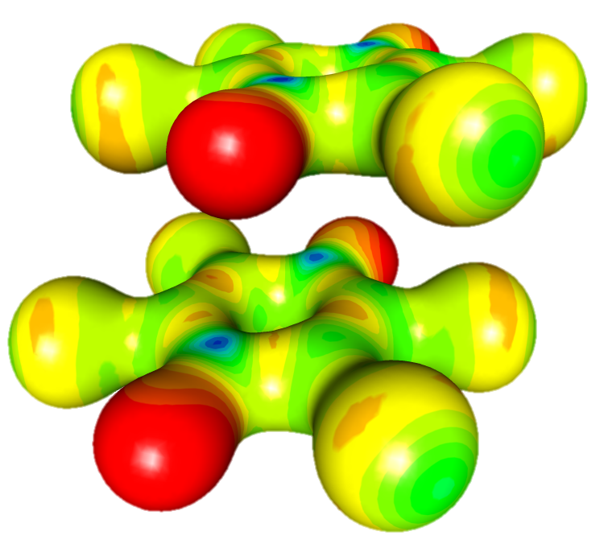
Interactions between the rings
(antiferromagnet)
3.28 Å
Offset: 2.06 Å
0.5 e Å⁻³

Slide 37

Critical points (antiferromagnet)
ρ_{max} < 0.050 e Å⁻³
3.28 Å
(3, -1) bond
(3, +1) ring cenroid
(3, +3) cage centroid

Slide 38
Stacking geometry: dimer vs. equdistant stack
dimer
equidistant
2.90 Å
3.28 Å
Offset: 2.07 Å
Offset: 2.06 Å

Slide 39
Conductivity?
Isolator
Semiconductor
e⁻
e⁻
2.90 Å
3.28 Å
e⁻
huge ΔE
3.66 Å
3.28 Å
e⁻
e⁻
2.90 Å
3.28 Å
ΔE = 0.34 eV

Slide 40

Electric conductivity
Stacking direction
1 mm
Band gap, activation energy:
Possible electron „jumping” between the radicals
Energy barrier for the „jumping”
Possible application?

Slide 41
Electric conductivity
vs. interplanar distance (100 K)
Cl₄Q∙N-MePy
Br₄Q∙N-MePy
DDQ∙N-Me2Pic
3.2855(16) Å
3.1587(13) Å
3.122(3) Å

Slide 42



Inductive effect of the substituents
Br₄Q
Cl₄Q
DDQ
LUMO
LUMO
LUMO
ΔE
ΔE
ΔE
HOMO
HOMO
HOMO

Slide 43


Direction of the offset
Longitudinal offset
Transversal offset
RbDDQ·2H₂O
CsDDQ·2H₂O
LiDDQ·2H₂O·MeCOEt
Molčanov, Babić, Kojić-Prodić, Stare, Maltar-Strmečki,
Androš Dubraja, Acta Cryst B., 2014, 70, 181-190.

Slide 44


Orientation of the stacked rings
ΔE ≈ 2.4 kJ mol⁻¹
Antiparallel
NaDDQ∙2H₂O∙MeCOEt
Diamagnetic, isolator
Parallel
KDDQ∙H₂O
Antiferromagnetic,
semiconductor
Acta Cryst B., 2014, 70, 181-190; CrystEngComm, 2017, 19, 1801-1808.

Slide 45

Orientation of the stacked rings
CsDDQ∙0.25H₂O
Diamagnetic, isolator
gauche
Antiparallel
gauche
Antiparallel
Molčanov & Kojić-Prodić, CrystEngComm, 2017, 19, 1801-1808.

Slide 46

Geometric parameters for description of stacking
Additional parameters for quinoid rings:
δ
∙
ε
Molčanov & Kojić-Prodić, CrystEngComm, 2017, 19, 1801-1808.

Slide 47

Charge-transfer complexes
TTF∙Cl₄Q
δ–
δ⁺
A classical
example
δ–
e⁻
δ⁺
δ–
≈ 3.60 Å
δ⁺
Mayerle, Torrance, Crowley, Acta Cryst. B, 1979, 35, 2988.
Lecomte et al., Faraday Discuss., 2007, 135, 271.

Slide 48

Charge-transfer complexes
[N-Me-4-(Me)₂NPy]₂(Cl₄Q)₃
2.84 Å
2.84 Å
1.32 Å
3.59 Å
≈1.76 Å

Slide 49
Charge-transfer complexes
[N-Me-4-(Me)₂NPy]₂(Cl₄Q)₃
–0,58
Charges derived from P_{val}:
+0.96
–0,76
–1.92
–0,58
+0.96
2–
1+
1+

Slide 50


Charge-transfer complexes
ρ_{max} < 0.045 e Å⁻³
3.59 Å
2.84 Å
ρ_{max} > 0.077 e Å⁻³

Slide 51

Metal-chelate rings: aromatic?
[Cu(CA)₂(H₂O)₂]Him₂
Jurić, Molčanov, Žilić, Kojić-Prodić, RSC Adv., 2016, 6, 62785-62796.

Slide 52



Metal-chelate rings: aromatic?
[Cu(CA)₂(H₂O)₂]Him₂

Slide 53

Metal-chelate rings: aromatic?
Laplacian of electron density
Cu-O bond critical points (3,-1):
Cu1-O1
ρ_{tot} = 0.3520 e Å⁻³
Laplacian = 6.29
Cu1-O2
ρ_{tot} = 0.3898 e Å⁻³
Laplacian = 7.08

Slide 54

Stacking of metal-chelate rings in [Cu(CA)(2,2’-bpy)]
c
b
0
a
Jurić, Molčanov, Kojić-Prodić, Dalton Trans., 2013, 42, 15756-15765.

Slide 55


Stacking of metal-chelate rings: chelate∙∙∙chelate, chelate∙∙∙aromatic and chelate∙∙∙quinone
Interplanar distance ≈ 3.28 Å
3.40 Å < Cg…Cg < 3.84 Å
α ≈ 2 °
Jurić, Molčanov, Kojić-Prodić, Dalton Trans., 2013, 42, 15756-15765.

Slide 56

Stacking of metal-chelate rings: electrostatic potential
Jurić, Molčanov, Kojić-Prodić, Dalton Trans., 2013, 42, 15756-15765.

Slide 57


Stacking of metal-chelate rings:
Voronoi-Dirichlet polyhedra
Jurić, Molčanov, Kojić-Prodić, Dalton Trans., 2013, 42, 15756-15765.

Slide 58

π-Stacking of the coordination polymers: [Cu(CA)(MeCN)]_{n}
3.26 Å
offset:
≈ 1.6 Å
Jurić, Molčanov, Žilić, Kojić-Prodić, RSC Adv., 2016, 6, 62785-62796.

Slide 59


π-Stacking of the coordination polymers: [Cu(CA)(MeCN)]_{n}
Jurić, Molčanov, Žilić, Kojić-Prodić, RSC Adv., 2016, 6, 62785-62796.

Slide 60

Stacking or bonding?
[Cu(CA)(1,10’-phen)]
c
2.574(2) Å
0
b
≈ 3.2 Å
a
Jurić, Molčanov, Kojić-Prodić, Dalton Trans., 2014, 43, 7208-7218.

Slide 61

Stacking or bonding?
[Cu(CA)(1,10’-phen)]
Jurić, Molčanov, Kojić-Prodić, Dalton Trans., 2014, 43, 7208-7218.

Slide 62

Cooperative stacking?
3.88 Å

Slide 63



Anion∙∙∙π interactions?
…with a partial charge transfer!
e⁻
Br₄Q
70 – 80°
3.54 – 3.94 Å
offset ≈ 1 Å
N-Me-2-pic∙I∙Br₄Q

Slide 64


Anion∙∙∙π interactions?
electrostatic potential
Voronoi-Dirichlet
polyhedra

Slide 65
Conclusions
Closed-shell rings:
occur between all planar rings
dominantly electrostatic
stronger between rings with little or no π electron delocalisation
weak between fully delocalised systems
energy of interaction varies from < 1 kcal mol⁻¹ to > 15 kcal mol⁻¹
potential use in crystal engineering

Slide 66
Conclusions
2) Radicals:
energy of interaction exceeds 15 kcal mol⁻¹
dominant interaction is spin coupling (interplanar distance)
secondary: electrostatic (offset)
possible electron transfer between the rings: semiconductivity
magnetic properties can be tuned by tuning geometry of stacking

Slide 67


Acknowlegdements
Université de Lorraine
Christian Jelsch
Claude Lecomte
Emmanuel Wenger
RBI, Zagreb
Biserka Kojić-Prodić
Zoran Štefanić
Marijana Jurić
Lidija Androš Dubraja
Nadica Maltar-Strmečki
Ana Šantić
Dijana Žilić
Darko Babić
Valentina Milašinović
Lidija Kanižaj
University of Ljubljana
Anton Meden
University of Zagreb
Vladimir Stilinović
Damir Pajić
Nikolina Novosel
Krešo Zadro
Mario Cetina
KI, Ljubljana
Jernej Stare
Gregor Mali
Dušan Hadži
Jože Grdadolnik
Rigaku Oxford Diffraction Ltd.
Marcus Winter
Dyanne Cruikshank
Croatian Science Foundation, grant no. IP-2014-09-4079
Croatian Academy of Sciences and Arts
French-Croatian bilateral, Slovenian-Croatian bilateral
Croatian Association of Crystallographers

