Slide 1
INSTITUTE OF SOCIAL SCIENCES IVO PILAR CROATIAN CENTER OF SCIENTIFIC EXCELLENCE
IN SCHOOL EFFECTIVENESS AND MANAGEMENT RESEARCH
Low-Performing STEM students in Croatian primary schools: The possible gains of JOBSTEM project in improving students STEM performance
Josip Burušić¹, Toni Babarović ¹, Mara Šimunović ¹
¹ Ivo Pilar Institute of Social Sciences, Zagreb, Croatia
Funding source: Croatian Science Foundation, grant n° JOBSTEM HRZZ IP-09-2014-9250

Slide 2
JOBSTEM PROJECT: STEM career aspirations during primary schooling: A cohort-sequential longitudinal study of relations between achievement, self-competence beliefs, and career interests
Brings together researchers from:
Croatia
Institute of Social Sciences Ivo Pilar
University of Split, Faculty of Philosophy
University of Zagreb, Faculty of Electrical Engineering and Computing
University of Zagreb, Faculty of Teacher Education
France
Université de Poitiers
Hungary
Central European University
United States
University of California Irvine

Slide 3
The JOBSTEM project: Three main research goals
To examine how students’ general and specific STEM career aspirations form and how they change over time
To examine how students’ school achievement and self-competence beliefs relate to students’ general and specific STEM vocational preferences and the dynamics of these relations during primary school
To examine how students’ general and specific STEM career aspirations are shaped by their families and gender

Slide 4
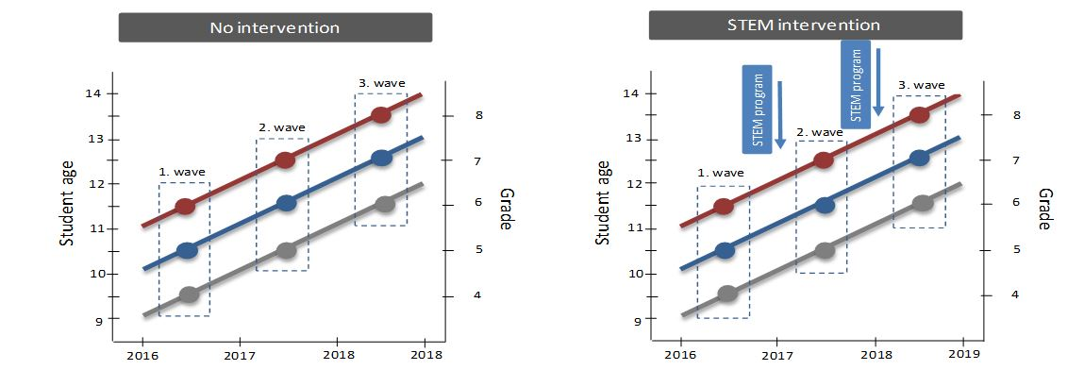
The longitudinal-sequential design of the study with a two-group pre- and post-test randomized experiment

Slide 5
Participants
Three cohorts of primary school students in three waves during three consecutive years

Slide 6
This study - Background
Achievement in STEM school subjects in primary school determines high school opportunities and choices. High school choice further influences access to postsecondary and professional opportunities in STEM fields.
However, research in STEM achievement has generally focused on the high school years (Singh, Granville, & Dika, 2002).
Furthermore, historically, research has focused on cognitive factors as determinants of STEM learning and achievement. However, IQ accounts for about 25% of the variance in school achievement (Lau & Roeser, 2002). → Other factors are important!
Social-cognitive models of achievement motivation emphasize beliefs, achievement values, goals, and interests as major influences on person’s achievement (Wigfield & Cambria, 2010).

Slide 7
This study - Background
Self-concept of ability and value are constructs that are connected to various motivational theories. Empirical findings confirm these constructs are important predictors of participation and performance in different domains (Simpkins, Fredricks, & Eccles, 2014).
Furthermore, interest in academic domains is particularly important for long-term outcomes such as educational and career choices (Hulleman & Harackiewicz, 2009).
Children’s everyday activities also play a role in explaining differences in STEM achievement. Research have shown that STEM out-of-school activities are positively associated with children’s interest in science and self-concept of abilities in these domains (Dickhauser & Stiensmeier-Pelster, 2002).
Research questions: How low-STEM performing primary school students differ from high-performing students in relation to various motivational and behavioral factors? Do these differences emerge across the entire STEM school domain?

Slide 8
Methods

Slide 9
Respondents
1920 primary school students (age 10 – 12; 4th to 6th grade), from 16 primary schools in Zagreb and its surroundings participated in the study
Equally represented by gender and grade
Assessment
Paper and pencil method
Group assessment, in the classes during the regular school activities
Data collection lasted 45 minutes

Slide 10
Measures
In the Croatian school system and school curriculum the STEM area is covered by the following school subjects, depending on the grade:
Mathematics
Nature
Informatics Subjects taught in participants’ grades
Technical education
Geography
Biology
Chemistry
Physics

Slide 11
Measures
STEM achievement
Total score on the objective integrated STEM achievement test (TR = 0 - 20)
Self-concept of ability in STEM
e.g.: “How good are you at math? ”/1=not very good, 7=very good/
Importance value of STEM school subjects
Attainment component e.g.: „Compared to other activities, how important is it to you to be good at math?”/1 = unimportant, 7 = important)/
Utility component e.g.: „How useful is what you learn in nature?”/ 1 = not useful as the things I learn in other subjects, 7 = much more useful than the things I learn in other subjects/

Slide 12
Measures
Interest in STEM school subjects
e.g.: „How interesting do you find informatics?” /1 = I don't find it interesting at all, 5 = I find it very interesting/
Interest in STEM professional careers
e.g.: „How much would you like to work as a biologist?”/1 = I wouldn’t like it at all, 5 = I would like it very much/
Participation in STEM-related activities e.g.: „How often do you read a book or magazine about science?”/ 1 = almost never, 5 = very often/
→ Items are derived from Jacqueline Eccles headed longitudinal “The Childhood And Beyond (CAB)” research project, and from the ASPIRES research project (DeWitt et al., 2013)

Slide 13
Results

Slide 14
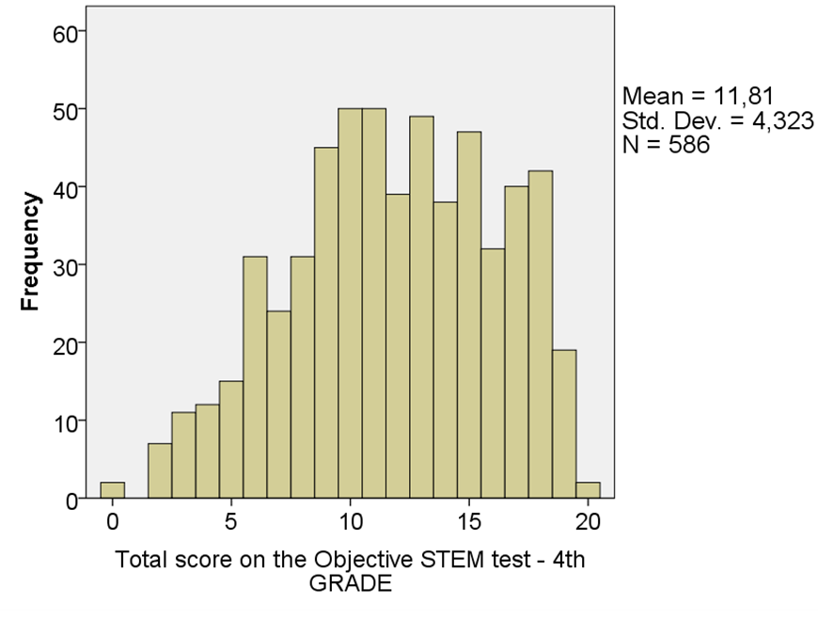
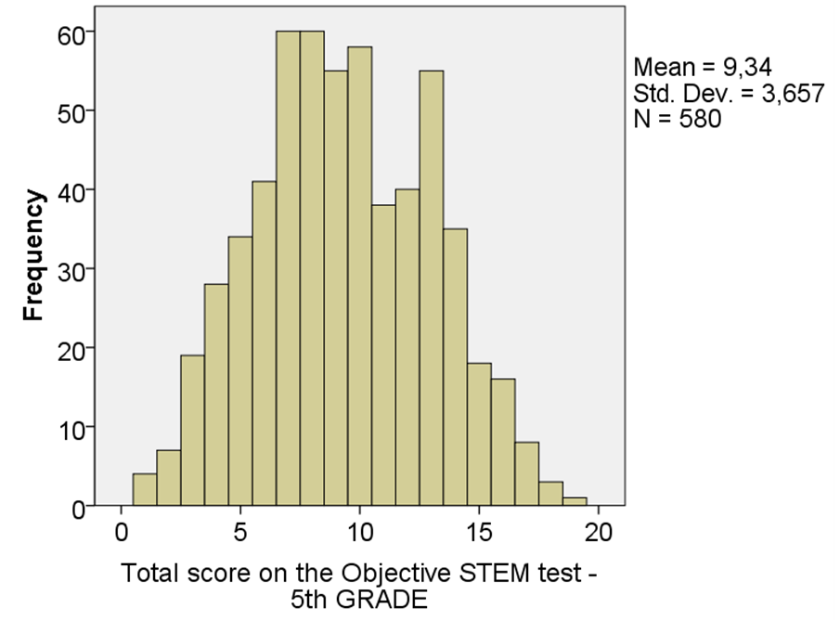
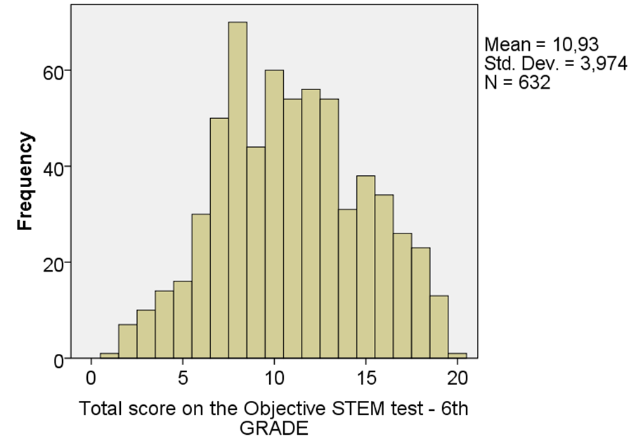
Results Objective test of STEM achievement
4th Grade 5th Grade 6th Grade
→ The distribution of test scores in all three tests were nearly normal; the distributions indicate good discriminating power of all three tests

Slide 15
Results Objective test of STEM achievement - Comparison groups
Students’ test scores were transformed into z-values, centered around corresponding grade mean
Z-scores for 4th, 5th , and 6th graders were combined into a single scale
Students who scored z > 1 (N = 319) and z < -1 (N = 272) were selected for comparisons to create a clear distinction between the groups and increase the chances of finding meaningful differences

Slide 16
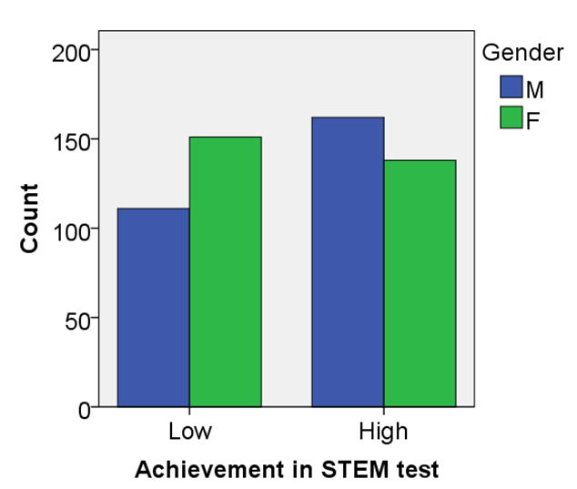
Results Differences between high and low-achievers
Gender
Phi value (Φ) = .12
→ small effect size
χ2 = 7.58; df = 1; p < 0.01

Slide 17
Results Self-concept of ability in STEM domains
e.g. „Compared to other subjects how good are you at ____?„
Table 1
Univariate results from MANOVA comparing self-concept of ability in STEM domain
** p < .001
 | Low achieving |  | High achieving
 | M | SD | M | SD | F | d
Math | 3.69 | 1.04 | 5.74 | 1.04 | 257.72** | 1.97
Nature | 4.66 | 1.21 | 5.48 | 1.00 | 36.02** | 0.74
Geography | 4.06 | 1.23 | 5.41 | 1.14 | 87.17** | 1.14
Technical education | 5.17 | 1.26 | 5.47 | 1.18 | 4.03
Informatics | 5.55 | 1.28 | 6.04 | 1.05 | 11.69** | 0.42
large effect size
large effect size

Slide 18
Results Importance value of STEM domains
e.g. „Compared to other subjects how useful is _____? „
Table 1
Univariate results from MANOVA comparing importance value of STEM domains
** p < .001
 | Low achieving |  | High achieving
 | M | SD | M | SD | F | d
Math | 5.19 | 1.08 | 5.76 | 1.00 | 21.31** | 0.55
Nature | 4.89 | 1.21 | 4.73 | 1.05 | 1.28
Geography | 4.83 | 1.19 | 5.15 | 0.99 | 5.65
Technical education | 4.49 | 1.38 | 4.30 | 1.20 | 1.42
Informatics | 5.36 | 1.27 | 5.57 | 1.10 | 2.07
medium effect size

Slide 19
Results Interest in STEM school subjects
e.g. „How interesting do you find _____?”
Table 2
Univariate results from MANOVA comparing interests in STEM school subjects
** p < .001; * p < 0.1 Unexpected result
 | Low achieving |  | High achieving
 | M | SD | M | SD | F | d
Math | 3.19 | 1.04 | 3.79 | 1.12 | 21.42** | 0.56
Nature | 3.91 | 1.00 | 3.73 | 1.17 | 1.99
Geography | 3.46 | 1.27 | 3.88 | 1.10 | 9.13* | 0.35
Technical education | 3.66 | 1.32 | 3.14 | 1.24 | 11.61** | 0.41
Informatics | 4.28 | 1.08 | 4.28 | 0.98 | 0.00

Slide 20
Results Interest in STEM professional careers
e.g. „How much would you like to work as a physicist?”
Table 4
Univariate results comparing interests in STEM professional careers
** p < .001 medium to large effect size
 | Low achieving |  | High achieving
 | M | SD | M | SD | t | d
 | 2.15 | 0.79 | 2.75 | 0.87 | -8.36** | 0.72

Slide 21
Results Participation in STEM-related activities
e.g. „How often in your spare time do you do science activities - e.g., science kits,nature walks, do experiments?„
Table 3
Univariate results comparing participation in STEM-related activities
** p < .001 small to medium effect size
 | Low achieving |  | High achieving
 | M | SD | M | SD | t | d
 | 2.44 | 0.77 | 2.77 | 0.81 | -4.84** | 0.42

Slide 22
Summarized Findings
Results indicate that when using objective STEM test as a measure of STEM achievement, girls perform slightly lower than boys
In comparison with the high - achievers, students in the low - achieving group:
had lower self-concept of ability in math, nature, geography, and informatics
perceived lower importance value for math
expressed lower interest for math and geography, but higher interest for technical education
showed lower interest in STEM professions
reported to participate less often in STEM out-of-school activities
The largest differences were recorded in students’ self-concept of ability in STEM subjects and students’ interests in STEM professional careers

Slide 23
Discussion and Implications
Differences in self-concept of ability in low and high-achievement groups are not consistent across STEM area → this confirms the multidimensionality of academic self-concept
Low achieving students differ the most from the high achieving in the math self-concept → Special attention in the classroom should be given to fostering low achieving students competence beliefs in math tasks
Interestingly, low achieving students perceive lower importance value only for math, but not for the other STEM subjects → Low achieving students need external support in perceiving relevance, usefulness and value in their math schoolwork. This may also lead to the improvement in their interest in math, since studies have shown that perceiving a topic to be useful and relevant predicts subsequent interest in a course (Hulleman, Durik, Schweigert, & Harackiewicz, 2008)

Slide 24
Discussion and Implications
Unexpected higher interest in technical education in low-achievers can be seen as an opportunity for the educators to motivate even less achieving students to persue careers in technical professions of the STEM domain
Quite large difference in the interest for STEM careers can in school context be addressed through increasing the attractiveness of STEM professions among lower achieving students, namely by building on the disciplines in which lower groups do not lack interest, i.e. ICT & technical domain
Low-achieving students participate less in STEM-related out-of-school activities → Fostering this involvement, especially in younger cohorts, can present a potential avenue for parents and educators to increase later choices in STEM domain, since longitudinal research confirmed the links between early STEM involvement – positive STEM-related beliefs – and consequently STEM choices (Simpkins, Davis-Kean, & Eccles, 2006).

Slide 25
Thank you! josip.burusic@pilar.hr
INSTITUTE OF SOCIAL SCIENCES IVO PILAR CROATIAN
CENTER OF SCIENTIFIC EXCELLENCE
IN SCHOOL EFFECTIVENESS AND MANAGEMENT RESEARCH Marulicev trg 19, HR - 10000 Zagreb, CROATIA
more info at
www.jobstem.eu

Slide 26
Literature
DeWitt, J., Osborne, J., Archer, L., Dillon, J., Willis, B., & Wong, B. (2013). Young children's aspirations in science: The unequivocal, the uncertain and the unthinkable. International Journal of Science Education, 35(6), 1037-1063.
Dickhauser, O., & Stiensmeier-Pelster, J. (2002). Gender differences in computer work: Evidence for the model of achievement-related choices. Contemporary Educational Psychology, 27, 486–496.
Hulleman, C. S., Durik, A. M., Schweigert, S. B., & Harackiewicz, J. M. (2008). Task values, achievement goals, and interest: An integrative analysis. Journal of Educational Psychology, 100(2), 398-416.
Hulleman, C. S., & Harackiewicz, J. M. (2009). Promoting interest and performance in high school science classes. Science, 326(5958), 1410-1412.
Lau, S., & Roeser, R. W. (2002). Cognitive abilities and motivational processes in high school students' situational engagement and achievement in science. Educational Assessment, 8(2), 139-162.
Singh, K., Granville, M., & Dika, S. (2002). Mathematics and science achievement: Effects of motivation, interest, and academic engagement. The Journal of Educational Research, 95(6), 323-332.
Simpkins, S.D., Davis-Kean, P.E., & Eccles, J.S. (2006). Math and science motivation: A longitudinal examination of links between choices and beliefs. Developmental Psychology, 42, 70–83.
Simpkins, S.D., Fredricks, J., & Eccles, J.S. (2012). Charting the Eccles' expectancy-value model from mothers' beliefs in childhood to youths' activities in adolescence. Developmental Psychology, 48(4), 1019-1032.
Wigfield, A., & Cambria, J. (2010). Students’ achievement values, goal orientations, and interest: Definitions, development, and relations to achievement outcomes. Developmental Review, 30(1), 1-35.

