Slide 1

Two-electron multicentric covalent bonding: how many centres?
Krešimir Molčanov, Biserka Kojić-Prodić, Vladimir Stilinović, Zhongyu Mou, Miklos Kertesz, Bruno Landeros-Rivera, Jesús Hernández-Trujillo

Slide 2
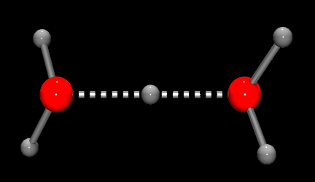
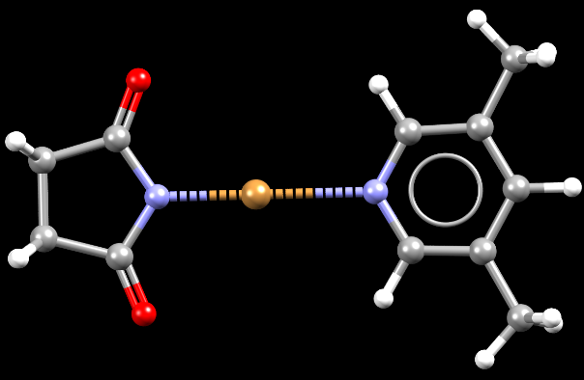
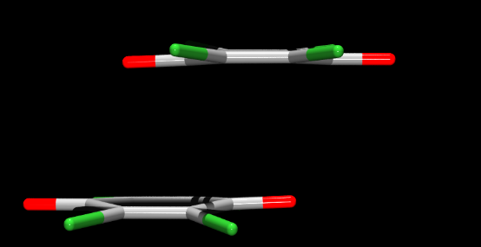
Three most important intermolecular interactions
Hydorgen bonding: short, strong HB O···H···O in the Zundel ion
Halogen bonding: Br atom shifted towards the acceptor in N-bromosuccinimide∙3,5-dimethylpyridine
π-stacking: strong interactions between semiquinone radical anions

Slide 3
Electron pairs: covalent bond
G. N. Lewis, 1916.
M. L. Huggins, 1919.
Latimer & Rodebush, 1920.

Slide 4

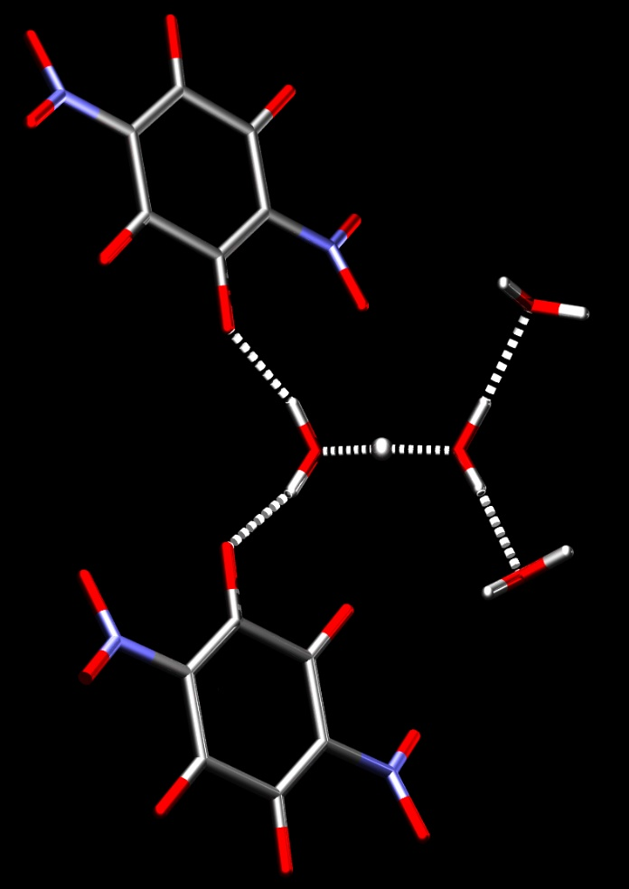
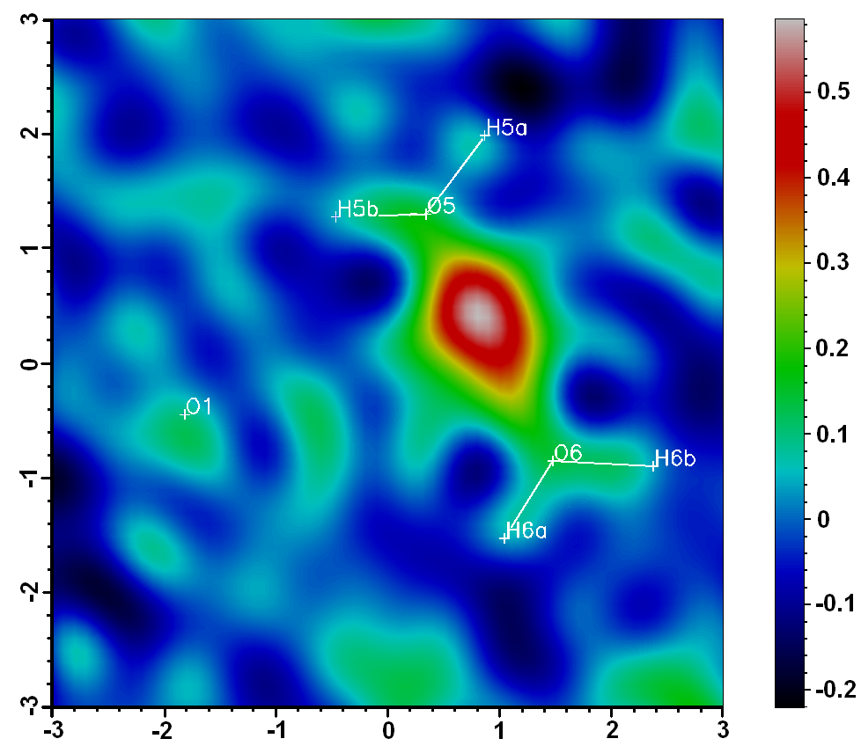
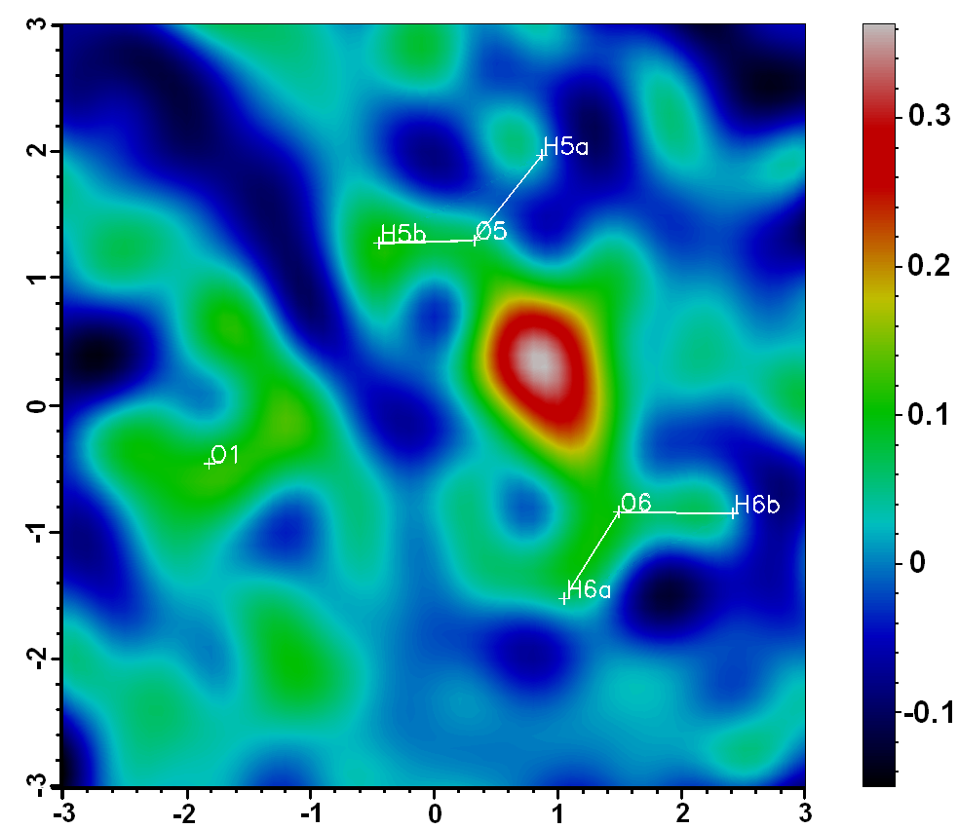
Zundel ion (H₅O₂⁺)
(Georg Zundel, 1968)
2.39 – 2.44 Å
100 K
293 K
Slo-Cro meeting, Pokljuka, 2012.
Phys. Chem. Chem. Phys., 2014, 16, 998-1007.

Slide 5
Single-well potential
Slo-Cro meeting, Pokljuka, 2012.
Phys. Chem. Chem. Phys., 2014, 16, 998-1007.

Slide 6
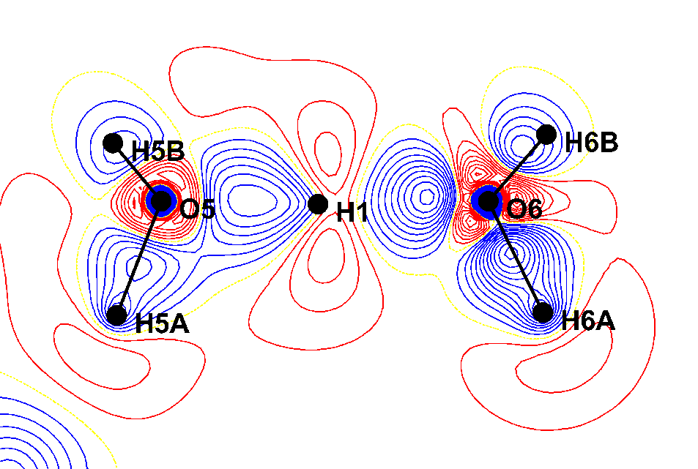
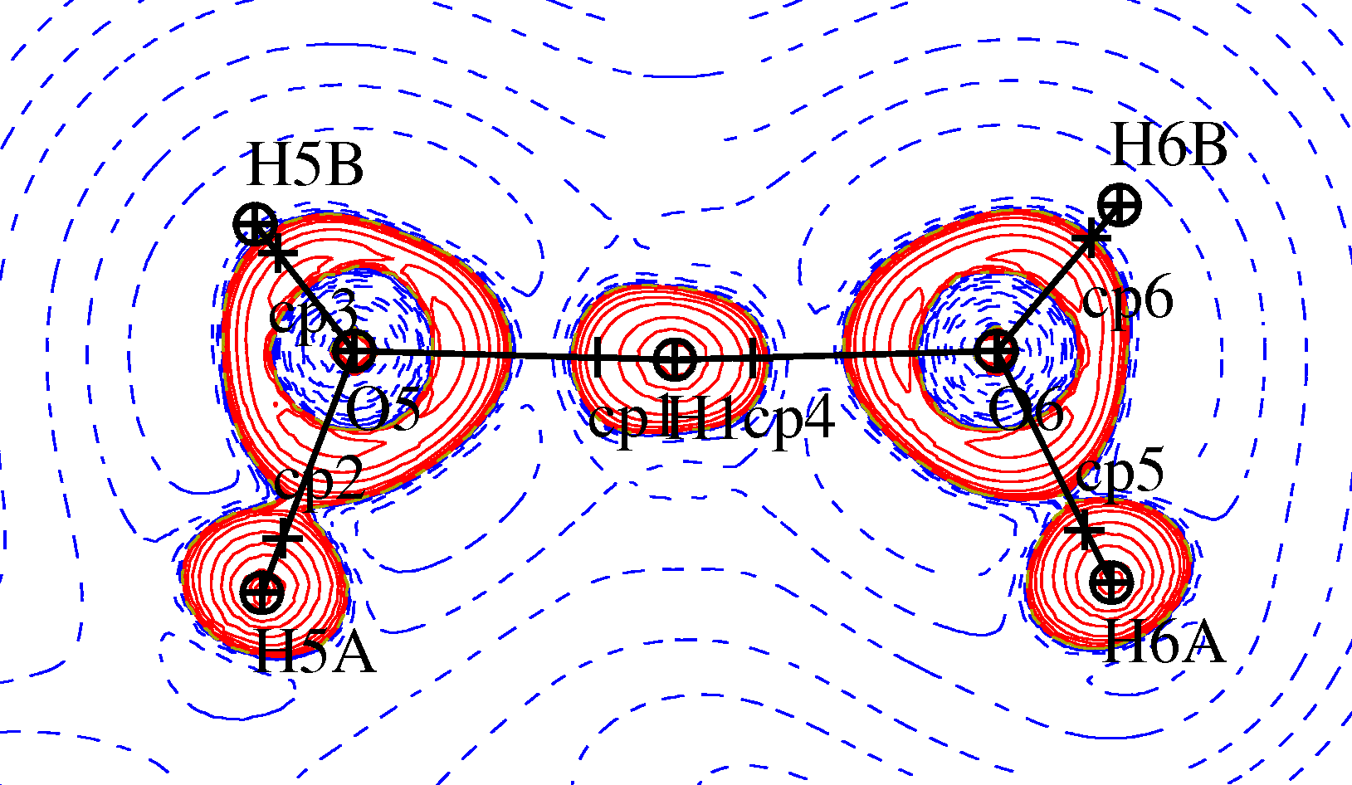
Charge density of the Zundel ion
 | ρ_{CP} (eÅ⁻³) | Laplacian (eÅ⁻³) | Bond order, n_{topo}
O5-H1 | 1.0890 | -11.45 | 0.310
O6-H1 | 0.9555 | -6.46 | 0.263
O5-H5A | 2.0785 | -25.42 | 0.473
H6A-O7^{i} | 0.2015 | 3.90 | 0.061
CrystEngComm, 2017, 19, 3898-3901.

Slide 7
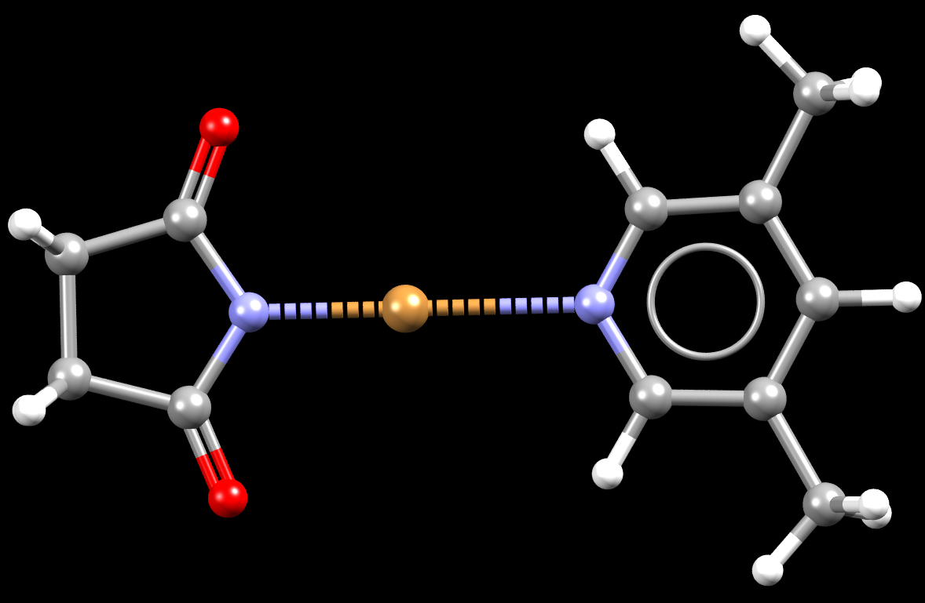
Halogen transfer in strong halogen bonds:
N-bromosuccinimide∙3,5-dimethylpyridine
C6
O1
C4
C2
C1
180°
C3
C5
N1
N2
1.932 Å
2.319 Å
N∙∙∙Br / Å
N-bs | 1.836
N-bs∙3,5-dmp „bond” | 1.932
N-bs∙3,5-dmp „contact” | 2.319
intermolecular N∙∙∙Br | > 3.12
sum of van der Waals radii | 3.40
}
Δ = 0.387 Å

Slide 8
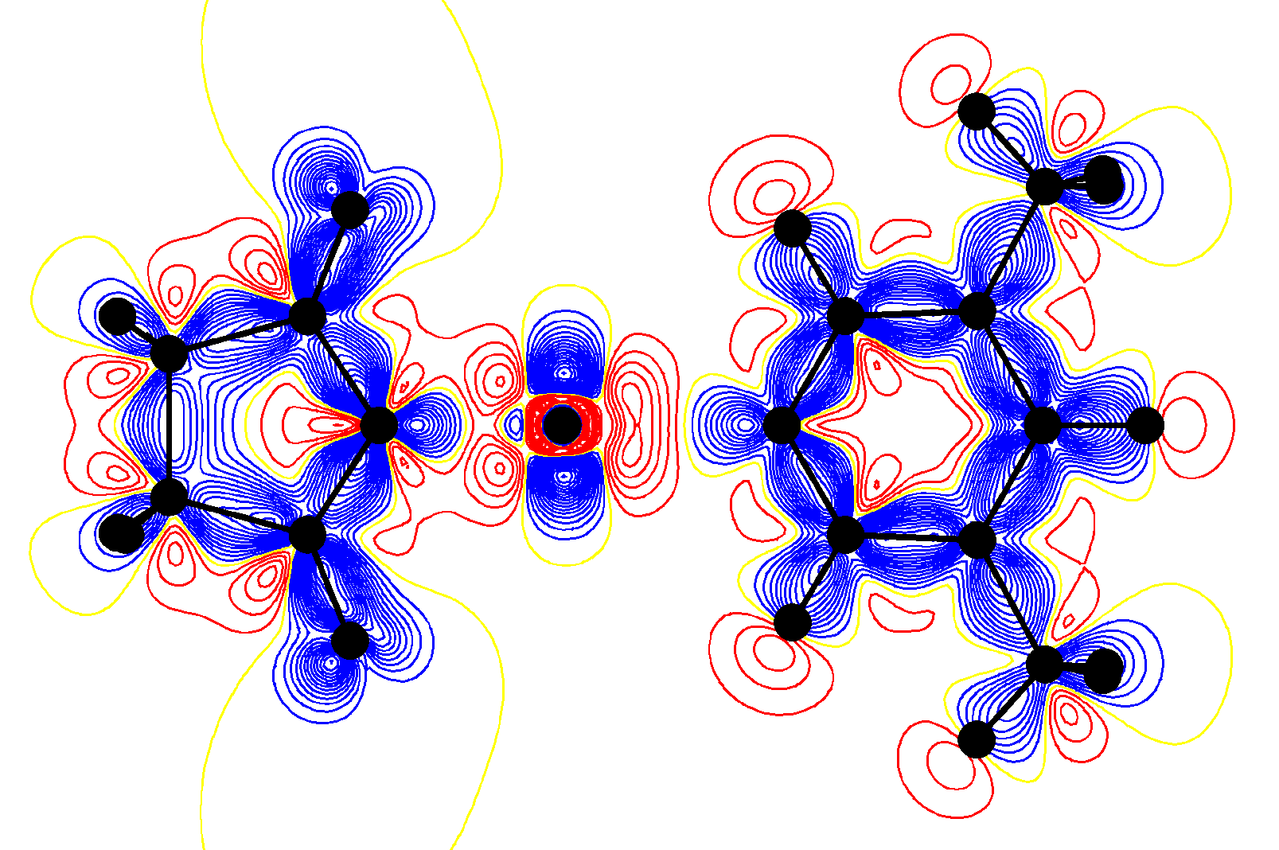
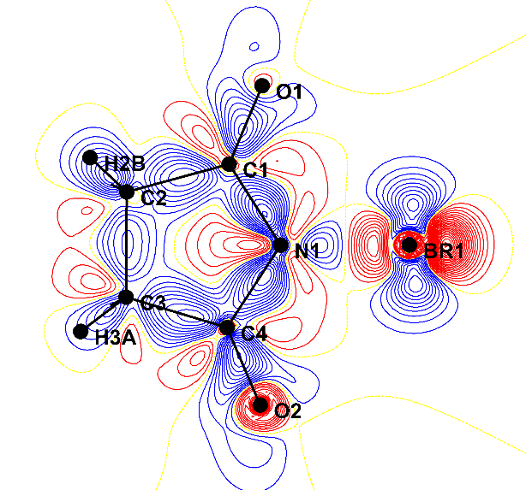
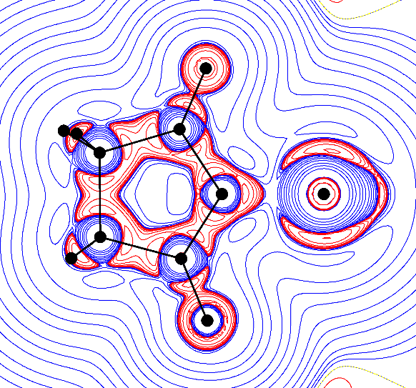
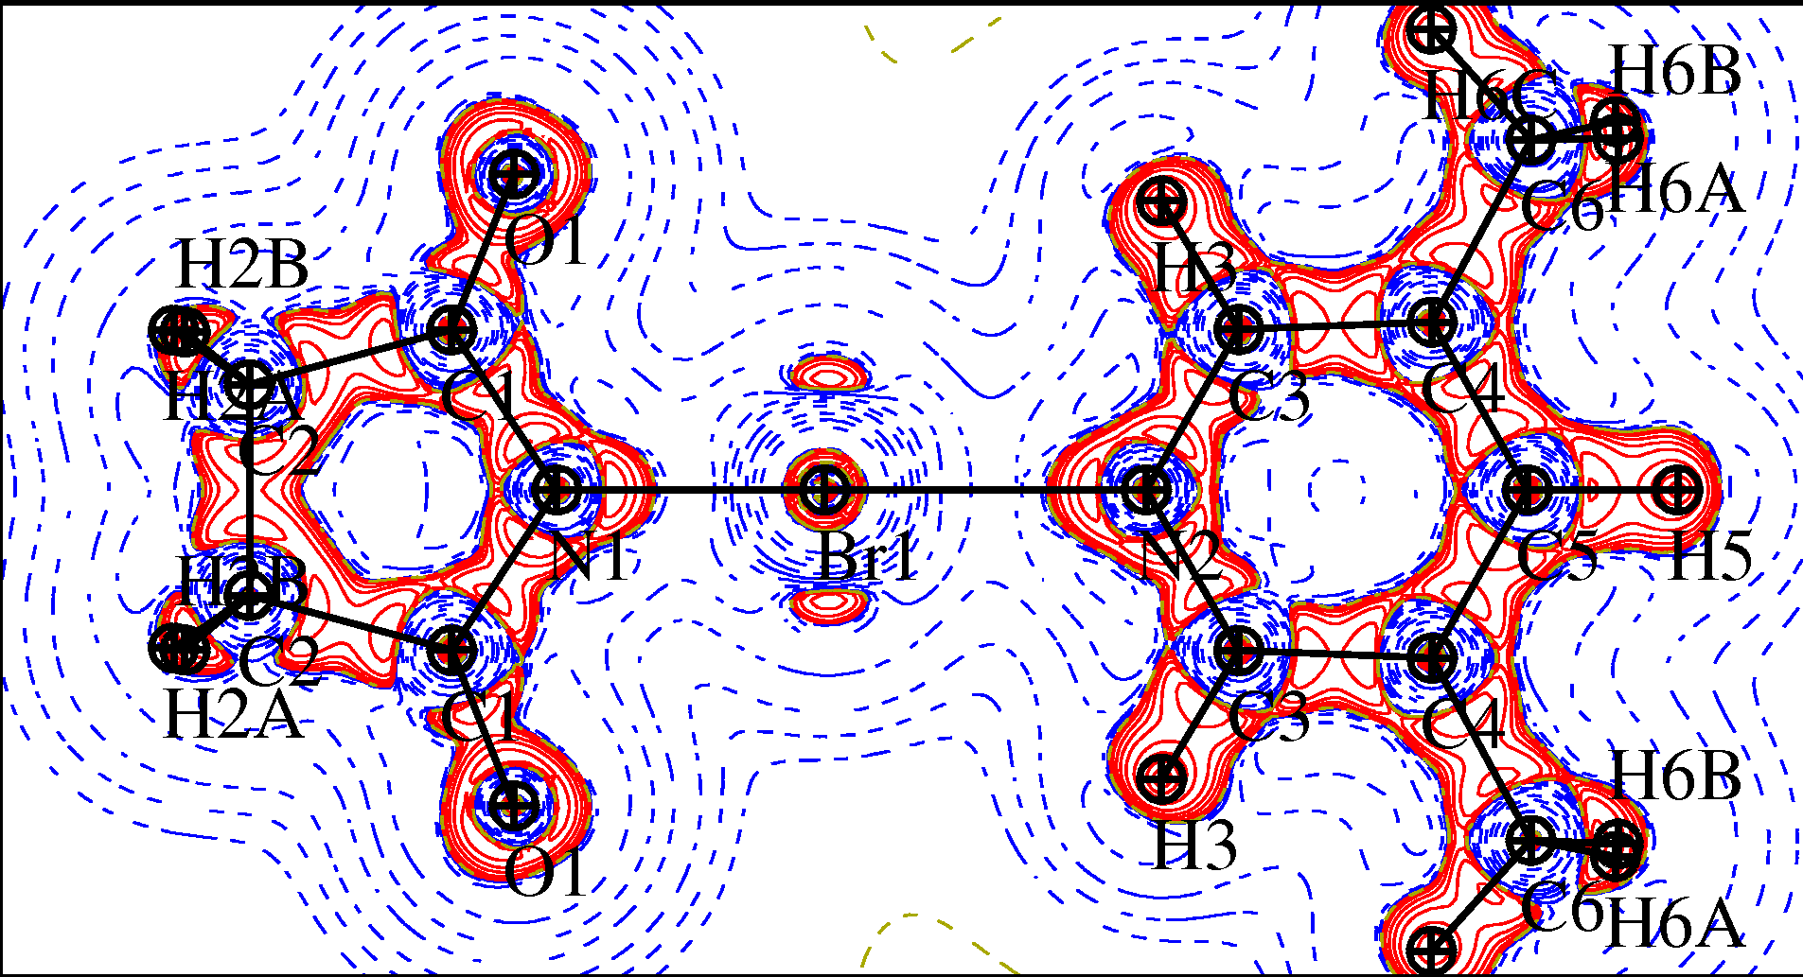
Charge densities:
N-bs
N-bs·3,5-dmp

Slide 9
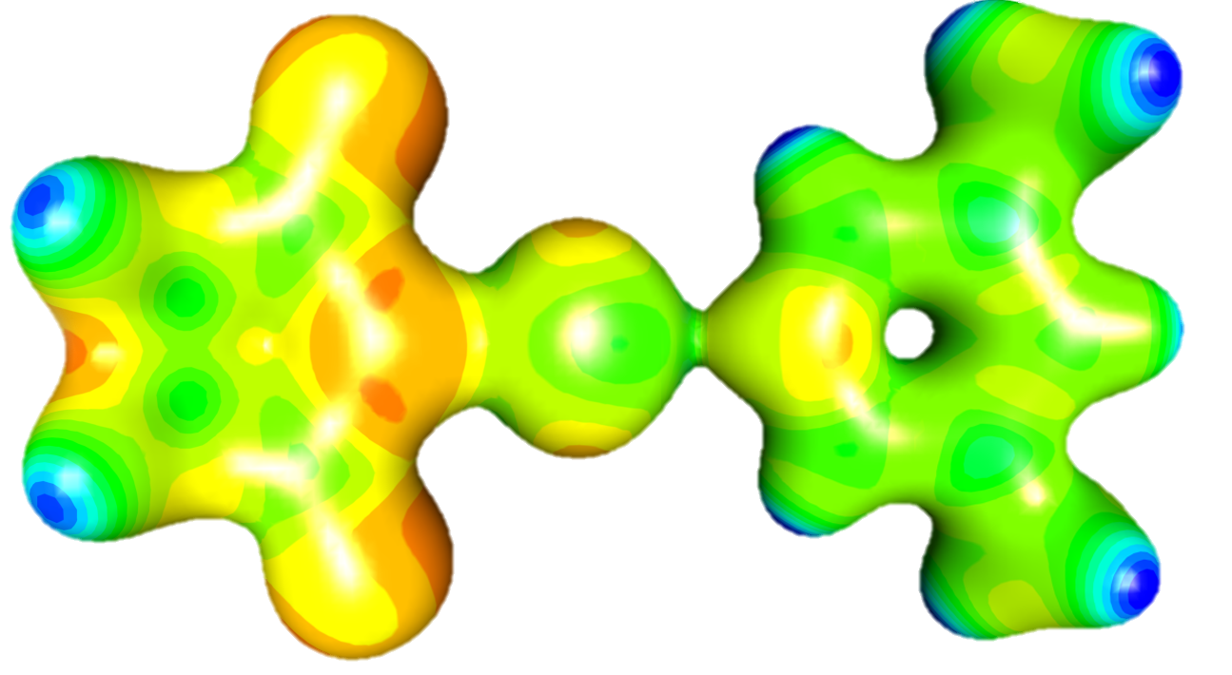
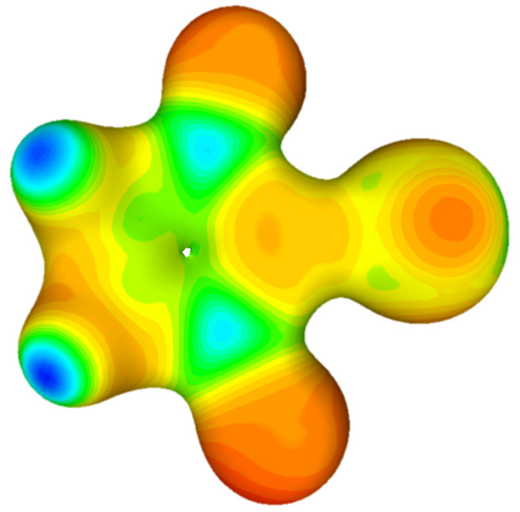
Electrostatic potential (electron density isosurface of 0.35 e Å⁻³)
N-bs·3,5-dmp
N-bs

Slide 10
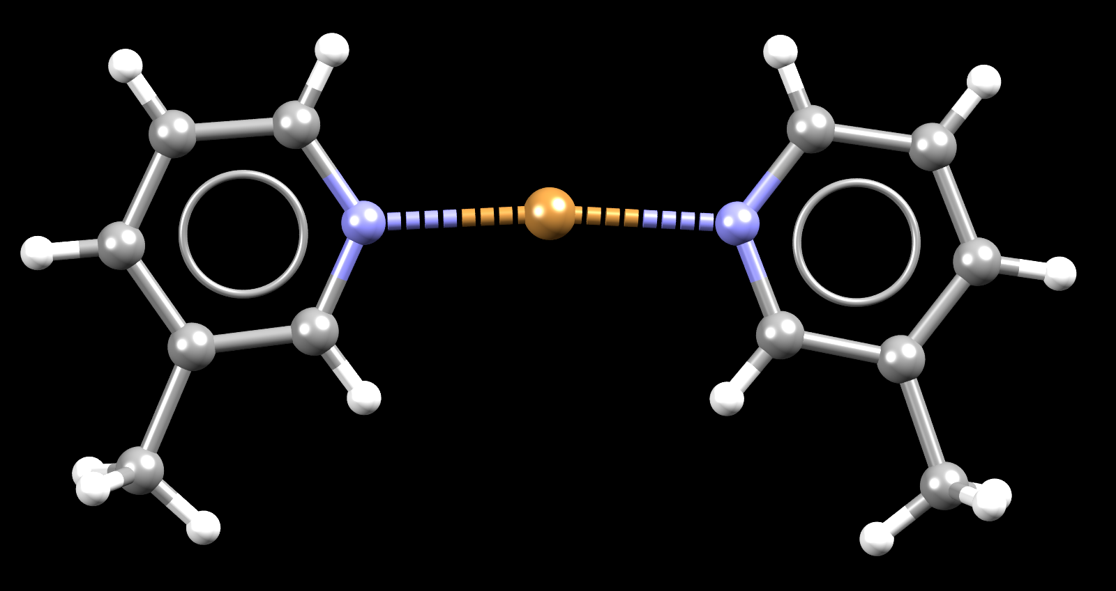
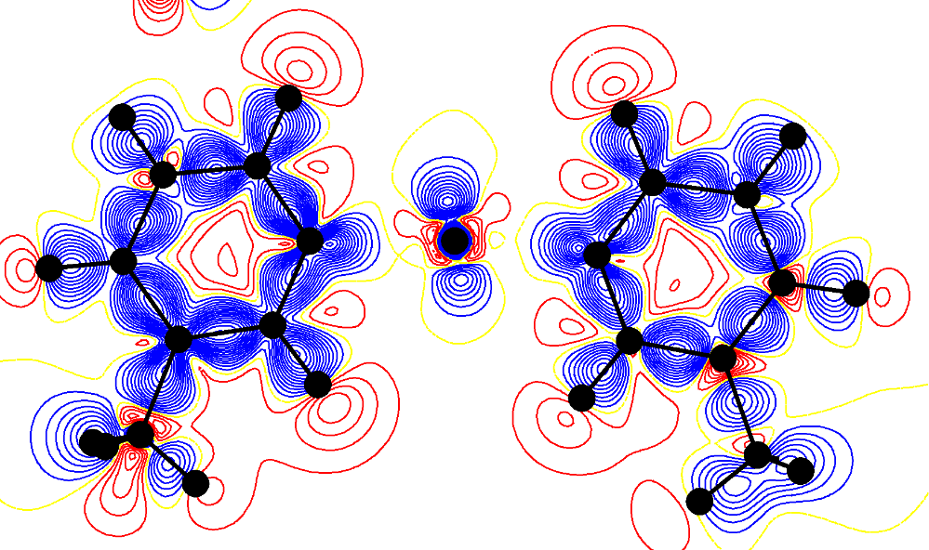
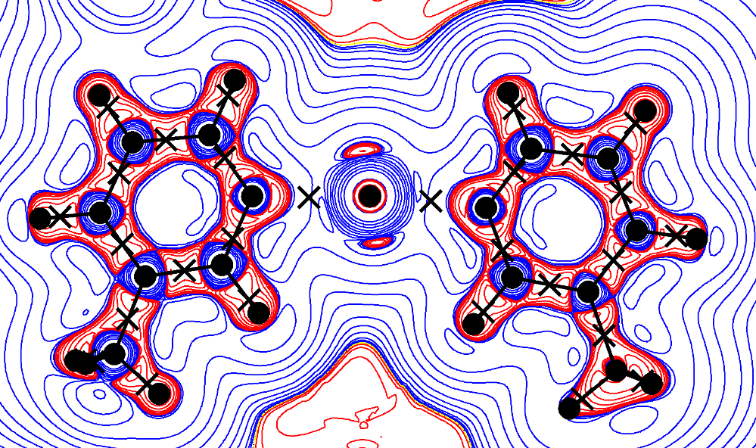
Bromonium ion
173.8°
2.080 Å
2.105 Å

Slide 11
Three-centre / two-electron covalent bond!
Bond | Length (Å) | ρ_{cp} (eÅ⁻³) | Laplacian (eÅ⁻³)
N1–Br1 | 1.8360(3) | 1.118 | 0.82
N1–Br1 | 1.9321(4) | 0.923 | 5.67
N2∙∙∙Br1 | 2.3186(4) | 0.339 | 3.28
N∙∙∙Br∙∙∙N | 2.082 | 0.724 | 4.95
 | 2.105 | 0.708 | 4.61
N∙∙∙Br | 2.806 | 0.148 | -2.2
N-bs
}
N-bs·3,5-dmp
}
bromonium
Theoretical value by
Crugeiras & Rios, PCCP, 2016, 18, 30961-30971.

Slide 12
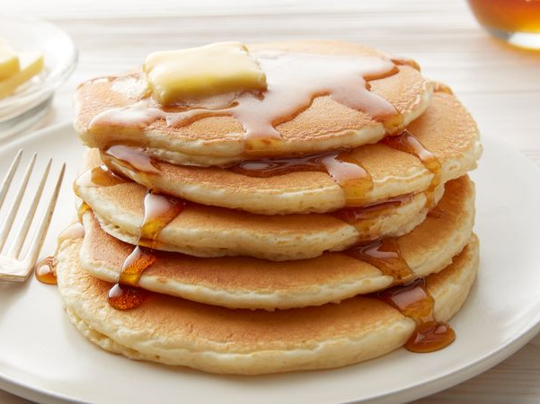
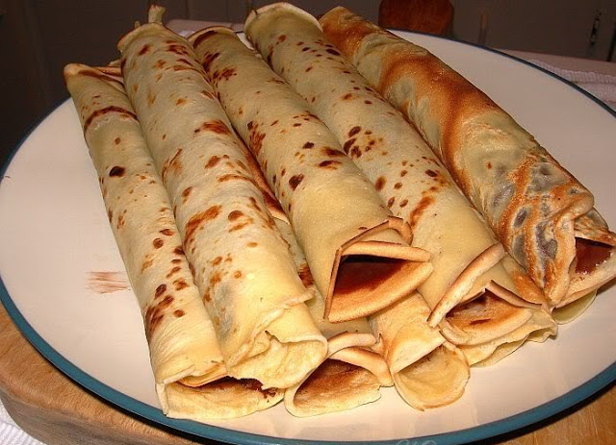
„Pancake bonding”: multicentric two-electron bonding
R. S. Mulliken, 1960s
pancake
palačinka

Slide 13
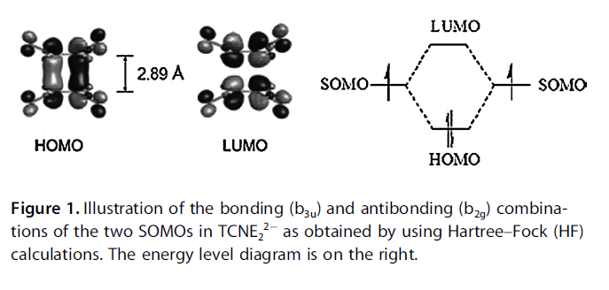
„Pancake bonding”: multicentric two-electron bonding
Cui, Lischka, Mueller, Plasser, Kertesz, ChemPhysChem, 2014, 15, 165-176.
Miller & Novoa, Acc. Chem. Res., 2007, 40, 189-196.

Slide 14
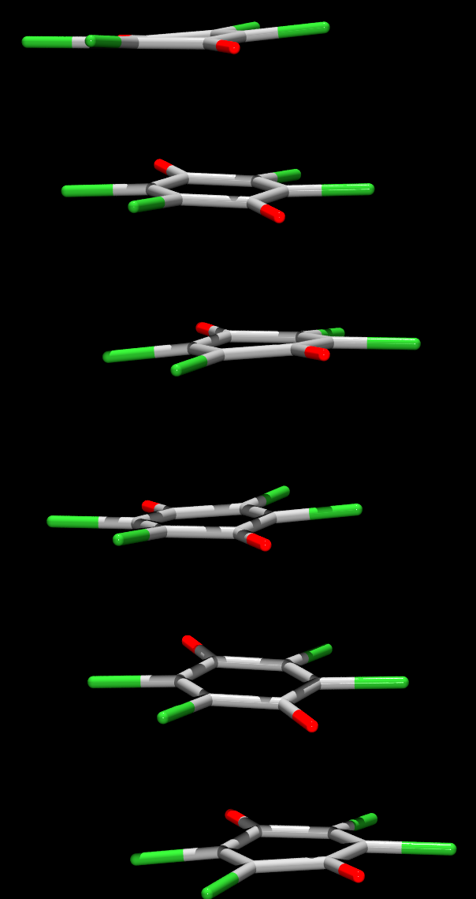

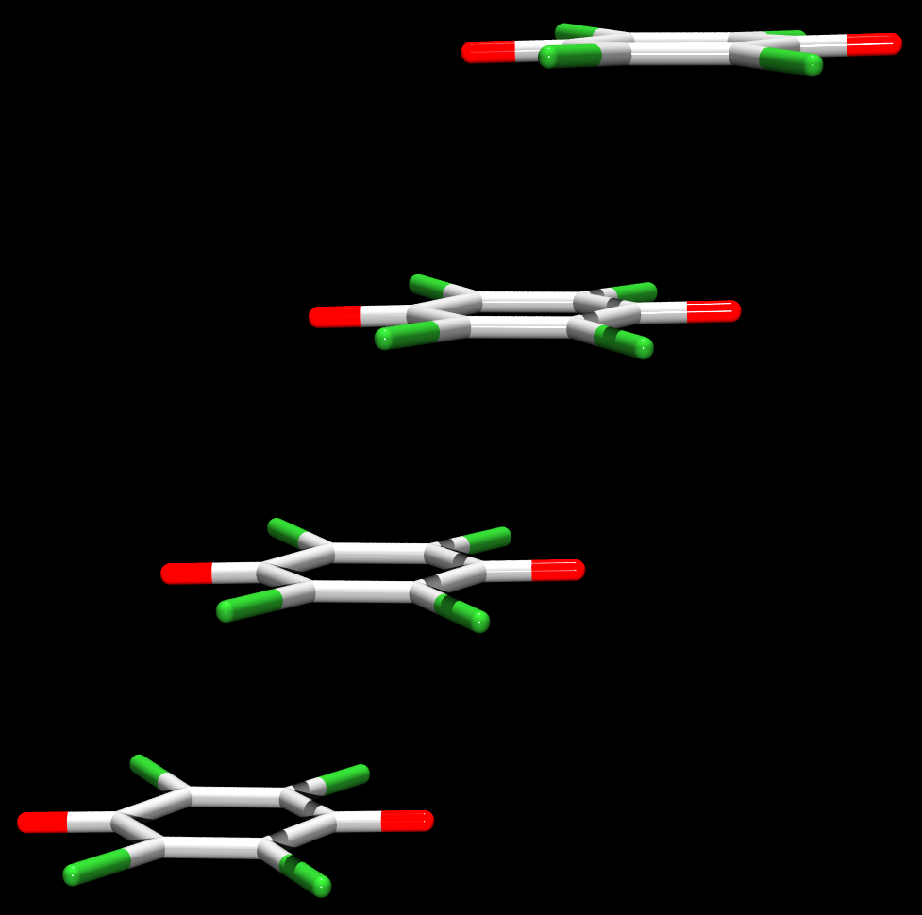
„Pancake bonding” between semiquinone radicals
dimers
equidistant radicals
trimers
2.84 Å
2.86 Å
3.60 Å
3.17 Å
3.59 Å
B
A
Cryst. Growth Des., 2016, 16, 4777-4782.
Chem. Eur. J., 2018, 24, DOI: 10.1002/chem.201800672

Slide 15
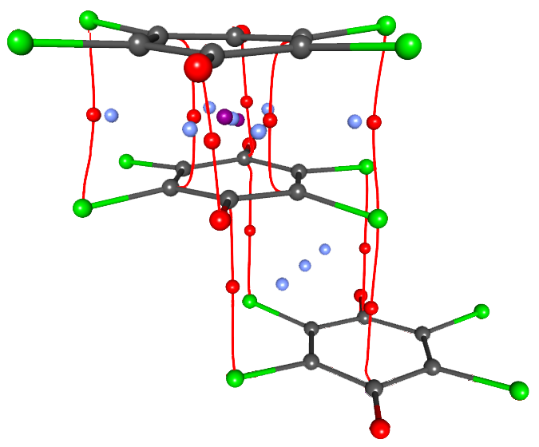
„Pancake bonded” dimers
(diamagnetic): critical points
ρ_{max} > 0.095 e Å⁻³
2.86 Å
ρ_{max} < 0.040 e Å⁻³
3.60 Å
(3, -1) bond
(3, +1) ring cenroid
(3, +3) cage centroid

Slide 16
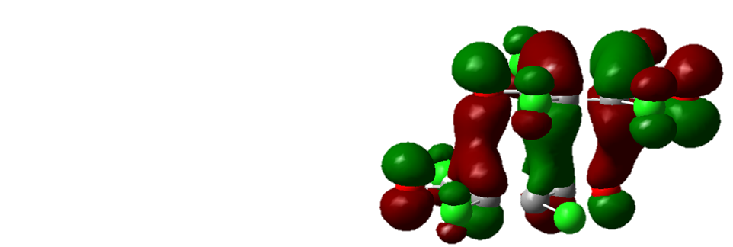
„Pancake bonded” dimer
(diamagnetic): HOMO orbitals
Intermolecular bond order
all atoms | 0.80
only C atoms | 0.27
inter-dimer | 0.04
Covalent contribution: –9.4 kcal mol⁻¹

Slide 17
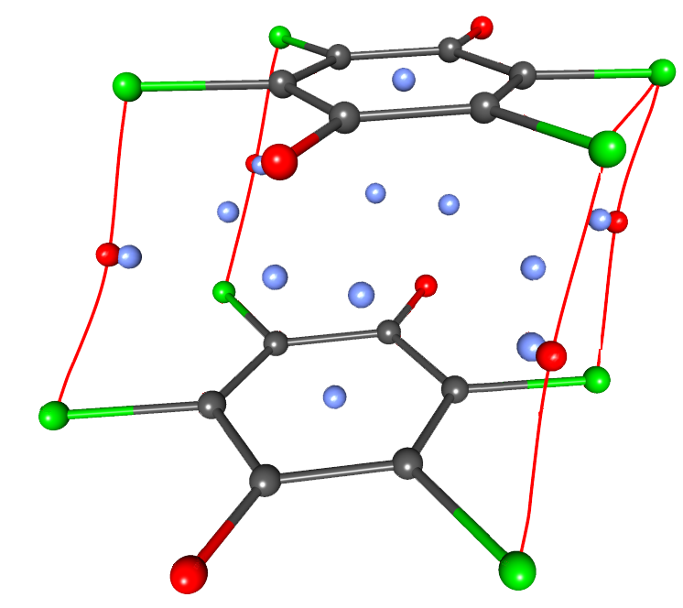
„Pancake bonding” in a stack of equidistant rings: critical points
ρ_{max} < 0.050 e Å⁻³
3.17 Å
(3, -1) bond
(3, +1) ring cenroid
(3, +3) cage centroid

Slide 18
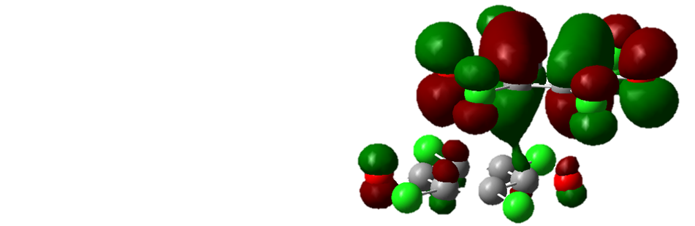
„Pancake bonding”between equidistant rings: HOMO orbitals
Intermolecular bond order
all atoms | 0.26
only C atoms | 0.09
Covalent contribution: –2.9 kcal mol⁻¹

Slide 19
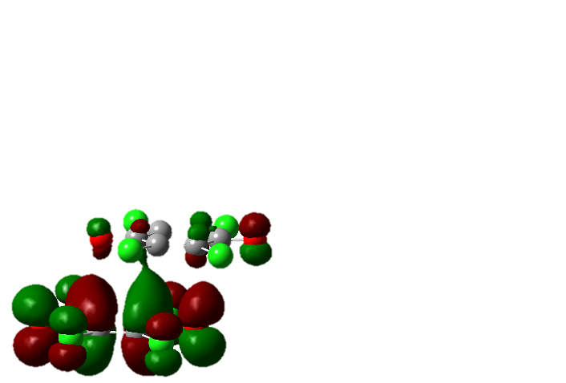
„Pancake bonded” polymer!
e⁻
e⁻
e⁻
e⁻
ΔE = 0.34 eV

Slide 20
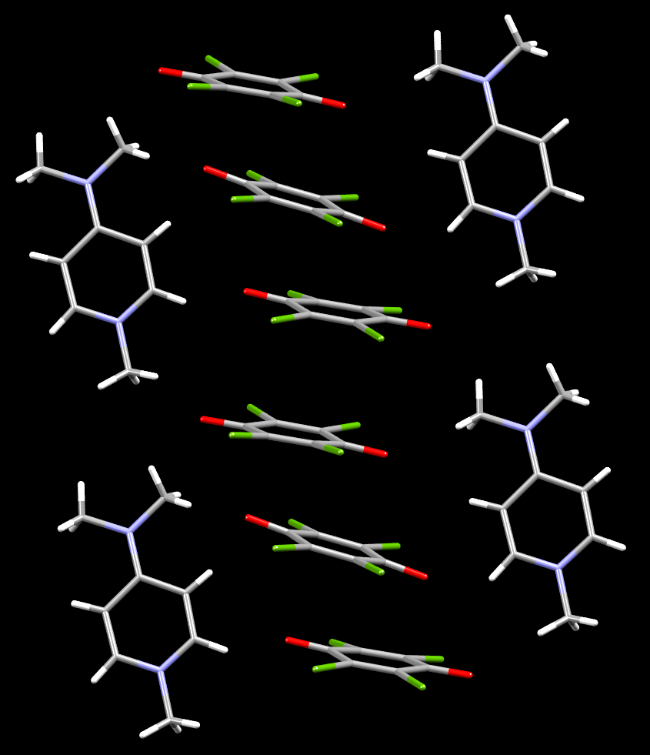
[N-Me-4-(Me)₂NPy]₂(Cl₄Q)₃
Charge-transfer complex
–0,58
Charges from P_{val}:
+0.96
–1.92
–0,76
–0,58
+0.96
2–
1+
1+
Chem. Eur. J., 2018, 24,
DOI: 10.1002/chem.201800672

Slide 21
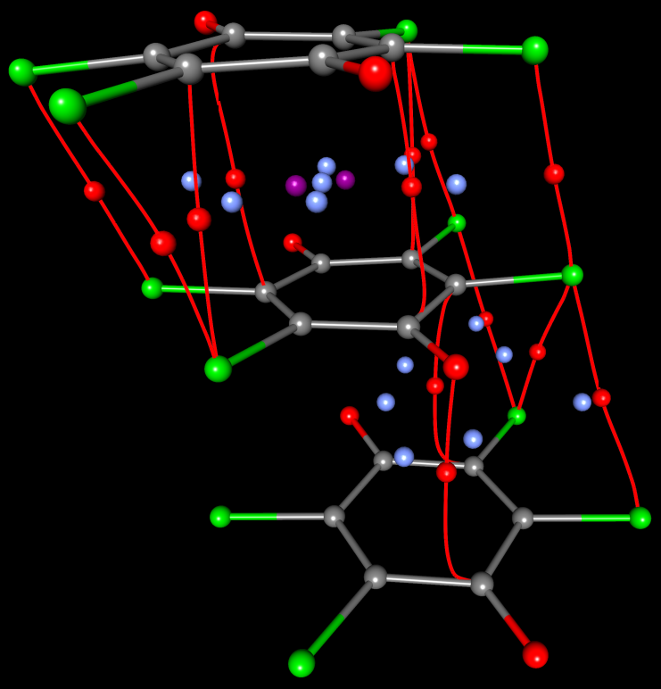
„Pancake bonding” between three rings
ρ_{max} > 0.077 e Å⁻³
2.84 Å
3.59 Å
ρ_{max} < 0.045 e Å⁻³
(3, -1) bond
(3, +1) ring cenroid
(3, +3) cage centroid
Chem. Eur. J., 2018, 24,
DOI: 10.1002/chem.201800672

Slide 22
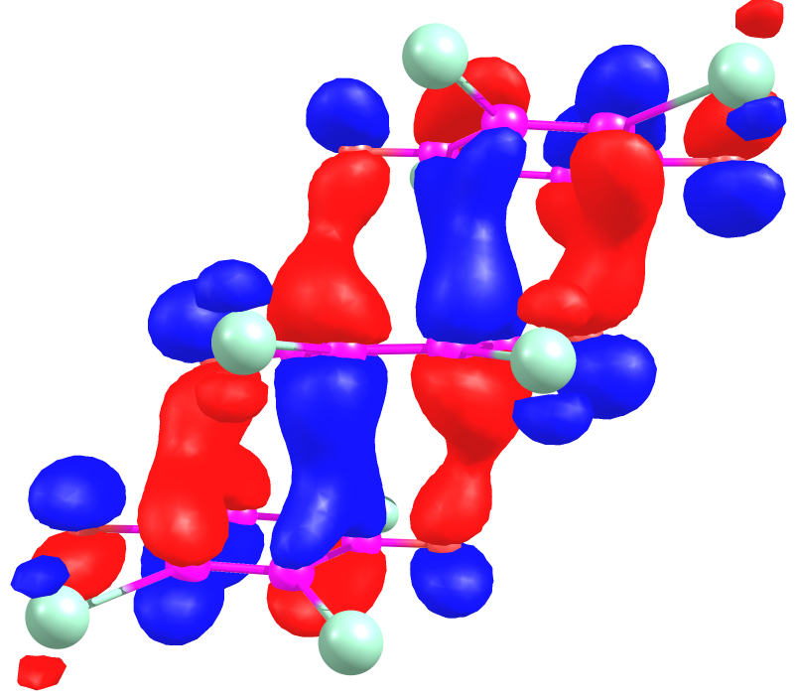
„Pancake bonding” between three rings: HOMO orbitals
Intermolecular bond order
all atoms | < 0.71
probably | ~ 0.5
Covalent contribution: –4.11 kcal mol⁻¹

Slide 23
Conclusions
Strong hydrogen bonds, strong halogen bonds and strongest π-stacking interactions are in fact weak covalent bonds!
Two-electron bonding between a pair of semiquinones (12 or 24 centres)
Two-electron bonding between three rings (18 or 36 centres)
1D multicentric-bonded „polymer”

Slide 24


Acknowledgements
Université de Lorraine
Christian Jelsch
Claude Lecomte
Emmanuel Wenger
RBI, Zagreb
Marijana Jurić
Lidija Androš Dubraja
Nadica Maltar-Strmečki
Ana Šantić
Dijana Žilić
Darko Babić
Valentina Milašinović
University of Zagreb
Vladimir Stilinović
Damir Pajić
Nikolina Novosel
Krešo Zadro
KI, Ljubljana
Jernej Stare
Gregor Mali
Universität Göttingen
Dietmar Stalke
Serhiy Demeshko
University of Ljubljana
Anton Meden
Croatian Science Foundation, grant no. IP-2014-09-4079
Croatian Academy of Sciences and Arts
French-Croatian bilateral, Slovenian-Croatian bilateral, German-Croatian bilateral

