Slide 1



MECHANOCHEMICAL SYNTHESIS OF GRAPHENE OXIDE WITH VARIABLE DEGREE OF OXIDATION
Magdalena Kralj,¹ Irena Sović¹, Ivan Halasz¹
¹Ruđer Bošković Institute, Zagreb, Croatia
Division of Physical Chemistry
Laboratory for Green Synthesis
Acknowledgements
This work was supported by the Ministry of Environment and Energy, the Ministry of Science and Education, the Environmental Protection and Energy Efficiency Fund and the Croatian Science Foundation under the project “New Materials for Energy Storage”, in the total amount of 1,962,100 HRK and by the Centre of Excellence for Advanced Materials and Sensing Devices, a project financed by the European Union through the European Regional Development Fund - the Competitiveness and Cohesion Operational Programme (KK.01.1.1.01.0001)

Slide 2
Mechanochemical preparation and characterization of graphene oxide (GO)
AIM
Find optimal synthesis conditions
Find influencing factors on the oxidation degree of GO
PURPOSE
Find new versatile and eco-friendly approach to prepare the large scale high quality graphene oxide with tunable degree of oxidation for further functionalization depending on its application
PURPOSE

Slide 3
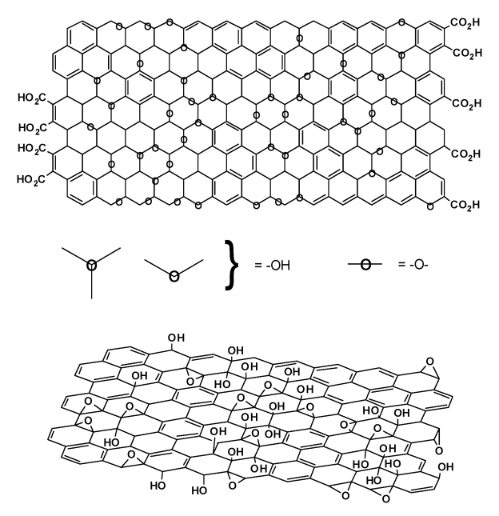
Graphene oxide (GO)
- single-atom carbon layer, combination of unsaturated benzene rings and aliphatic heterocycles containing range of reactive oxygen groups
Electronics
optical materials
supercapacitors
lithium-ion batteries
solar cells
Mass production of graphene
Potential use
Biomedicine
biosensors
Drug delivery agents
Enviroment
contaminant adsorption
water decontamination
solar desalination
enviromental sensing
Variations of the Lerf-Klinowski model
(Chem. Soc. Rev., 2010, 39, 228-240)
Notes:
Graphene oxide (GO) - single-atom carbon layer, combination of unsaturated benzene rings and aliphatic heterocycles containing range of reactive oxygen groups including hydroxyl, epoxy, carboxyl and carbonyl groups that can attach polymers or nanoparticles on the graphitic surface for potention use
The structure is strongly disorder with irregular packing of the layers. Generally is accepted Lerf-Klinowski model that is characterized by a non stoichiometric atomic composition with an amorphous character, where the basal plane is mostly covered with hydroxyl and epoxide (1.2 ether) functional groups causing structural deformations and molecular roughness of the GO layer while at the edges are located predominantly the carbonyl and carboxyl groups.
GO has remarkable physical and chemical properties which makes it a good material for applications in areas which include electronics, biomedicine and enviroment even though it is primarly used as potential material for the mass production of graphene.
GO is interesting because it electronic and mechanical properties can be effciently modified by controlling the oxygen functionalities attached to its carbon structure .

Slide 4
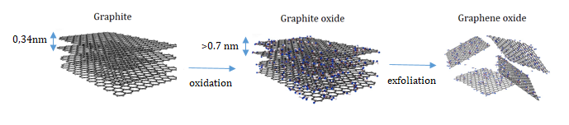
Oxidation of graphite and graphite oxide
Method name | Year | Oxidation agents
Brodie method | 1859. | HNO3, > 90 %, KClO3
Staudenmeier method | 1898. | HNO3, > 90%, H2SO4, conc., KClO3
Hoffman method | 1937. | HNO3, > 65%., H2SO4, conc., KClO3
Hummers method | 1958. | H2SO4, conc., NaNO3, KMnO4
Tour method | 2010. | H2SO4, conc., H3PO4, conc., KMnO4
Notes:
There is few widely known metods for GO preparation, each of them follow displayed sheme. Modification of the graphite structure is possible by oxidation with strong oxidizing agents in the presence of an acid, leads to an expansion of the graphite structure or the increase of the graphene layer distance from 0.34 nm in graphite to> 0.7 nm in graphite oxide - this material contains oxide functionalities , but retain a stucked structure similar to graphite, albeit with much wider spacing. graphite oxide is exfoliated into graphene oxide mostly with ultrasound and truly exists only in the solution phase where it is completely exfoliated into single-layer sheets.
Here you can see the most fameous methods for gaining GO, but Conventional chemical synthesis of GO mostly use Hummers method or its modified version because Hummers and Offeman⁵⁰ got rid of the requirement for KClO₃ and HNO₃ but using potassium permanganate and sodium nitrate (NaNO₃) in H₂SO₄ . This reduces the explosive nature of the reaction but a major issue remains due to the emission of toxic gases including NO₂ and N₂O₄.
All mentioned methods achieved similar level of oxidation (about 25%) and a little bit about them has change through all these year eventhough market demand for GO and graphene has grown tremendously.
Importantly, the products of these reactions show strong variance, depending not only on the particuar oxidant used but also on the graphite source and reaction conditions.
The most common source of graphite used for chemical reactions, including its oxidation, its flake graphite – naturally occuring mineral that is purified to remove heteroatomic contamination.

Slide 5
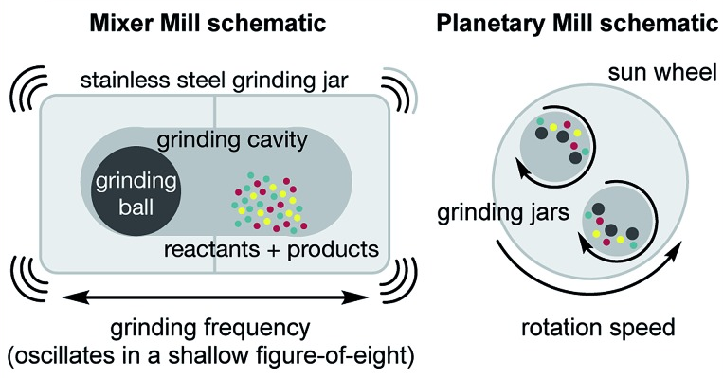
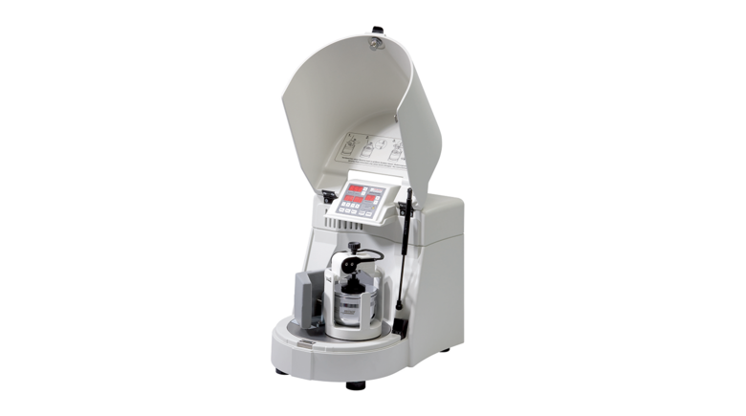
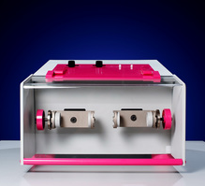
Mechanochemistry
Mechanochemical reaction - “a chemical reaction that is induced by the direct absorption of mechanical energy”
- solvent free or with nominal amount of solvent (LAG, ILAG)
Reflected better yield and selectivity
Why?
Better energy – and atom - economy
J.L. Howard, Q. Cao and D.L. Browne, Chem. Sci., 2018, 9, 3080–3094
reduce waste generation
https://www.fritsch-international.com/sample-preparation/milling/planetary-mills/details/product/pulverisette-6-classic-line/
https://www.insolidotech.com/ist600.html
Notes:
Mechanochemistry is becoming more widespread as a technique for molecular synthesis with new mechanochemical reactions being discovered at increasing frequency because it can promote reactions between solids quickly and quantitatively, with either no added solvent or only minimal amounts. Mechanochemical reaction usually refers to “a chemical reaction that is induced by the direct absorption of mechanical energy”
Lately mechanochemcal reactions offers advantages over traditional solvent based chemistry , reflected in better yields and selectivity,^{4,5} better energy- and atom-economy and reduced waste generation.¹
our current dependence on solvents appears increasingly unsustainable, environmentally problematic, hazardous (hazds) and energy-demanding with regard to solvent production, purification and recycling.
There exist different ball mills, Here you can see mixer and planetary ball mill, both have different way of milling the sample which has proved to be very important in the synthesis of GO, which can be prepared only with planetary ball milling

Slide 6
EXPERIMENTAL PART
Mechanochemical synthesis of GO

Slide 7
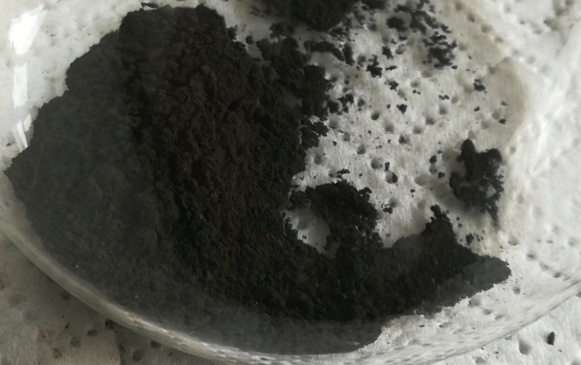
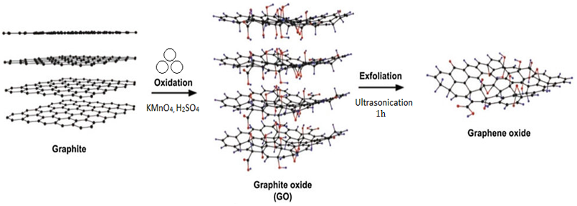
Chemical | Producer
graphite, x > 400 µm | Graphenea
KMnO₄ | E. Merch.
H₂SO₄ (87%) | Kemika
HCl (10%) | VWR
Deionized water | -
GO1 – milled 3 × 1h with 10 min pause in between
GO2, GO3, GO4 – milled 3.5h – 10min milling with 10 min pause in between
Washing – HCl (10%), deionized H₂O, dialysis (2 days)
Graphite oxide to graphene oxide – 15 min sonication before and 45 min sonication after dialysis
sample | G : H₂SO₄ : KMnO₄ | H₂SO₄ : KMnO₄
GO1 | 1 : 3.2 : 4.4 | 1 : 1.40
GO2 | 1 : 3.2 : 4.4 | 1 : 1.40
GO3 | 1 : 4 : 5.7 | 1 : 1.43
GO4 | 1 : 5 : 7 | 1 : 1.40
Reaction conditions - Planetary ball mill - PULVERISETTE 6
sample | jar | balls | amount | diameter (mm) | m_{powder} : m_{ball} | rpm | reaction time (h) | γ(mg/ml)
GO1 | ZrO2 | ZrO2 | 7 | 12 | 1:20 | 500 | 3 | 1.21
GO2 | ZrO2 | ZrO2 | 7 | 12 | 1:20 | 500 | 3.5 | 8.68
GO3 | ZrO2 | ZrO2 | 8 | 12 | 1:20 | 500 | 3.5 | 3.87
GO4 | ZrO2 | ZrO2 | 7 | 12 | 1:20 | 500 | 3.5 | 1.86
Notes:
Initially, for all 4 samples different amout of graphite flakes, potassium permanganate and stociometric amount of sulfuric acid were added and mechanochemically treated using planetary ball mill with ball to powder ratio 20 :1., for 3 and 3.5 h at a rotation rate of 500 rpm. Furthermore, GO1 was milled 3 times for 1h with 10 min pause in between and GO2, GO3, GO4 were milled 3.5 x 1h with 10 min pause in between.
-products of the mechanochemical treatment were washed with the HCL (10%), to remove undesirable products of the oxidation reaction and then with deionized water until forming a stable suspension and treated in an ultrasound washer for 15 min to obtain preliminary aqueous dispersions, which were additionally purified by dialysis for 2 days for removal of inorganic ions.

Slide 8
RESULTS AND DISCUSSION

Slide 9
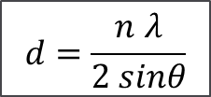
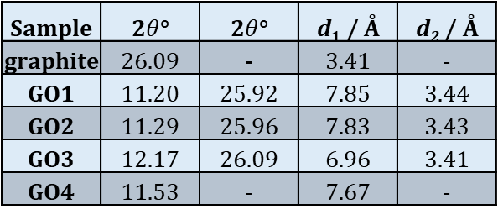
XRD analysis
XRD pattern of the flake graphite and samples GO1 – GO4
Sample | 2$θ$° | 2$θ$° | d₁ / Å | d₂ / Å
graphite | 26.09 | - | 3.41 | -
GO1 | 11.20 | 25.92 | 7.85 | 3.44
GO2 | 11.29 | 25.96 | 7.83 | 3.43
GO3 | 12.17 | 26.09 | 6.96 | 3.41
GO4 | 11.53 | - | 7.67 | -
d = interplanar spacing
n = order of reflection
λ (CuKα) = 0,15406 nm
$$d=\frac{n λ}{2 sinθ}$$
Notes:
Now you can see obtained results.
XRD analysis was used to characterize the crystalline nature and phase purity of the as-synthesized GO with different degrees of oxidation. As a reference, the XRD pattern of the flake graphite shows a diffraction peak at 26 degrees corresponding to an interlayer spacing of about 3.40 A . The interplane distance for the sample is calculated on the basis of the Bragg’s law .
Theoretically with increasing oxidation levels, the intensity of the peak at 26 should decrease.
For samples GO1, 2 and 3 the peak on 26 it can be seen fits to graphitic impurities, and peak on 11degrees which correspond to graphite oxide .These changes come from the heterogeneous nature of the oxidized graphite. Up to this point, the sample possesses graphitic and less oxidized domains beside graphit oxide
With further increases in the oxidation content, the XRD pattern of sample GO4 contain only the diffraction peaks due to the GO at 11 degrees respectively

Slide 10
Thermogravimetric Analysis
Sample | T/ °C | m(%) | weight loss (%)
GO1 | 30 | 100 | 0
 | 150 | 93 | 7
 | 300 | 74 | 19
 | 600 | 66 | 8
 | 800 | 63 | 3
degree of oxidation |  |  | 30
GO2 | 30 | 100 | 0
 | 150 | 86 | 14
 | 300 | 65 | 21
 | 600 | 57 | 8
 | 800 | 52 | 5
degree of oxidation |  |  | 34
GO3 | 30 | 100 | 0
 | 150 | 94 | 6
 | 300 | 75 | 19
 | 600 | 65 | 10
 | 800 | 60 | 5
degree of oxidation |  |  | 34
GO4 | 30 | 100 | 0
 | 150 | 92 | 8
 | 300 | 69 | 23
 | 600 | 53 | 16
 | 800 | 30 | 23
degree of oxidation |  |  | 62
150 ⁰C – loss of physisorbed water
200 ⁰C – main weight loss is due to the loss of carboxyl
and epoxy func. groups
600 – 800 ⁰C – lactone, phenol, ether func. groups
Notes:
The thermal stability of GO is a matter of discussion and highly important for commercializing, storing or processing of GO so thermogravimetric analysis were performed with a nitrogen gas in temperature range from 30 till 800 degree to get information about oxigen content in samples. Different oxigen functional groups decompose on different temperatures
we can clearly see that Go2 have highest amout of physisorbed water, biggest weight loss on 200C, GO4 unlike other samples, have bigger amount of lactone , phenole and ether groups and have bigest degree of oxidation ,
GO1 who was milled for 3 times for 1h milling and 10 minutes pause the smalest DO, and amounts 30 % (the influence of grinding on DO)!
GO2 and GO3 have the same DO, 34% and GO4 which has the highest amount of oxidizing agents has DO 62%

Slide 11
Fourier Tranform Infrared Spectroscopy
3430 cm⁻¹ stretching vibrations –OH group
1724 cm⁻¹ stretching vibrations of C=O bonds in carboxyl/carbonyl groups
1613 cm⁻¹ C=C stretching vibrations
1585 cm⁻¹ stretching vibrations within graphitic domains
970-1260 cm⁻¹ stretching vibrations C-OH and C-O bond
FT-IR Spectometer – PerkinElmer UATR Two
Notes:
-Here you can see FT-IR transmittance spectra of the as synthesized GO sample that is capable of elucidating the nature of various functional groups in the sample . The broad peak observed in the wavenumber of 3430 cm⁻¹ can be attributed to the stretching mode of the O-H groups. Presence of residual water molecules intercalated between the GO sheets also contributes to the broadening of this band.
-The strong band centered at 1725 cm⁻¹ can be attributed to the stretching vibration of C=O bonds in carboxyl/carbonyl groups.
The band at 1613 cm⁻¹ can be attributed to the C=C stretching vibration
band at ≈1585 cm⁻¹ corresponding to the stretching vibrations within graphitic domains pointing to a high quality of the as synthesized GO sample
Finally, the band at 1030 cm⁻¹ can be attributed to the stretching vibrations of the C–OH group and the C–O(epoxy) group respectively

Slide 12
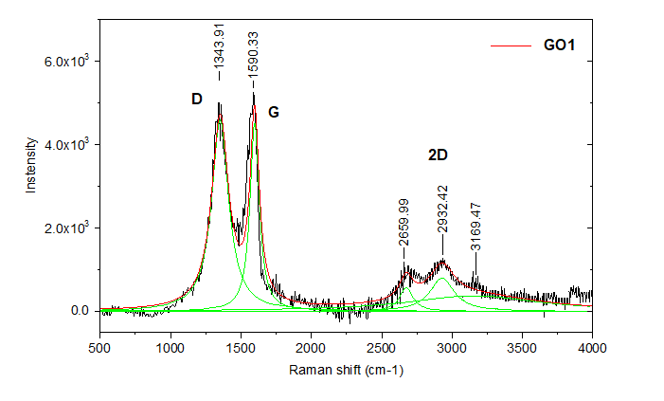
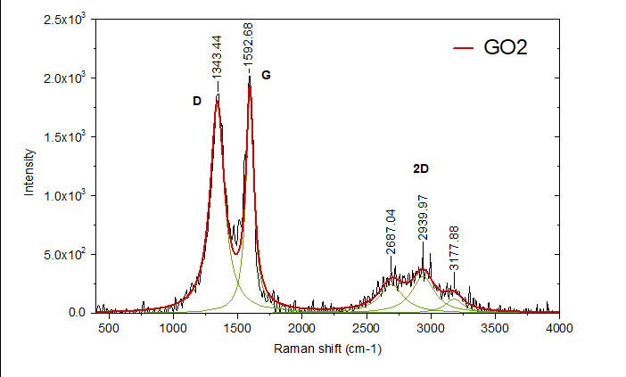
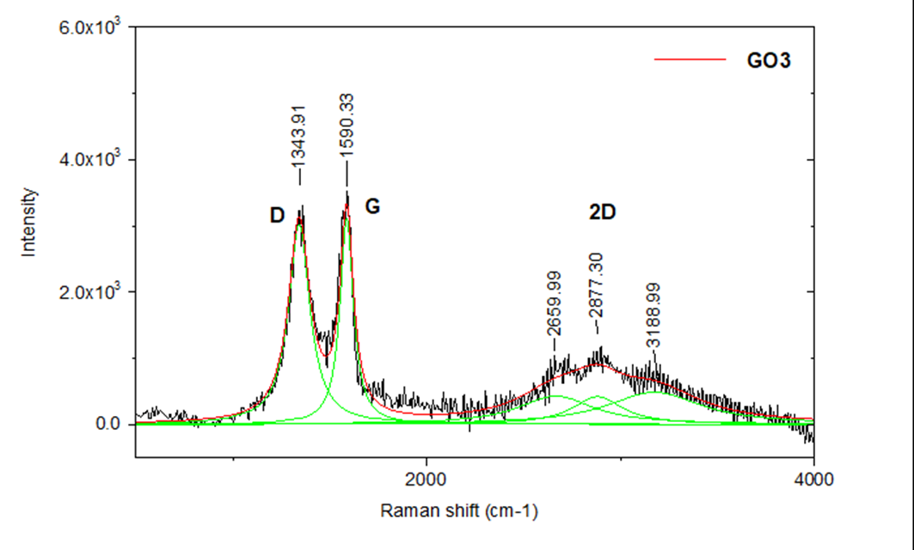
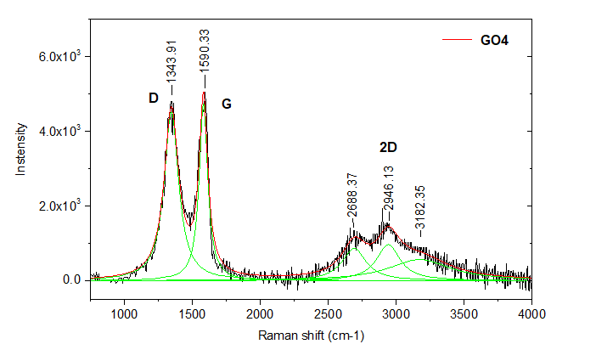
Raman spectroscopy
Sample | I_{D}/I_{G}
GO1 | 1.847
GO2 | 1.696
GO3 | 1.542
GO4 | 1.588
I_{D} / I_{G} - relative measure of the defects
contrary to the standard sp² materials for GO the following is true:
structural defect I_{D} / I_{G}
Notes:
Furthermore, The samples were charactarized and by Raman spectroscopy. In Raman spectra, a D-band at 1340 cm−1 and a G band at 1580 cm−1 can be seen. The presence of 2D band can be attributed to the double resonance transitions and is also an overtone of the D band. the D-band is associated with the breathing mode of the aromatic rings which is caused by the structural imperfections due to the attachment of oxygen based functional groups in the carbon basal plane, on the other hand The G band originates due to the bond stretching of sp² hybridized C=C in both rings and chains,
The intensity ratio of D/G bands usually is a relative measure of the defects present between samples - However, GO is not a purely sp² system but a highly disordered one with a significant sp³ content So, contrary to the standard sp² materials, the decrease of defects in GO would produce an increase of the D/G ratio.
So from id/ig ratio it is conclusive that GO3 has the most and GO1 the least defects in its structure.
<

Slide 13
Dynamic Light Scattering
Volume-weighted distribution represents relative proportion of multiple sizes in a particular sample based on their volume or size but not their intensity, while number-weighted distributions represent number of molecules in each bin in a given histogram
Notes:
As a further characterization tehnique, Dynamic Light Scattering is used to measure particle and molecule distribution and size, graphically it showes volume or number wighted distribution.
Number weighted distribution is practically the same for GO1 and GO3 and amounts 77nm, GO4 has biggest layer diameter of approximately 700 nm and GO2 of about 400 nm.

Slide 14
SEM ANALYSIS
a)
B)
b)
c)
d)
d)
c)
SEM images of a) GO1, b) GO2, c) GO3 and d) GO4
Notes:
to obtain information about the surface topography, morphology and composition we ve done SEM analysis
Here we can se tipical graphite oxide layered structure (you can see certain wrinkles and folds).
SEM analysis of layer size correspond to the DLS measurment results.

Slide 15
Conclusion
Lately, market and research demands for GO grow tremendously, therefore it is necessary to find new synthesis paths that would reduce waste generation and reaction time, but still provide better or same quality GO
XRD analysis shows that with increasing oxidation levels, the intensity of the peak at 26° decreases and for GO4 disappears entirely. Mechanocemical synthesis resulted with GO having an interlayer distance of 6.96 – 7.85 Å
Furthermore, its clearly visible from TGA that obtained samples contain 30 – 62% of oxygen, where GO4 unlike other samples contains a higher amount of lactone, phenol and ether groups
Presence of different oxygen functionalities in all samples are confirmed with FT-IR spectroscopy
Moreover, from Raman spectroscopy, I_{D}/I_{G} ratio is calculated and amouts 1.5 – 1.9 indicating that GO3 has the most and GO1 the least defects
Dynamic Light Scattering tells us that by planetary ball milling, graphite flakes reduce in size 10000 times and are in the range 77 - 721 nm
SEM analysis shows morphology of all samples corresponding to the literature GO morfology. SEM analysis of particle size corresponds to DLS measurments.
In summary, mechanochemical synthesis of graphene oxide is possible even though still in an early phase of its development. It has been shown that is possible to reduce explosive nature of reaction and eliminate emission of toxic gasses, using minimal amount of solvents, as well as greatly reduce the reaction time from 2-3 weeks to 3-4 days

Slide 16

Literature
P. Ranjan et al. A Low-Cost Non-explosive Synthesis of Graphene Oxide for Scalable Applications, Sci. Rep. (2018)
X. Li et al. Graphene oxide-based efficient and scalable solar desalination under one sun with a confined 2D water path. Proc. Nat. Acad. Sci. 113(49), 13953–13958 (2016)
Zhu, Y. et al. Graphene and graphene oxide: synthesis, properties, and applications. Advanced Materials 22, 3906–3924 (2010)
Dimiev, A. M. & Eigler, S., Graphene Oxide: Fundamentals and Applications. (Wiley, 2016)
S. L. James et al., Mechanochemistry: opportunities for new and cleaner synthesis, Chem. Soc. Rev., 41 , 413 (2012)
J. Chen et al., Water-enhanced oxidation of graphite to graphene oxide with controlled species of oxygenated groups, Chem. Sci. (2016)
W.L. Noorduin et al., Chem Soc.,130(4):1158-9 (2008)
K. Krishnamoorthy et al., The chemical and structural analysis of graphene oxide with different degrees of oxidation, Carbon, 53, 38 – 49 (2013)
J.L. Howard et al., Mechanochemistry as an emerging tool for molecular synthesis: what can it offer?, Chem. Sci. 9, 3080 (2018)
T. Ghosh et al., Solution-Processed Graphite Membrane from Reassembled Graphene Oxide, Chem. Mater., 24 (3), pp 594–599 (2012)
Notes:
P. Ranjan et al., A Low-Cost Non-explosive Synthesis of Graphene Oxide for Scalable Applications, Sci. Rep., (2018)
Sitko, R. et al. Adsorption of divalent metal ions from aqueous solutions using graphene oxide. Dalton Trans. 42, 5682–5689 (2013)
Li, X. Graphene oxide-based efficient and scalable solar desalination under one sun with a confined 2D water path. Proc. Nat. Acad. Sci. 113(49), 13953–13958 (2016)
Zhu, Y. et al. Graphene and graphene oxide: synthesis, properties, and applications. Advanced Materials 22, 3906–3924 (2010)
Dimiev, A. M. & Eigler, S. Graphene Oxide: Fundamentals and Applications. (Wiley, 2016)
S. L. James et al., Mechanochemistry: opportunities for new and cleaner synthesis, Chem. Soc. Rev., 41 , 413 (2012)
J. Chen et al., Water-enhanced oxidation of graphite to graphene oxide with controlled species of oxygenated groups, Chem. Sci. (2016)
W.L. Noorduin et al., Chem Soc.,130(4):1158-9 (2008)
K. Krishnamoorthy et al., The chemical and structural analysis of graphene oxide with different degrees of oxidation, Carbon, 53, 38 – 49 (2013)
J.L. Howard et al., Mechanochemistry as an emerging tool for molecular synthesis: what can it offer?, Chem. Sci. 9, 3080 (2018)
T. Ghosh et al., Solution-Processed Graphite Membrane from Reassembled Graphene Oxide, Chem. Mater., 24 (3), pp 594–599 (2012)

